Slide 1
Oregon Accessibility Supports
Demonstration Videos
Updated January 2025

Slide 2

Table of Contents
Section 1
Embedded Universal Tools
Section 2
Embedded Designated Supports
Section 3
Embedded Accommodations
Notes:
Universal tools are available to all students based on student preference and selection.

Slide 3
Embedded Universal Tools
Amplification
Audio Playback Speed
Breaks (pausing the test)
Calculator
Color Choices
Digital Notepad
English Dictionary & Thesaurus
Expandable Items and Stimuli
Global Notes
Glossary (English)
Highlighter
Keyboard Navigation
Line Reader
Mark for Review
Mouse Pointer
Navigation Language
Paginated Item Groups
Periodic Table
Response Recovery
Spell Check
Strikethrough
Tutorials
Writing Tools
Zoom
Table of Contents –
Universal Tools –
Designated Supports –
Accommodations

Slide 4
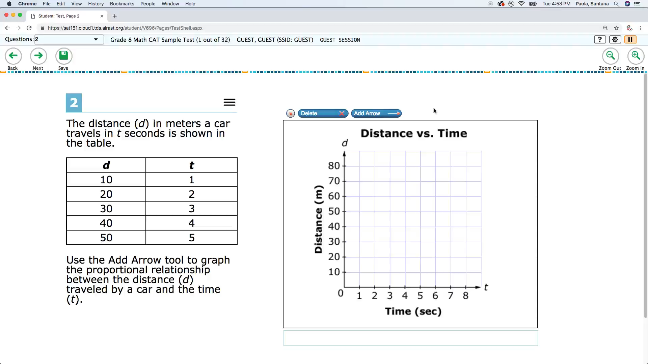
Amplification
Table of Contents –
Universal Tools –
Designated Supports –
Accommodations
Notes:
Amplification
Video Transcript: No audio included in video
The student raises or lowers the volume control, as needed, using headphones, or is tested one-on-one in a secure location where the external speakers can be used for additional volume control.
Basic feature of the assessment interface (available for all tests)

Slide 5
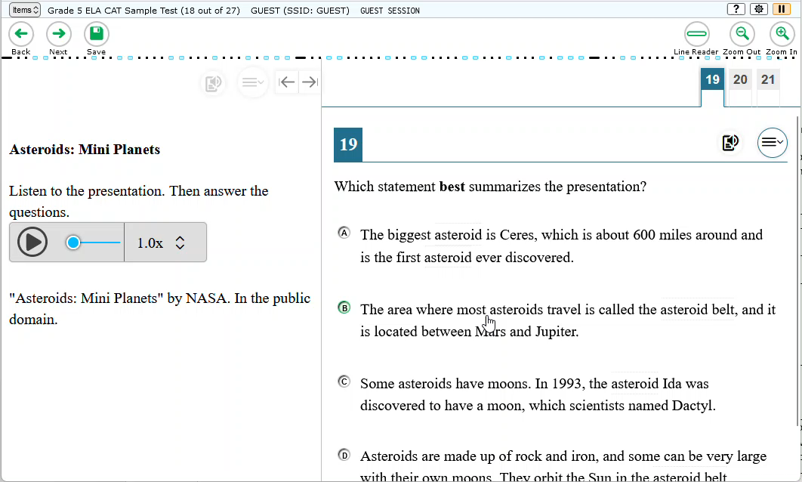
Audio Playback Speed
Table of Contents –
Universal Tools –
Designated Supports –
Accommodations
Notes:
Audio Playback Speed
Video Transcript: Next to the audio stimuli students have access to a dropdown that allows them to select the audio playback speed.
When this tool is turned on, students can change the playback speed on audio/video. Options are .5x, 1x, 1.5x, and 1.75x
ELA CAT, ELPA Summative, default ON

Slide 6
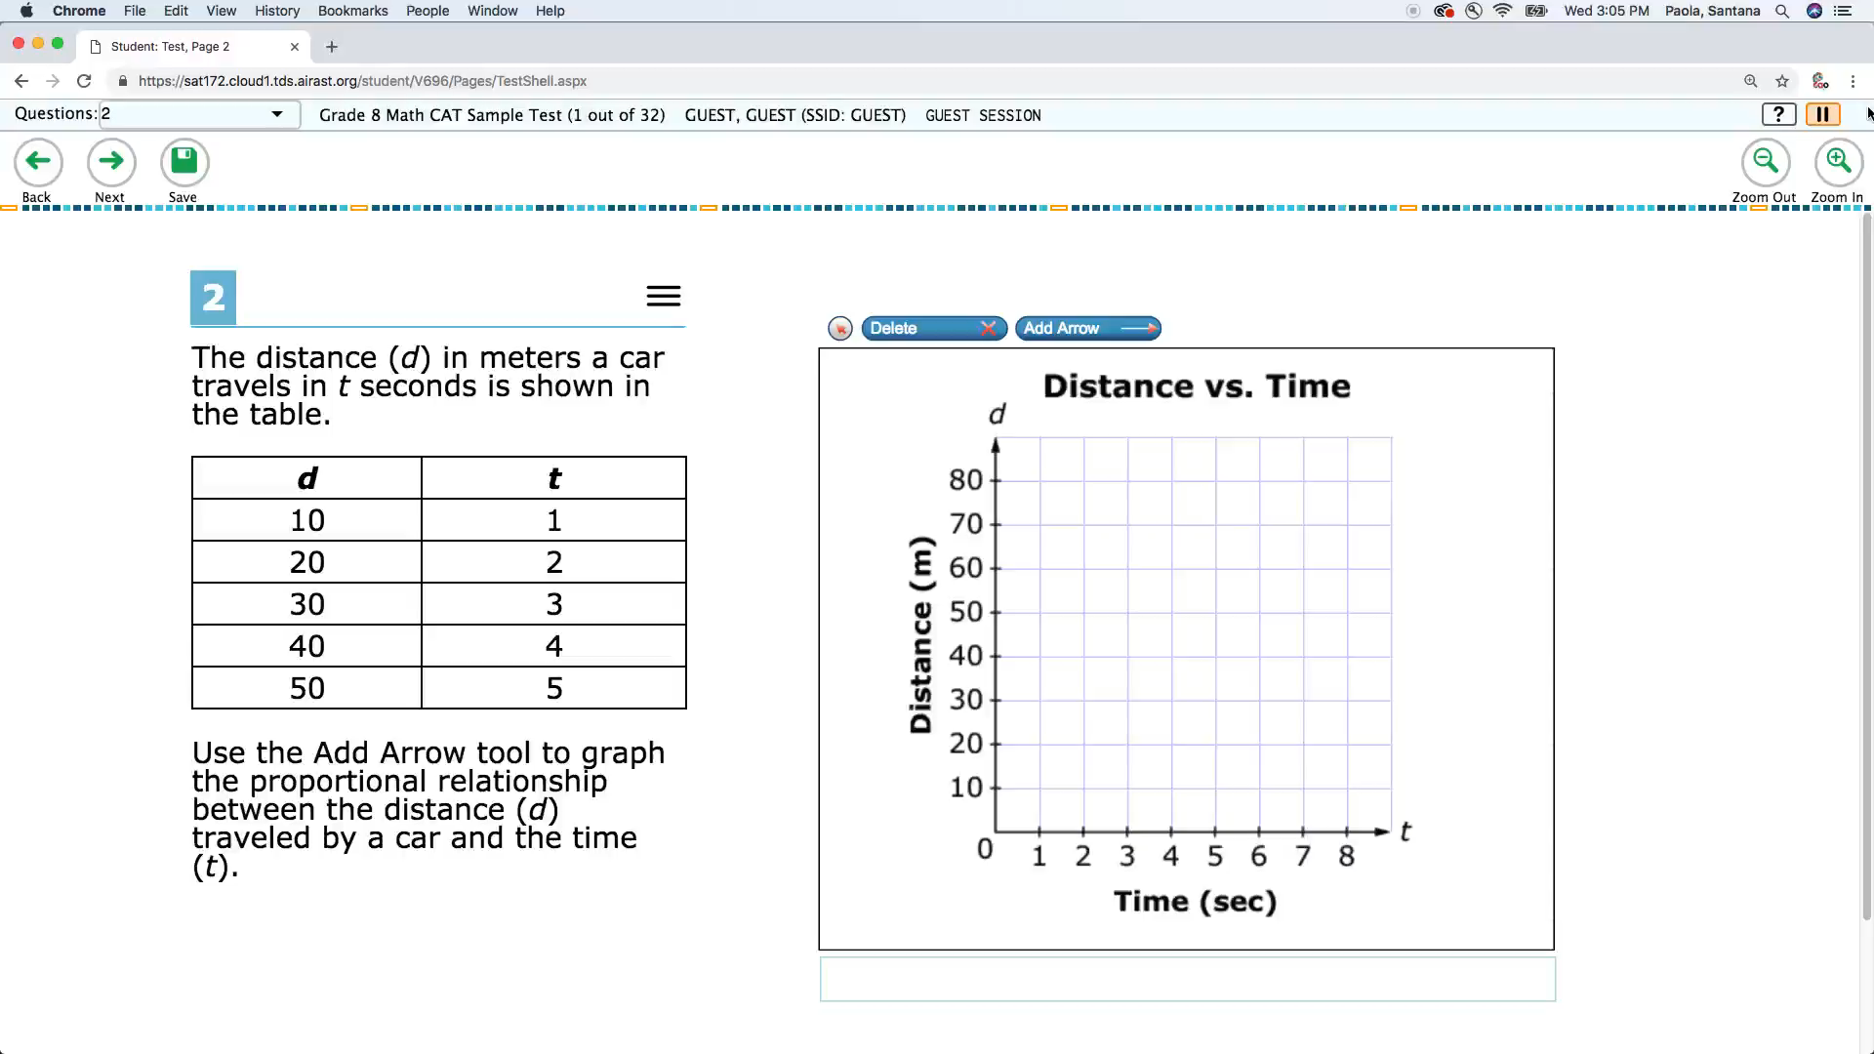
Breaks (Pausing the test)
Table of Contents –
Universal Tools –
Designated Supports –
Accommodations
Notes:
Breaks (Pausing the Test)
Video Transcript: No audio included in video
The number of items per session can be flexibly defined based on the student’s need. Note: for the CAT, if the student’s test is paused for more than 20 minutes, the student will no longer be able to return to previously answered items. There is no limit on the number of times that a student’s test may be paused. The use of this universal tool may result in the student needing additional overall time to complete the assessment. See Section 5.1 Testing Time and Recommended Order of Administration of the Test Administration Manual for guidance on estimated testing times for online assessments.
Basic feature of the assessment interface (available for all tests)

Slide 7
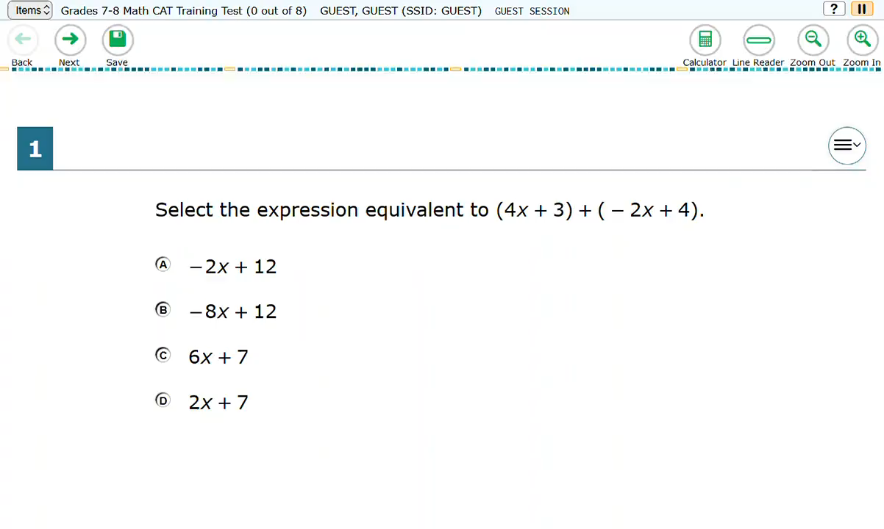
Calculator
Table of Contents –
Universal Tools –
Designated Supports –
Accommodations
Notes:
Calculator
Video Transcript: No audio included in video
An embedded on-screen digital calculator can be accessed for calculator-allowed items when students click on the calculator button. This tool is available only for those specific items for which the Item Specifications indicated that it would be appropriate; these items include a calculator icon in the upper right corner of the screen. When the embedded calculator, as presented for all students, is not appropriate for a student (for example, for a student who is blind), the student may use the calculator offered with assistive technology devices (such as a talking calculator or a braille calculator).
Available for the following tests:
Math – for calculator-enabled items in Grades 6-8, 11
Science

Slide 8
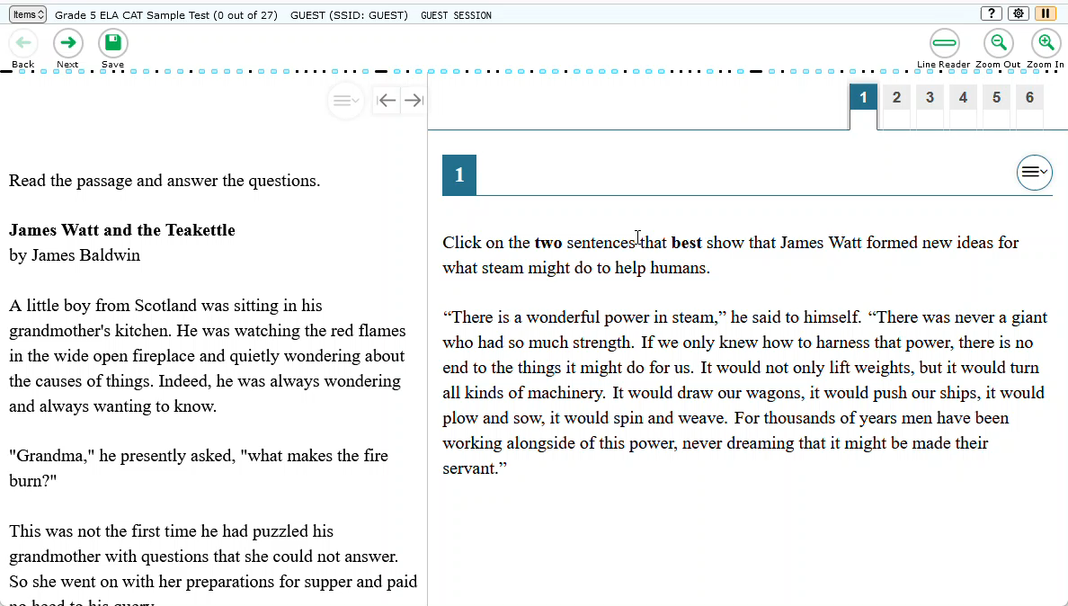
Color Choices
Table of Contents –
Universal Tools –
Designated Supports –
Accommodations
Notes:
Color Choices
Video Transcript: When the Dynamic Color Choices tool is turned on, the student will have the option to change the color contrast within their test by selecting the cog wheel icon and using the dropdown menu. The student selected choice will override the TA color choice selection, but will not persist across sessions.
Description
Enable students to adjust screen background and font color, based on student needs or preferences. This may include reversing the colors for the entire interface or choosing the color of font and background.
Recommendations for Use
Students with attention difficulties may need this support for viewing test content. It also may be needed by some students with visual impairments or other print disabilities (including learning disabilities). Choice of colors should be informed by evidence that color selections meet the student’s needs.
Basic feature of the assessment interface (available for all tests)

Slide 9
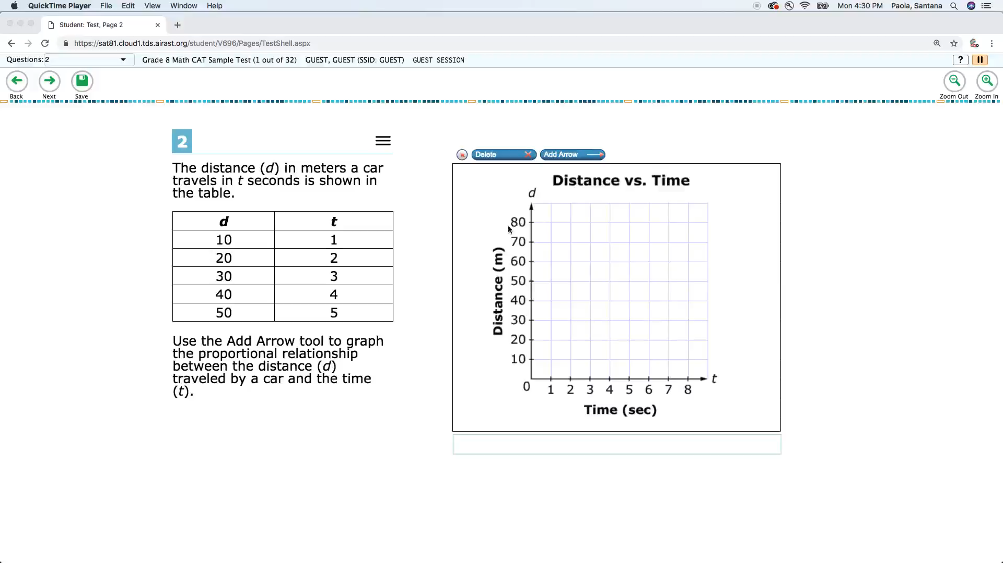
Digital Notepad
Table of Contents –
Universal Tools –
Designated Supports –
Accommodations
Notes:
Digital Notepad
Video Transcript: No audio included in video
This tool is used for making notes about an item. The digital notepad is item-specific and is available through the end of the test segment. Notes are not saved when the student moves on to the next segment or after a break of more than 20 minutes.
Available on all tests except ELA PT (Interim + Summative)

Slide 10
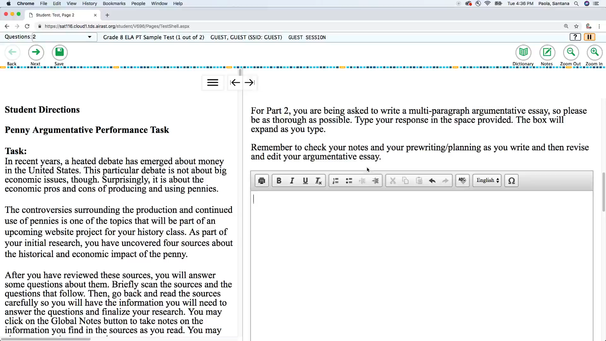
English Dictionary & Thesaurus
Table of Contents –
Universal Tools –
Designated Supports –
Accommodations
Notes:
English Dictionary & Thesaurus
Video Transcript: No audio included in video
An English dictionary is available for the full write portion of an ELA performance task. A full write is the second part of a performance task. The use of this universal tool may result in the student needing additional overall time to complete the assessment. An English thesaurus is available for the full write portion of an ELA performance task. A full write is the second part of a performance task. The use of this universal tool may result in the student needing additional overall time to complete the assessment.
Available for ELA PT Only (Interim + Summative)

Slide 11
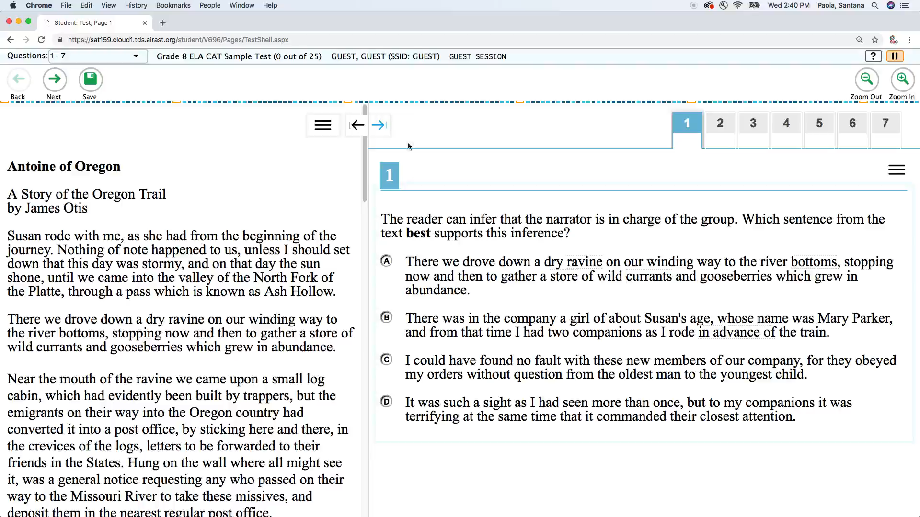
Expandable Items and Stimuli (Passages)
Table of Contents –
Universal Tools –
Designated Supports –
Accommodations
Notes:
Expandable Items and Stimuli (Passages)
Video Transcript: No audio included in video
Each stimulus (e.g., reading passages) can be expanded so that it takes up a larger portion of the screen.
Basic feature of the assessment interface (available for all tests)

Slide 12
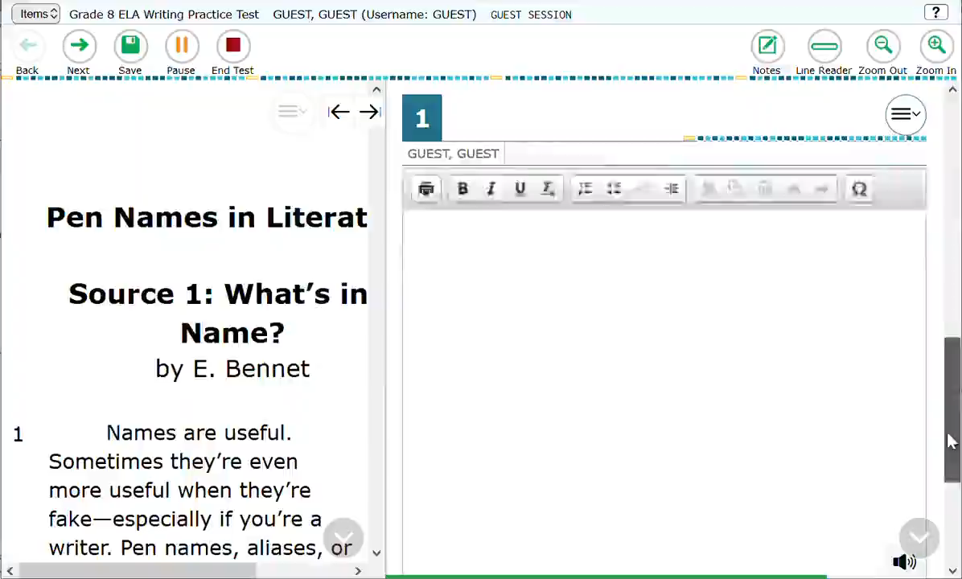
Global Notes
Table of Contents –
Universal Tools –
Designated Supports –
Accommodations
Notes:
Global Notes
Video Transcript: No audio included in video
Global notes is a notepad that is available for ELA performance tasks in which students complete a full write. A full write is the second part of a performance task. The student clicks on the notepad icon for the notepad to appear. During the ELA performance tasks, the notes are retained from segment to segment so that the student may go back to the notes even though the student is not able to go back to specific items in the previous segment. Students may copy/paste input from Global Notes into text/item response fields.
Available for the ELA PT Only (Interims + Summative)

Slide 13
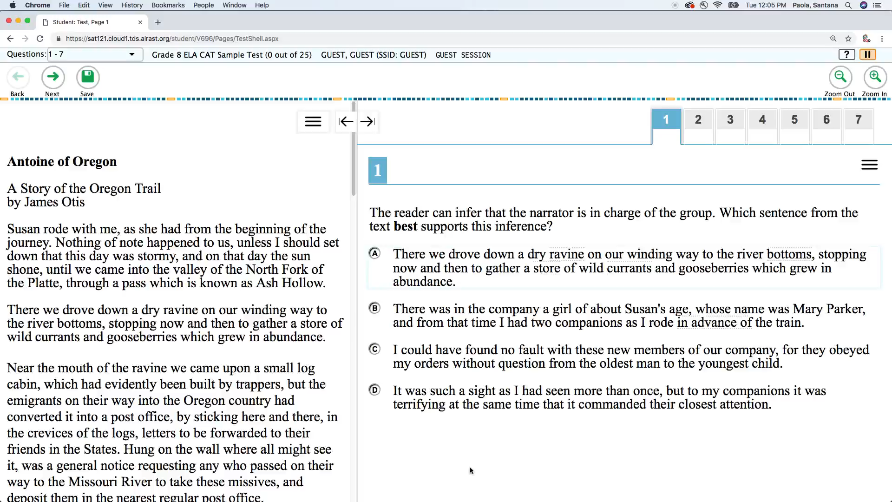
Glossary (English)
Table of Contents –
Universal Tools –
Designated Supports –
Accommodations
Notes:
Glossary English
Video Transcript: No audio included in video
Grade- and context-appropriate definitions of specific construct-irrelevant terms are shown in English on the screen via a pop-up window. The student can access the embedded glossary by clicking on any of the pre-selected terms. The use of this Universal Tool may result in the student needing additional overall time to complete the assessment.
Available for the following tests:
ELA, Math (Interim +Summative)

Slide 14
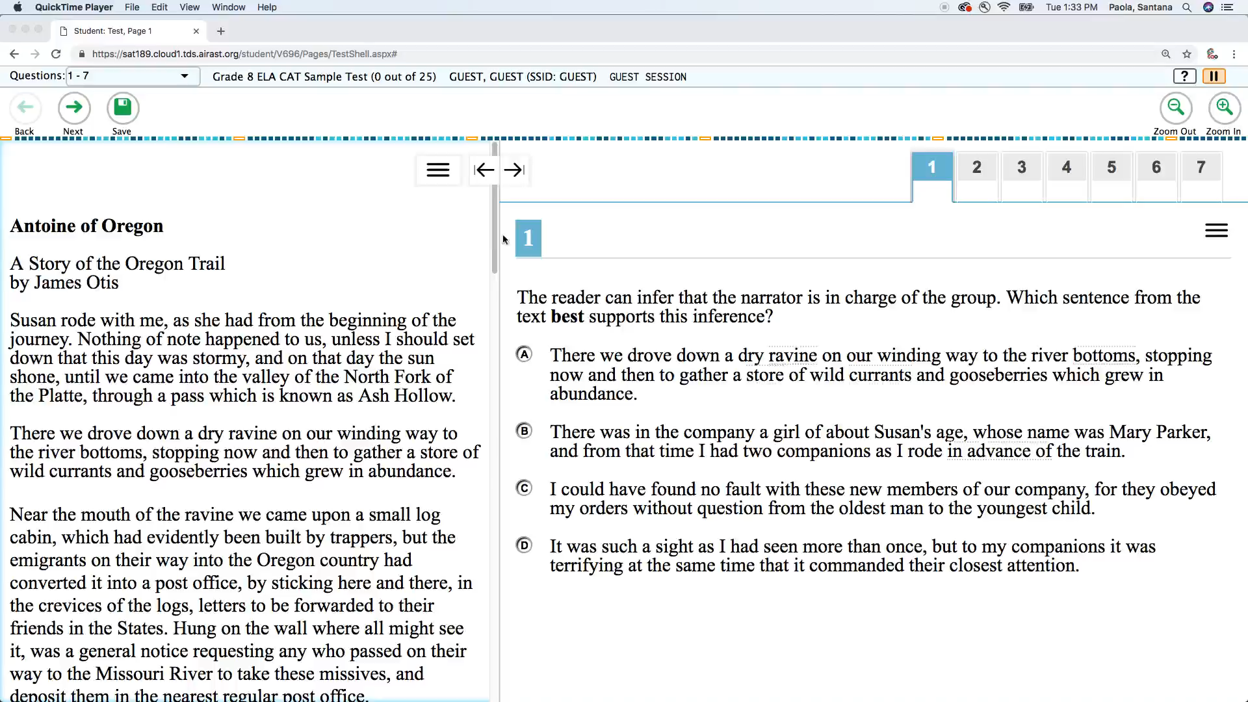
Highlighter
Table of Contents –
Universal Tools –
Designated Supports –
Accommodations
Notes:
Highlighter
Video Transcript: No audio included in video
A digital tool for marking desired text, item questions, item answers, or parts of these with a color. Multiple colors are available. Highlighted text remains available throughout each test segment.
Basic feature of the assessment interface (available for all tests)

Slide 15
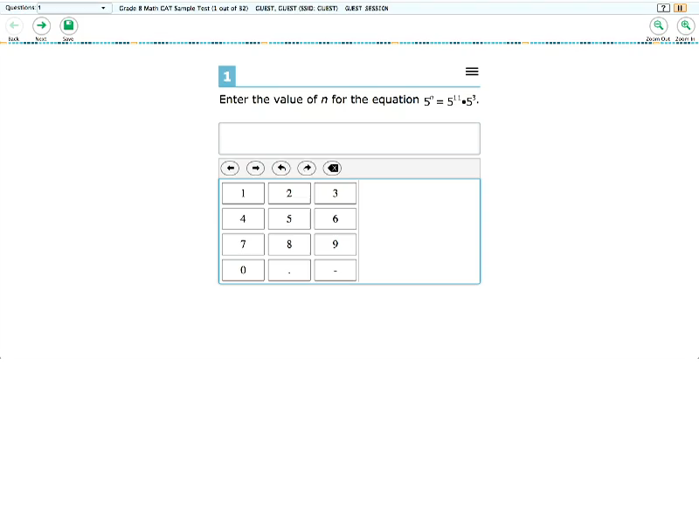
Keyboard Navigation
Table of Contents –
Universal Tools –
Designated Supports –
Accommodations
Notes:
Keyboard Navigation
Video Transcript: No audio included in video
Navigation throughout text can be accomplished by using a keyboard instead of a mouse.
Basic feature of the assessment interface (available for all tests)

Slide 16
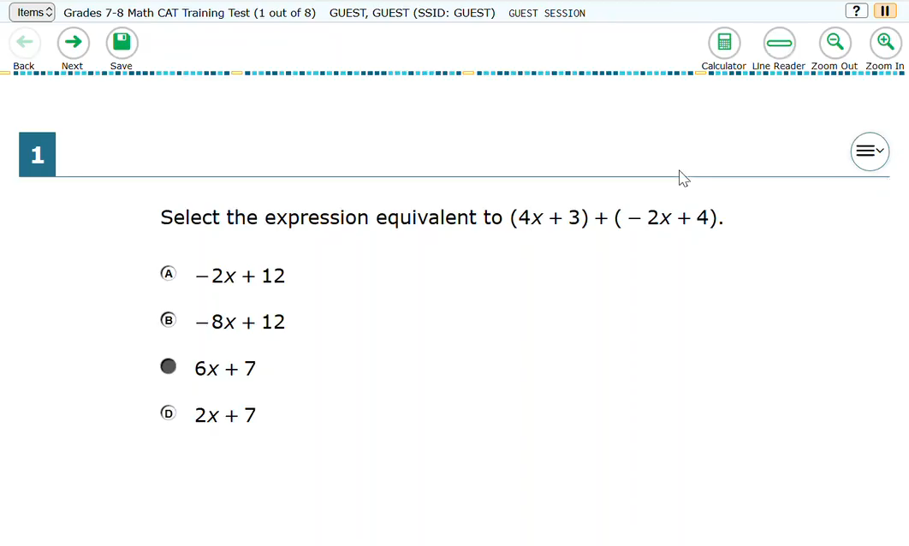
Line Reader
Table of Contents –
Universal Tools –
Designated Supports –
Accommodations
Notes:
Line Reader
Video Transcript: No audio included in video
Description:
The line reader makes all content except for the line in focus grayed out for greater emphasis.
Recommendations for Use:
Students with attention difficulties or reading disabilities may need assistance with tracking where they are reading. The student uses this onscreen tool to assist in reading by raising and lowering the tool for each line of text on the screen.
Available for all tests.

Slide 17

Mark for Review
Table of Contents –
Universal Tools –
Designated Supports –
Accommodations
Notes:
Mark for Review
Video Transcript: No audio included in video
Allows students to flag items for future review during the assessment. Markings are not saved when the student moves on to the next segment or after a break of more than 20 minutes. Note: students must still answer each item before moving on to the next.
Basic feature of the assessment interface (available for all tests)

Slide 18
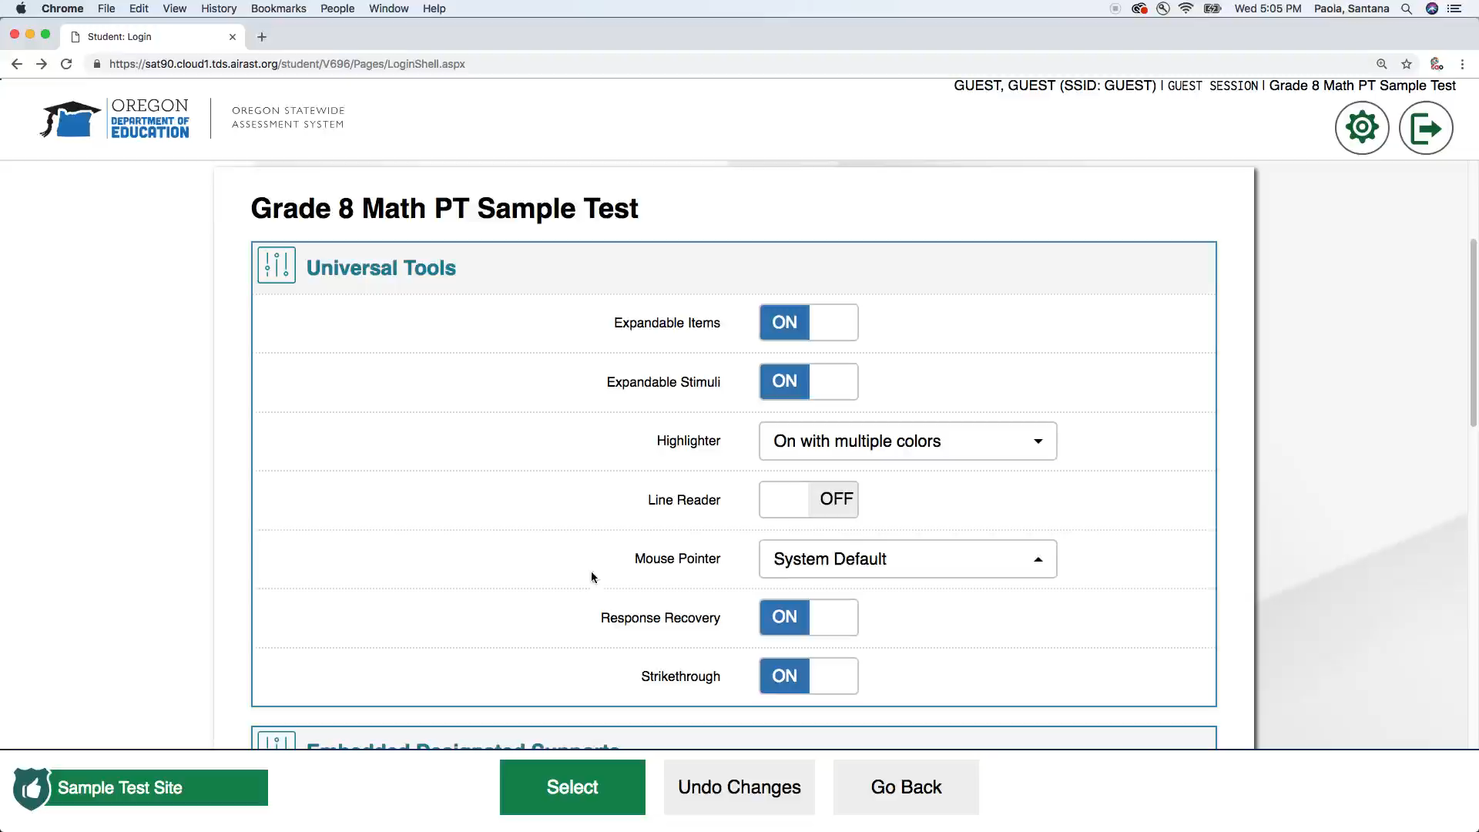
Mouse Pointer
Table of Contents –
Universal Tools –
Designated Supports –
Accommodations
Notes:
Mouse Pointer
Video Transcript: No audio included in video
To provide enhanced visibility the mouse pointer may be changed in color and increased in size.
Basic feature of the assessment interface (available for all tests)

Slide 19
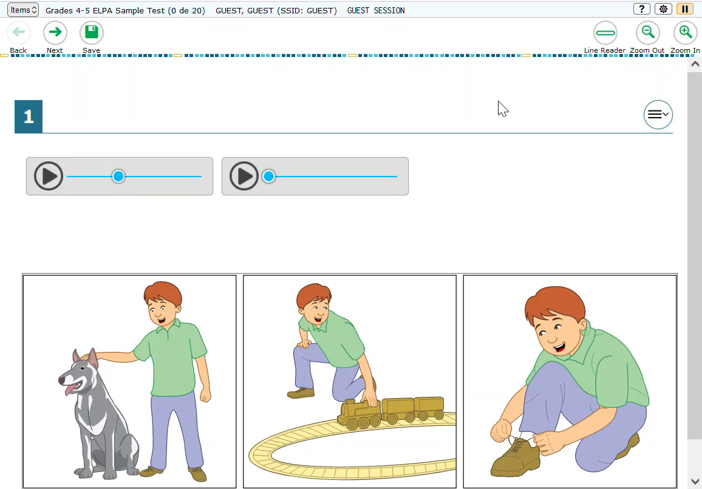
Navigation Language
Table of Contents –
Universal Tools –
Designated Supports –
Accommodations
Notes:
Navigation Language
Video Transcript: No audio included in video
For students who are more comfortable using Spanish navigation buttons, this tool allows students to change the navigation button language (buttons, context menu options) by selecting either Spanish or English via the cog wheel.
Available on ELA (Interims + Summative) and ELPA (Summative)

Slide 20

Paginated Item Groups
Table of Contents –
Universal Tools –
Designated Supports –
Accommodations
Notes:
Paginated Item Groups
Video Transcript: No audio included in video
Allows students to navigate between items in an item group by selecting a page for individual viewing.
Navigation buttons for each question in a group appear in the upper-right corner. Students click these buttons to proceed to the corresponding question.
Available on:
ELA CAT
ELA PT
Math CAT
ELPA

Slide 21
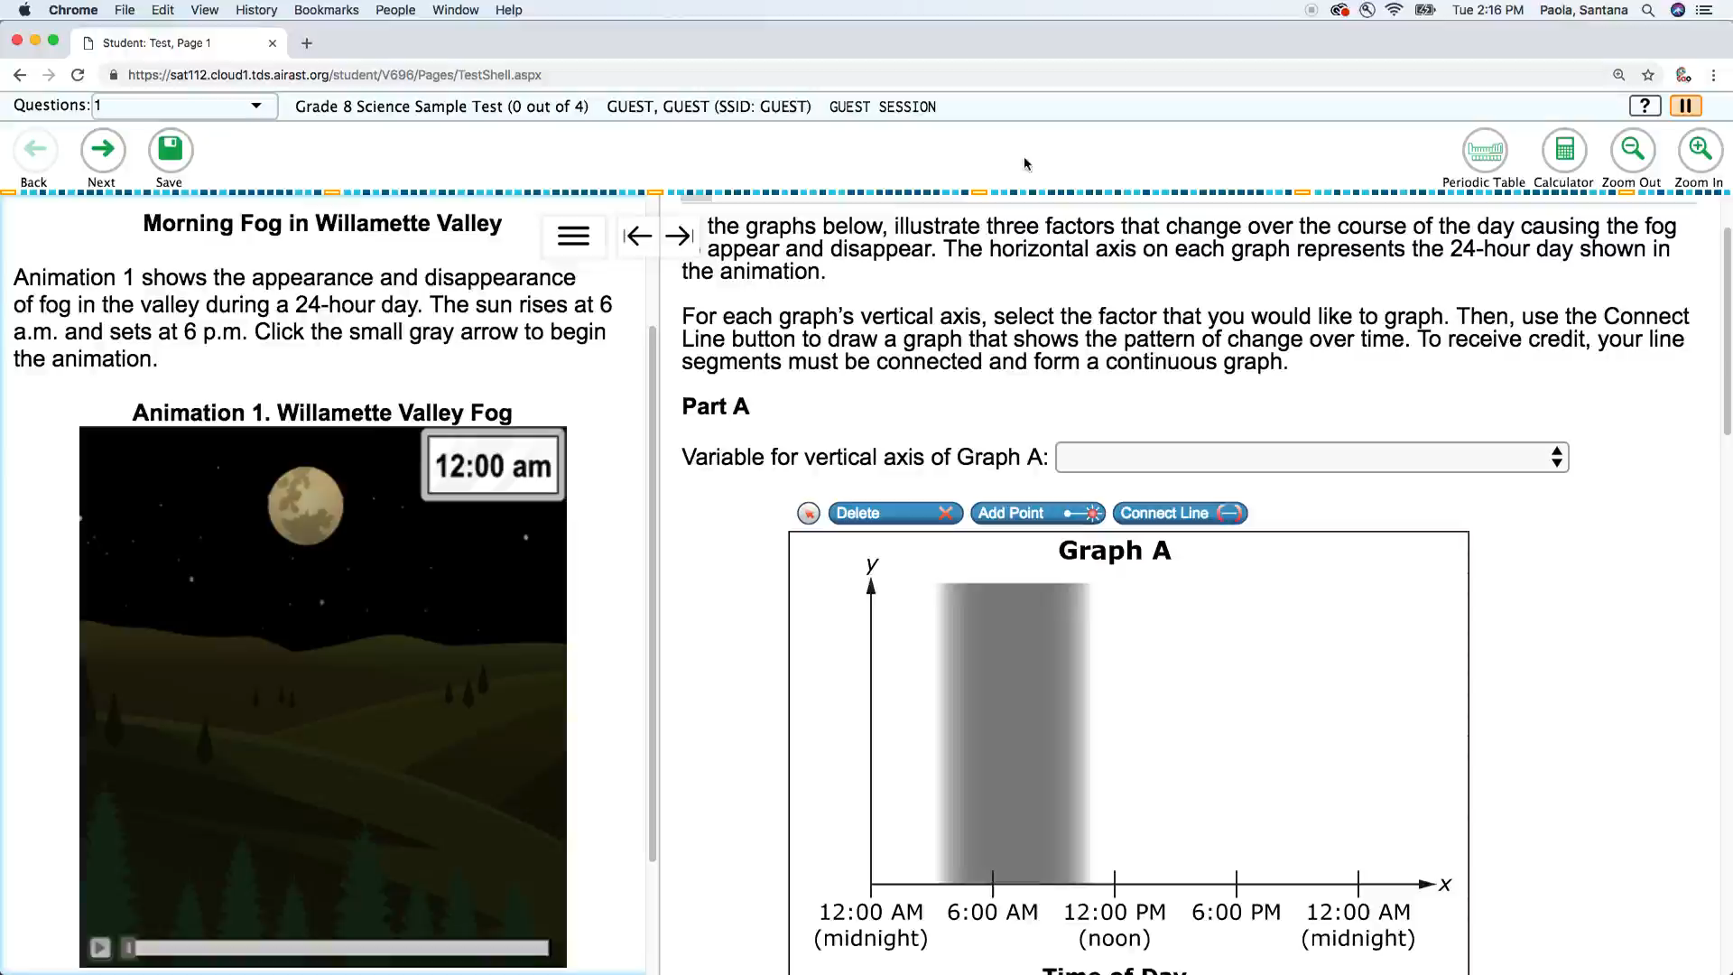
Periodic Table
Table of Contents –
Universal Tools –
Designated Supports –
Accommodations
Notes:
Periodic Table
Video Transcript: No audio included in video
All students in grade 8 and high school are able to access the state approved online Periodic Table of the Elements
Available for the following tests:
Science Grades 8 & HS

Slide 22
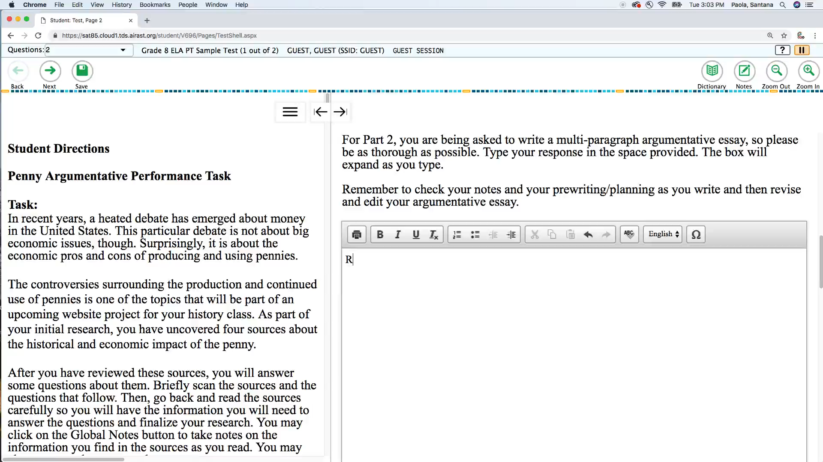
Response Recovery
Table of Contents –
Universal Tools –
Designated Supports –
Accommodations
Notes:
Response Recovery
Video Transcript: No audio included in video
Enables a student to recover every saved (or auto-saved) draft. All drafts are ordered from most recent to oldest and grouped by sitting (each time the student logged in and tested)
Available for the following tests:
ELPA Summative
ELPA Screener
ELA/Math Performance Tasks (Interim + Summative)
SEED Survey

Slide 23
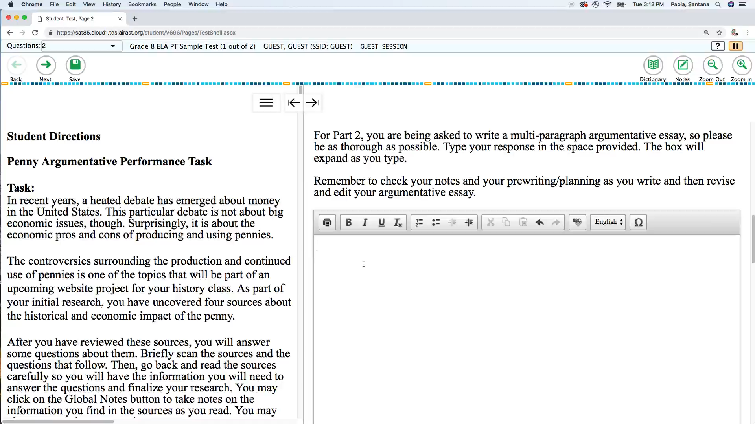
Spell Check
Table of Contents –
Universal Tools –
Designated Supports –
Accommodations
Notes:
Spell Check
Video Transcript: No audio included in video
Writing tool for checking the spelling of words in student-generated responses. Spell check only gives an indication that a word is misspelled; it does not provide the correct spelling. This tool is available only with the specific items for which the Smarter Balanced Item Specifications indicate that spell check is appropriate. Spell check is bundled with other embedded writing tools for all ELA performance task full writes (planning, drafting, revising, and editing). A full write is the second part of a ELA performance task.
Available for the following tests:
ELA PT, Math PT (Interim + Summative)
ELPA Summative & ELPA Screener

Slide 24
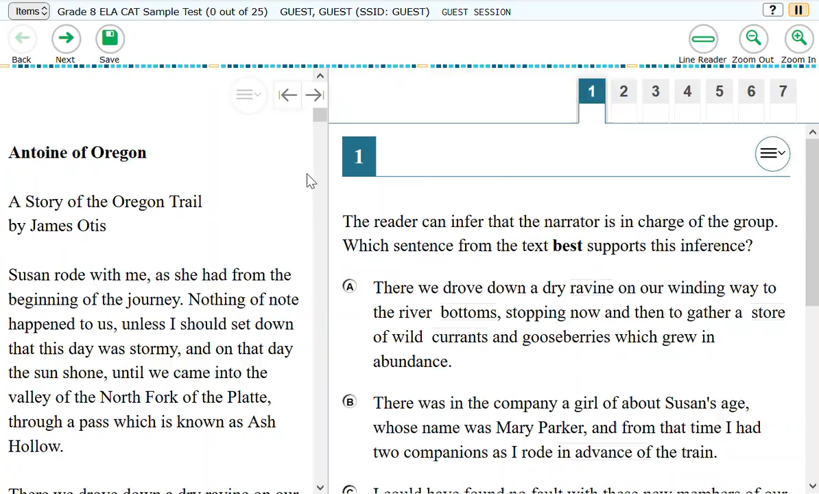
Strikethrough
Table of Contents –
Universal Tools –
Designated Supports –
Accommodations
Notes:
Strikethrough
Video Transcript: No audio included in video
Allows users to cross out answer options. If an answer option is an image, a strikethrough line will not appear, but the image will be grayed out.
Basic feature of the assessment interface (available for all tests)

Slide 25
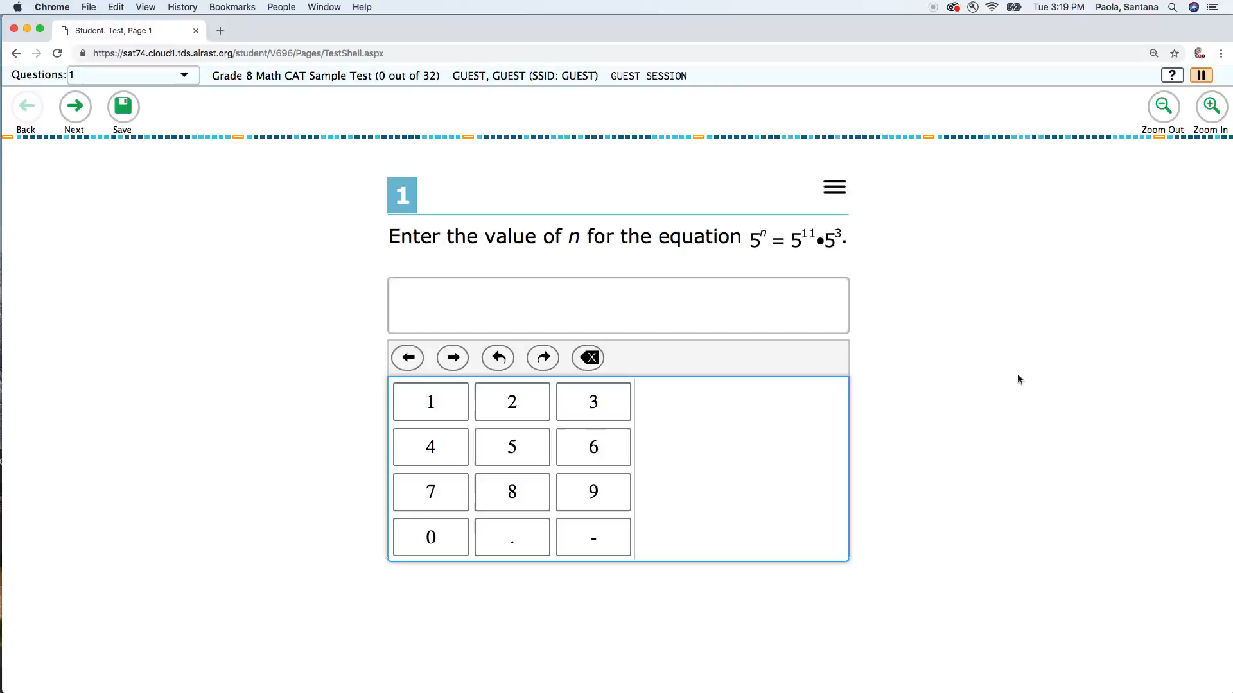
Tutorials
Table of Contents –
Universal Tools –
Designated Supports –
Accommodations
Notes:
Tutorials
Video Transcript: No audio included in video
Basic feature of the assessment interface (available for all tests)

Slide 26
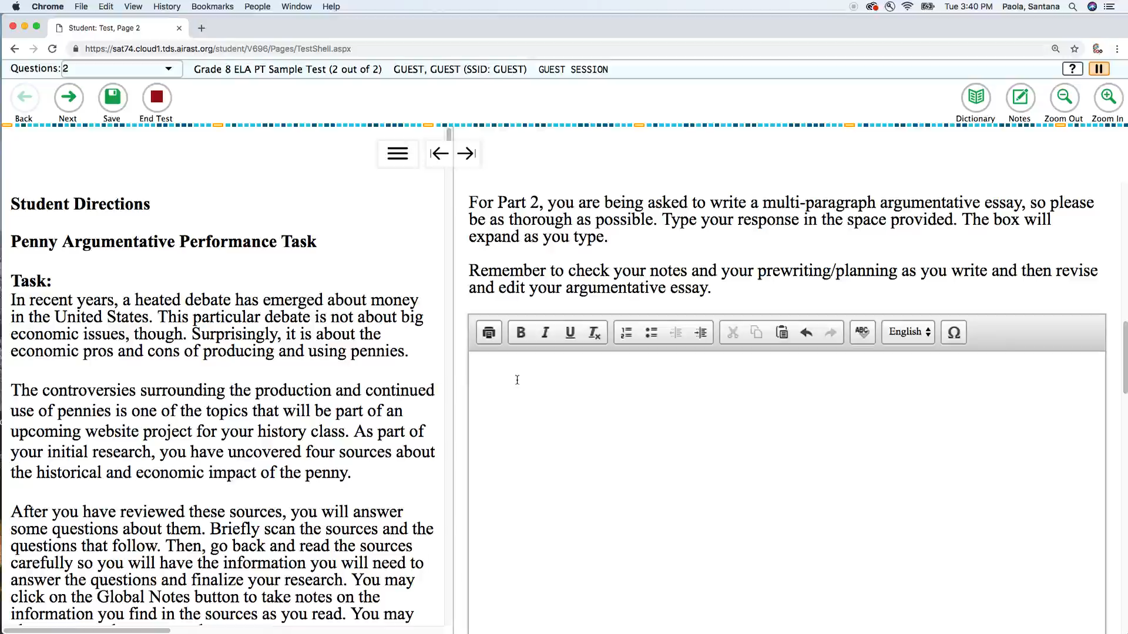
Writing Tools
Table of Contents –
Universal Tools –
Designated Supports –
Accommodations
Notes:
Writing Tools
Video Transcript: No audio included in video
Selected writing tools (i.e., bold, italic, bullets, undo/redo) are available for all student-generated responses. (Also see spell check.)
Available for the following tests:
ELPA Summative
ELPA Screener
ELA PT/Math PT (Interim + Summative)

Slide 27
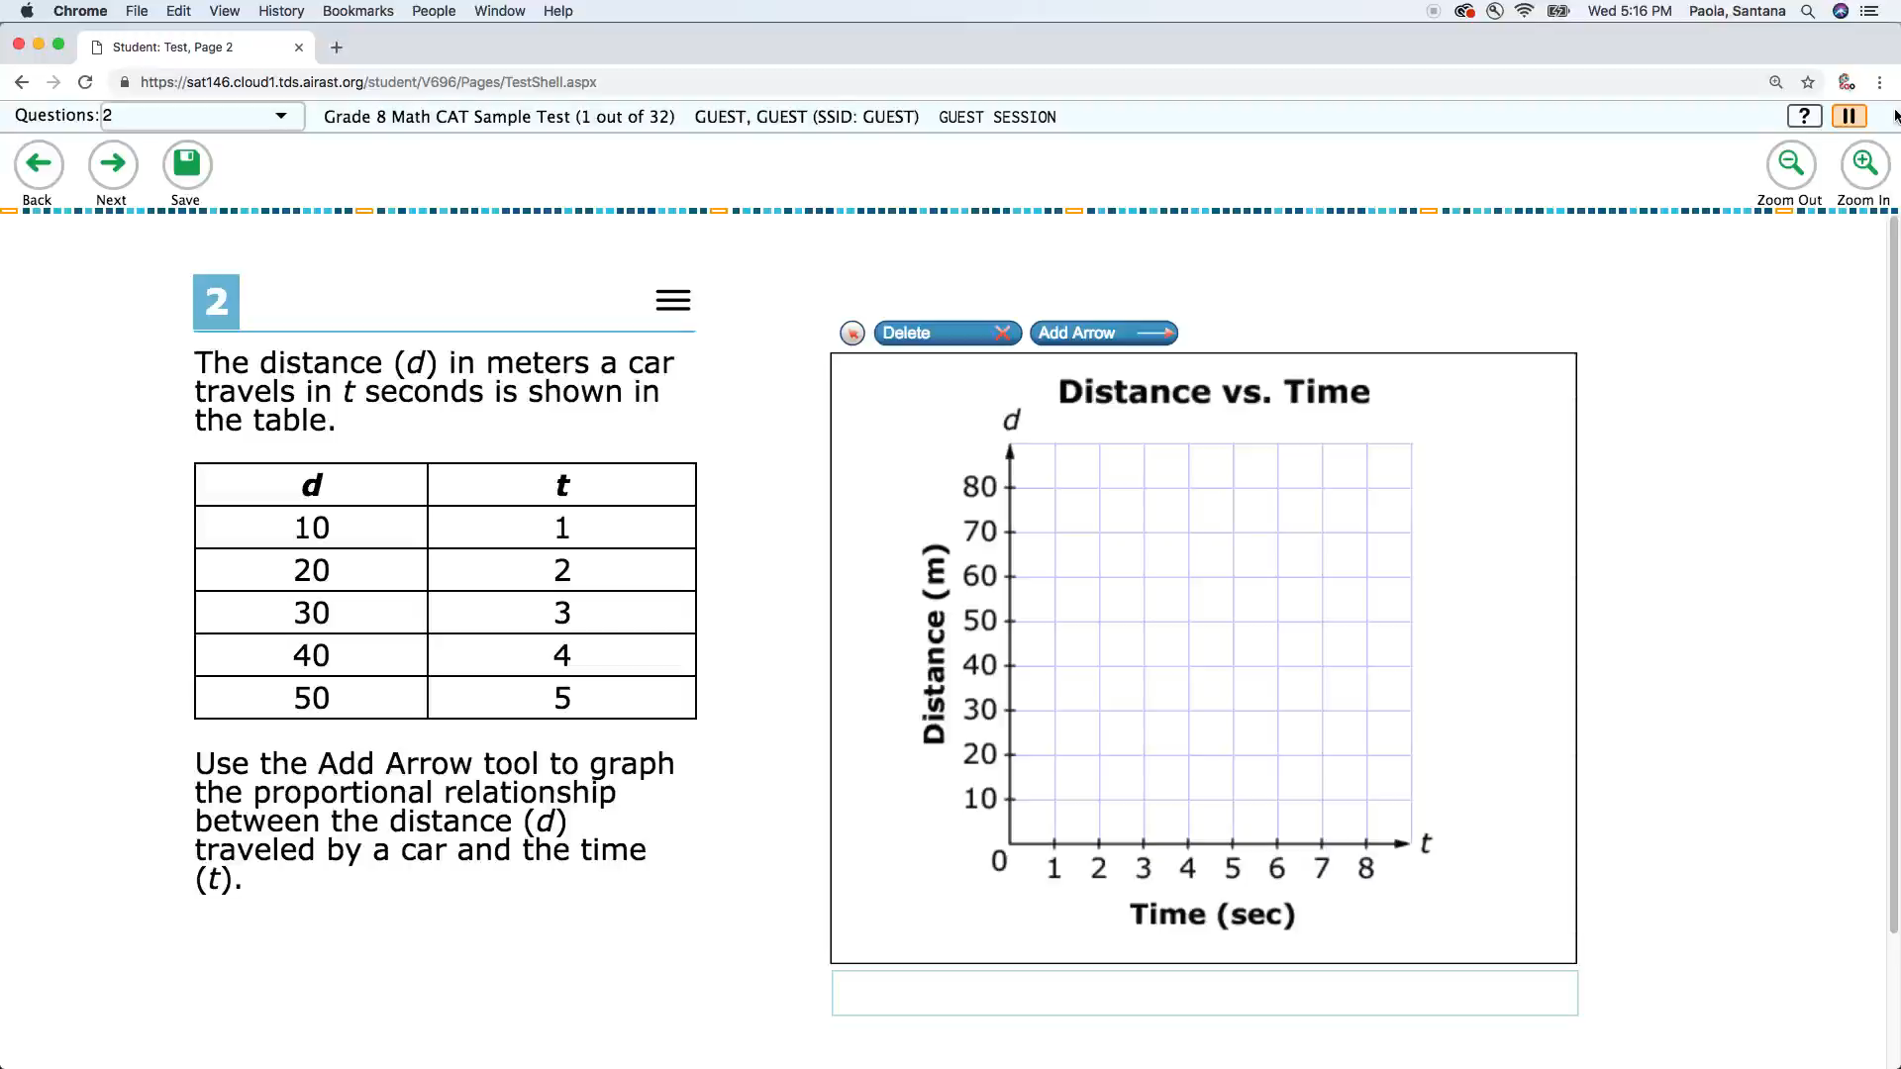
Zoom
Table of Contents –
Universal Tools –
Designated Supports –
Accommodations
Notes:
Zoom
Video Transcript: No audio included in video
A tool for making text or other graphics in a window or frame appear larger on the screen. The default font size for all tests is 14 pt. The student can make text and graphics larger by clicking the Zoom In button. The student can click the Zoom Out button to return to the default or smaller print size. When using the zoom feature, the student only changes the size of text and graphics on the current screen. The use of this Universal Tool may result in the student needing additional overall time to complete the assessment. (Note: a student’s default font size can be updated for all items and stimuli on the test using the Print Size designated support (see Table 3 SB: Embedded Designated Supports)
Basic feature of the assessment interface (available for all tests)

Slide 28
Embedded Designated Supports
Dictation (Embedded Speech-to-Text)
Dictation (Embedded Speech-to-Text, Spanish)
Full Screen Mode
Glossary (Illustrated)
Glossary (Translated)
Masking
Presentation (Toggled Spanish/English)
Print on Request
Print Size
Streamlined Interface Mode
Text-to-Speech
Text-to-Speech on Constructed Responses
Text-to-Speech Tracking with Line Reader
Text-to-Speech Tracking without Line Reader
Table of Contents –
Universal Tools –
Designated Supports –
Accommodations
Notes:
Access features of the assessment available for use by any student for whom the need has been indicated by an educator (or team of educators with parent/guardian and student). They are either provided as digitally delivered components of the test administration system or separate from it.

Slide 29
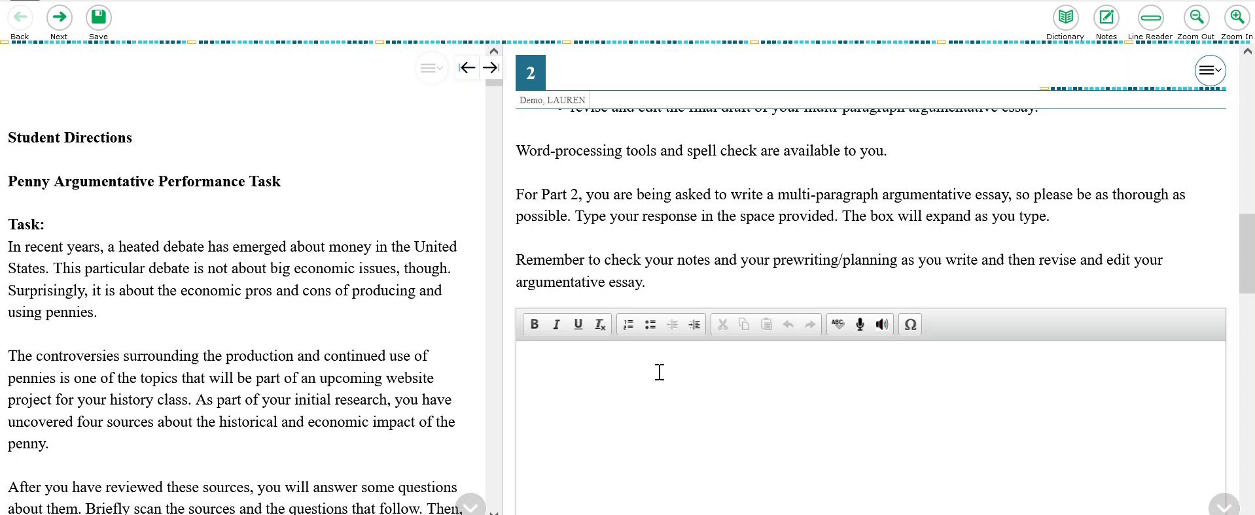
Dictation (Embedded Speech-to-Text)
Table of Contents –
Universal Tools –
Designated Supports –
Accommodations
Notes:
Dictation (Embedded Speech-to-Text)
VIDEO TRANSCRIPT: To use dictation, press on the microphone button at the top of the answer space. Start speaking. When you are done speaking, press the microphone again to turn the tool off. “I am speaking out loud.” The tool will not auto-punctuate the dictated text. The commands “period, comma, question mark, and exclamation point,” are recognized by the tool. All other punctuation must be inserted manually.
DESCRIPTION: Students can dictate responses to constructed-response items embedded in the computer system. It is the student’s responsibility to ensure the accuracy of the transcription as well as grammar and punctuation.
RECOMMENDATIONS FOR USE: Students who have documented significant motor or processing difficulties, or who have had a recent injury (such as a broken hand or arm) that make it difficult to produce responses may need to dictate their responses, which is transcribed as text in the item response area.
Available for the following tests:
Math – Designated Support
ELA - Accommodation

Slide 30
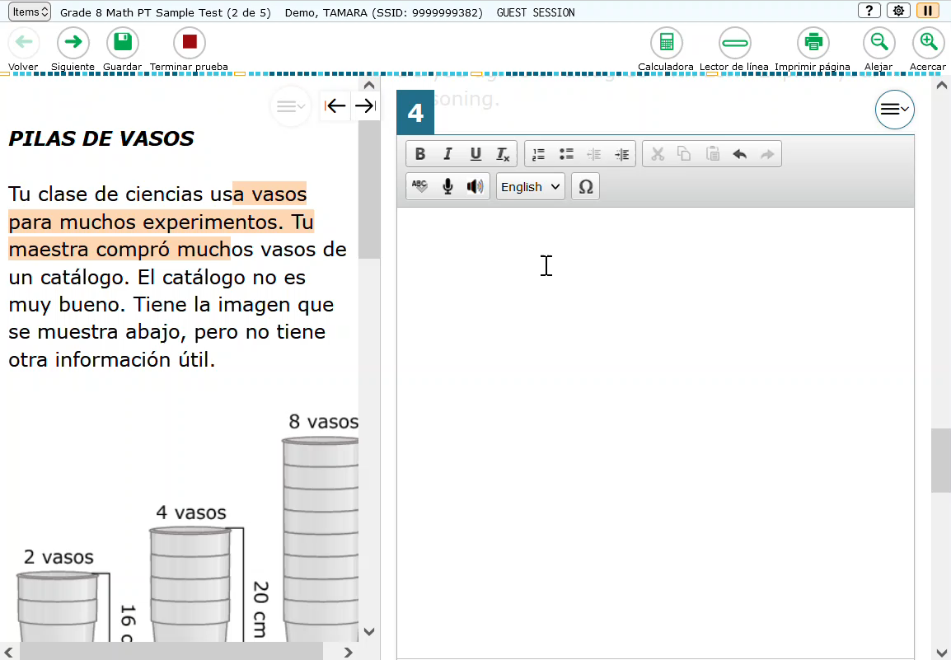
Dictation (Embedded Speech-to-Text, Spanish)
Table of Contents –
Universal Tools –
Designated Supports –
Accommodations
Notes:
Dictation (Embedded Speech-to-Text, Spanish)
VIDEO TRANSCRIPT: Hello, how are you? Hola, como estas?
DESCRIPTION: Student with a Spanish Designated Support can dictate responses in Spanish or English to constructed-response items. It is the student’s responsibility to ensure the accuracy of the transcription as well as grammar and punctuation.
RECOMMENDATIONS FOR USE: Students who have documented significant motor or processing difficulties, or who have had a recent injury (such as a broken hand or arm) that make it difficult to produce responses may need to dictate their responses, which is transcribed as text in the item response area.
Available for the following tests:
Math – Designated Support
ELA - Accommodation

Slide 31
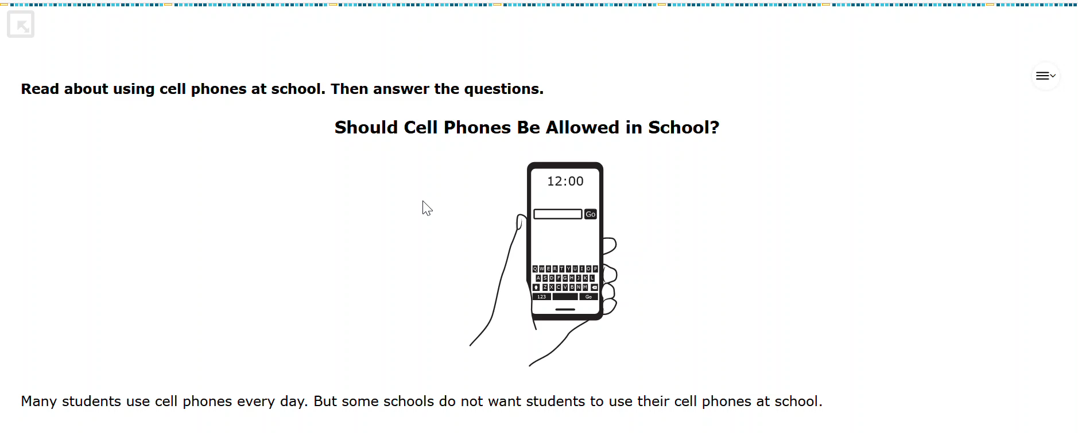
Full Screen Mode
Table of Contents –
Universal Tools –
Designated Supports –
Accommodations
Notes:
Full Screen Mode
VIDEO TRANSCRIPT: When full screen mode is enabled in the TA Interface or TIDE, the test will automatically start with full screen mode on. Full screen mode eliminates the global tool bar from the top of the screen in order to provide a more simplified interface. To close full screen mode, click on the light gray arrow box on the upper left side of the screen. The global menu will reappear at the top of the screen. If the TA wishes to turn full screen mode back on, press on the full screen mode button in the global menu.
DESCRIPTION: This designated support removes the global menu from the top of the test interface screen, and replaces it with a single large button that says “next”.
RECOMMENDATIONS FOR USE: This designated support may benefit students who need simplified test navigation controls. This support is only available on the Alt ELPA, which is a 1:1 administered assessment. Users may move in and out of Full Screen Mode during the test. Full Screen Mode must be exited at the end of the test to access the “End Test” button.
Available for the following tests:
Alt ELPA

Slide 32
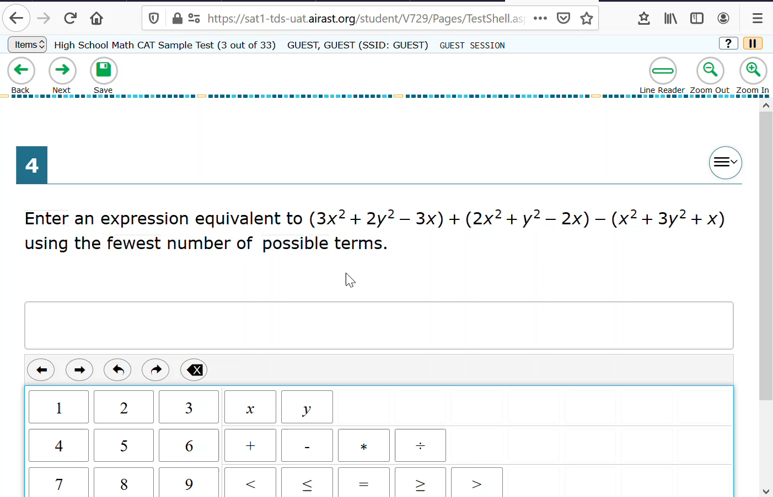
Glossary (Illustrated)
Table of Contents –
Universal Tools –
Designated Supports –
Accommodations
Notes:
Glossary (Illustrated)
Video Transcript: No audio included in video
Description:
Translated glossaries are a language support. The translated glossaries are provided for selected construct-irrelevant terms for math and appear on the computer screen when students with the language glossary setting enabled click on the term. Students can also select the audio icon next to the glossary term and listen to the audio recording of the glossary.
Recommendations for Use:
Students who have limited English language skills (whether or not designated as English Learners (ELs) or ELs with disabilities) can use the translation glossary for specific items. The use of this support may result in the student needing additional overall time to complete the assessment.
Available for the following tests:
Math

Slide 33
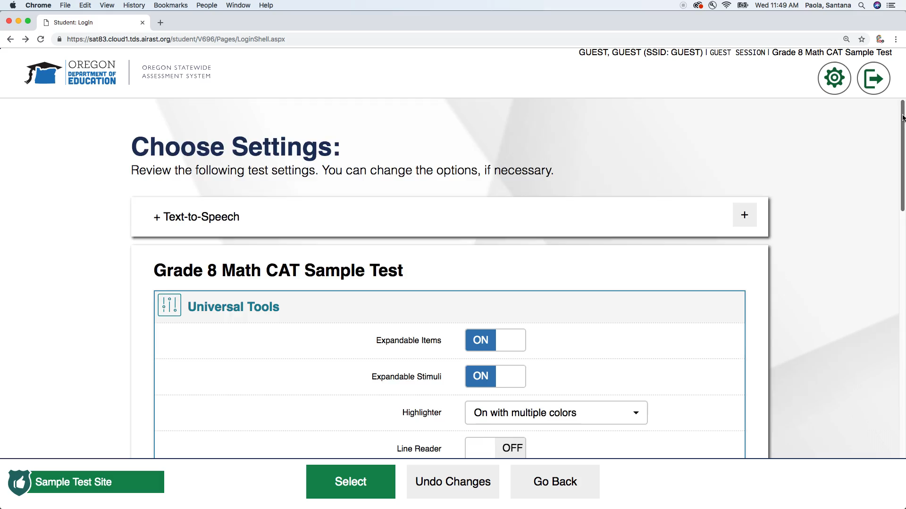
Glossary (Translated)
Table of Contents –
Universal Tools –
Designated Supports –
Accommodations
Notes:
Glossary (Translated)
Video Transcript: No audio included in video
Description:
Translated glossaries are a language support. The translated glossaries are provided for selected construct-irrelevant terms for math and appear on the computer screen when students with the language glossary setting enabled click on the term. Students can also select the audio icon next to the glossary term and listen to the audio recording of the glossary.
Recommendations for Use:
Students who have limited English language skills (whether or not designated as English Learners (ELs) or ELs with disabilities) can use the translation glossary for specific items. The use of this support may result in the student needing additional overall time to complete the assessment.
Available for the following tests:
Math

Slide 34
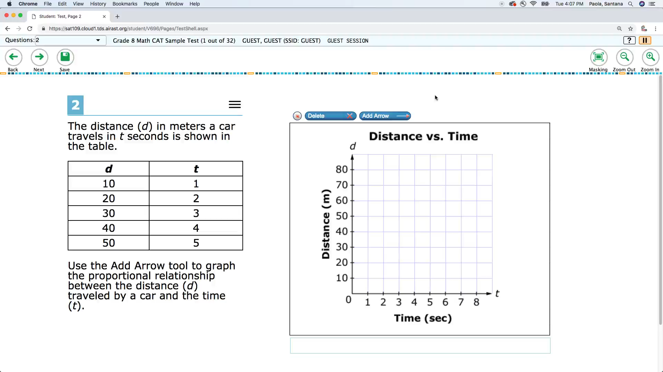
Masking
Table of Contents –
Universal Tools –
Designated Supports –
Accommodations
Notes:
Masking
Video Transcript: No audio included in video
Description:
Masking involves blocking off content that is not of immediate need or that may be distracting to the student, including individual answer options and navigational buttons and menus. Students are able to focus their attention on a specific part of a test item by masking.
Recommendations for Use:
Students with attention difficulties may need to mask content not of immediate need or that may be distracting during the assessment. This support also may be needed by students with print disabilities (including learning disabilities) or visual impairments
Available for all tests.

Slide 35
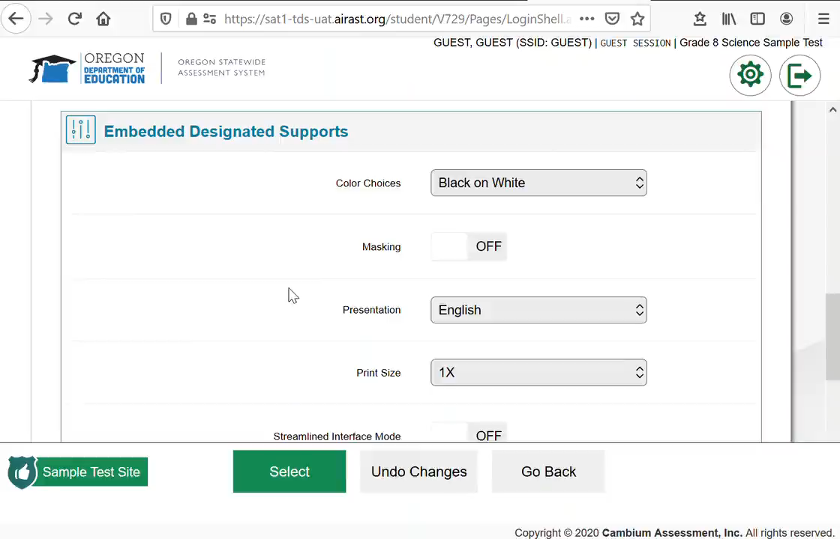
Presentation (Toggled Spanish/English)
Table of Contents –
Universal Tools –
Designated Supports –
Accommodations
Notes:
Presentation (Toggled Spanish/English)
Video Transcript: No audio included in video
Description:
Toggled translations are a language support that provides the student to toggle between the full translation of each Science stimulus and item in Spanish and English, using a button at the top of the page.
Recommendations for Use:
For students whose primary language is Spanish and who use dual language supports in the classroom, use of the toggle (dual language) translation may be appropriate. Students participate in the assessment regardless of the language. This support will increase reading load and cognitive load. The use of this support may result in the student needing additional overall time to complete the assessment.
Available for the following tests:
Science

Slide 36
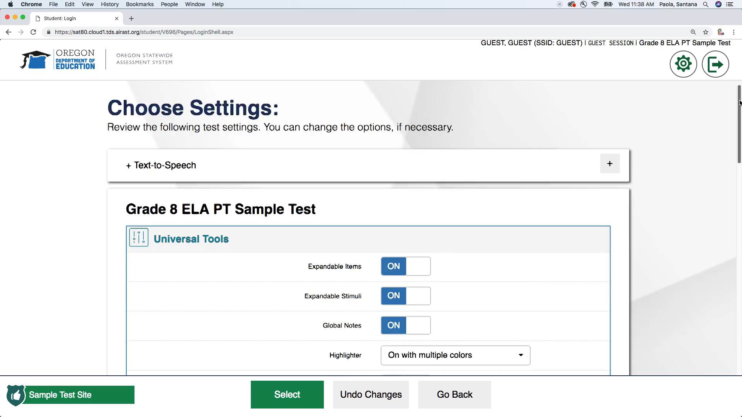
Print on Request
Table of Contents –
Universal Tools –
Designated Supports –
Accommodations
Notes:
Print on Request
Video Transcript: No audio included in video
Description:
Paper copies of stimuli (including passages) and/or items are printed for students. Test content of online items may be printed with different colors. Choice of colors should be informed by evidence of those colors that meet the student’s needs.
All printed test materials (including embossed Braille print-outs) must be collected and securely shredded immediately following each testing event. Students may not keep printed test items for use during future testing events.
Recommendations for Use:
Some students with disabilities, including visual impairments or other print disabilities, may need paper copies of their test content. Students with attention difficulties may need the support of printing in different colors when digitally-provided color contrasts do not meet their needs. A very small percentage of students should need this support. The use of this support may result in the student needing additional time to complete the assessment.
Available for all tests.

Slide 37
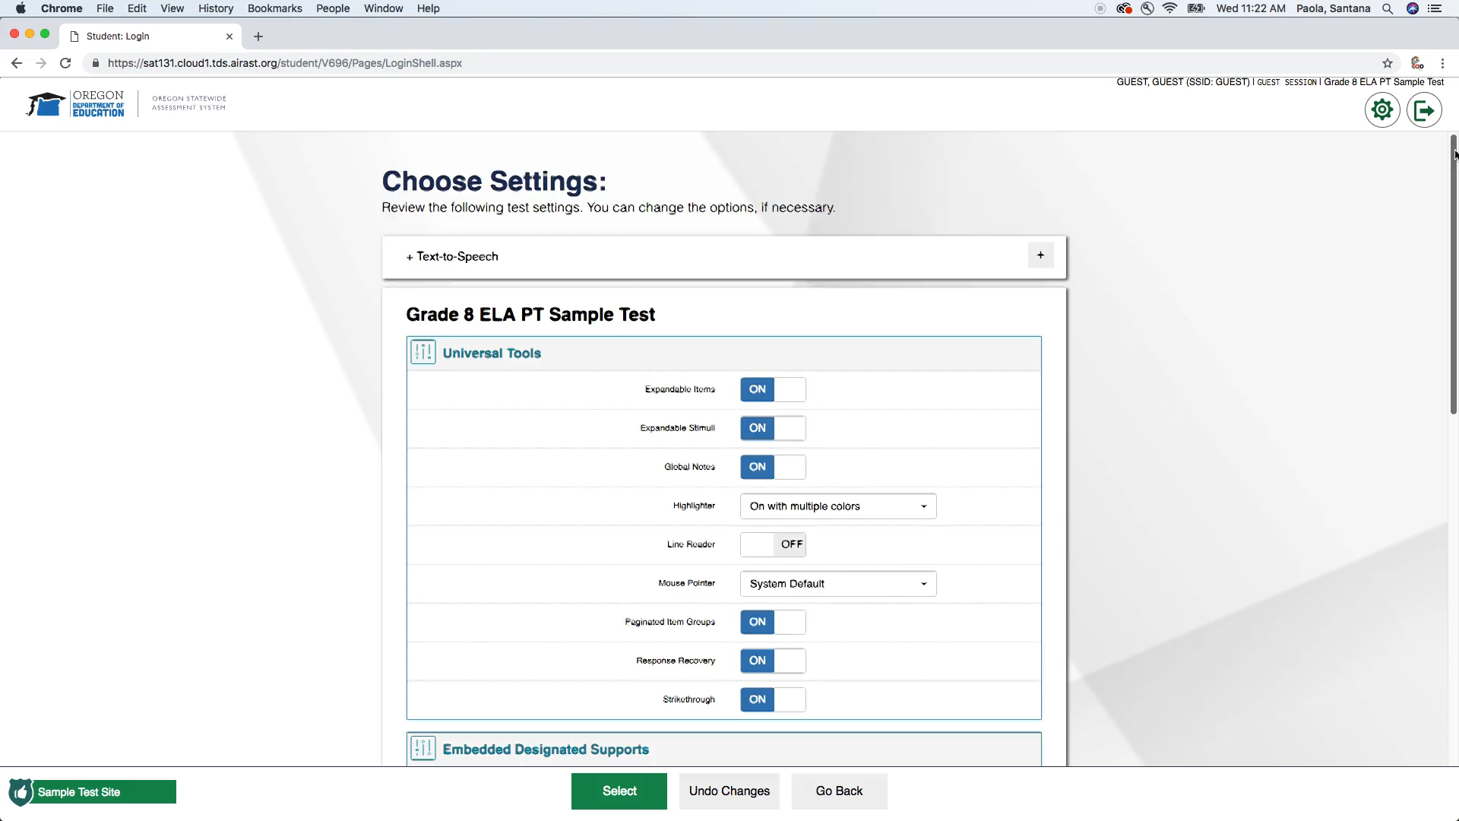
Print Size
Table of Contents –
Universal Tools –
Designated Supports –
Accommodations
Notes:
Print Size
Video Transcript: No audio included in video
Description:
Paper copies of stimuli (including passages) and/or items are printed for students. Test content of online items may be printed with different colors. Choice of colors should be informed by evidence of those colors that meet the student’s needs.
All printed test materials (including embossed Braille print-outs) must be collected and securely shredded immediately following each testing event. Students may not keep printed test items for use during future testing events.
Recommendations for Use:
Some students with disabilities, including visual impairments or other print disabilities, may need paper copies of their test content. Students with attention difficulties may need the support of printing in different colors when digitally-provided color contrasts do not meet their needs. A very small percentage of students should need this support. The use of this support may result in the student needing additional time to complete the assessment.
Available for all tests.

Slide 38
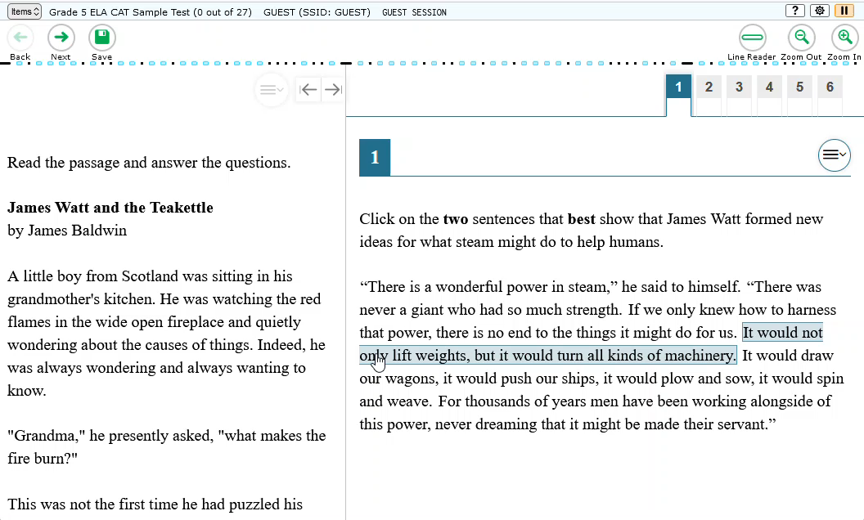
Streamlined Interface Mode
Table of Contents –
Universal Tools –
Designated Supports –
Accommodations
Notes:
Streamlined Interface Mode
Video Transcript: Tests without Stremlined Interface Mode present a split screen, with the stimulus on the left and the items on the right. In Streamlined Interface Mode, there is no split screen. The stimulus is presented first and items are presented below.
Description:
This designated support provides a streamlined interface of the test in an alternate, simplified format in which the items are displayed below the stimuli.
Recommendations for Use:
This designated support may benefit a small number of students who have specific learning and/or reading disabilities and/or visual impairment in which the text is presented in a more sequential format. Students should have familiarity interacting with items in a streamlined format.
Available for all tests.

Slide 39
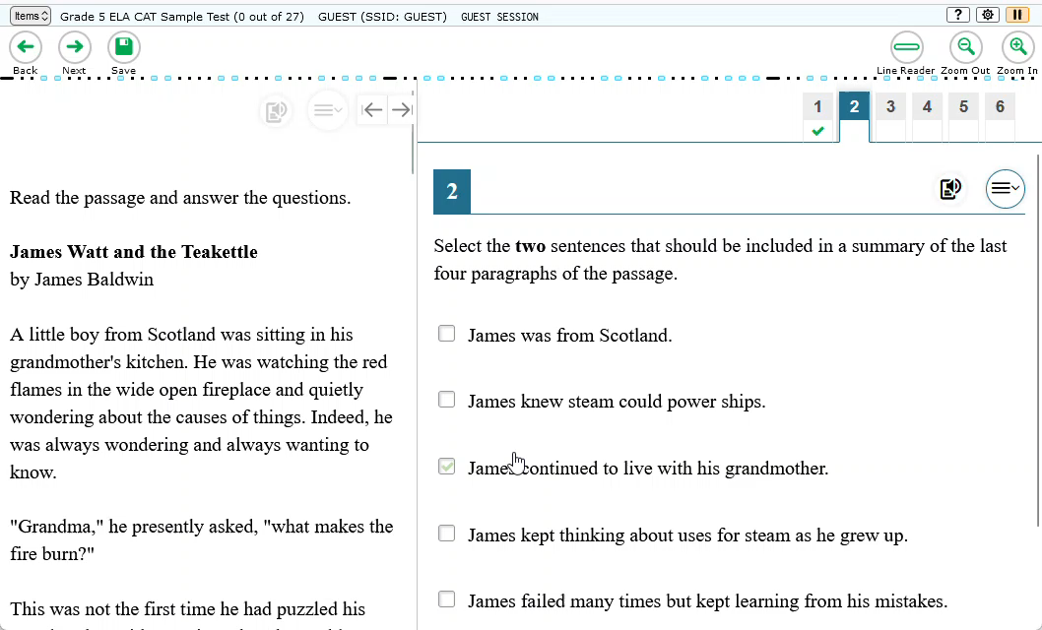
Text-to-Speech
Table of Contents –
Universal Tools –
Designated Supports –
Accommodations
Notes:
Text-to-Speech
Video Transcript: Text-to-speech is now available via an icon to the left of the context menu, rather than within the context menu. Students may still right click to access TTS options.
Description:
Text is read aloud to the student via embedded text-to-speech technology. The student is able to control the speed as well as raise or lower the volume of the voice via a volume control.
English text-to-speech is available for Math for students with the Translations (stacked Spanish/English) and for Science with the Translations (toggle Spanish/English) designated support assigned to them.
Recommendations for Use:
Students who are struggling readers may need assistance accessing the assessment by having all or portions of the assessment read aloud. This support also may be needed by students with reading-related disabilities, or by students who are blind and do not yet have adequate braille skills. This support will likely be confusing and may impede the performance of students who do not regularly have the support during instruction. Students who use text-to-speech will need headphones unless tested individually in a separate setting.
*Note: The embedded designated support of text-to-speech is not available for Smarter ELA items through the Braille Interface. The non-embedded Read-Aloud designated support is available for students using the Braille Interface who require read-aloud support for ELA items (see Table 4 SB).
Available for the following tests:
ELA CAT – Accommodation for ELA Reading Stimuli or Items & Stimuli; Designated Support for Items Only
ELA PT (Interim + Summative) – Designated Support for all options
Math –English TTS available on Stacked Spanish/English tests
Science - Available in Spanish & English
SEED Survey - Available in Spanish & English

Slide 40
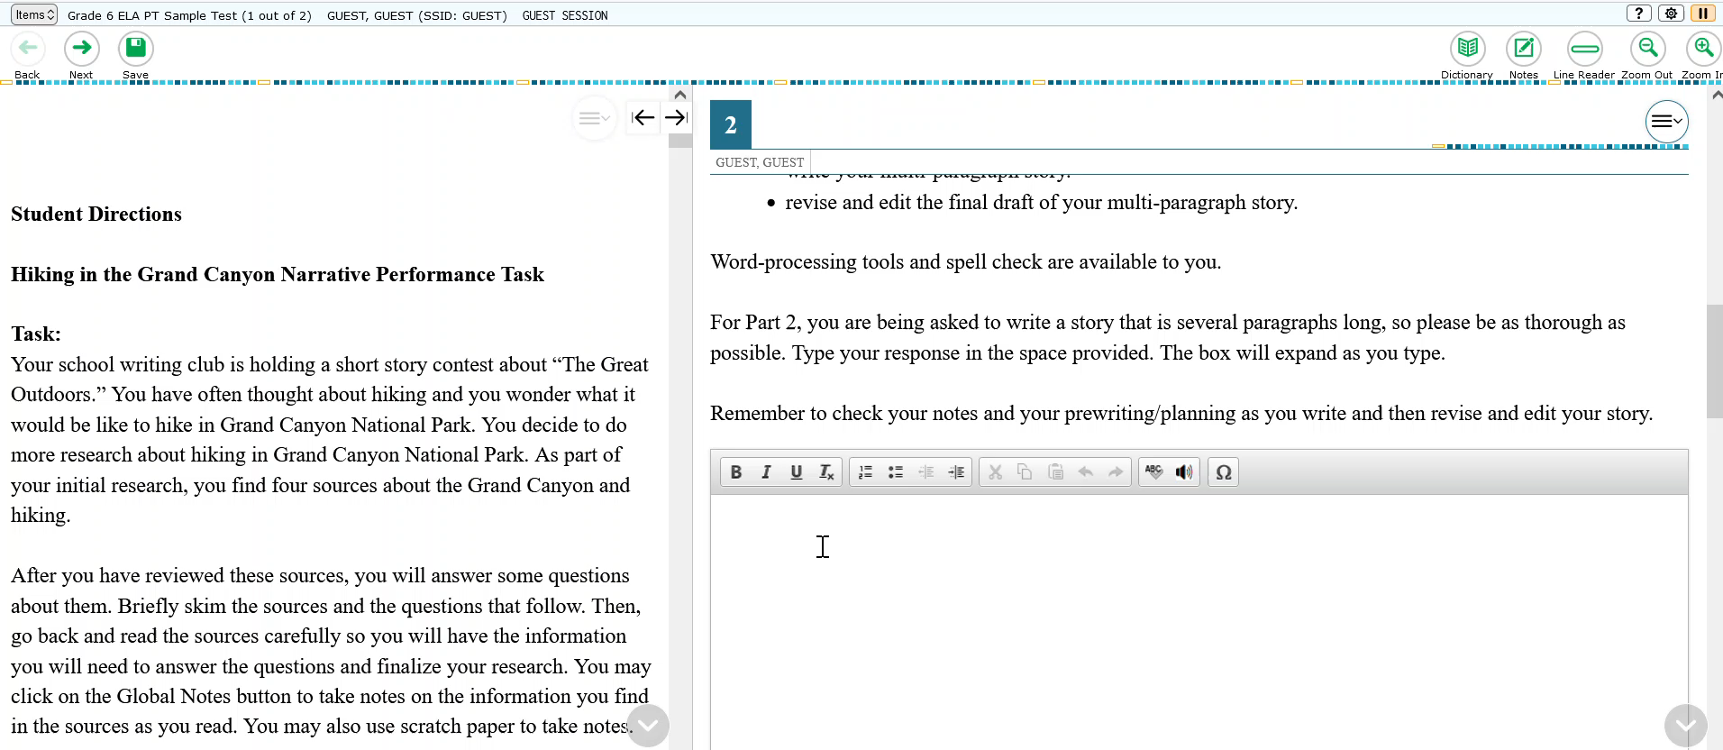
Text-to-Speech on Constructed Responses
Table of Contents –
Universal Tools –
Designated Supports –
Accommodations
Notes:
Text-to-Speech on Constructed Responses
Video Transcript: Students may listen to the text-to-speech read back of their written response by clicking on the speaker button at the top of the answer space.
Description:
Students with either TTS or Dictation enabled may use TTS to listen to their responses to select constructed-response items. Students can select the speaker icon at the bottom of the text-response area to listen to the text as entered. Available for English responses only.
Recommendations for Use:
Students who are struggling readers may need assistance accessing the assessment by having all or portions of the assessment read aloud. This support also may be needed by students with reading-related disabilities, or by students who are blind and do not yet have adequate braille skills. This support will likely be confusing and may impede the performance of students who do not regularly have the support during instruction. Students who use text-to-speech will need headphones unless tested individually in a separate setting.
Available for the following tests:
ELA PT (Interim +Summative) – Automatically available on constructed response long-write items
Math PT –Automatically available on constructed response long-write items
SEED Survey

Slide 41
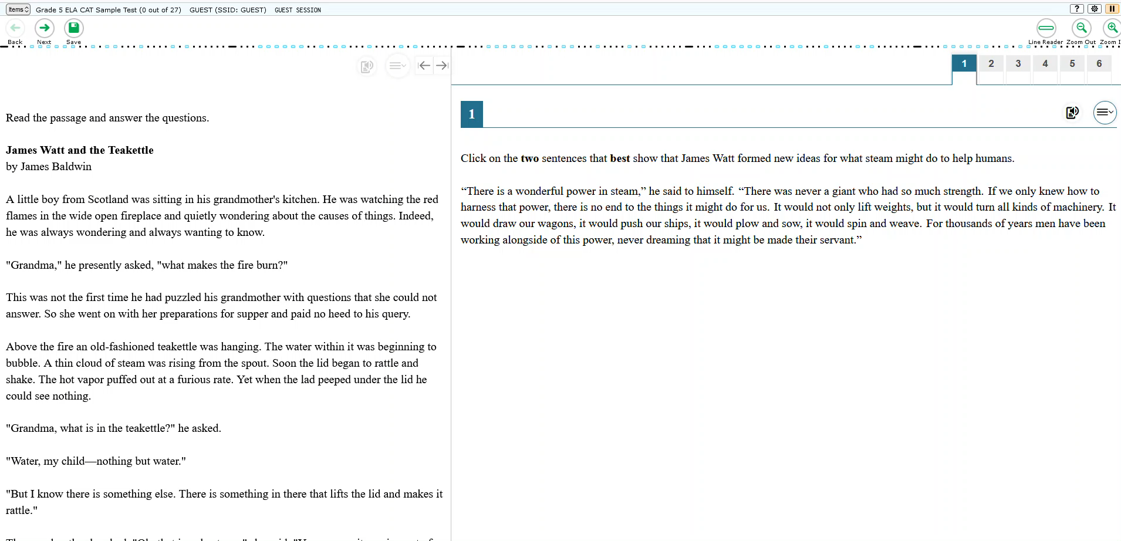
Text-to-Speech Tracking with Line Reader
Table of Contents –
Universal Tools –
Designated Supports –
Accommodations
Notes:
Text-to-Speech Tracking with Line Reader
Video Transcript: When a student is using TTS and TTS Tracking with line reader enabled on their test, the line reader will invoke itself when TTS is being used. The background will be masked as shown in this video. If the student does not want the background to be masked, the TA should turn off Line Reader in the TA interface before the student begins the test.
Description:
Text is highlighted as it is read aloud to the student via embedded text-to-speech technology.
Recommendations for Use:
Students who are struggling readers may need assistance accessing the assessment by having all or portions of the assessment read aloud. This support also may be needed by students with reading-related disabilities, or by students who are blind and do not yet have adequate braille skills. This support will likely be confusing and may impede the performance of students who do not regularly have the support during instruction. Students who use text-to-speech will need headphones unless tested individually in a separate setting.
*Note: The embedded designated support of text-to-speech is not available for Smarter ELA items through the Braille Interface. The non-embedded Read-Aloud designated support is available for students using the Braille Interface who require read-aloud support for ELA items (see Table 4 SB).
Available for the following tests:
ELA
Math – Both Segments – English TTS available on Stacked Spanish/English tests
Science - Available in Spanish & English

Slide 42
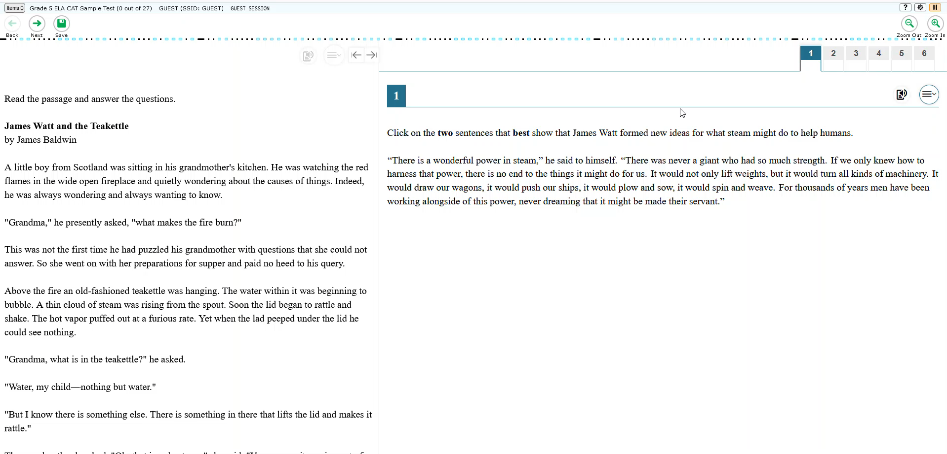
Text-to-Speech Tracking without Line Reader
Table of Contents –
Universal Tools –
Designated Supports –
Accommodations
Notes:
Text-to-Speech Tracking
Video Transcript: When a student is using TTS and TTS Tracking with line reader disabled on their test, the background will be not be masked. If the student wants to have the background masked, the TA should turn On the Line Reader in the TA interface before the student begins the test.
Description:
Text is highlighted as it is read aloud to the student via embedded text-to-speech technology.
Recommendations for Use:
Students who are struggling readers may need assistance accessing the assessment by having all or portions of the assessment read aloud. This support also may be needed by students with reading-related disabilities, or by students who are blind and do not yet have adequate braille skills. This support will likely be confusing and may impede the performance of students who do not regularly have the support during instruction. Students who use text-to-speech will need headphones unless tested individually in a separate setting.
*Note: The embedded designated support of text-to-speech is not available for Smarter ELA items through the Braille Interface. The non-embedded Read-Aloud designated support is available for students using the Braille Interface who require read-aloud support for ELA items (see Table 4 SB).
Available for the following tests:
ELA
Math – Both Segments – English TTS available on Stacked Spanish/English tests
Science - Available in Spanish & English

Slide 43
Embedded Accommodations
Audio Transcripts
American Sign Language
Closed Captioning
Equation Editor – Braille Interface
Presentation (Braille)
Word Prediction - without audio
Word Prediction – with audio
Table of Contents –
Universal Tools –
Designated Supports –
Accommodations
Notes:
Accommodations are changes in procedures or materials that increase equitable access during the statewide assessments. Assessment accommodations generate valid assessment results for students who need them; they allow these students to show what they know and can do. Note: accommodations are available only for students with documented Individualized Education Programs (IEPs) or Section 504 Plans. Accommodations do not compromise the learning expectations, construct, grade-level standard or intended outcome of the assessment.

Slide 44
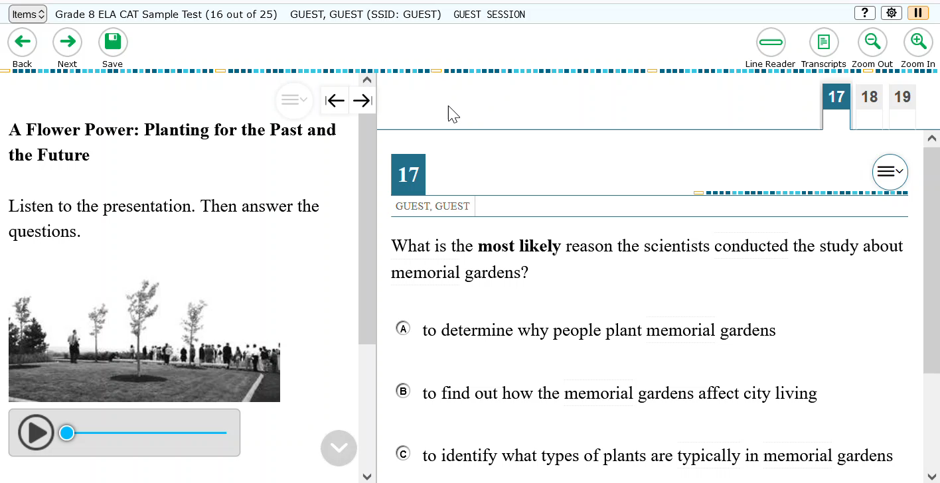
Audio Transcripts
Table of Contents –
Universal Tools –
Designated Supports –
Accommodations
Notes:
Audio Transcripts
Video Transcript: Audio transcripts are available on ELA CAT test items that include audio stimuli. The tool provides a static written transcript of an audio stimulus in a dialog box. The tool is available via a button in the global menu. This accommodation may benefit a small number of students who typically use closed captioning or ASL, but need a static document that they can read at their own pace.
Description:
This accommodation provides a static written transcript of an audio stimulus in a dialog box.
Recommendations for Use:
This accommodation may benefit a small number of students who typically use closed captioning or ASL, but need a static document that they can read at their own pace.
Available for the following tests:
ELA CAT

Slide 45
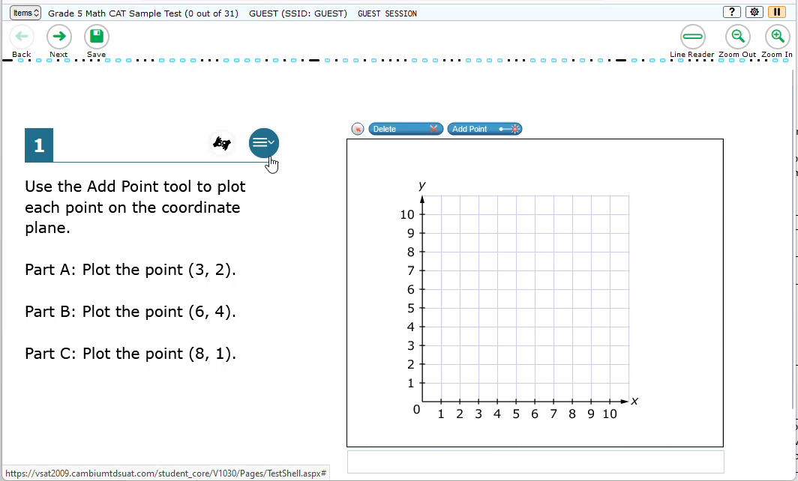
American Sign Language
Table of Contents –
Universal Tools –
Designated Supports –
Accommodations
Notes:
American Sign Language
Video Transcript: No audio included in video
Description:
Test content is translated into ASL video. ASL human signer and the signed test content are viewed on the same screen. Students may view portions of the ASL video as often as needed.
Recommendations for Use:
Some students who are deaf or hard of hearing and who typically use ASL may need this accommodation when accessing text-based content in the assessment. The use of this accommodation may result in the student needing additional overall time to complete the assessment. For many students who are deaf or hard of hearing, viewing signs is the only way to access information presented orally. It is important to note, however, that some students who are hard of hearing will be able to listen to information presented orally if provided with appropriate amplification and a setting in which extraneous sounds do not interfere with clear presentation of the audio presentation in a listening test.
Available for the following tests:
ELA CAT listening items
Math
SEED Survey

Slide 46
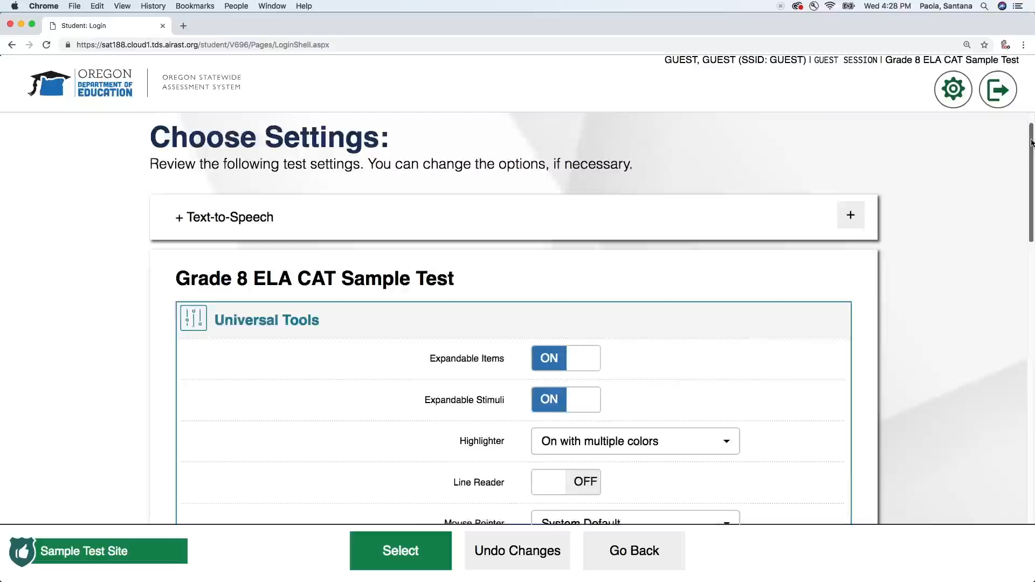
Closed Captioning
Table of Contents –
Universal Tools –
Designated Supports –
Accommodations
Notes:
Closed Captioning
Video Transcript: No audio included in video
Description:
Printed text that appears on the computer screen as audio materials are presented.
Recommendations for Use:
Students who are deaf or hard of hearing and who typically access information presented via audio by reading words that appear in synchrony with the audio presentation may need this support to access audio content. For many students who are deaf or hard of hearing, viewing words (sometimes in combination with reading lips and ASL) is how they access information presented orally. It is important to note, however, that some students who are hard of hearing will be able to listen to information presented orally if provided with appropriate amplification and a setting in which extraneous sounds do not interfere with clear presentation of the audio presentation in a listening test.
Available for the following tests:
ELA CAT Segment on items with audio stimulus

Slide 47
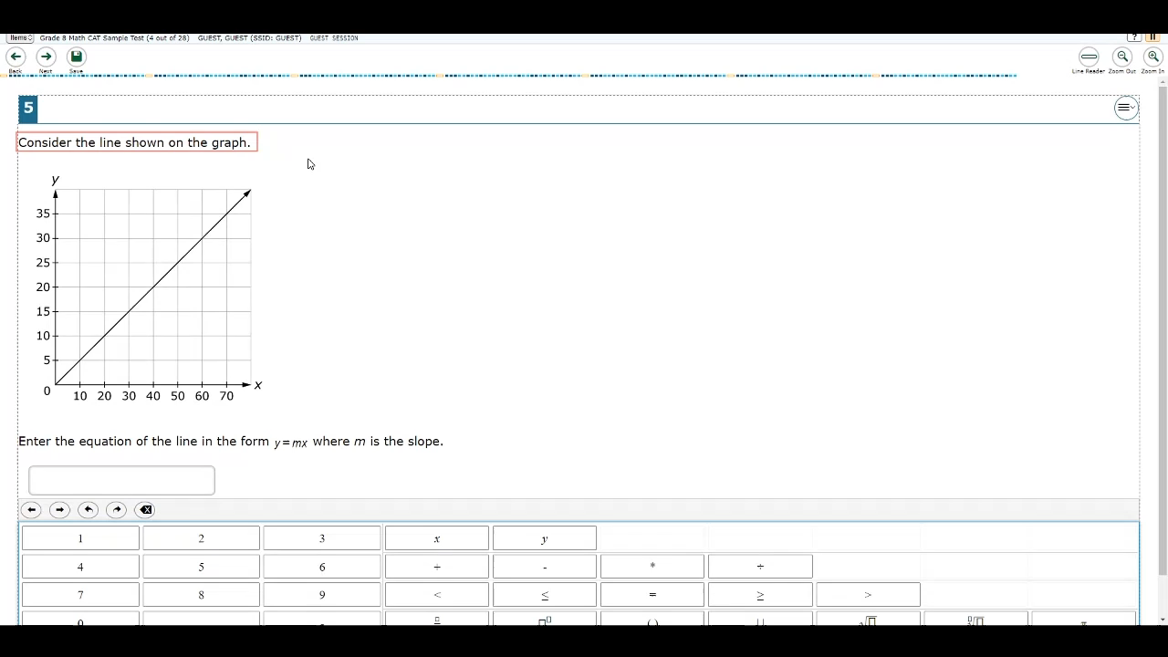
Equation Editor – Braille Interface
Table of Contents –
Universal Tools –
Designated Supports –
Accommodations
Notes:
Equation Editor – Braille Interface
Video Transcript: Once focus is on the text entry box, press enter to move focus inside the text box to begin typing. Pressing Alt-7 brings up the math commands window which will allow you to enter keys that are not present on your keyboard.
When the focus is on the combo box, up and down arrows can be used to navigate potential options. Once the desired option is announced, press tab to navigate down to the insert symbol button, then press enter to insert the option into the equation editor box.
Description:
The equation editor is now available in the Braille interface. Previously students had to write out the description of an equation. Now the equation editor is available in the Braille interface and students may navigate the interface to input his/her answer.
Recommendations for Use:
This accommodation may benefit students by providing a more straightforward method of inputting complex equations in their responses
Available for the following tests:
Math
Science

Slide 48
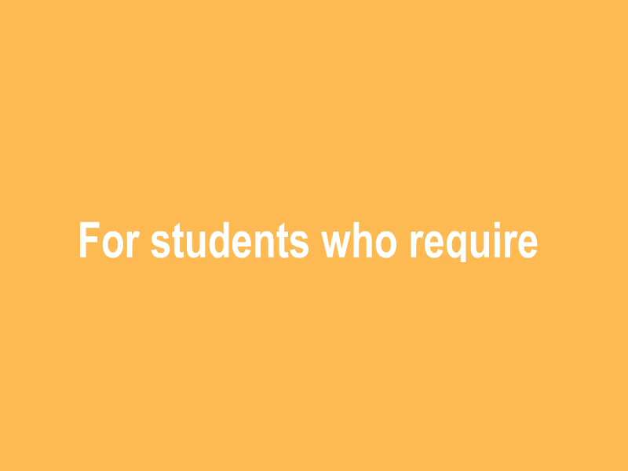
Presentation (Braille)
Table of Contents –
Universal Tools –
Designated Supports –
Accommodations
Notes:
Presentation (Braille)
Video Transcript: No audio included in video
Description:
A raised-dot read with the fingertips. Refreshable braille is available only for ELA because Nemeth Code is not available via refreshable braille. For Math, braille will be presented via embosser; embosser-created braille can be used for ELA also, as well as for graphic material (e.g., maps, charts, graphs, diagrams, and illustrations). The type of braille presented to the student (UEB/EBAE, contracted or non-contracted) is set in TIDE.
Recommendations for Use:
Students with visual impairments may read text via braille. The use of this accommodation may result in the student needing additional overall time to complete the assessment.
Available for the following tests:
ELA
Math
Science

Slide 49
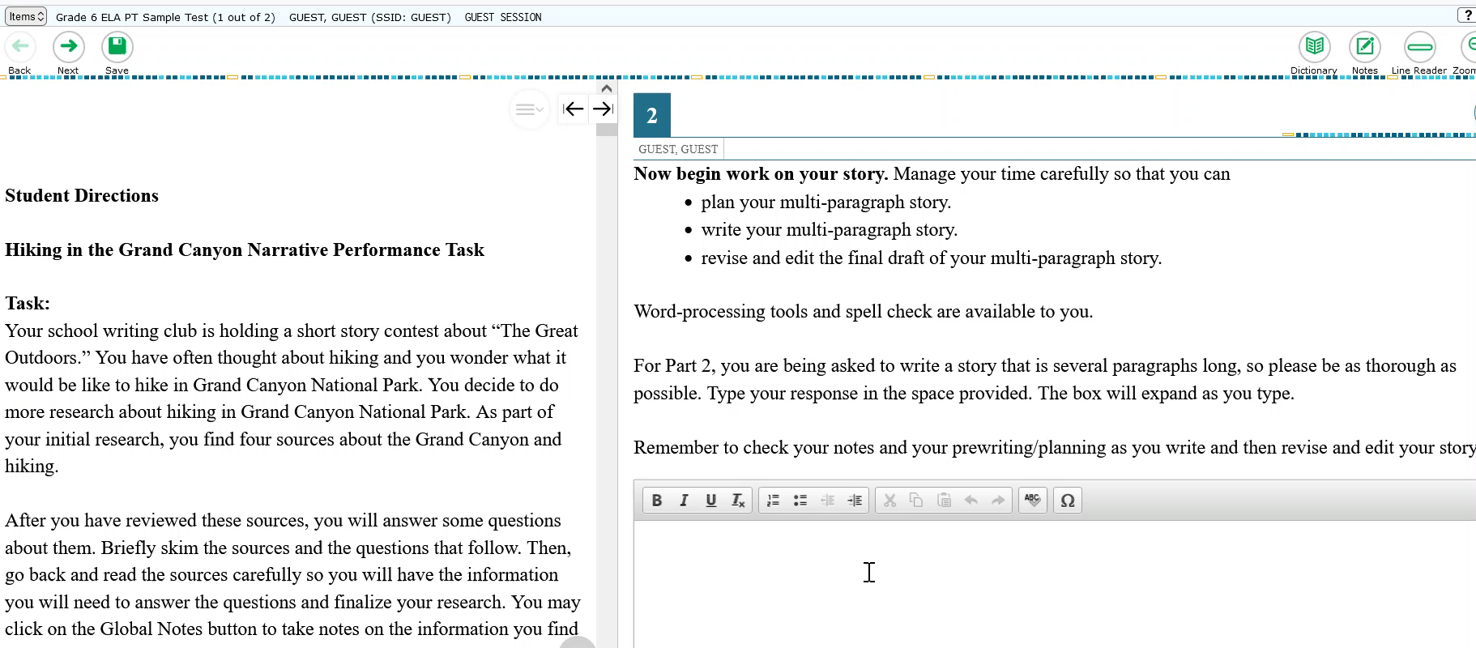
Word Prediction – without audio
Table of Contents –
Universal Tools –
Designated Supports –
Accommodations
Notes:
Word Prediction – without audio
VIDEO TRANSCRIPT: To use word prediction place your cursor in the answer space. A box will appear. Type the first letter of the word you intend to write. In the box a list of possible words will appear. To select a word you can either use your cursor to select the word from the list or you can type the number associated with the word in the list.
DESCRIPTION: Word prediction allows students to begin writing a word and choose from a list of words that have been predicted from word frequency and syntax rules. When this tool is enabled, suggested words will pop up in a menu as students type a written response. Students can select a word in the pop-up menu instead of typing it out manually.
RECOMMENDATIONS FOR USE: Students who have documented motor or orthopedic impairments, which severely impairs their ability to provide written or typed responses without the use of assistive technology, may use word prediction. Students with moderate to severe learning disabilities that prevent them from recalling, processing, or expressing written language may also use word prediction.
Available for the following tests:
Math
ELA

Slide 50
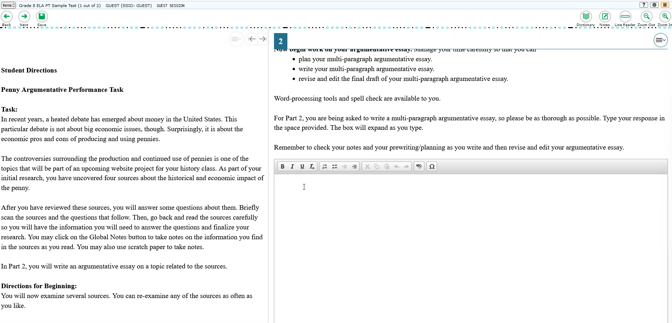
Word Prediction – with audio
Table of Contents –
Universal Tools –
Designated Supports –
Accommodations
Notes:
Word Prediction – with audio
VIDEO TRANSCRIPT: The Word Prediction tool now has two options. On with audio and On without audio. The On with audio option will provide an audio preview of the words available in the dropdown list when the student hovers over the word with their cursor. Once punctuation is added to a sentence, the entire sentence will be read aloud. The tool is available in item notes, global notes, and constructed response items. Note: when Word Prediction with audio is turned on, the student will receive a text-to-speech hardware check during their login process.
DESCRIPTION: Word prediction allows students to begin writing a word and choose from a list of words that have been predicted from word frequency and syntax rules. When this tool is enabled, suggested words will pop up in a menu as students type a written response. Students can select a word in the pop-up menu instead of typing it out manually.
RECOMMENDATIONS FOR USE: Students who have documented motor or orthopedic impairments, which severely impairs their ability to provide written or typed responses without the use of assistive technology, may use word prediction. Students with moderate to severe learning disabilities that prevent them from recalling, processing, or expressing written language may also use word prediction.
Available for the following tests:
Math
ELA

