Slide 1
Public Transparency

Slide 2
Purpose
Purpose: Ensuring resources are connected to improved student outcomes by providing timely, transparent, and accessible financial and academic data so that communities, districts, and state leaders have clear sightlines into funding and outcomes.
Desired Outcomes:
Increased access to data
Improved availability and timeliness of information
Our strategies:
Support districts in avoiding unexpected financial hardship
Strengthen long-term planning
Enable earlier identification of academic challenges

Slide 3
Current Challenges
Financial and academic data is only published once a year.
Communities lack clarity on how funds are being used and do not have access to financial or academic data presented in a way they can easily understand.
Legislature and Governor’s Office do not have a clear sightline into funding levels, student outcomes, or the connection between the two.
Districts may experience financial hardship, including unexpected budget shortfalls, difficulty in long-term planning, and disruptions to student services.
Districts may also face academic challenges, such as delays in identifying struggling schools, gaps in timely supports for students, and limited ability to track whether investments are improving outcomes.

Slide 4
Ideal State
Enhance Transparency & Oversight
Give policymakers a clear sightline into funding and outcomes.
Connect financial investments directly to academic results.
Support District Planning & Sustainability
Reduce unexpected financial hardships by improving reporting timeliness.
Provide tools and processes that help districts plan long-term.
Build Future-Ready Systems
Explore feasibility of a local district financial grant module.
Establish agency policies to sustain ongoing reporting and data use.
Make Data Usable & Accessible
Provide year-over-year academic and financial data in clear, interactive visualizations (PowerBI dashboards, consolidated reports).
Ensure communities, districts, and policymakers easily understand the data.
Improve Accuracy & Consistency
Implement a standardized chart of accounts and source coding.
Incorporate district feedback to strengthen data quality and interpretation.

Slide 5
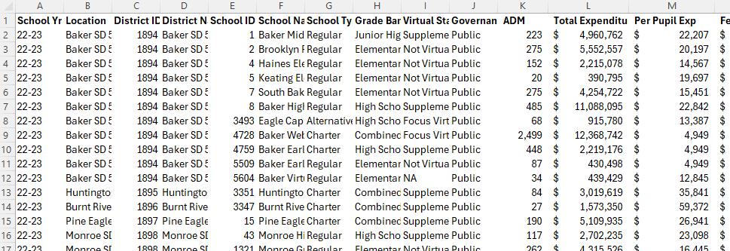
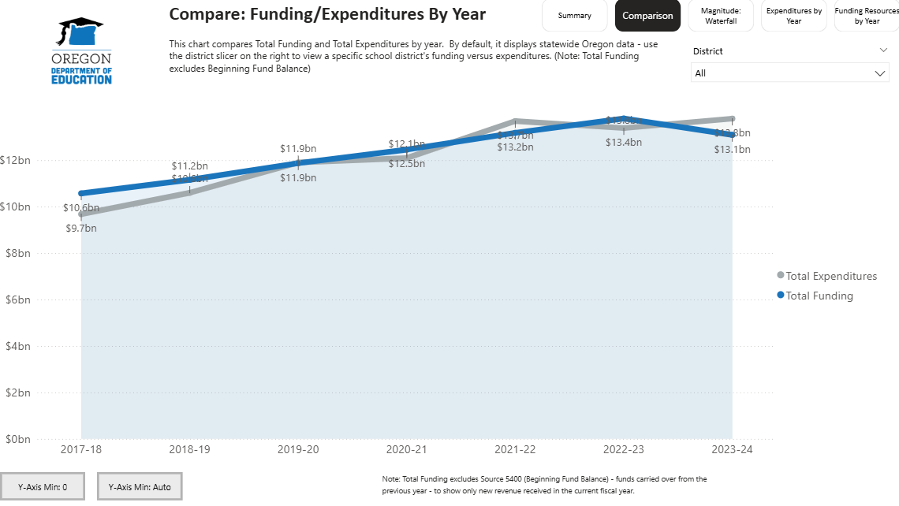
Current State - Financial Data in Static Spreadsheets
Future State - Interactive Data Visualizations
Mockup

Slide 6
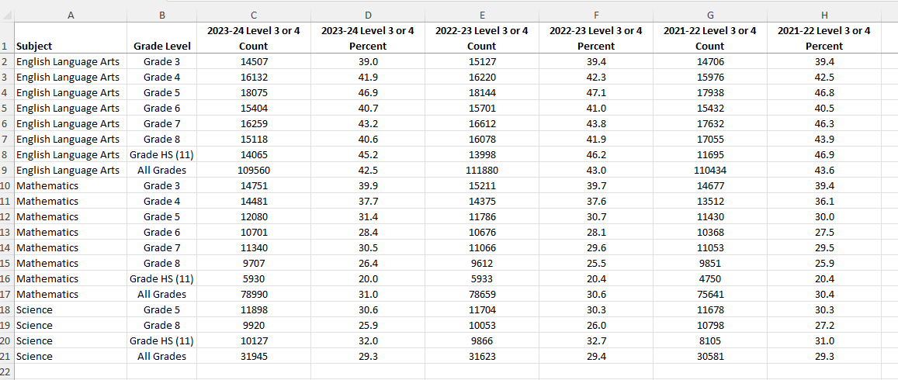
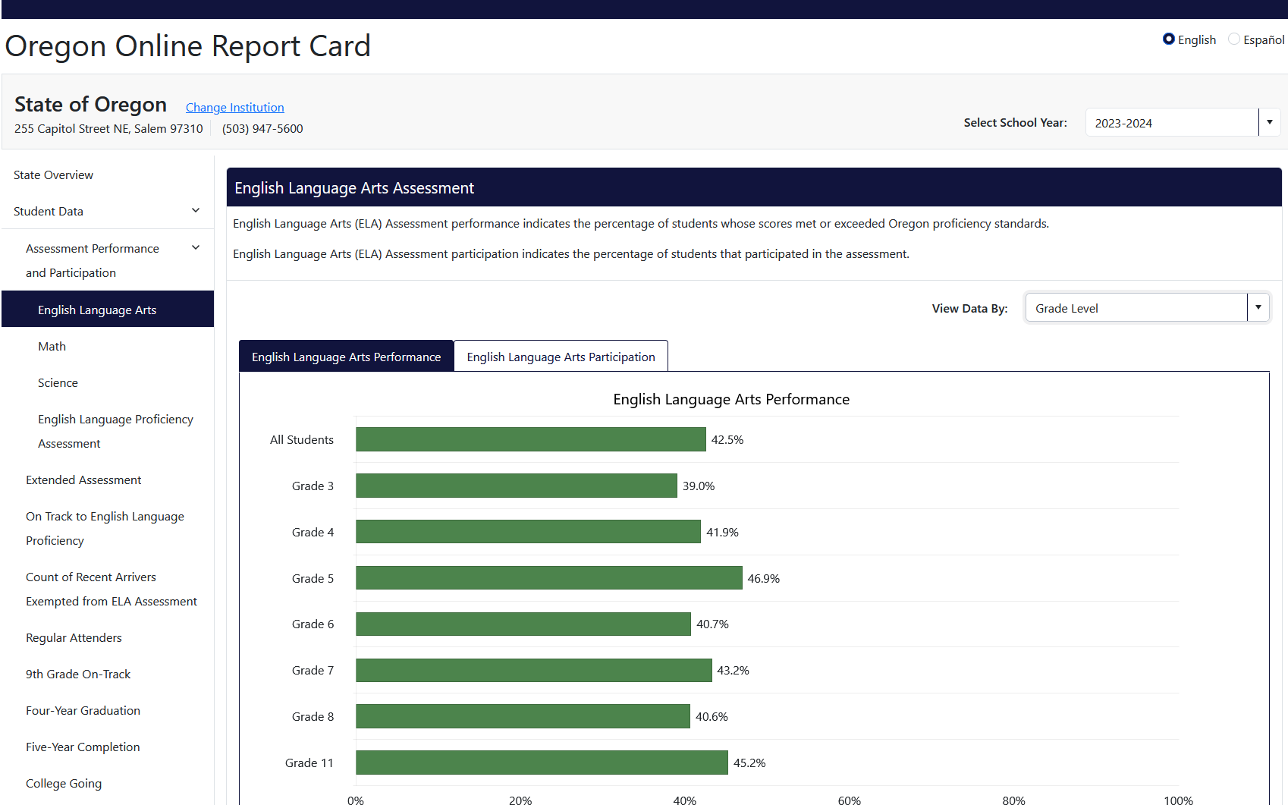
Current State - Academic Data in Static Spreadsheets
Future State - Interactive Data Visualizations

Slide 7
Key Dates
Summer 2025 - Winter 2026
Centralize and consolidate existing ODE reports and data to make them easier to locate and access.
Summer 2025 - Fall 2027
Design and implement internal policies that guide the development, publication, and use of transparent, accessible data tools and that ensure consistent, equitable communication of education data.
Summer 2025 - Fall 2027
Develop and maintain an academic and financial data dashboard that integrates key educational performance metrics and financial data.
Develop and launch a dynamic public dashboard with state and local metrics and visual indicators for progress across metrics, including interim assessment data, disaggregated student group performance, and the status of supports provided through the Continuum of Supports.

