Slide 1
District Performance & Continuum of Supports
Updated October 2025

Slide 2
Vision
The State will develop a transparent, equity-centered system where all Oregon districts have the clarity, tools, and aligned resources needed to continuously improve and meet student success priorities, resulting in measurable, sustained gains in student learning and wellbeing.

Slide 3
A Clear Line of Supports from the State to School Districts
Where We’ve Been
It is not always clear which districts need support and the type of support needed.
It is not always clear which staff from ODE is providing what support.
Districts are not required to complete interim assessments.
Technical assistance is not clearly defined.
Professional development standards are not defined.
Where We’re Headed
ODE is a “one-stop shop” with a variety of supports available for school districts.
ODE’s Continuum of Supports has clearly defined entry points and exit points, informed by adopted growth targets.
ODE has cross-office regional support teams to address district needs, support progress monitoring, and deliver coaching and technical assistance as appropriate.
ODE adheres to consistent technical assistance and professional development standards.
Districts administer interim assessments in math & language arts in Grades K-8.

Slide 4
Key Deliverables - Resource Repository
Student Success Needs Assessment
An assessment aligned to the Five Priorities for Student Success to guide districts in identifying strengths and areas for growth.
Responsive Strategy Menu
A menu of evidence-based response strategies connected to the Five Priorities for Student Success.
Strategy Learning Library
Accessible resources for school districts as they implement strategies.

Slide 5
Key Deliverables - Continuum of Supports
ODE Support Suite
A centralized hub to internally explore and access ODE’s technical assistance, coaching, and professional learning offerings.
Regional Support Teams
Teams of ODE staff that will provide coherent, aligned, and responsive support to districts.

Slide 6
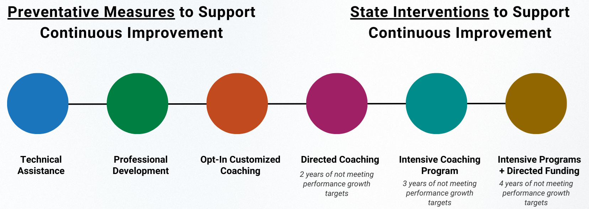
Continuum of Supports
Allows ODE to deliver consistent, aligned, and responsive support to school districts across the state.
Currently Available
2028-29
2029-30
2030-31

Slide 7
Key Deliverables - District Performance Review
District Performance Review
ODE will conduct annual performance reviews of each school district’s outcome data, based on seven Performance Growth Targets and locally defined metrics.
Regular Attenders
K-2 Regular Attenders (New)
3rd Grade Reading
8th Grade Math (New)
9th Grade On Track
4-Year Grad Rates
5-Year Completers
Local Metric (New)

Slide 8
Key Dates
During the 2025-26 School Year
Engagement and rulemaking for:
  Developing a Continuum of Supports with clear entry and exit points for each stage.
  Developing a list of up to five local metrics that districts may choose from.
  Expanding statewide performance growth targets (to include K-2 attendance & 8th grade math).
  Developing a list of up to four approved interim assessments that districts may choose from.
School districts and charters set growth targets for new metrics (they must select one local metric from the board-adopted options).
During the 2026-27 School Year
ODE begins reviewing and tracking progress towards local and statewide metrics, annually.
During the 2027-28 School Year
School districts and charter schools administer interim assessments three times per year in grades K-8 in Math and ELA and review the data during a public meeting.

