Slide 1
ODA Certification & Licensing program overview
Rebecca Howes
July 17, 2024

Slide 2
Presentation Overview
Certification & Licensing Program
Noncommercial Pesticide Applicator License (NPA)
When is a license required?

Slide 3
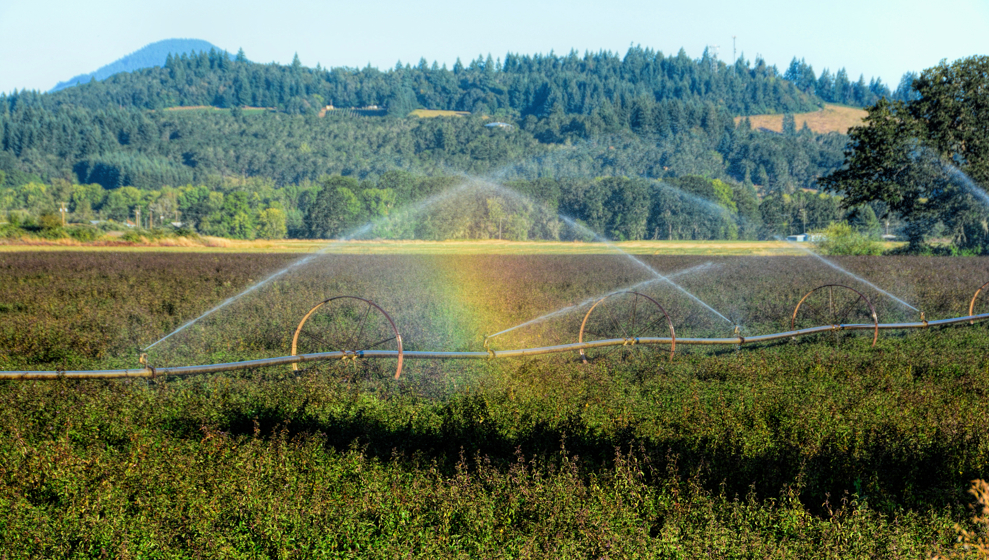
Pesticides Program
Non Enforcement
Pesticide Product Registration
Certification & Licensing
Compliance & Enforcement
Pesticide Analytical & Response Center (PARC)
Pesticide Stewardship Partnership (PSP)
Worker Protection Standard (WPS)

Slide 4

Certification $\&$ Licensing

Slide 5

Certification $≠$ Licensing
Certification refers to the process of demonstrating that you know how to handle and apply pesticides in a safe and responsible manner.
  Certification is the first step to getting licensed
  Exams must be taken in specific categories relevant to the work you plan on doing

Slide 6
Certification $≠$ Licensing
Licensing refers to the process of obtaining the documentation that shows you have met the certification requirements to make specific pesticide applications under that license.
  ODA provides the necessary forms
  Pay the license fee and any other associated fees
  Submit both the form & payment to ODA

Slide 7
Certified Licenses | Noncertified Licenses
Aerial Pesticide Applicator | Commercial Pesticide Operator
Commercial Pesticide Applicator | Pesticide Dealer
Noncommercial Pesticide Applicator | Immediately Supervised Trainee
Pesticide Consultant* | Pesticide Apprentice
Private Pesticide Applicator
Public Pesticide Applicator

Slide 8
Certification & Licensing
Licensing
Exams
Study Material
Recertification Courses

Slide 9
Noncommercial Pesticide Applicator License

Slide 10
HB 4062 (2022)
The Oregon Legislature created new noncommercial license types through House Bill 4062
ODA had to go through the rulemaking process to implement HB 4062
The new rules went into effect November 17, 2023
Notes:
ODA had been receiving feedback from industry and partners that the current licensing options were not appropriate for their work, so ODA engaged with the legislative process to help get this new license type.

Slide 11
Who’s covered? (part I)
Individuals (except government employees) who apply, use, or supervise the use of restricted use pesticides (RUPs) on property they or their employer owns or leases for a purpose other than the production of an agricultural commodity or forest crop
  Examples:
    golf course employees
    wood treatment facilities
    wineries that fumigate wine barrels/corks
    businesses that treat purchased ag commodities

Slide 12
Who’s covered? (part II)
AND
Private school employees or owners who apply or supervise the application of any pesticide to their own private school campus, as defined in ORS 634.700.
Notes:
634.700 Definitions for ORS 634.700 to 634.750. As used in ORS 634.700 to 634.750:
(1) “Campus” means the buildings, other structures, playgrounds, athletic fields and parking lots of a school and any other areas on the school property that are accessed by students on a regular basis.

Slide 13
Potential Benefits
Employers of Noncommercial Pesticide Applicators (NPAs) do not need to be licensed as CPOs
Exam competency, recertification credit, and recordkeeping requirements are all the same as for CPAs & CPOs
Notes:
For NPAs, the applicator is responsible for maintaining the records, instead of the CPO.

Slide 14
To Qualify
Be at least 18 years old
AND
Pass Laws and Safety and at least one “appropriate” category exam
OR
Certified CPAs and PPAs with an “appropriate” category, and certified and licensed Pesticide Consultants with the Demo & Research category, qualify to apply for the NPA license without needing to take additional exams
Notes:
Must also at least be 18

Slide 15
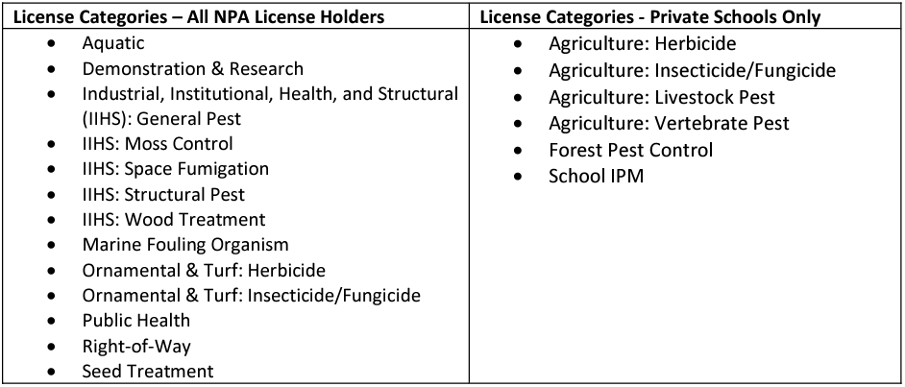
“Appropriate” License Categories
Notes:
To prevent overlap with the PAL license, HB 4062 excluded agricultural commodity and forest crop production from the NPA license. Because private school employees don’t have access to the PAL license, they are the only ones that can use ag categories with the NPA.

Slide 16
Who needs a pesticide license?

Slide 17
When is a pesticide license required?
Buy, apply, or supervise the use of Restricted Use Pesticides (RUPs). Certain exceptions apply*.
Apply or supervise the application of any pesticide to someone else’s property (private or public land), except when part of very limited landscape maintenance work that meets specific conditions.
Apply or supervise the application of any pesticide on a school campus as defined in ORS 634.700

Slide 18
When is a pesticide license required?
Apply any pesticide by aircraft (e.g., fixed-wing, helicopter, unmanned aircraft systems).
Apply or supervise the application of any pesticide as a public employee using power-driven application equipment.
Apply pesticides for research purposes. Note, in addition to licensing requirements an Experimental Use Permit may be required.

Slide 19
When is a pesticide license required?
Advise others on the use of RUPs.
Sell or distribute RUPs (license required for each facility).
Own or operate a business, including a non-profit organization, that advertises pesticide application services or that otherwise engages in the application of any pesticide to someone else’s property.

Slide 20
When is a pesticide license NOT required?
Applying general use pesticides to property owned or leased by you or your employer, except on a school campus as defined in ORS 634.700
As a public employee, applying general use pesticides using application equipment that is not power-driven (e.g., hand-pump backpack sprayer), except when applying on a school campus as defined in ORS 634.700

Slide 21
When is a pesticide license NOT required?
Applying general use pesticides as part of a landscape maintenance service if all of the following criteria are met:
  The use of pesticides is not stated in advertisements or contracts;
  Applications are to small residential lawns or gardens only; no applications can be made to commercial properties;
  No restricted-use pesticides are used; and
  No use of fuel or electric-powered sprayers or spreaders.
  ​Pesticides are not applied on a school campus as defined in ORS 634.700​.

Slide 22
When is a pesticide license NOT required?
Under specific conditions*, using Restricted Use Pesticides (RUPs) under the supervision of a licensed Private Applicator.
  * Unlicensed individuals can make ground applications of Restricted Use Pesticides (RUPs) if permitted by the pesticide labeling and they are supervised by a licensed Private Applicator that is their employer or co-worker. The pesticide application must be for the purpose of producing agricultural commodities or forest crops, and must be made on land owned or leased by the individual or the employer of the individual.

Slide 23
When is a pesticide license NOT required?
Providing advice only on general use pesticides.
Selling only general use pesticides at your retail establishment.

Slide 24
Thank you!
Rebecca Howes
PH: 971.600.5943 | WEB: Oregon.gov/ODA
Rebecca.HOWES@oda.Oregon.gov

