Slide 1
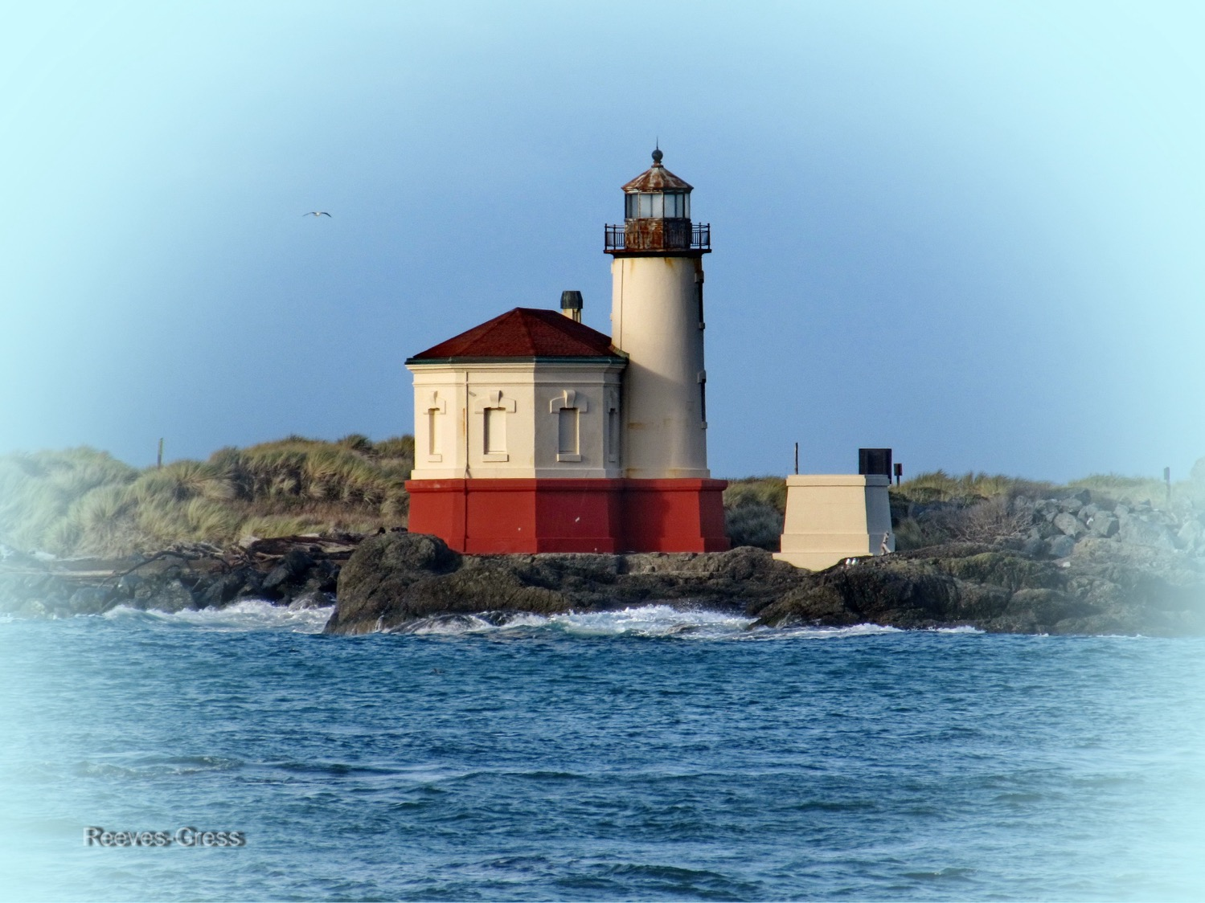
Seasonal Climate Forecast
May – July 2026
Issued: April 16, 2026
Contact: ODF Lead Meteorologist Pete Parsons
503-945-7448 or peter.gj.parsons@odf.oregon.gov
ODA Team: Andy Zimmerman; Jenn Ambrose; Laura Passage; Weston Hustace ODF Team: Julie Vondrachek; Kristin Cody; Sherri Pugh; Gary Votaw

Slide 2
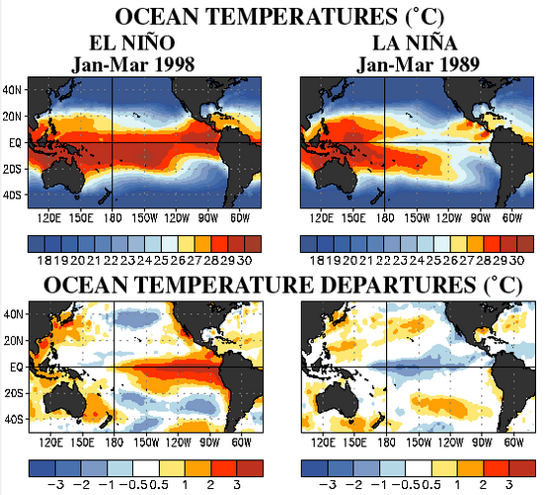
El Niño vs La Niña
(SST Patterns in the Tropical Pacific Ocean)
Courtesy: https://www.cpc.ncep.noaa.gov/products/analysis_monitoring/ensocycle/ensocycle.shtml

Slide 3
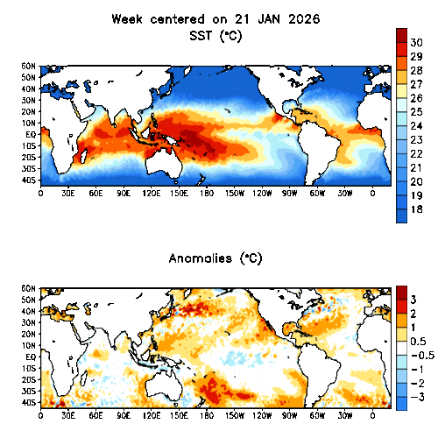
Sea Surface Temperatures (SSTs)
Animated (PowerPoint only) SSTs (top) / Anomalies (bottom)
ENSO-neutral conditions are present
Courtesy: https://www.cpc.ncep.noaa.gov/products/analysis_monitoring/enso_update/gsstanim.shtml
Notes:
Image available at: https://www.cpc.ncep.noaa.gov/products/analysis_monitoring/enso_update/gsstanim.shtml

Slide 4
El Niño Southern Oscillation (ENSO)
Current Status and Forecast
There were multiple changes in analog years this month. 1963 remained, but 1968 & 2018 were replaced by 1997 & 2002.
The Jan. – Mar. 2026 Oceanic Niño Index (ONI) rose (warmed) to -0.2°C, marking a transition from La Niña to ENSO-neutral conditions.
NOAA’s Climate Prediction Center (CPC) expects SSTs in the central Tropical Pacific to continue warming, with a transition to El Niño likely during the May – July 2026 period and lasting through year’s end.
Note: This “Seasonal Climate Forecast” does not consider NOAA’s ENSO forecast. It uses only historical and current ENSO conditions to find “analog years” that most-closely match the recent evolution of the ENSO state.
https://www.cpc.ncep.noaa.gov/products/analysis_monitoring/lanina/enso_evolution-status-fcsts-web.pdf
Notes:
Weekly ENSO update: https://www.cpc.ncep.noaa.gov/products/analysis_monitoring/lanina/enso_evolution-status-fcsts-web.pdf

Slide 5
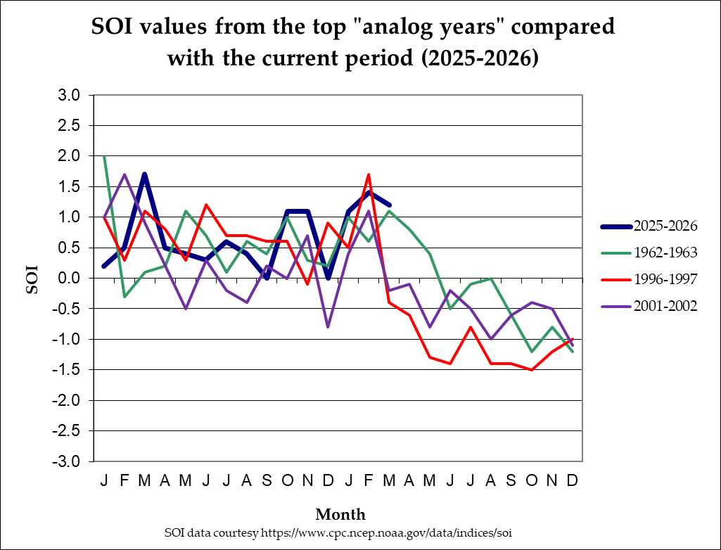
Southern Oscillation Index (SOI)
(1962-1963; 1996-1997; 2001-2002)
Mar 2026 SOI (1.2) reflected weak La Niña conditions
La Niña
ENSO-neutral
Mar SOI analogs had ENSO-neutral or La Niña conditions
El Niño
Notes:
SOI data from: https://www.cpc.ncep.noaa.gov/data/indices/soi

Slide 6
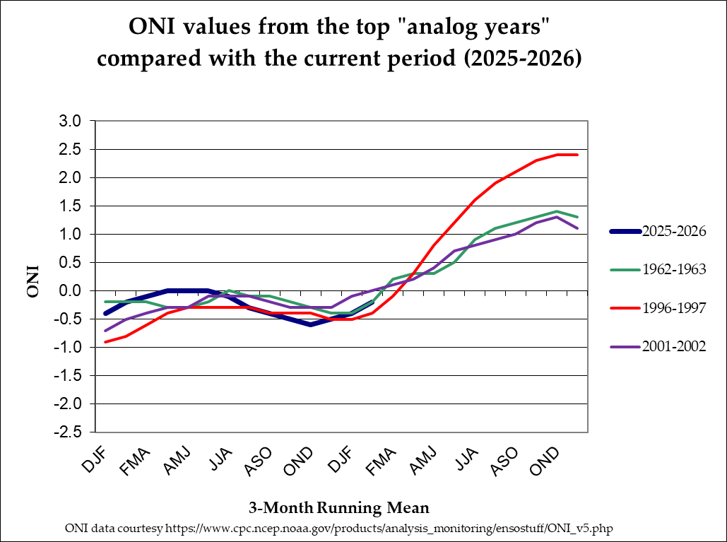
Oceanic Niño Index (ONI)
(1962-1963; 1996-1997; 2001-2002)
Jan – Mar 2026 ONI (-0.2°C) is in the ENSO-Neural zone
Strong
Moderate
El Niño
Weak
ENSO-neutral
Weak
Moderate
La Niña
Strong
Jan – Mar ONI analogs were in the ENSO-neutral zone
Notes:
ONI data from: https://origin.cpc.ncep.noaa.gov/products/analysis_monitoring/ensostuff/ONI_v5.php

Slide 7
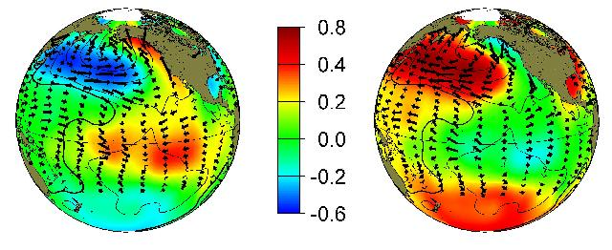
The Pacific Decadal Oscillation (PDO) (Reflects SST “Phase” in the North Pacific Ocean )
Positive (Warm)
“Phase”
Negative (Cool)
“Phase”
SST Anomalies
Courtesy: http://research.jisao.washington.edu/pdo/img/pdo_warm_cool.jpg

Slide 8
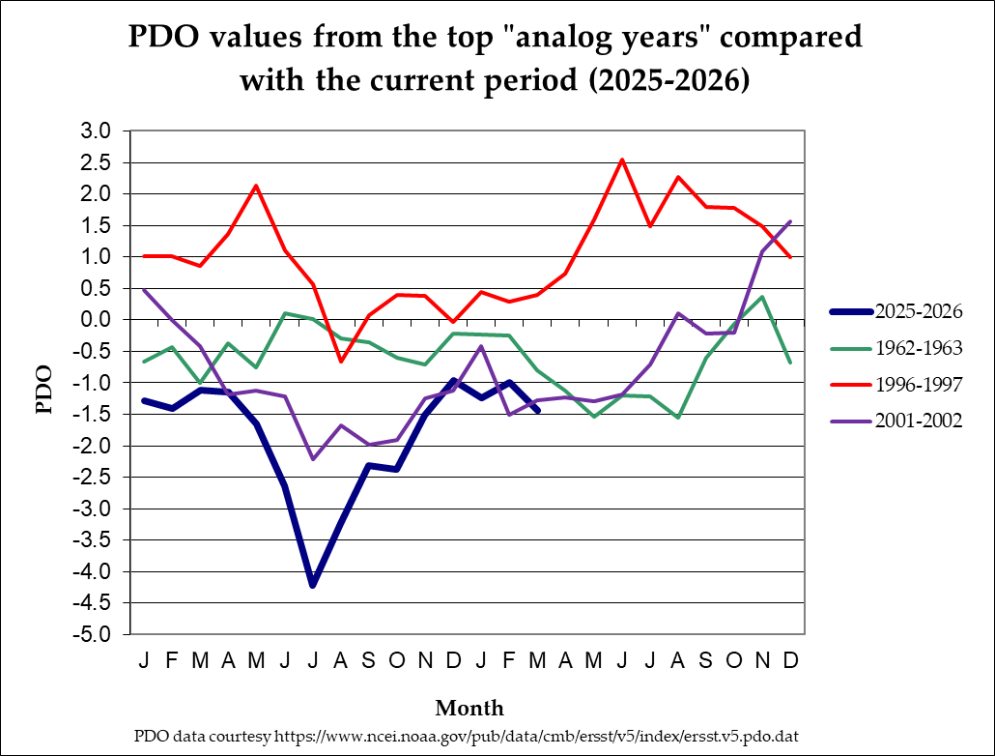
North Pacific Ocean
(Poleward of 20°N Latitude)
(1962-1963; 1996-1997; 2001-2002)
March PDO analogs were in the “Neutral” or “Cool” Phase
Warm Phase
Neutral Phase
Cool Phase
March 2026 PDO (-1.44) in “Cool” Phase
Notes:
PDO data from: https://oceanview.pfeg.noaa.gov/erddap/tabledap/cciea_OC_PDO.htmlTable?time,PDO

Slide 9
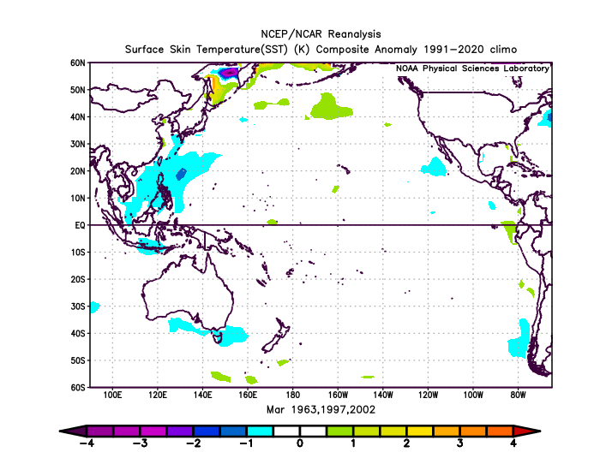
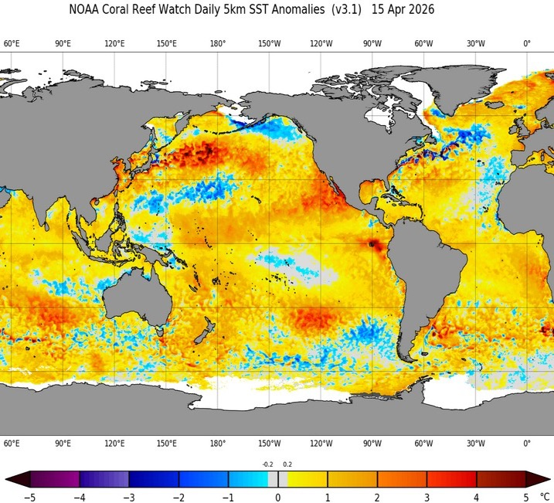
SST Anomalies Comparison
March Analogs
April 14, 2026
The analog composite of March SST anomalies (left) and the recent SST anomaly pattern (right) both reflect ENSO-neutral conditions.
The March 2026 SST anomaly map, normally obtained from NOAA’s Physical Sciences Laboratory (PSL) is not currently available.
Notes:
Charts generated at: https://www.esrl.noaa.gov/psd/cgi-bin/data/composites/printpage.pl

Slide 10
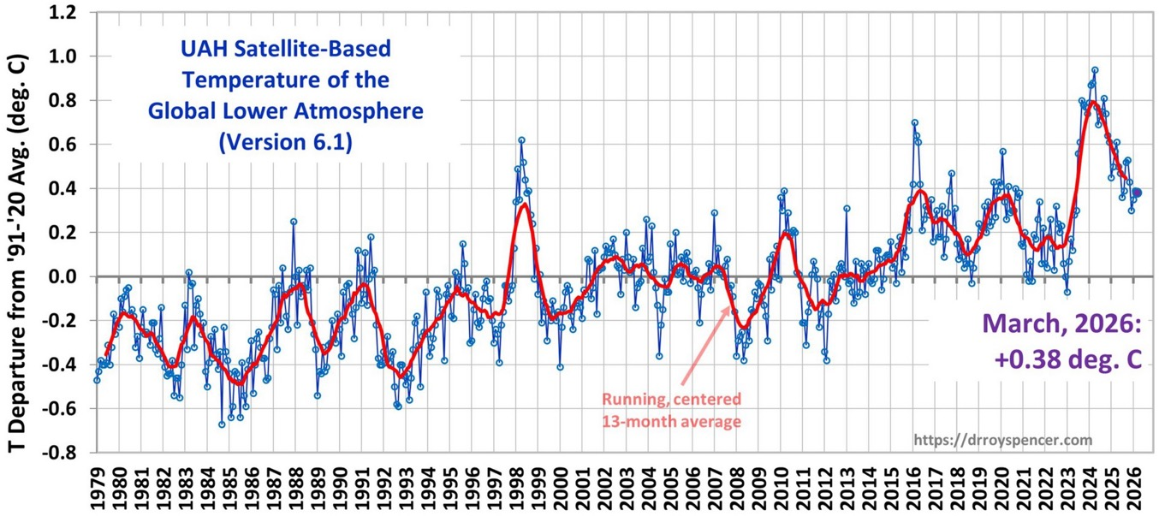
The ENSO Signal is
Reflected in Global Temperatures
El Niño
La Niña
Courtesy: http://www.drroyspencer.com/latest-global-temperatures/
Notes:
Charts generated at: https://www.esrl.noaa.gov/psd/cgi-bin/data/composites/printpage.pl

Slide 11
How Do Analog Years Align With
Global Temperature Fluctuations?
March 2026
April Analogs -
1963; 1997; 2002
?
Courtesy: http://www.drroyspencer.com/latest-global-temperatures/
Notes:
Charts generated at: https://www.esrl.noaa.gov/psd/cgi-bin/data/composites/printpage.pl

Slide 12
Global Temperature Changes
Increase Error in Analog Forecasts!
March 2026
Warming of ≈ 0.15°C / Decade Since 1979
Courtesy: http://www.drroyspencer.com/latest-global-temperatures/
Notes:
Charts generated at: https://www.esrl.noaa.gov/psd/cgi-bin/data/composites/printpage.pl

Slide 13
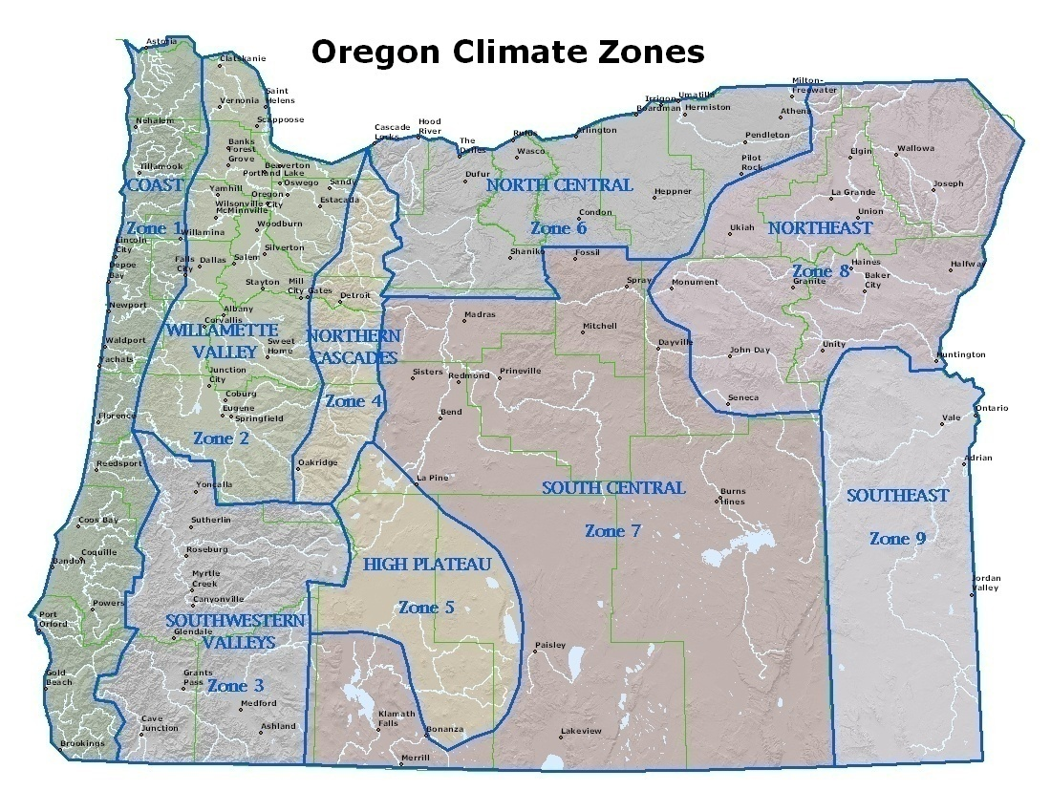
Notes:
Map created by ODA. Shape file from Oregon Climate Service (George Taylor)

Slide 14
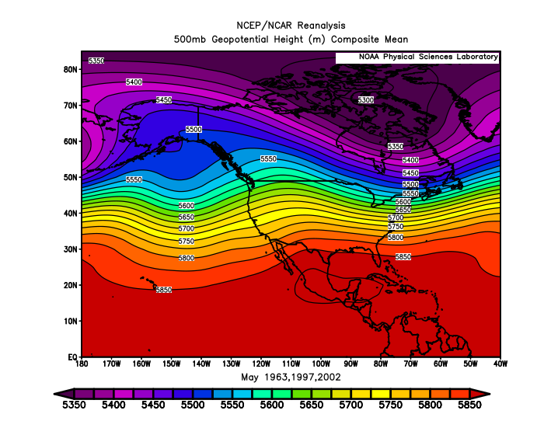
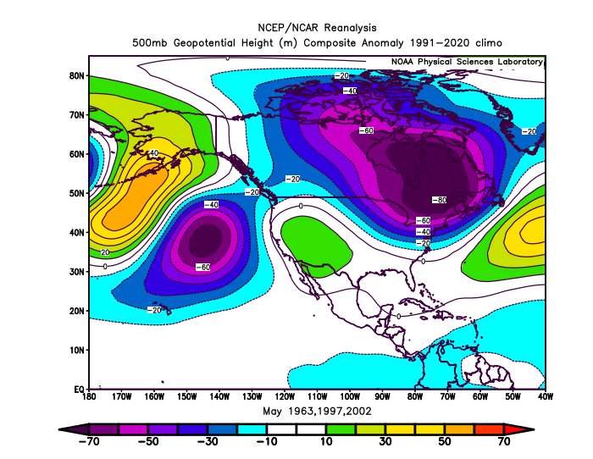
May 2026 Forecast
Mean Upper-Air Pattern
Upper-Air Anomalies
1963 & 2002 had slightly more troughing than normal, but 1997 had anomalous ridging centered over the SW US extending over Oregon.
Slightly enhanced SW-W flow aloft over Oregon favors conditions not deviating far from average.
Notes:
Charts generated at: https://www.esrl.noaa.gov/psd/cgi-bin/data/composites/printpage.pl

Slide 15
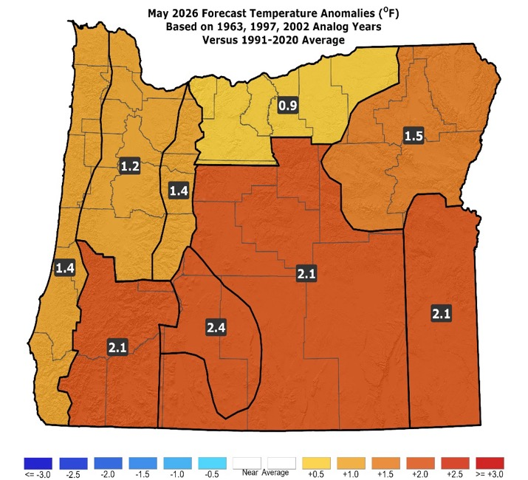
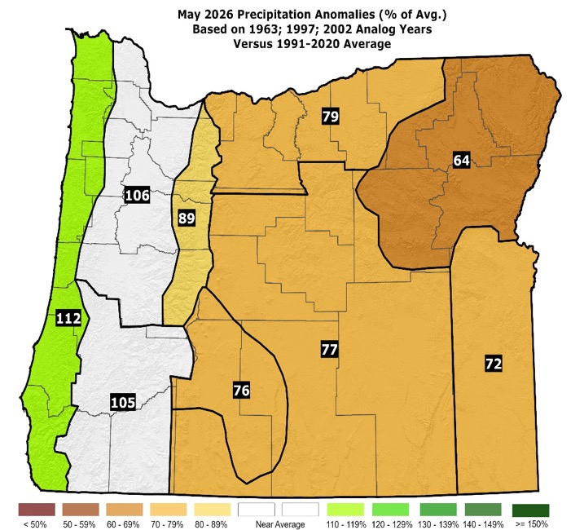
May 2026 Forecast
Temperatures
Precipitation
A relatively warm 1997 more than countered near-average temperatures in 1963 and a slightly cooler-than-average 2002.
Analogs favor near or below average rainfall with the best chances for above-average rainfall along the coast.
Notes:
Data from NCEI: https://www.ncdc.noaa.gov/ & Charts generated locally by ODA

Slide 16
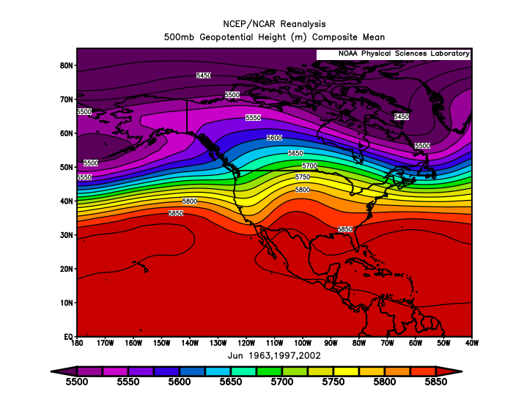
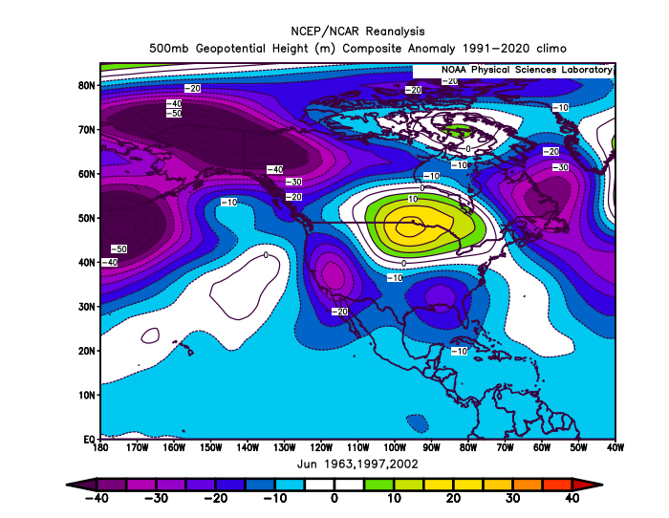
June 2026 Forecast
Mean Upper-Air Pattern
Upper-Air Anomalies
The anomalous troughing over Oregon 1963 & 1997 more than countered the anomalous ridging in 2002 (mean shown above right).
None of the analog years had prolonged periods of strong ridging or excessive heat.
Notes:
Charts generated at: https://www.esrl.noaa.gov/psd/cgi-bin/data/composites/printpage.pl

Slide 17
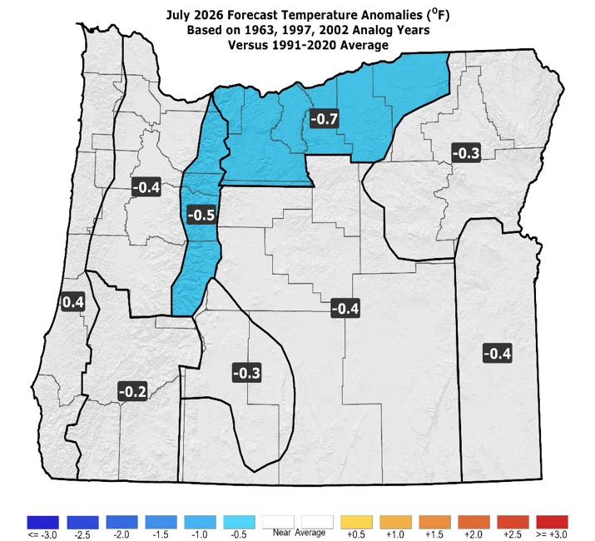
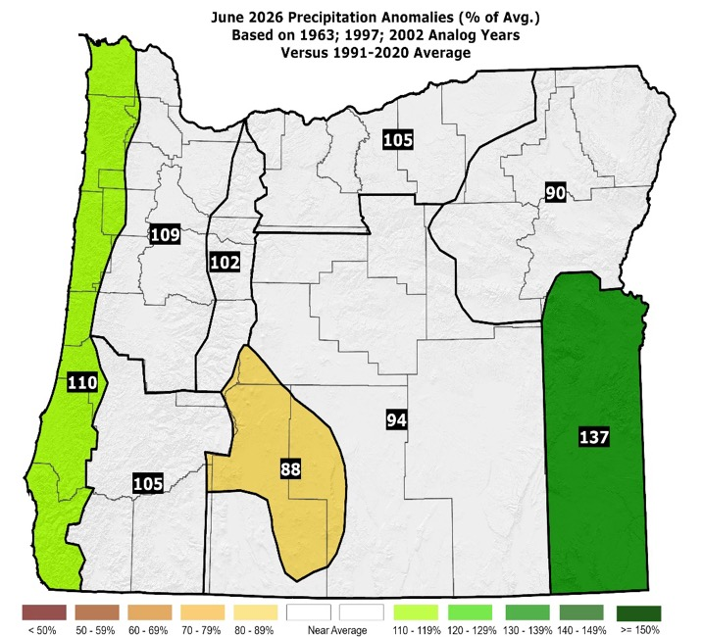
June 2026 Forecast
Temperatures
Precipitation
Although the 2002 analog was slightly warmer than average, cooler years of 1963 & 1997 skewed the forecast slightly cool.
Rainfall close to 30-year averages. Nothing “extreme” highlighted by the analogs.
Notes:
Data from NCEI: https://www.ncdc.noaa.gov/ & Charts generated locally by ODA

Slide 18
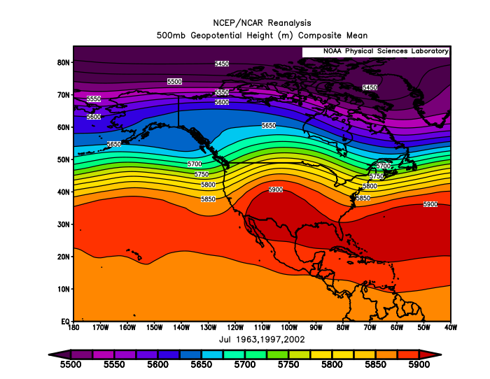
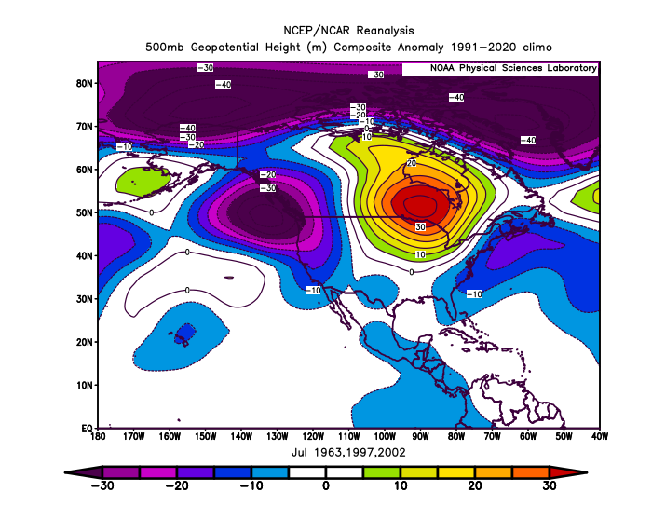
July 2026 Forecast
Mean Upper-Air Pattern
Upper-Air Anomalies
Analog’s upper-air patterns have huge variation, ranging from strongly anomalous troughing in 1963 to anomalous ridging in 2002.
2002 stood out as significantly warmer and drier than 1963 & 1997, but except for a few days at mid-month, even it was not excessively hot.
Notes:
Charts generated at: https://www.esrl.noaa.gov/psd/cgi-bin/data/composites/printpage.pl

Slide 19

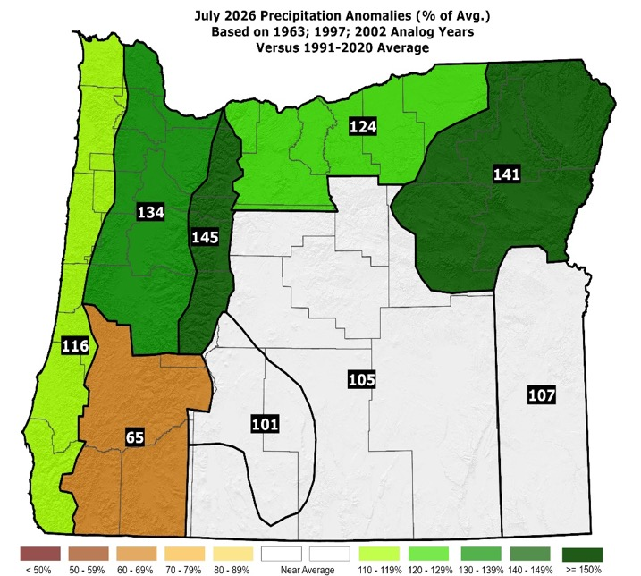
July 2026 Forecast
Temperatures
Precipitation
A cold 1963 & cool 1997 counter a warmer-than-average 2002 in the blend shown above, which lowers forecast confidence.
Rainfall was near or above average in 1963 & 1997 but below average in 2002, which also lowers forecast confidence.
Notes:
Data from NCEI: https://www.ncdc.noaa.gov/ & Charts generated locally by ODA

Slide 20
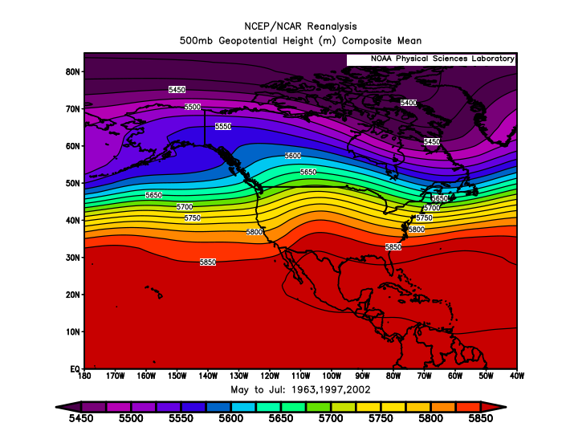
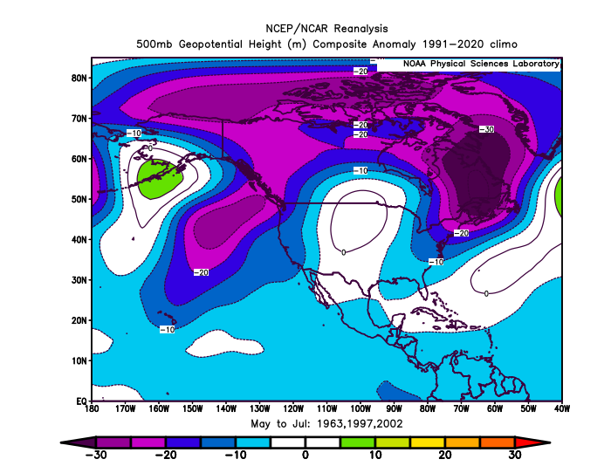
May – July 2026 Forecast
Mean Upper-Air Pattern
Upper-Air Anomalies
The analog blend (shown above), favors more troughing than normal over Oregon, especially near the coast.
However, inconsistencies among the analogs lowers forecast confidence.
Notes:
Charts generated at: https://www.esrl.noaa.gov/psd/cgi-bin/data/composites/printpage.pl

Slide 21
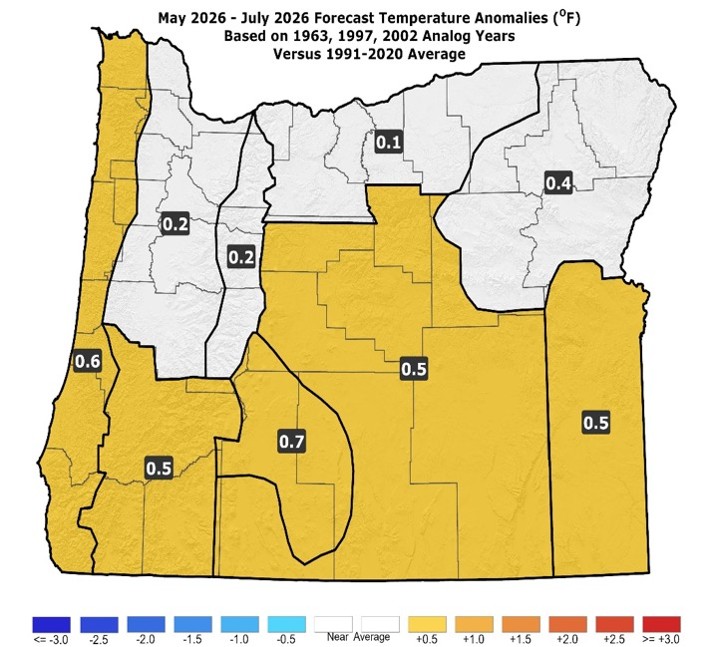
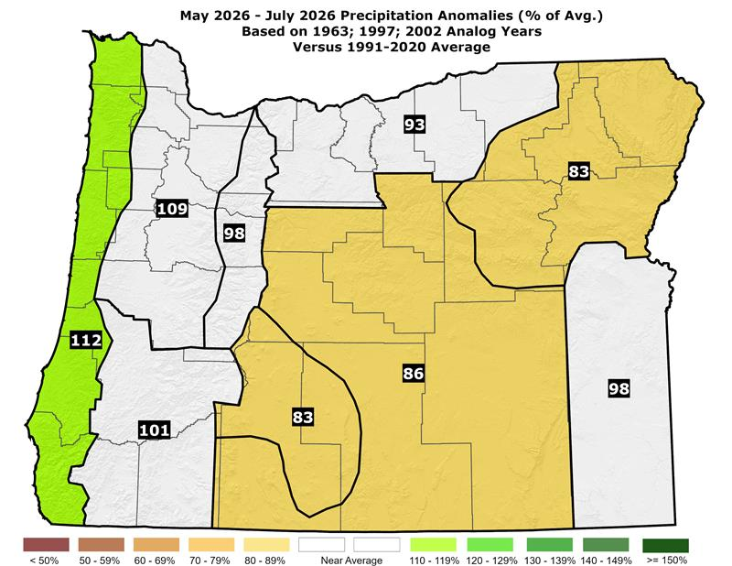
May – July 2026 Forecast
Temperatures
Precipitation
The 3-month analog blend (above) does not show large departures from average in either temperatures or precipitation.
However, individual monthly analogs did vary significantly from average, in both directions, especially with temperatures.
Notes:
Data from NCEI: https://www.ncdc.noaa.gov/ & Charts generated locally by ODA

Slide 22
Forecast Highlights
This forecast is based on the 1963, 1997, & 2002 analog years. The 1968 & 2018 analogs (used last month) were dropped.
3-month signals show near-average temperatures & precipitation. However, significant monthly and/or 3-monthly departures from average were evident in the analogs. They just balanced each other out.
Forecast confidence is lowered because of large variations, in both temperatures and precipitation, among the top analog years.
The chances for anomalously cool weather appear just as great as those for anomalously warm weather, which may sound surprising, after such a mild winter!
Disclaimer: This forecast is not associated with NOAA’s Climate Prediction Center (CPC). See “Forecasting Methods…” at: https://www.oregon.gov/oda/natural-resources/pages/weather.aspx.

Slide 23
Forecast Resources
ODA Seasonal Climate Forecast Home:
https://www.oregon.gov/oda/natural-resources/pages/weather.aspx
CPC Official US Three-Month Forecasts (Graphics):
https://www.cpc.ncep.noaa.gov/products/predictions/long_range/seasonal.php?lead=01
CPC US 30-Day & 90-Day Forecasts (Discussions):
https://www.cpc.ncep.noaa.gov/products/predictions/long_range/fxus07.html
CPC Weekly & Monthly ENSO Discussions: https://www.cpc.ncep.noaa.gov/products/analysis_monitoring/enso_advisory
Australian Government Climate Model Summary:
http://www.bom.gov.au/climate/model-summary/#region=NINO34&tabs=Overview
Australian Government ENSO Wrap-Up:
http://www.bom.gov.au/climate/enso
IRI ENSO Quick Look:
https://iri.columbia.edu/our-expertise/climate/forecasts/enso/current/

Slide 24
Water Supply / Fire-Potential Outlook
CPC U.S. Seasonal Drought Outlook:
https://www.cpc.ncep.noaa.gov/products/expert_assessment/season_drought.png
NRCS Snow Water Equivalent Oregon Map:
https://www.wcc.nrcs.usda.gov/ftpref/data/water/wcs/gis/maps/or_swepctnormal_update.pdf
NRCS/USDA Snow Water Equivalent Products:
https://www.nrcs.usda.gov/wps/portal/wcc/home/snowClimateMonitoring/snowpack/
NDMC U.S. Drought Monitor:
https://droughtmonitor.unl.edu/
NIDIS North American Drought Portal:
https://www.drought.gov/nadm/content/percent-average-precipitation
WRCC WestWideDroughtTracker:
https://www.wrcc.dri.edu/wwdt/
NWCC Northwest Interagency Coordination Center (video)
https://gacc.nifc.gov/nwcc/predict/outlook.aspx

Slide 25

Updated Monthly
Your Feedback is Welcome!
Sign-up for Email Notification of Updates at:
https://public.govdelivery.com/accounts/ORODA/subscriber/new?topic_id=ORODA_14
Contact: Pete Parsons, ODF Lead Meteorologist
at 503-945-7448 or peter.gj.parsons@odf.oregon.gov

