Slide 1
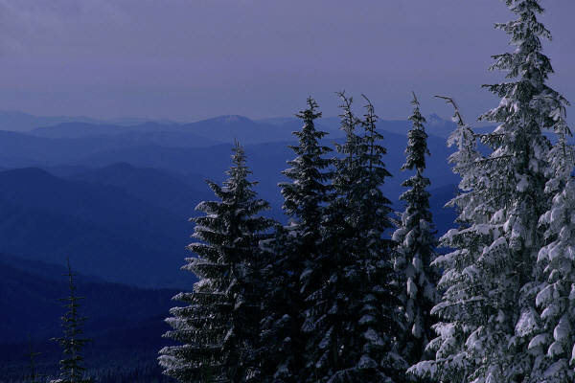
Seasonal Climate Forecast Verification
January – March 2026
Issued: April 11, 2026
Contact: Pete Parsons, ODF Lead Meteorologist
503-945-7448 or peter.gj.parsons@odf.oregon.gov
ODA Team: Andy Zimmerman; Jenn Ambrose; Laura Passage; Weston Hustace ODF Team: Julie Vondrachek; Kristin Cody; Gary Votaw; Sherri Pugh

Slide 2
Format and Purpose:
A side-by-side comparison of the “Seasonal Climate Forecast” vs. what (Actually Occurred) is done for both the 1-month & 3-month forecasts.*
The accuracy of each forecast is reviewed, and the need for analog-year updates is examined.
This is part of an ongoing assessment of the utility of this forecast method.**
*Utilizes 1991-2020 long-term averages
**See “Forecasting Methods…” at:
https://www.oregon.gov/oda/natural-resources/pages/weather.aspx

Slide 3
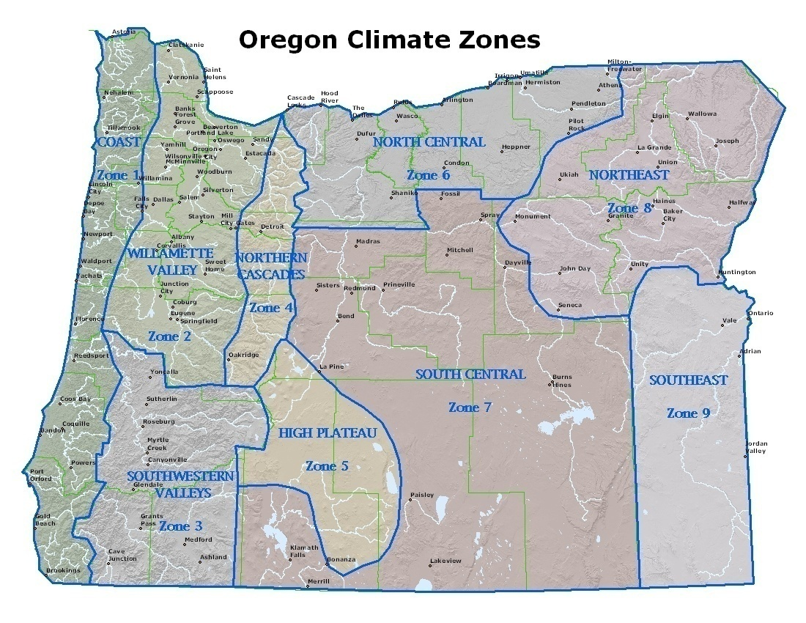

Slide 4
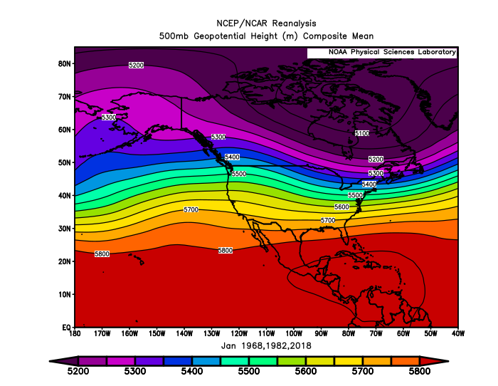
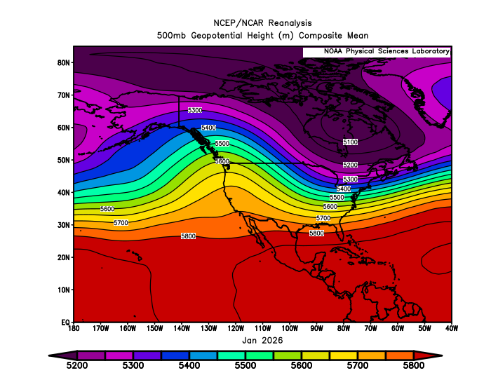
January 2026
(Forecast Issued December 18, 2025)/(Actual)
Forecast Upper-Air Pattern
Actual Upper-Air Pattern
1968 & 1982 analogs had anomalous ridging in the western and central Gulf of Alaska respectively. 2018 had anomalous ridging over the Rockies.
Actual ridging was strong and centered over the west coast. A “forecast miss.”

Slide 5
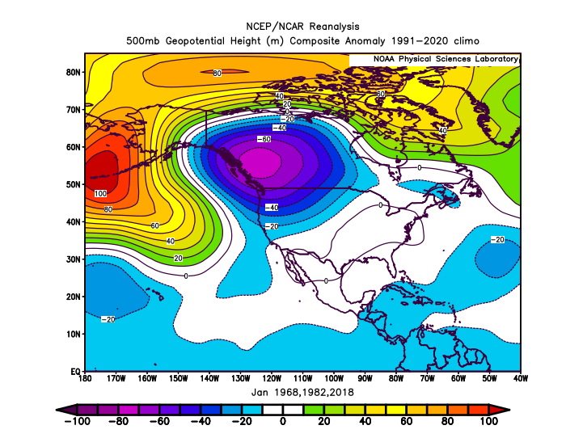
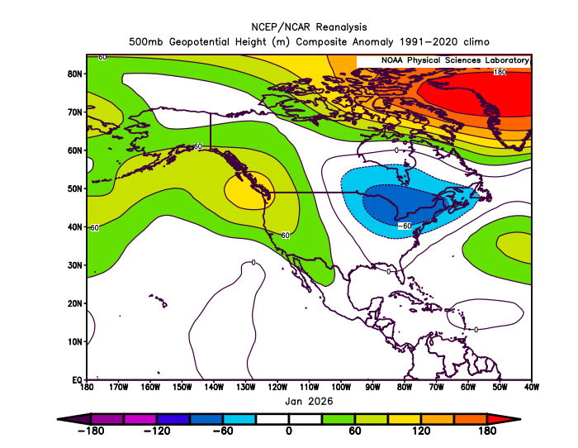
January 2026
(Forecast Issued December 18, 2025)/(Actual)
Forecast Upper-Air Anomalies
Actual Upper-Air Anomalies
Analog average (left) had anomalous troughing over Oregon. Strong anomalous ridging was observed (right). A “forecast miss.”
The best analog match was 2018, which also had anomalous ridging over Oregon.

Slide 6
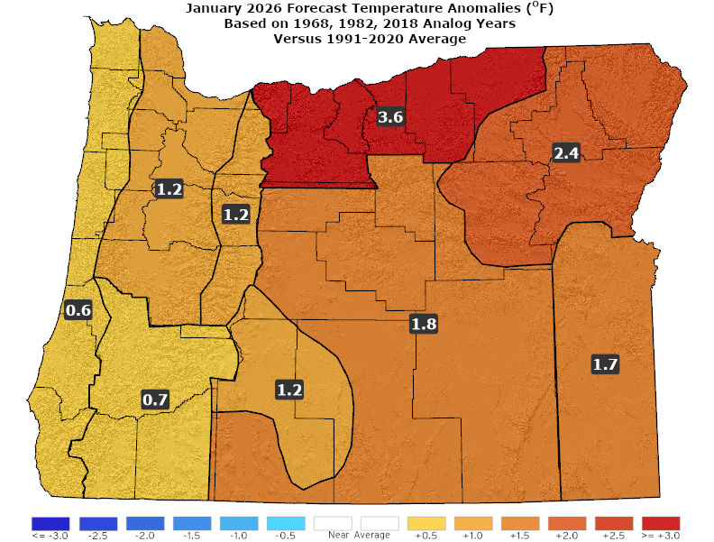
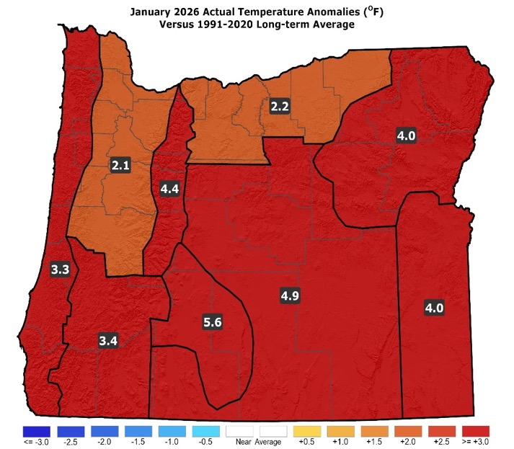
January 2026
(Forecast Issued December 18, 2025)/(Actual)
Forecast Temperatures
Actual Temperatures
Data courtesy of the National Centers for Environmental Information (NCEI)
Notes:
Temp Data: ftp://ftp.ncdc.noaa.gov/pub/data/cirs/drd964x.tmp.txt Precip Data: ftp://ftp.ncdc.noaa.gov/pub/data/cirs/drd964x.pcp.txt

Slide 7
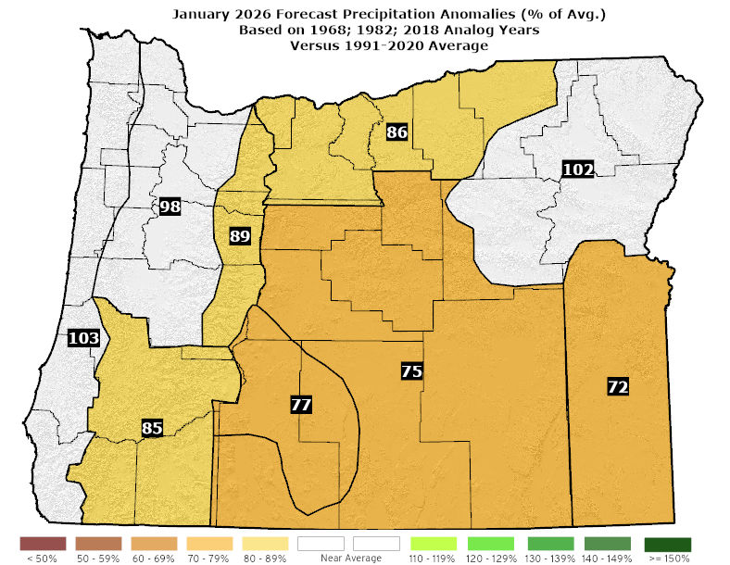
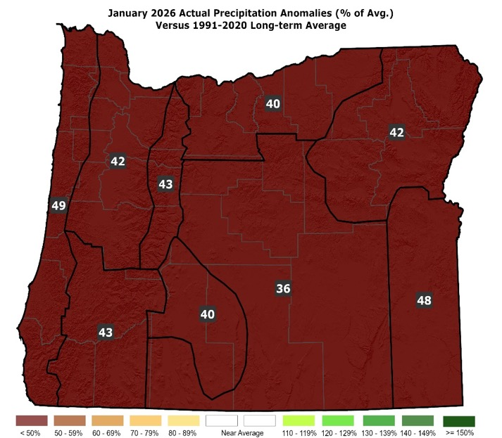
January 2026
(Forecast Issued December 18, 2025)/(Actual)
Forecast Precipitation
Actual Precipitation
Data courtesy of the National Centers for Environmental Information (NCEI)
Notes:
Temp Data: ftp://ftp.ncdc.noaa.gov/pub/data/cirs/drd964x.tmp.txt Precip Data: ftp://ftp.ncdc.noaa.gov/pub/data/cirs/drd964x.pcp.txt

Slide 8
January 2026
(Forecast Issued December 18, 2025)/(Actual)
2018 (which turned out being best analog match) was “blow-torch” warm and skewed the analog average warm, despite 1968 & 1982 being cool. (January 2026 temperatures looked remarkably like 2018...well above average but not record warm.) A “partial forecast hit.”
Near or below-average precipitation. 1968 & 2018 had below-average mountain now. 1982 had the reverse. (January 2026 had well-below-average precipitation and mountain snow.) A “partial forecast hit.”

Slide 9
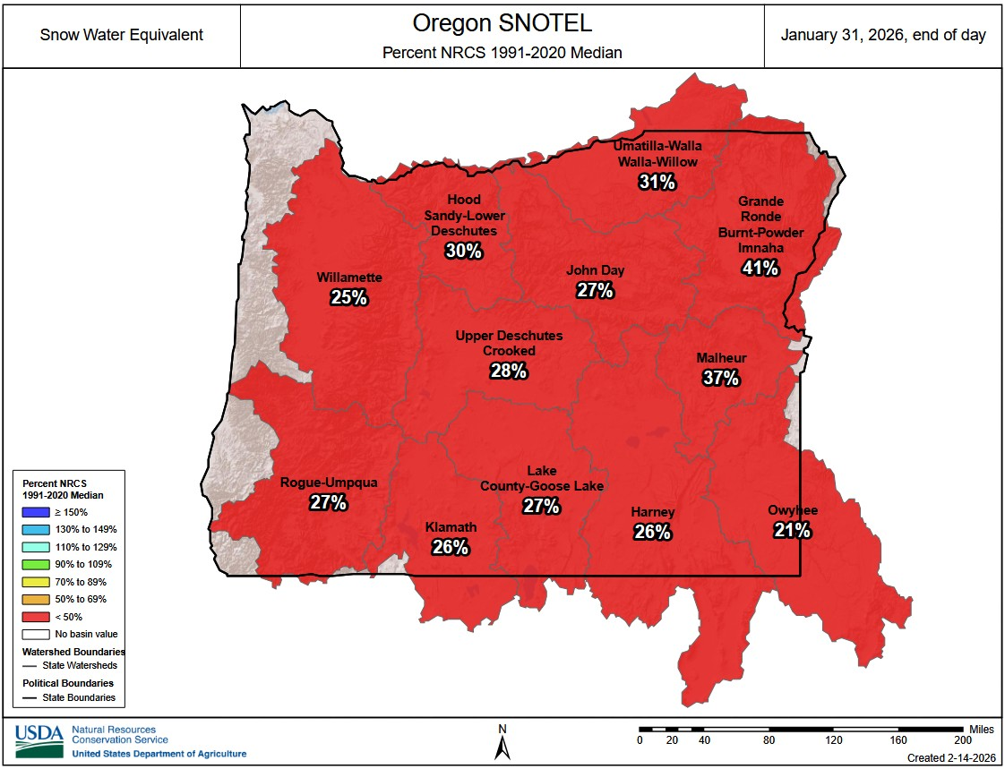

Slide 10
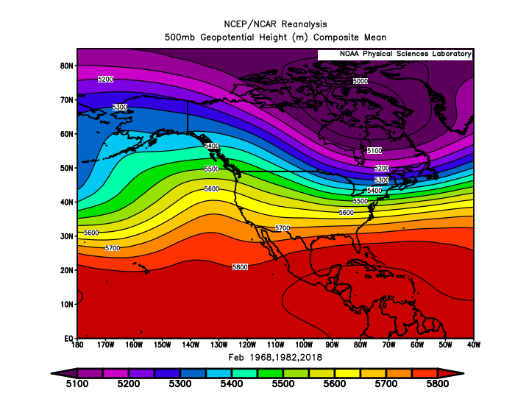
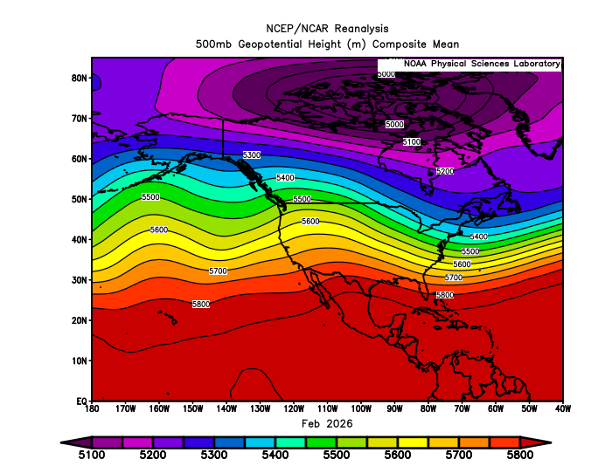
February 2026
(Forecast Issued January 15, 2026)/(Actual)
Forecast Upper-Air Pattern
Actual Upper-Air Pattern
The forecast (left) and the observed pattern (right) both showed mean ridging near the west coast. A “partial forecast hit.”

Slide 11
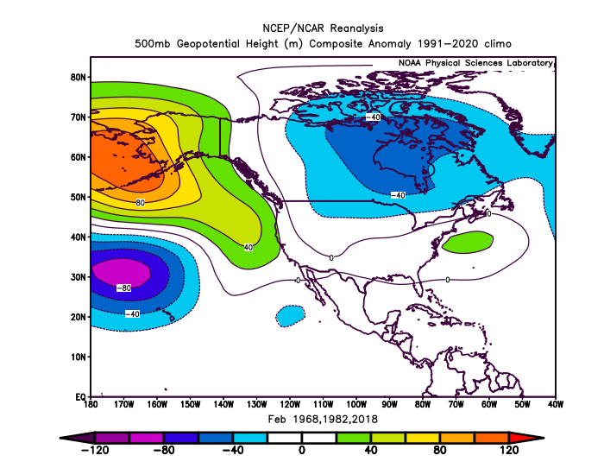
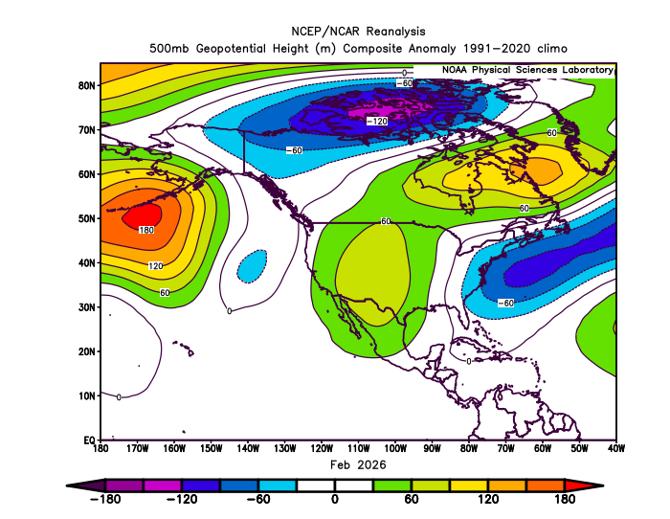
February 2026
(Forecast Issued January 15, 2026)/(Actual)
Forecast Upper-Air Anomalies
Actual Upper-Air Anomalies
Upper-air anomalies were minimal for both the analog composite (left), which had widely varying individual solutions, and the observed pattern (right). The latter had more ridging over the Rockies... Only a “partial forecast hit.”

Slide 12
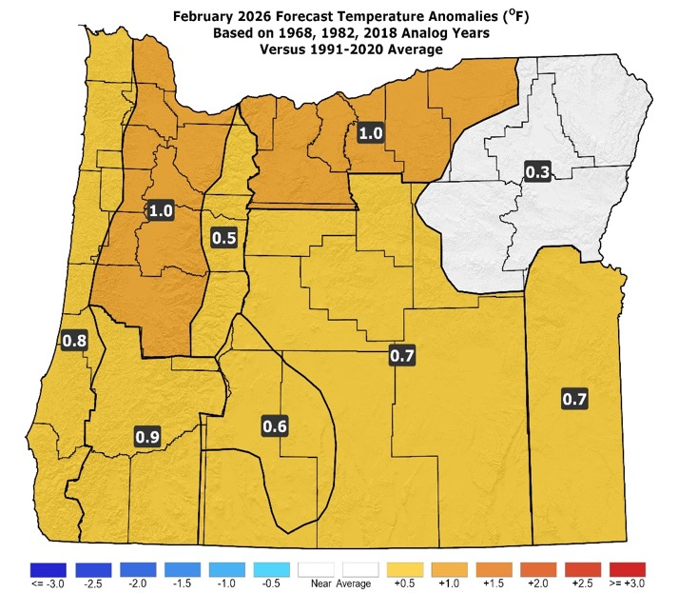
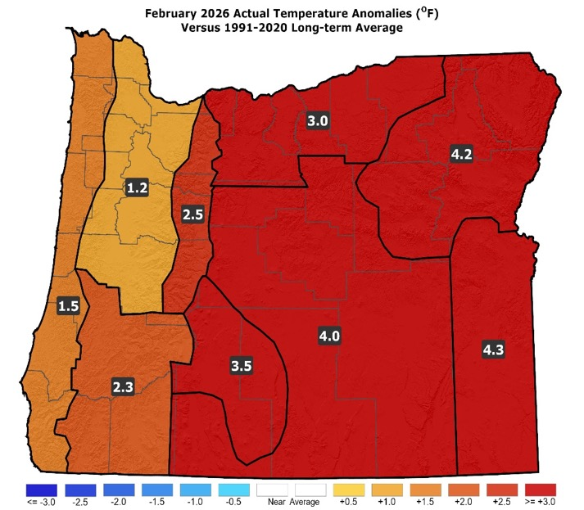
February 2026
(Forecast Issued January 15, 2026)/(Actual)
Forecast Temperatures
Actual Temperatures
Data courtesy of the National Centers for Environmental Information (NCEI)
Notes:
Temp Data: ftp://ftp.ncdc.noaa.gov/pub/data/cirs/drd964x.tmp.txt Precip Data: ftp://ftp.ncdc.noaa.gov/pub/data/cirs/drd964x.pcp.txt

Slide 13
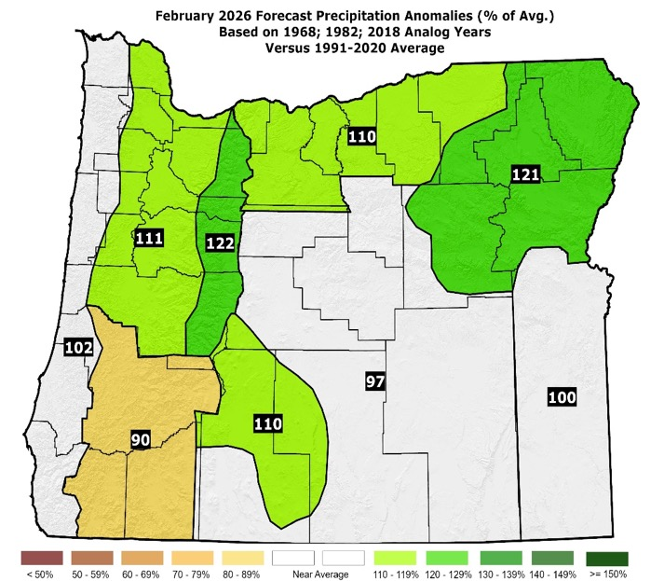
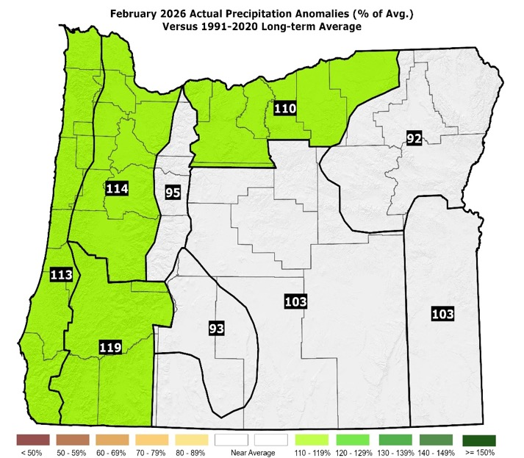
February 2026
(Forecast Issued January 15, 2026)/(Actual)
Forecast Precipitation
Actual Precipitation
Data courtesy of the National Centers for Environmental Information (NCEI)
Notes:
Temp Data: ftp://ftp.ncdc.noaa.gov/pub/data/cirs/drd964x.tmp.txt Precip Data: ftp://ftp.ncdc.noaa.gov/pub/data/cirs/drd964x.pcp.txt

Slide 14
February 2026
(Forecast Issued January 15, 2026)/(Actual)
Analogs had diverse weather. 1968 was very mild with anomalous ridging over Oregon. 1982 & 2018 had more active and cooler weather. Their blend called for slightly warmer than average conditions. (Strong ridging early in the month transitioned to a cool mid-month trough, then a period of mild SW flow, before a ridge returned. Temperatures were quite mild.) A “partial forecast hit.”
1968 & 1982 were wetter than average...2018 was drier but had significant valley snow. (The analog-blend forecast for precipitation was solid. There were some areas with brief western valley snow at mid-month. Mountain snowpacks remained well below normal.) A “partial forecast hit.”

Slide 15
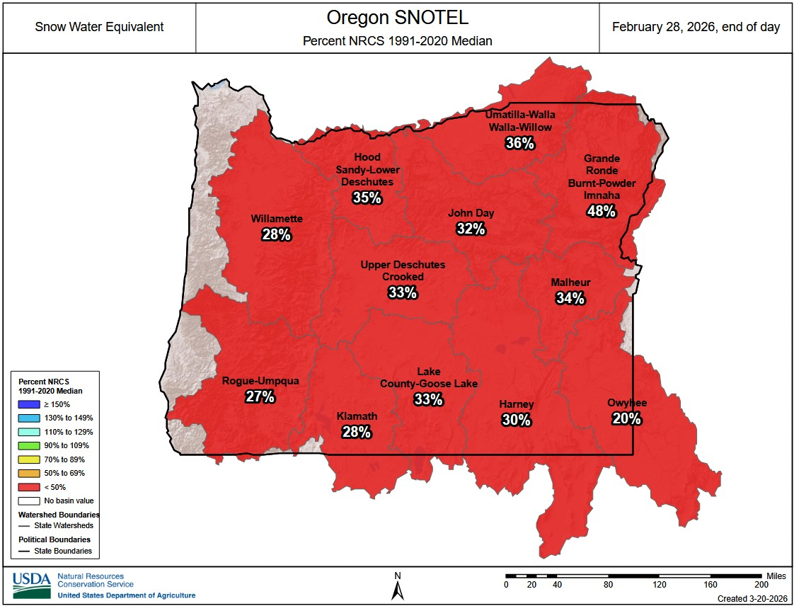

Slide 16
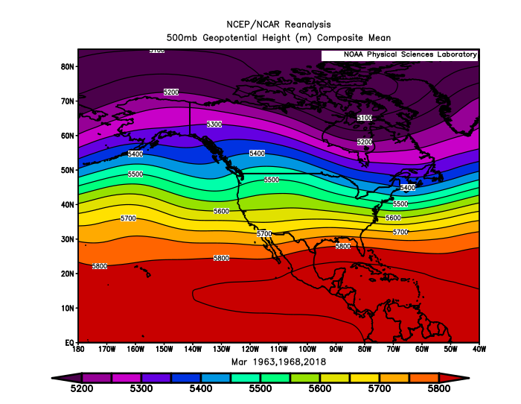
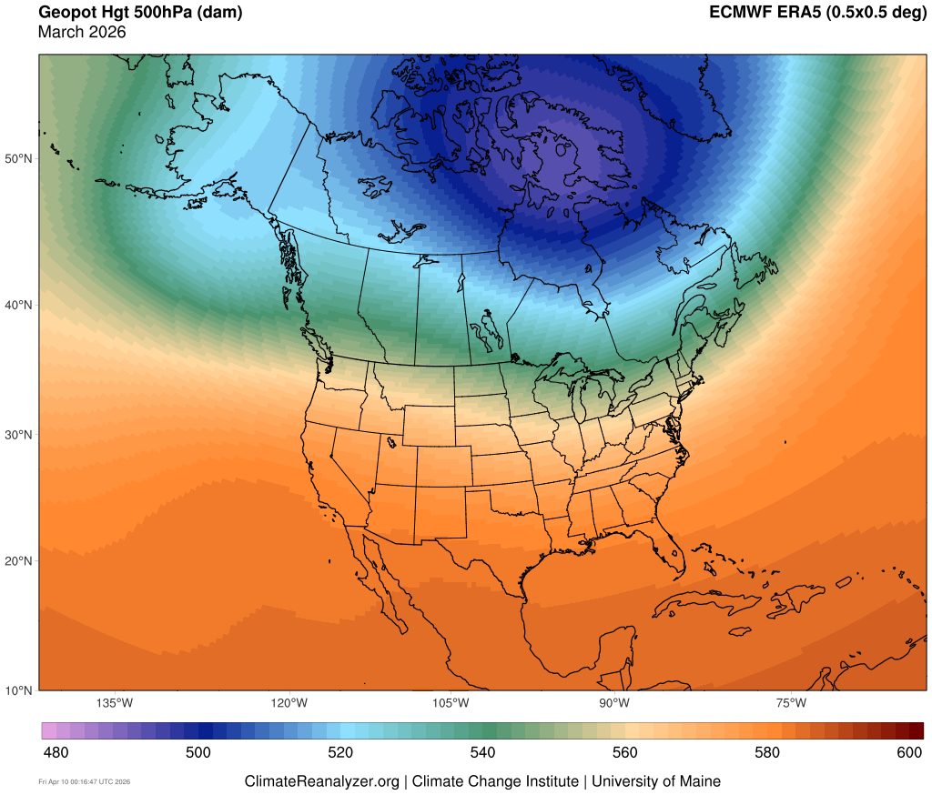
March 2026
(Forecast Issued February 20, 2026)/(Actual)
Forecast Upper-Air Pattern
Actual Upper-Air Pattern
Analogs (left) had some anomalous troughing with WSW flow aloft over Oregon. Oregon did have prevailing WSW flow aloft (right) but with more ridging than indicated by the analogs. A “partial forecast hit.”

Slide 17
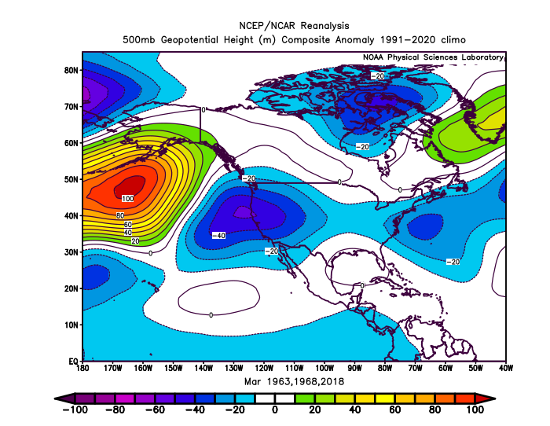
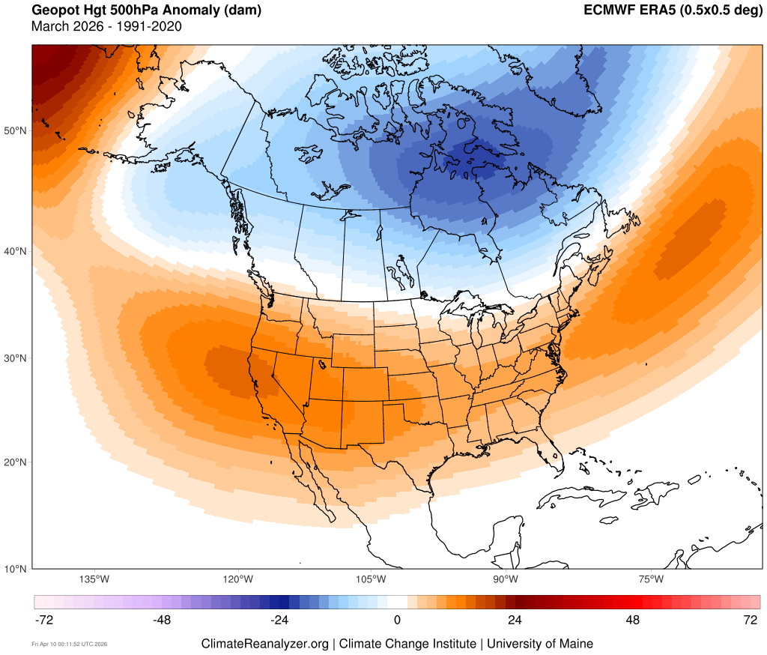
March 2026
(Forecast Issued February 20, 2026)/(Actual)
Forecast Upper-Air Anomalies
Actual Upper-Air Anomalies
The analog forecast (left) showed anomalous troughing over Oregon, which was in stark contrast to the anomalous ridging observed (right). A big “forecast miss.”

Slide 18
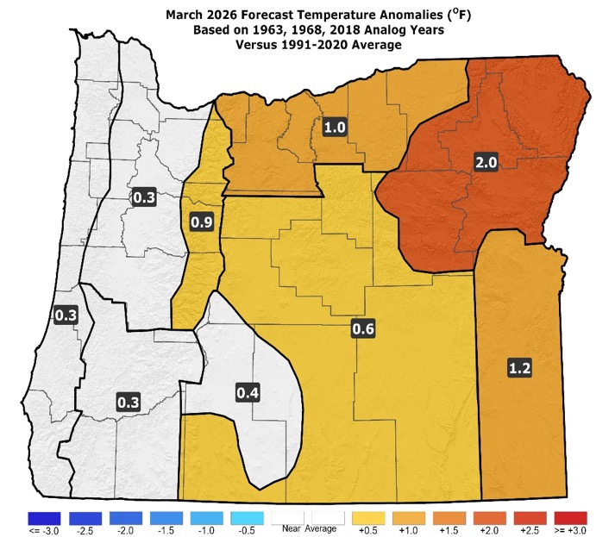
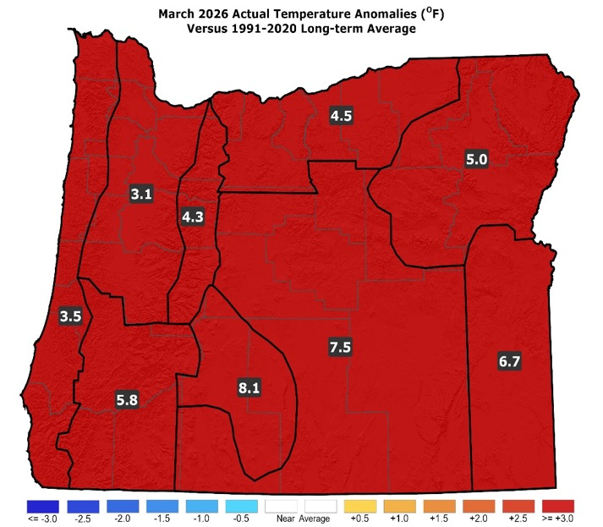
March 2026
(Forecast Issued February 20, 2026)/(Actual)
Forecast Temperatures
Actual Temperatures
Data courtesy of the National Centers for Environmental Information (NCEI)
Notes:
Temp Data: ftp://ftp.ncdc.noaa.gov/pub/data/cirs/drd964x.tmp.txt Precip Data: ftp://ftp.ncdc.noaa.gov/pub/data/cirs/drd964x.pcp.txt

Slide 19
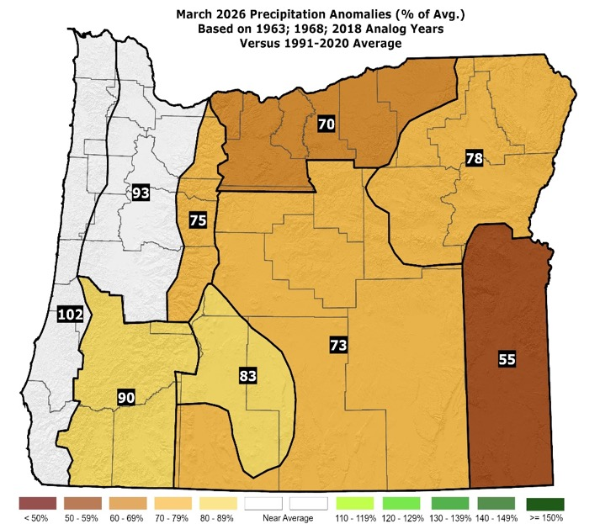
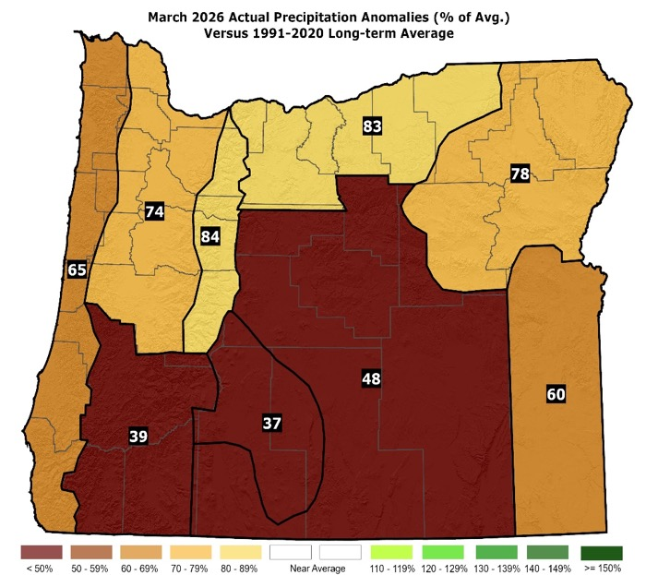
March 2026
(Forecast Issued February 20, 2026)/(Actual)
Forecast Precipitation
Actual Precipitation
Data courtesy of the National Centers for Environmental Information (NCEI)
Notes:
Temp Data: ftp://ftp.ncdc.noaa.gov/pub/data/cirs/drd964x.tmp.txt Precip Data: ftp://ftp.ncdc.noaa.gov/pub/data/cirs/drd964x.pcp.txt

Slide 20
March 2026
(Forecast Issued February 20, 2026)/(Actual)
Analogs had high variability in temperatures, ranging was a relatively warm 1963 to a cool 2018. Their blend predicted warmer-than-average conditions, especially east. (Temperatures were well-above normal. The southern half of central and eastern Oregon...zones 5, 7, & 9...recorded their warmest March on record.) A “partial forecast hit.”
The 1963 analog was wetter than average, but the analog blend was drier than average. (Despite a mid-month “Atmospheric River” event across northern zones, the month was generally dry. Mountain snowpacks finished March at near-record-low levels (next slide). A “partial forecast hit.”

Slide 21


Slide 22
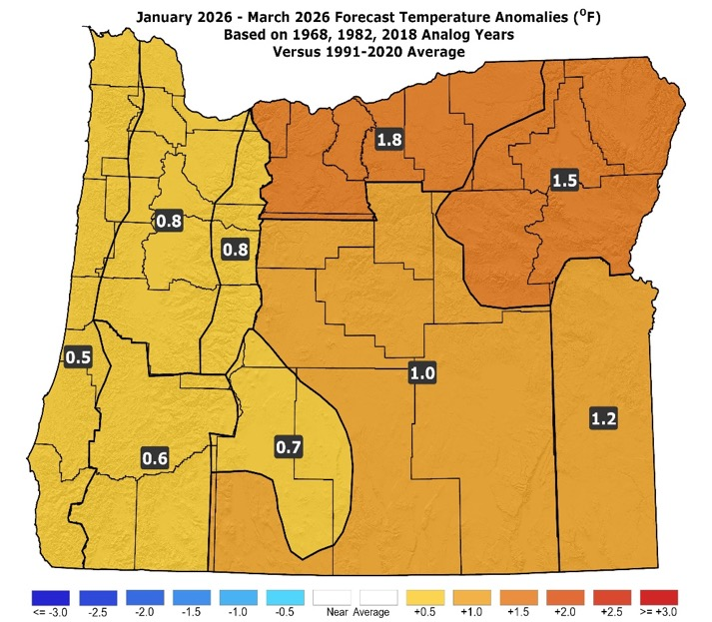
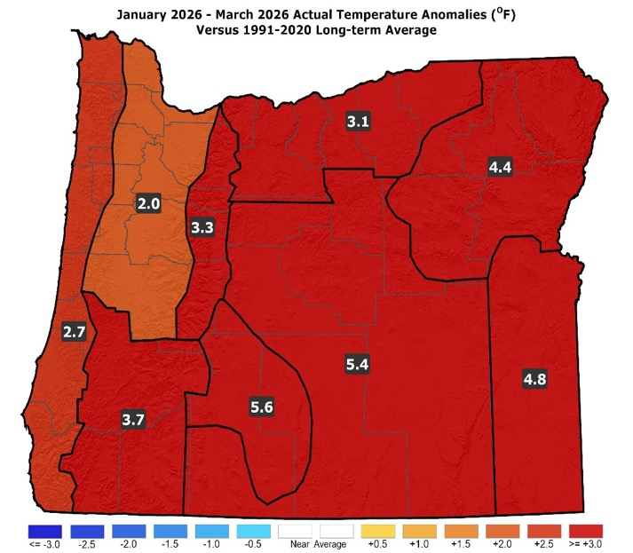
January – March 2026
(Forecast Issued December 18, 2025)/(Actual)
Forecast Temperatures
Actual Temperatures
Data courtesy of the National Centers for Environmental Information (NCEI)
Notes:
Temp Data: ftp://ftp.ncdc.noaa.gov/pub/data/cirs/drd964x.tmp.txt Precip Data: ftp://ftp.ncdc.noaa.gov/pub/data/cirs/drd964x.pcp.txt

Slide 23
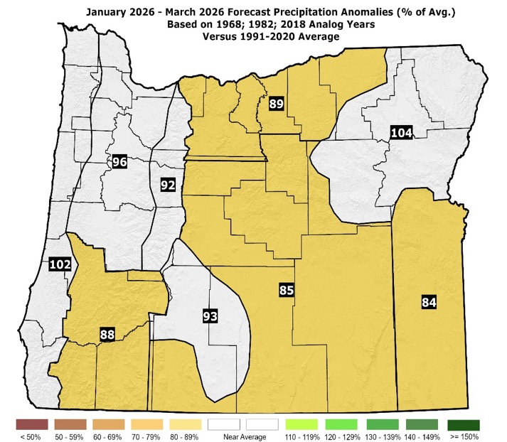
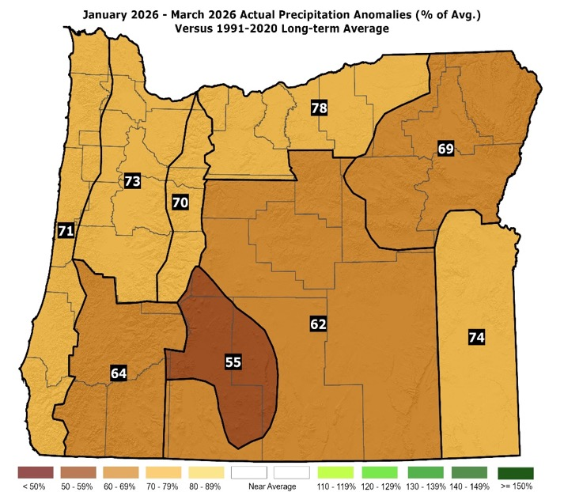
January – March 2026
(Forecast Issued December 18, 2025)/(Actual)
Forecast Precipitation
Actual Precipitation
Data courtesy of the National Centers for Environmental Information (NCEI)
Notes:
Temp Data: ftp://ftp.ncdc.noaa.gov/pub/data/cirs/drd964x.tmp.txt Precip Data: ftp://ftp.ncdc.noaa.gov/pub/data/cirs/drd964x.pcp.txt

Slide 24
January – March 2026
(Forecast Issued December 18, 2025)/(Actual)
A relative warm 1968 was somewhat countered by cooler 1982 and 2018 analogs, but their blend remained warm. (Extremely mild conditions dominated the period.) Only a “partial forecast hit (direction of anomaly correct).”
Near or slightly-below-average precipitation. (January had below-average rain and mountain snow. February was slightly wet with near-average mountain snow. March skewed dry, despite a wet week north at mid-month. Overall, precipitation was below average, and mountain snowpacks were abysmal.) A “partial forecast hit (direction of anomalies correct).”

Slide 25
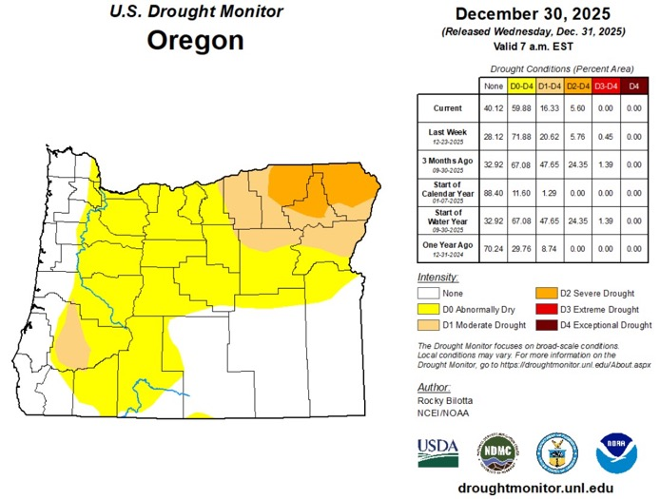
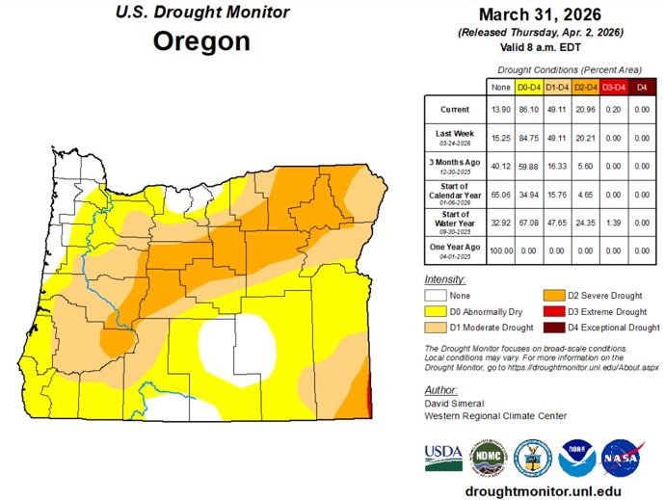
Oregon Drought Status
(Drought Worsened During the “Wet” Season!)
December 30, 2025
March 31, 2026
Courtesy: National Drought Mitigation Center (NDMC)
https://droughtmonitor.unl.edu/

Slide 26
Forecast Resources
ODA Seasonal Climate Forecast Home:
https://www.oregon.gov/oda/natural-resources/pages/weather.aspx
CPC Official US Three-Month Forecasts (Graphics):
https://www.cpc.ncep.noaa.gov/products/predictions/long_range/seasonal.php?lead=01
CPC US 30-Day & 90-Day Forecasts (Discussions):
https://www.cpc.ncep.noaa.gov/products/predictions/long_range/fxus07.html
CPC Weekly & Monthly ENSO Discussions: https://www.cpc.ncep.noaa.gov/products/analysis_monitoring/enso_advisory
Australian Government Climate Model Summary:
http://www.bom.gov.au/climate/model-summary/#region=NINO34&tabs=Overview
Australian Government ENSO Wrap-Up:
http://www.bom.gov.au/climate/enso
IRI ENSO Quick Look:
https://iri.columbia.edu/our-expertise/climate/forecasts/enso/current/

Slide 27
Water Supply / Fire-Potential Outlook
CPC U.S. Seasonal Drought Outlook:
https://www.cpc.ncep.noaa.gov/products/expert_assessment/season_drought.png
NRCS Snow Water Equivalent Oregon Map:
https://www.wcc.nrcs.usda.gov/ftpref/data/water/wcs/gis/maps/or_swepctnormal_update.pdf
NRCS/USDA Snow Water Equivalent Products:
https://www.nrcs.usda.gov/wps/portal/wcc/home/snowClimateMonitoring/snowpack/
NDMC U.S. Drought Monitor:
https://droughtmonitor.unl.edu/
NIDIS North American Drought Portal:
https://www.drought.gov/nadm/content/percent-average-precipitation
WRCC WestWideDroughtTracker:
https://www.wrcc.dri.edu/wwdt/
NWCC Northwest Interagency Coordination Center (video)
https://gacc.nifc.gov/nwcc/predict/outlook.aspx

Slide 28
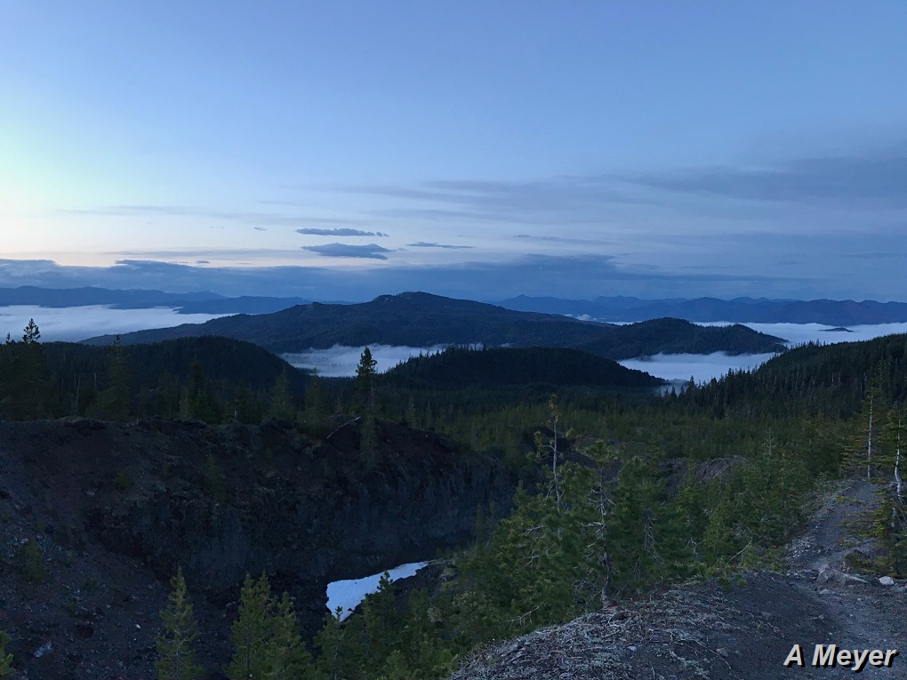
Updated Mid-Month
Your Feedback is Welcome!
Sign-up for Email notification of updates at:
https://public.govdelivery.com/accounts/ORODA/subscriber/new?topic_id=ORODA_14
Contact: Pete Parsons, ODF Lead Meteorologist
at 503-945-7448 or peter.gj.parsons@odf.oregon.gov

