Slide 1
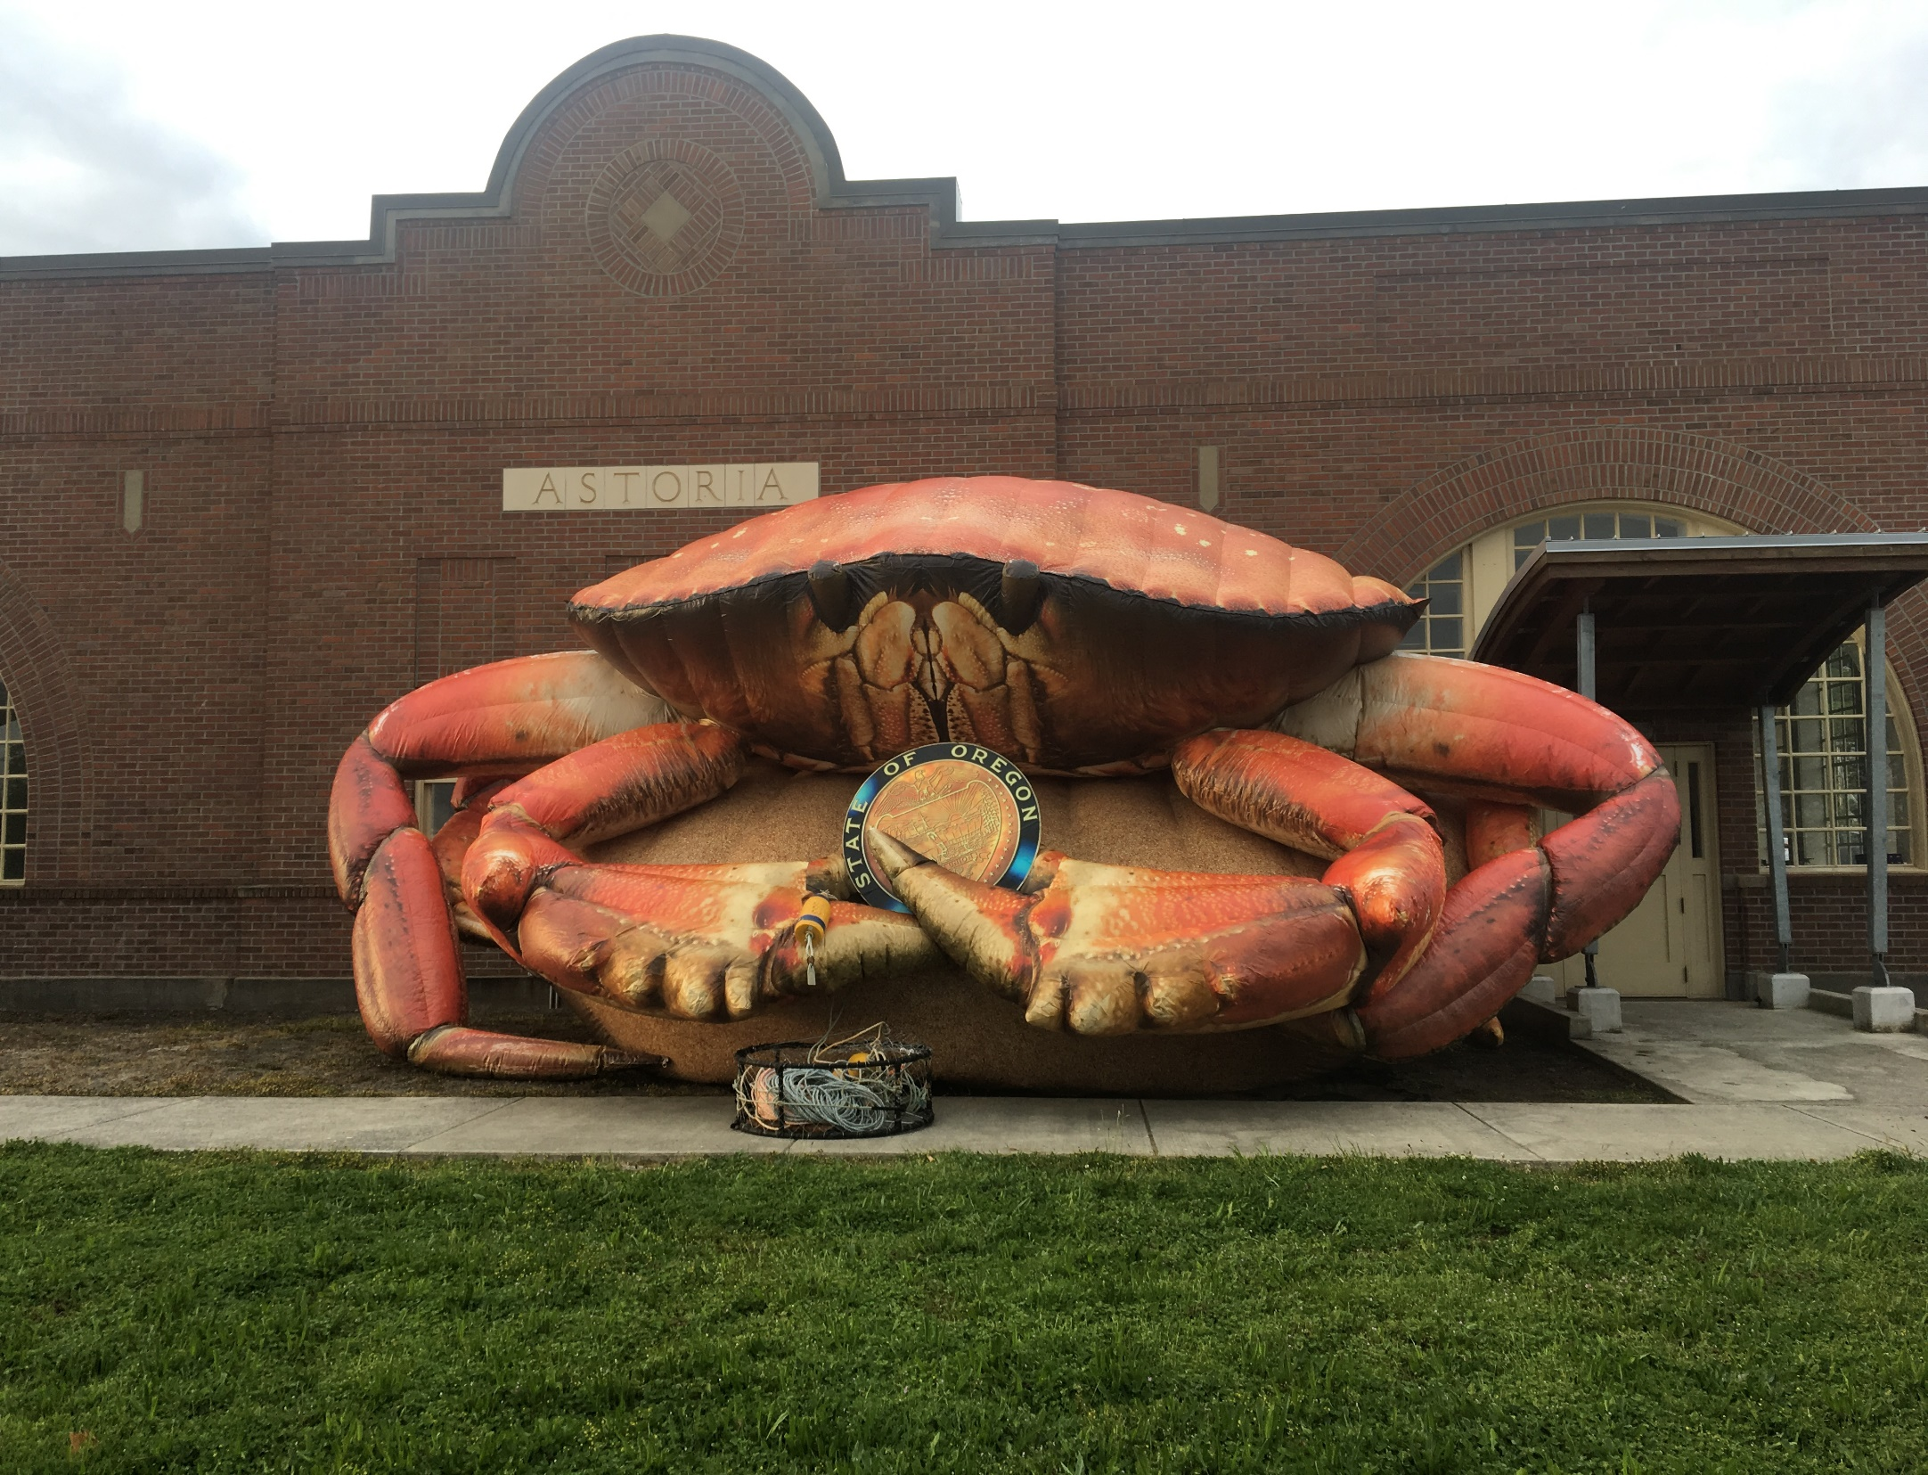
Oregon Dungeness Crab Commission
Notes:
My Name is Crystal Adams, and I am the Executive Director of the ODCC appointed to the position in October of 2023. I’m excited today to tell you a little about our commission and the Oregon Dungeness crab fishery.

Slide 2
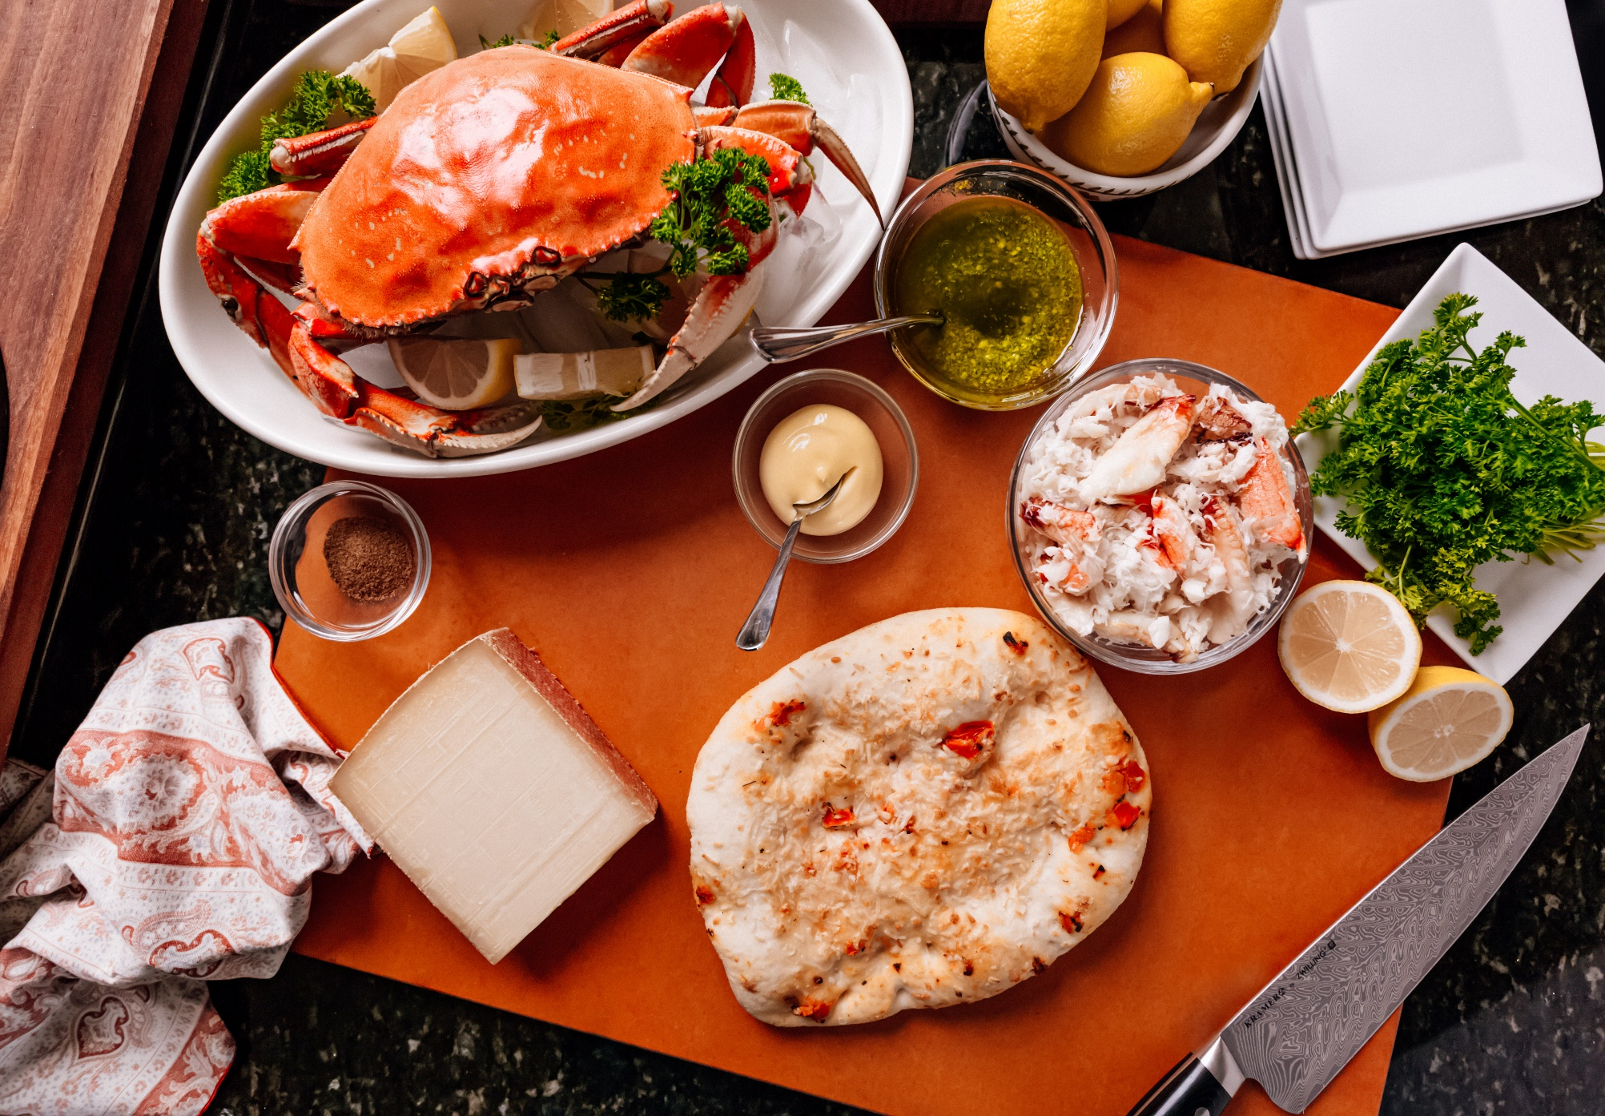
Notes:
Oregon Dungeness Crab Focaccia with Pesto and Gruyere/ recipes can be found at oregondungeness.org

Slide 3
ODCC – Who we are, what we do…
One of 22 Commissions under the umbrella of ODA Commodity Commission Program, ODCC established in 1977
The Program began in 1947 – first in the nation – provides legislative authority which allows growers/harvesters to tax themselves and use pooled funds to increase value, use and recognition of commodity – totally industry funded
4 seafood: Crab, Trawl, Salmon & Albacore
Funding – Assessment of 1% of the catch value of crab landed in Oregon ($350k - $950k+)
Direction – 8-member Commission (5/2/1) appointed by the ODA Dir. for 3-yr terms
Primary Functions – Marketing, Education, Research & Information – advertising; promotional & “pos” material; trade shows (domestic & international); targeted promotions; trade leads & contacts; market data; newsletter; industry representation in Salem & D.C. etc., facilitate State supervised price negotiations

Slide 4
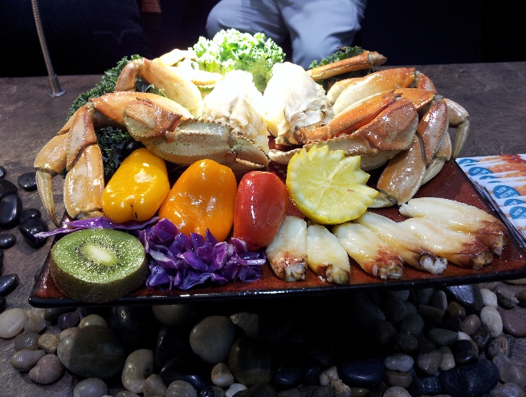
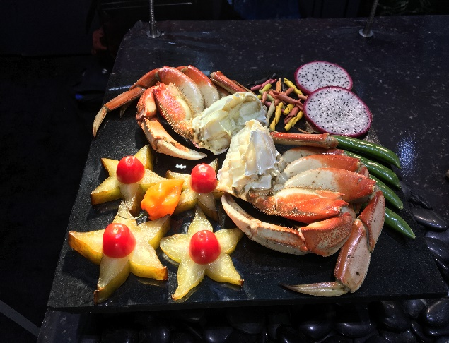
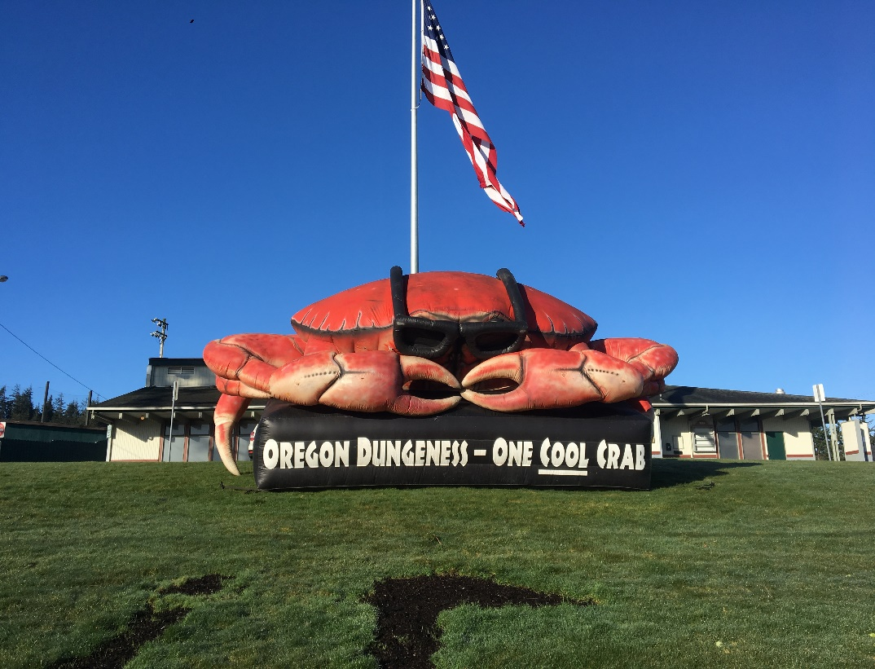
Marketing examples: T.V., Radio, Print ad – consumer and trade,
Social Media, Point of Sale, Inflatable program, Trade shows, etc.
Notes:
First recorded commercial landings in 1889 – 6,628 lbs. Since that date we have had record years of up to 31 million pounds. Our season has just opened yesterday at 9am and I can’t wait to see what it has in store for us this year.

Slide 5

2018 TV Advertisement

Slide 6
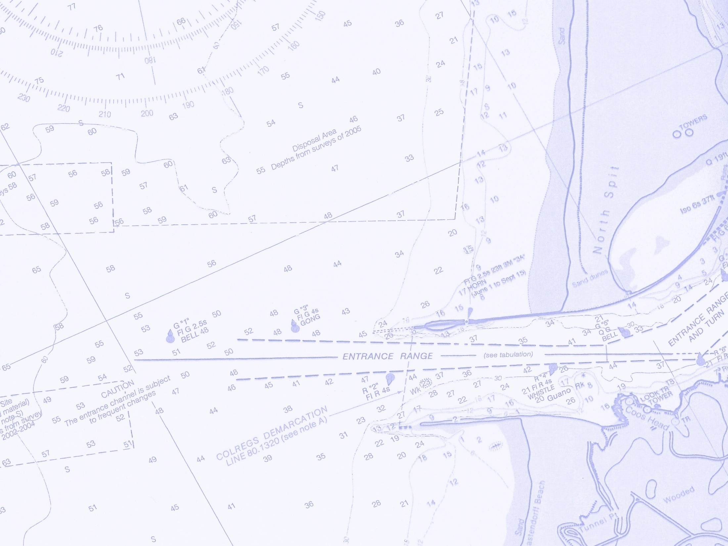
Last Season – 2023-2024
Astoria – 7,270,000 lbs.
Newport – 9,030,000 lbs.
Charleston –3,400,000 lbs.
Brookings – 1,180,000 lbs.
Mix Ports – 8,392,000 lbs.
Local value $93.6 m (to date)
Harvest to date = 24.6 m/lbs.
‘Ex-vessel’ value = $93.6 m
7 year (‘16-’23) Landings & Value all Species
Total Seafood Pounds Total Seafood Dollars
146,694,688 Lbs. | $ 512,200,000,000
Notes:
and the state’s largest single-species fishery and highest value protein in Oregon. And even this past seasons, somewhat average landings, keep in mind that as you look at the money pumped into the local and state economy. Factoring a conservative multiplier of two, this year’s average season will have infused the state’s economy with over $180 million dollars.

Slide 7
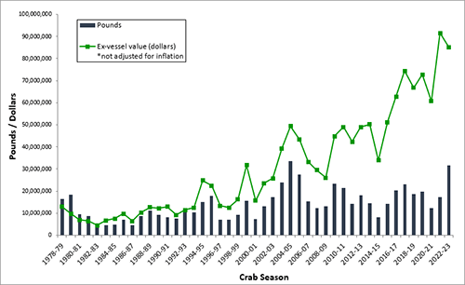
Annual Landings of Dungeness Crab in Oregon
(1978 to present)
Notes:
All time high 33m for $52.9m in 04-05, close second was 2022-23 season with 31.5 million pounds although the value for that season was $85m

Slide 8
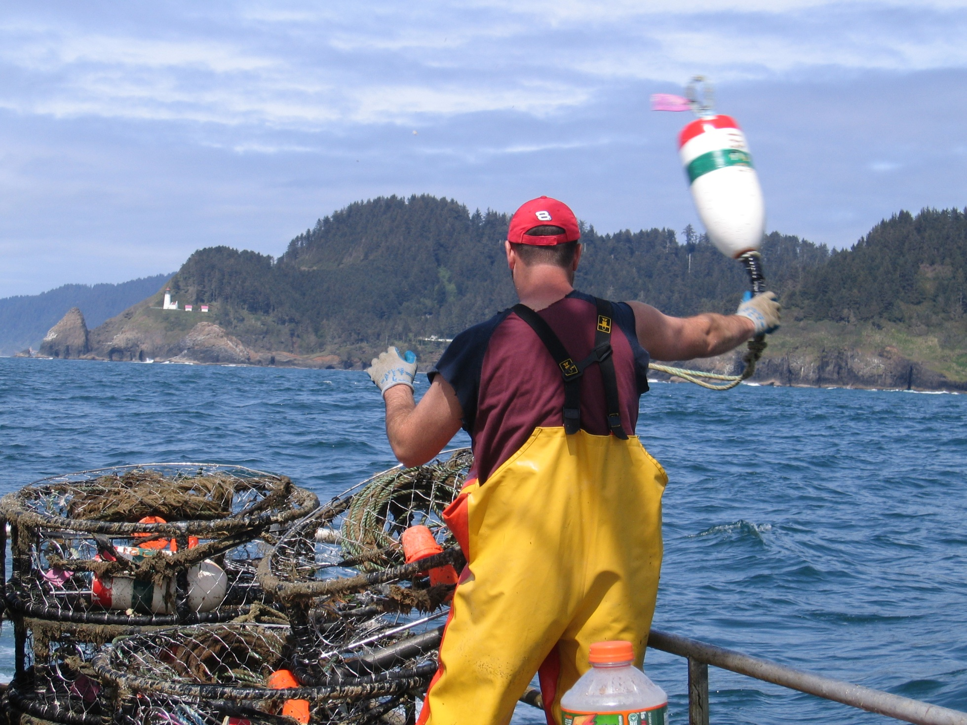
Conservation-minded Gear Regulations...
Notes:
Oregon Dungeness crabbers prioritize conservation through stringent gear regulations, including the use of escape rings that allow undersized males and females to escape from traps, as well as biodegradable components that prevent "ghost fishing" by releasing trapped crabs if pots are lost. Their commitment to sustainability is further demonstrated by initiatives to recover derelict gear, which helps protect marine life and maintain the health of crab populations for future generations.

Slide 9
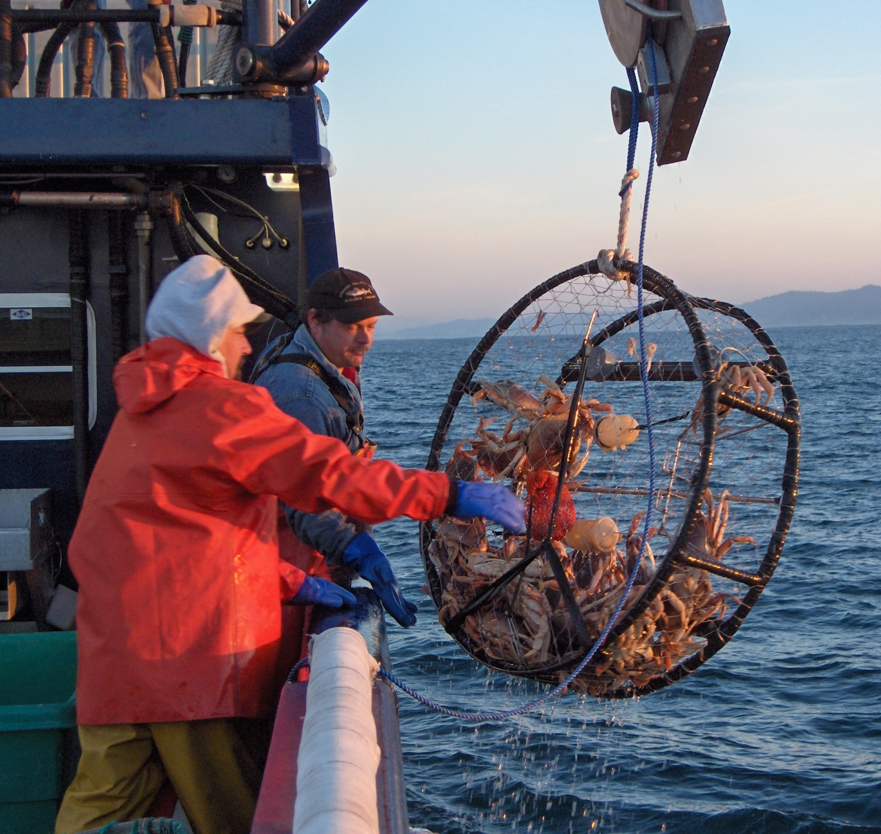
Targeted Harvest Method...
Notes:
Oregon Dungeness crabbers employ highly targeted harvest methods to ensure sustainability. They use circular steel traps called pots which are bottom friendly for a healthy rebound to the ocean floor

Slide 10
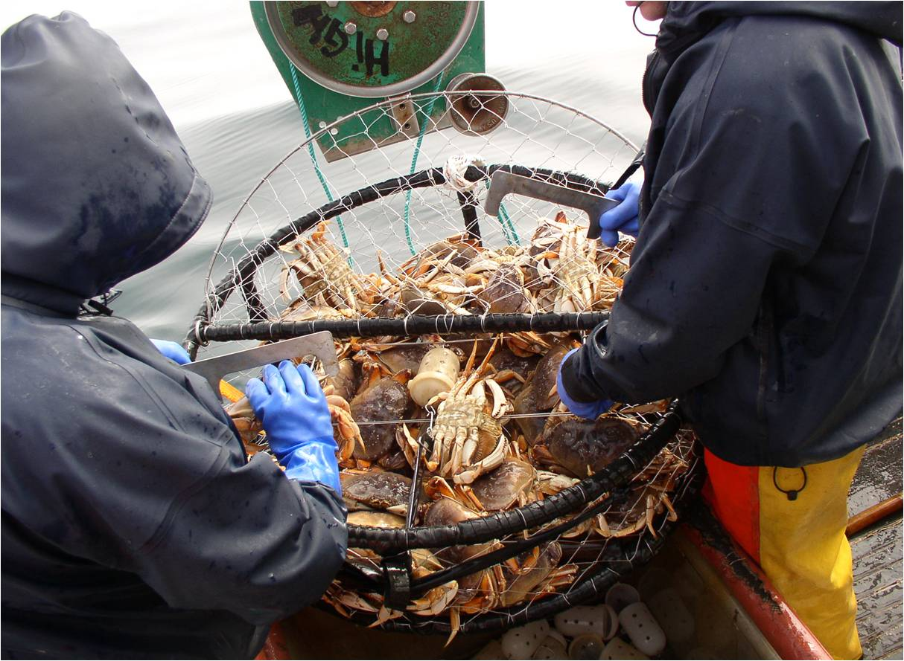
3-S Management...
Notes:
Oregon runs on a 3’s management style that was implemented in the early 1900’s

Slide 11
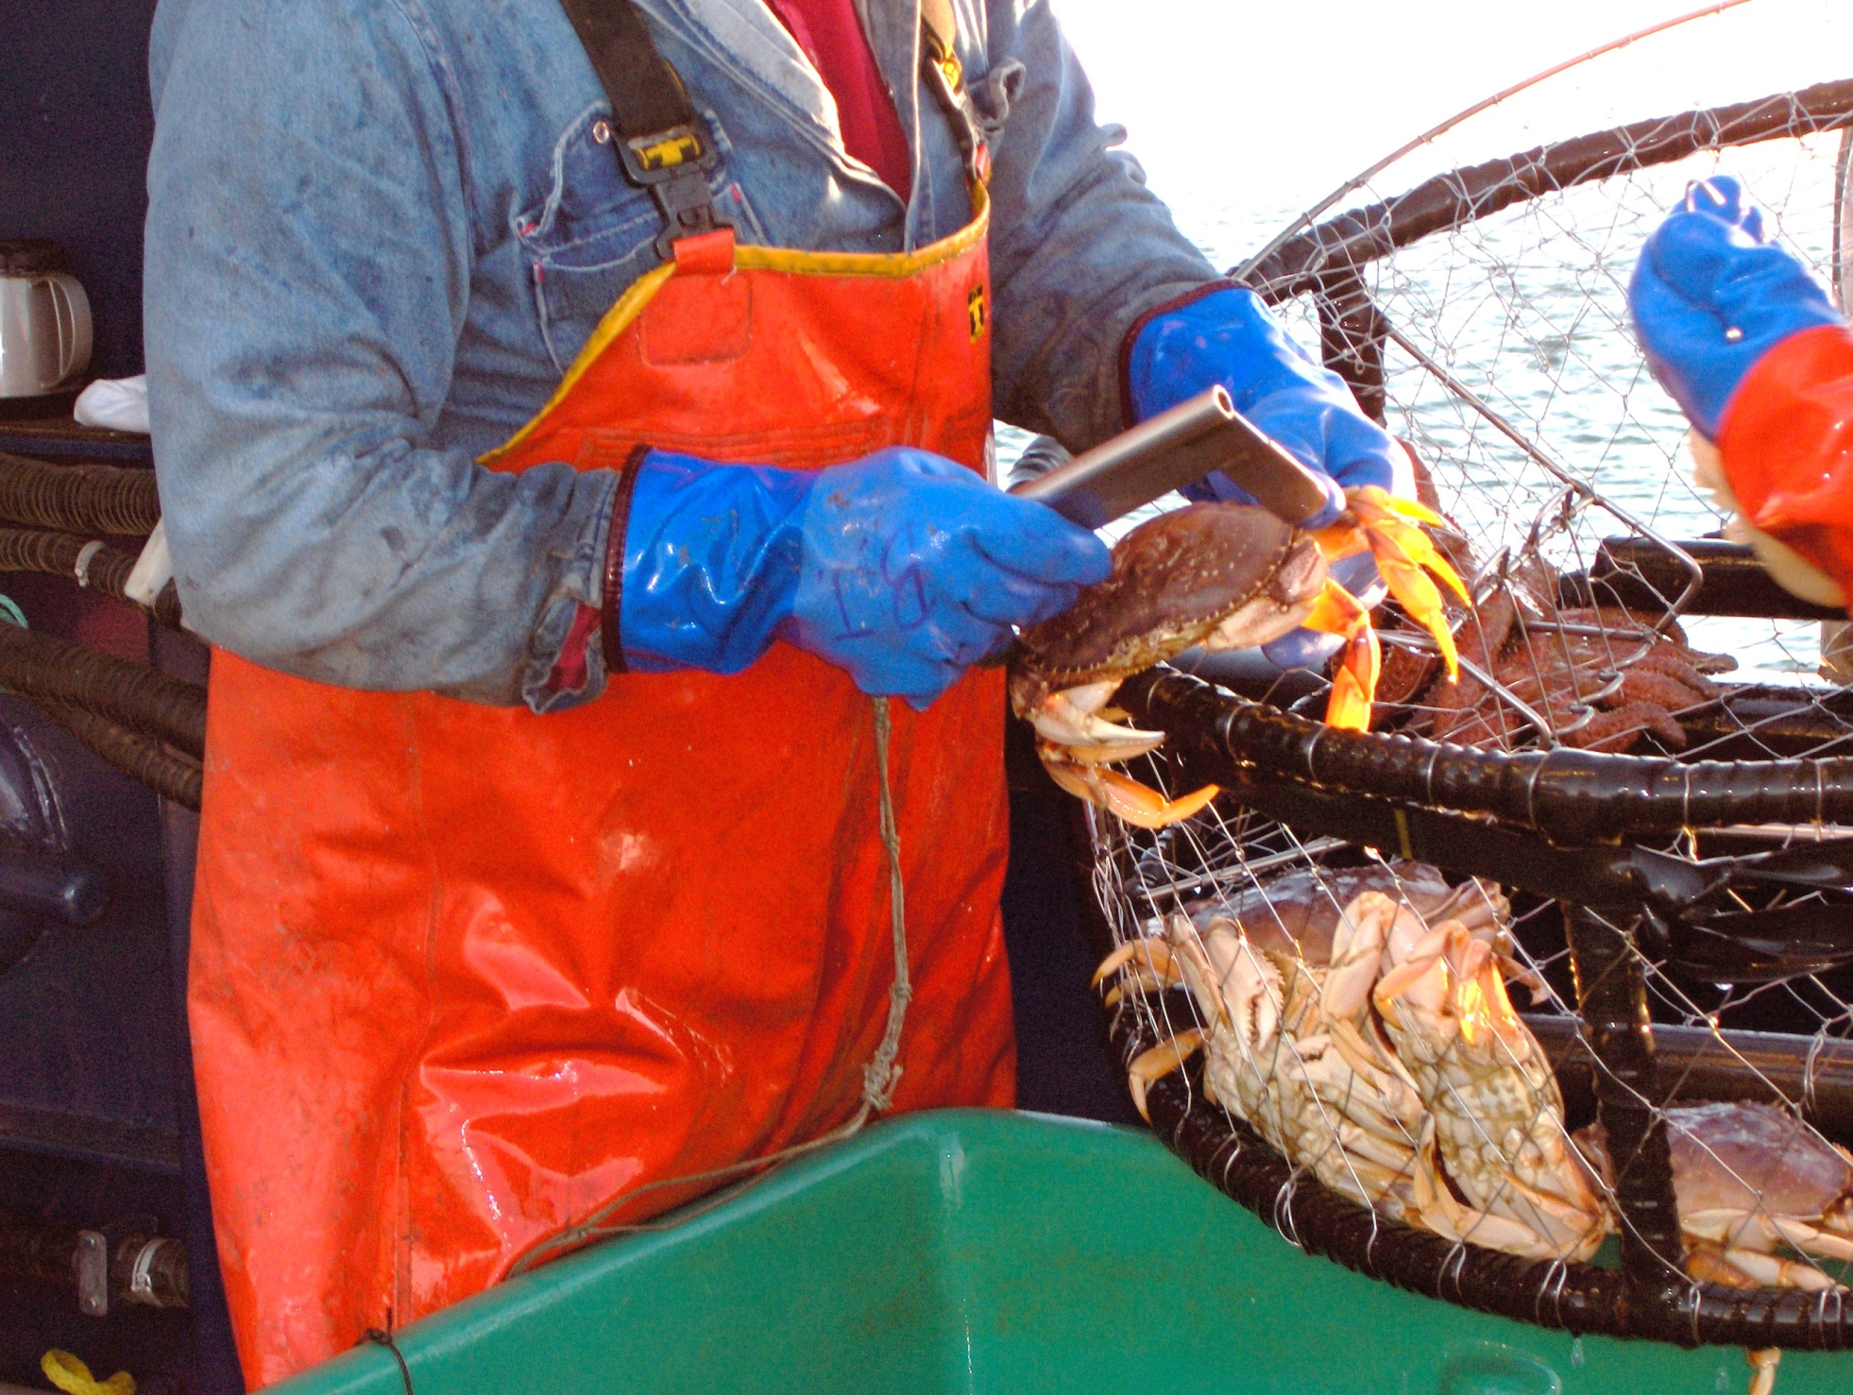
Size...
Notes:
Size: Only mature male crabs measuring at least 6 1⁄4 inches across the back of the shell can be harvested.

Slide 12
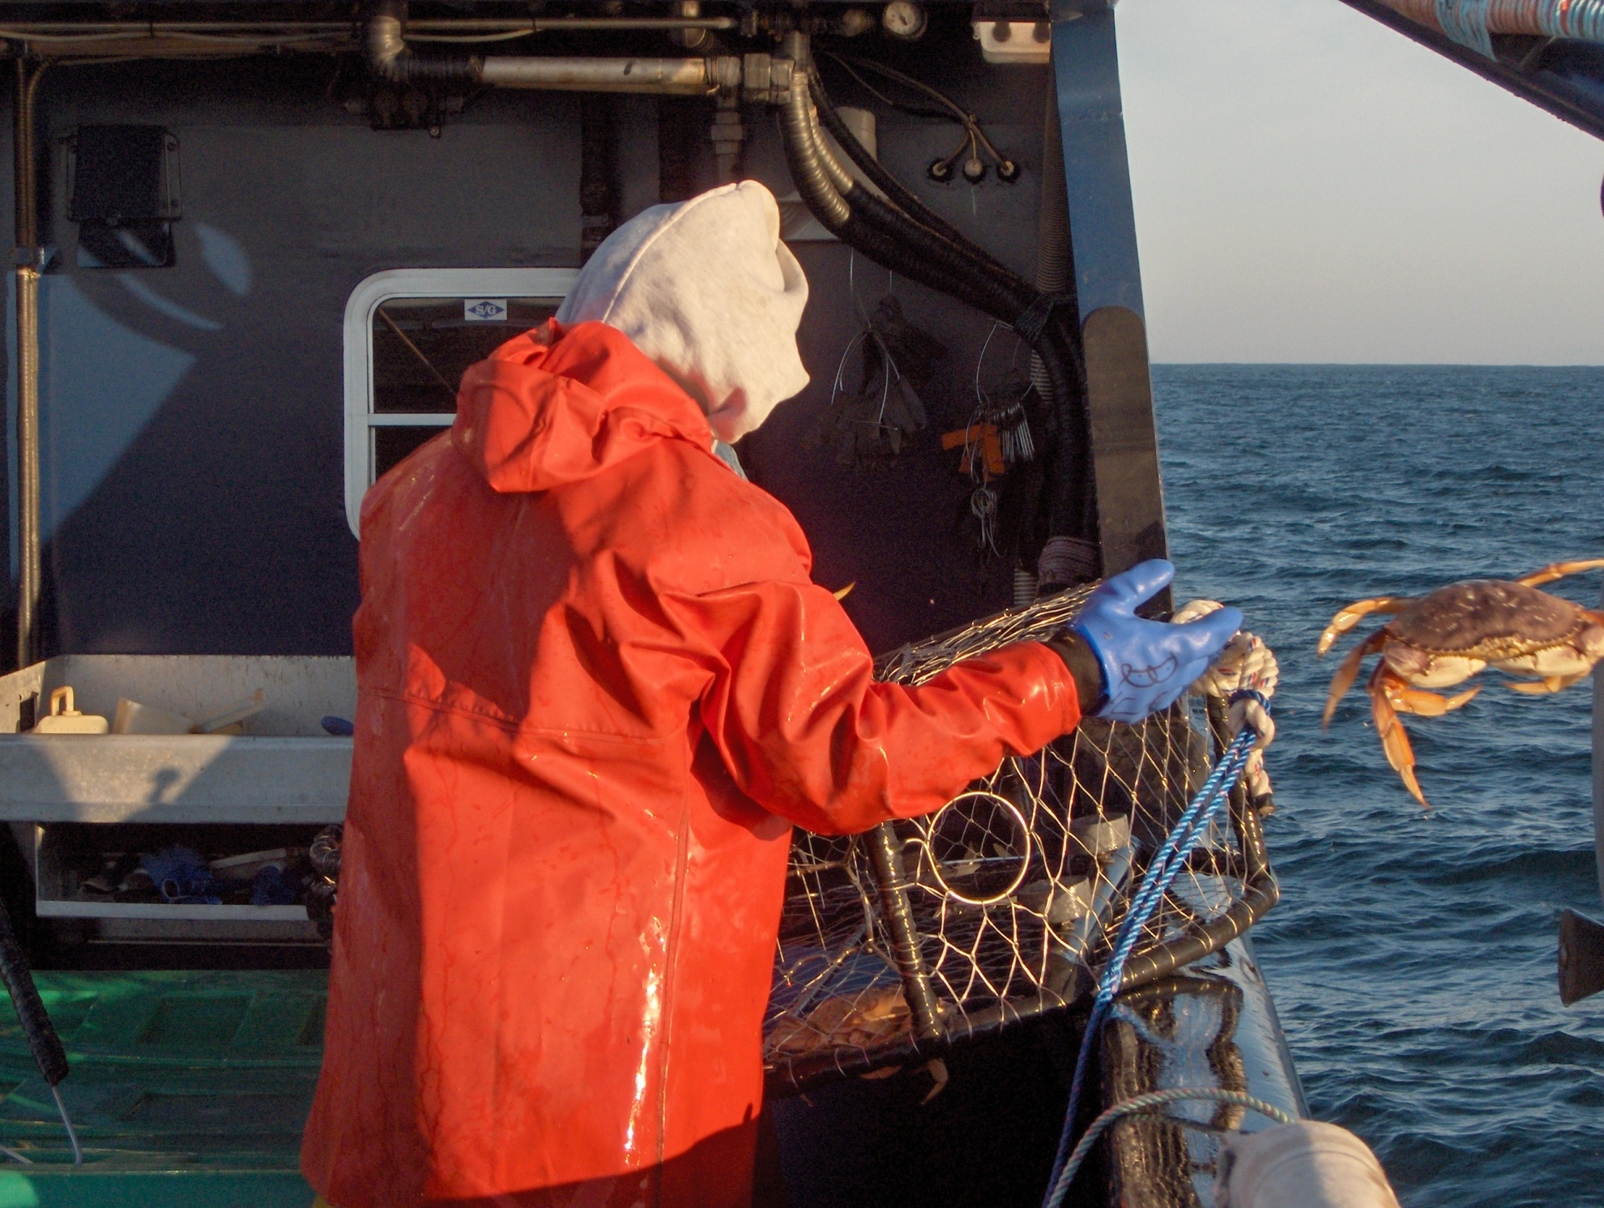
Sex...
Notes:
Sex: All female crabs must be released unharmed.

Slide 13
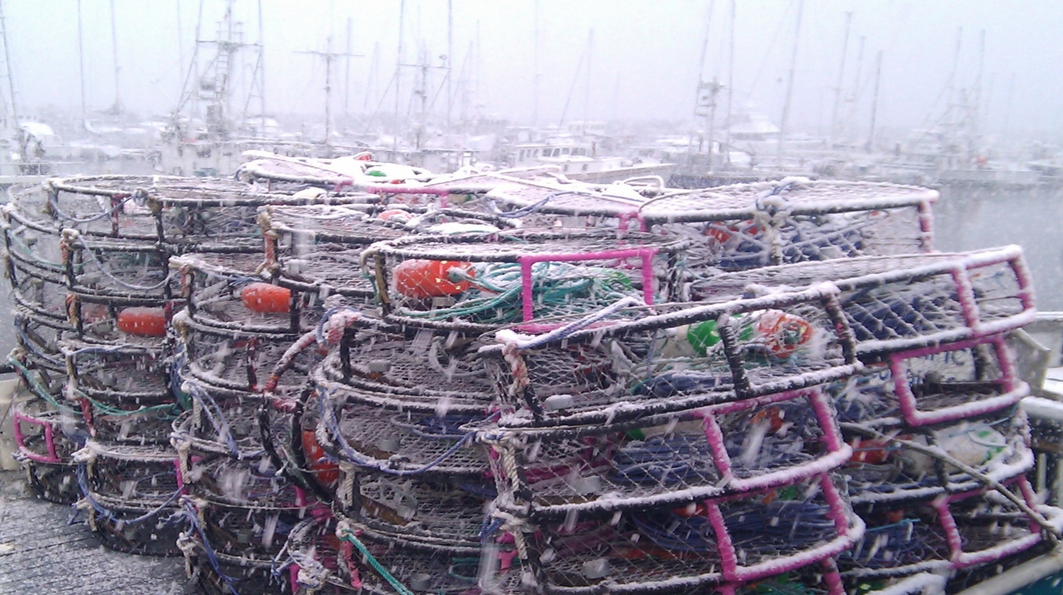
Season...
Notes:
Season: The annual harvest begins on December 1 and closes on August 14th, and the fishing season is timed to protect soft-shelled crabs, collectively maintaining a sustainable fishery.

Slide 14
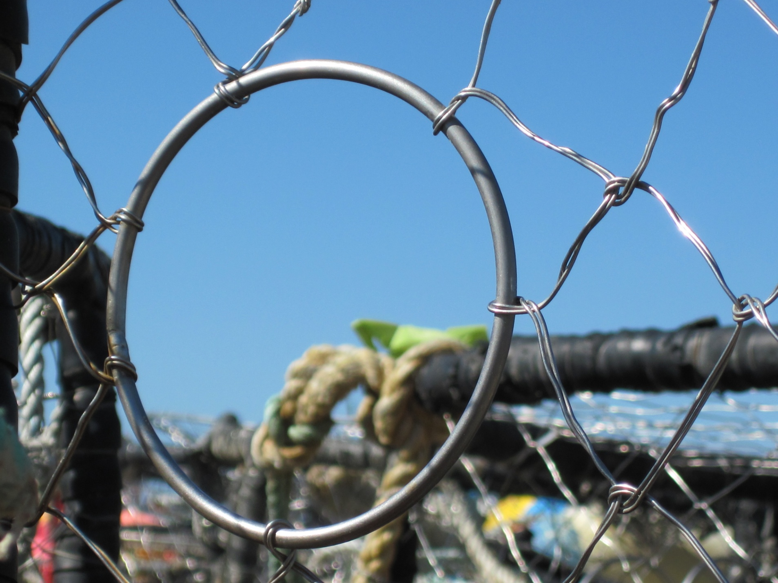
Escape Ring...
Notes:
Escape rings serve two primary purposes:
1. Allow undersized male crabs to exit the pot
2. Permit female crabs to escape, ensuring they can continue the reproductive cycle
- Each crab pot must have a minimum of two escape rings
- The escape rings must be circular with an inside diameter of at least 4-1/4 inches
- They must be located on the top or upper half of the sides of the pot

Slide 15
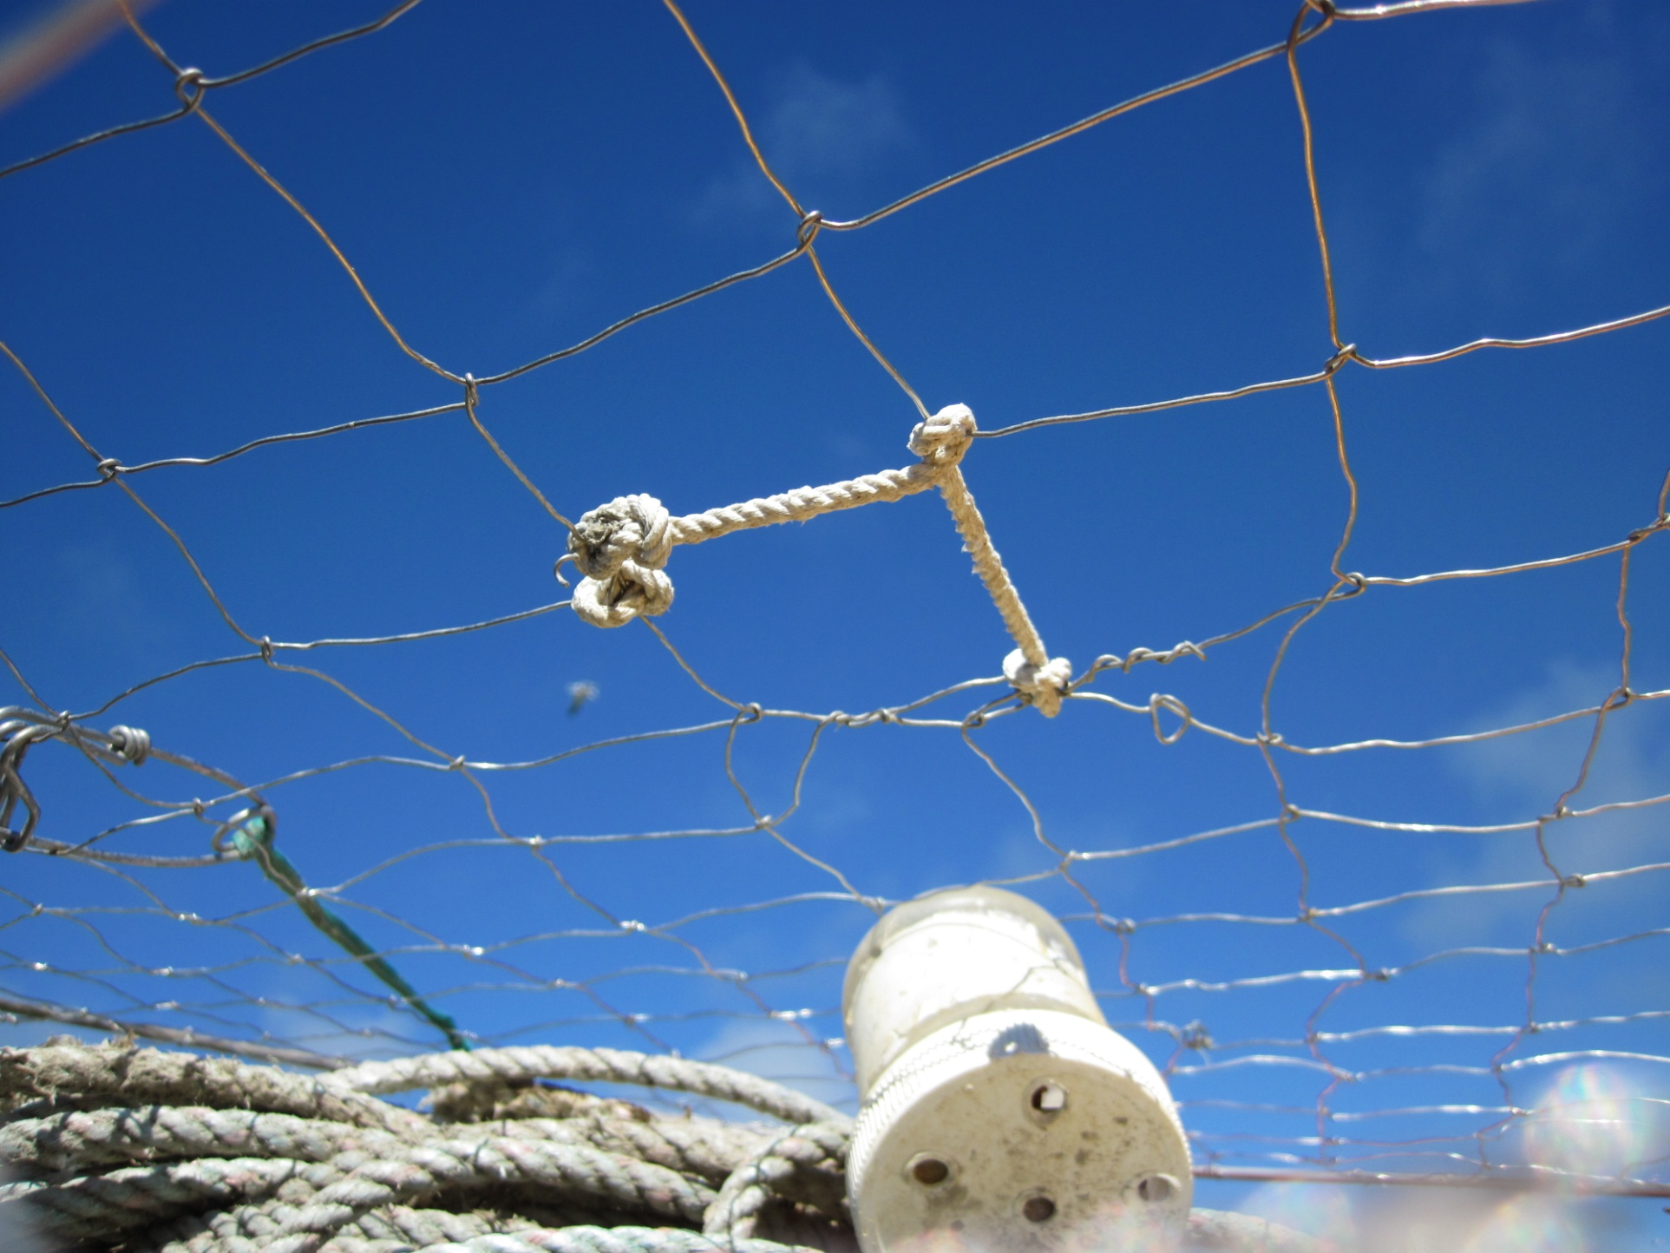
Biodegradable Cotton...
Notes:
Biodegradable components: Pot lids must include a biodegradable element (usually cotton twine) to prevent ghost fishing if pots are lost

Slide 16
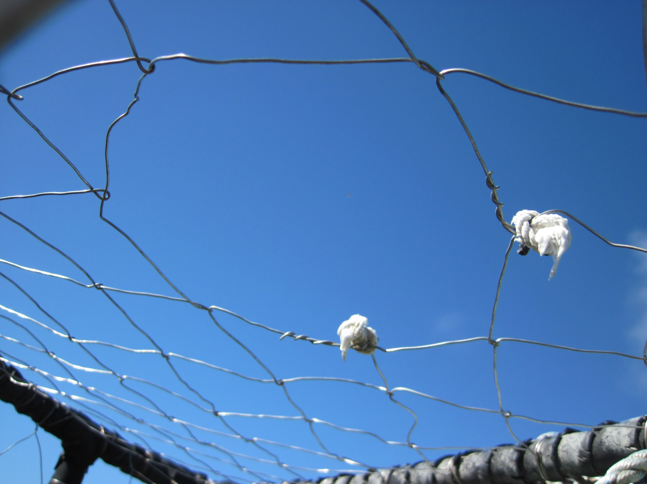
Notes:
How it opens up to let marine life escape after about 30 days

Slide 17
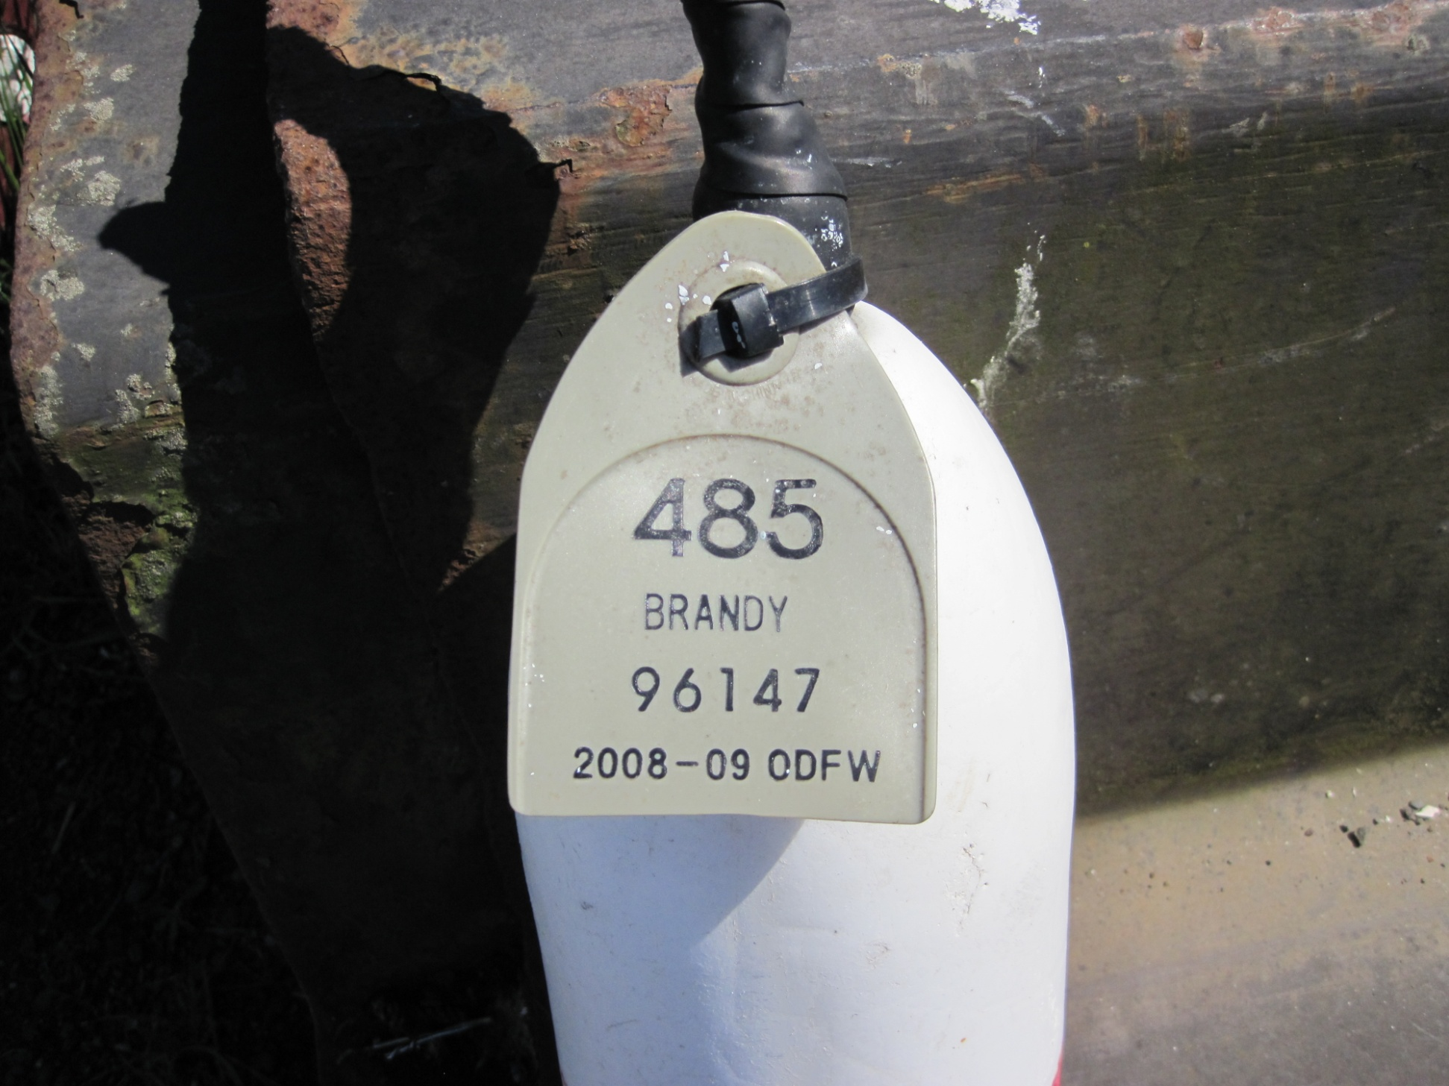
1996 – Limited Entry...
Notes:
In 1996, ‘limited entry’ was implemented in the Oregon Dungeness fishery due to concerns about ‘over capitalization’ and increased effort, and in response to WA-state’s crab L/E program which went into effect a year or two (?) earlier. 433 permits were established, with the present number down to 424 as a result of non-renewals

Slide 18
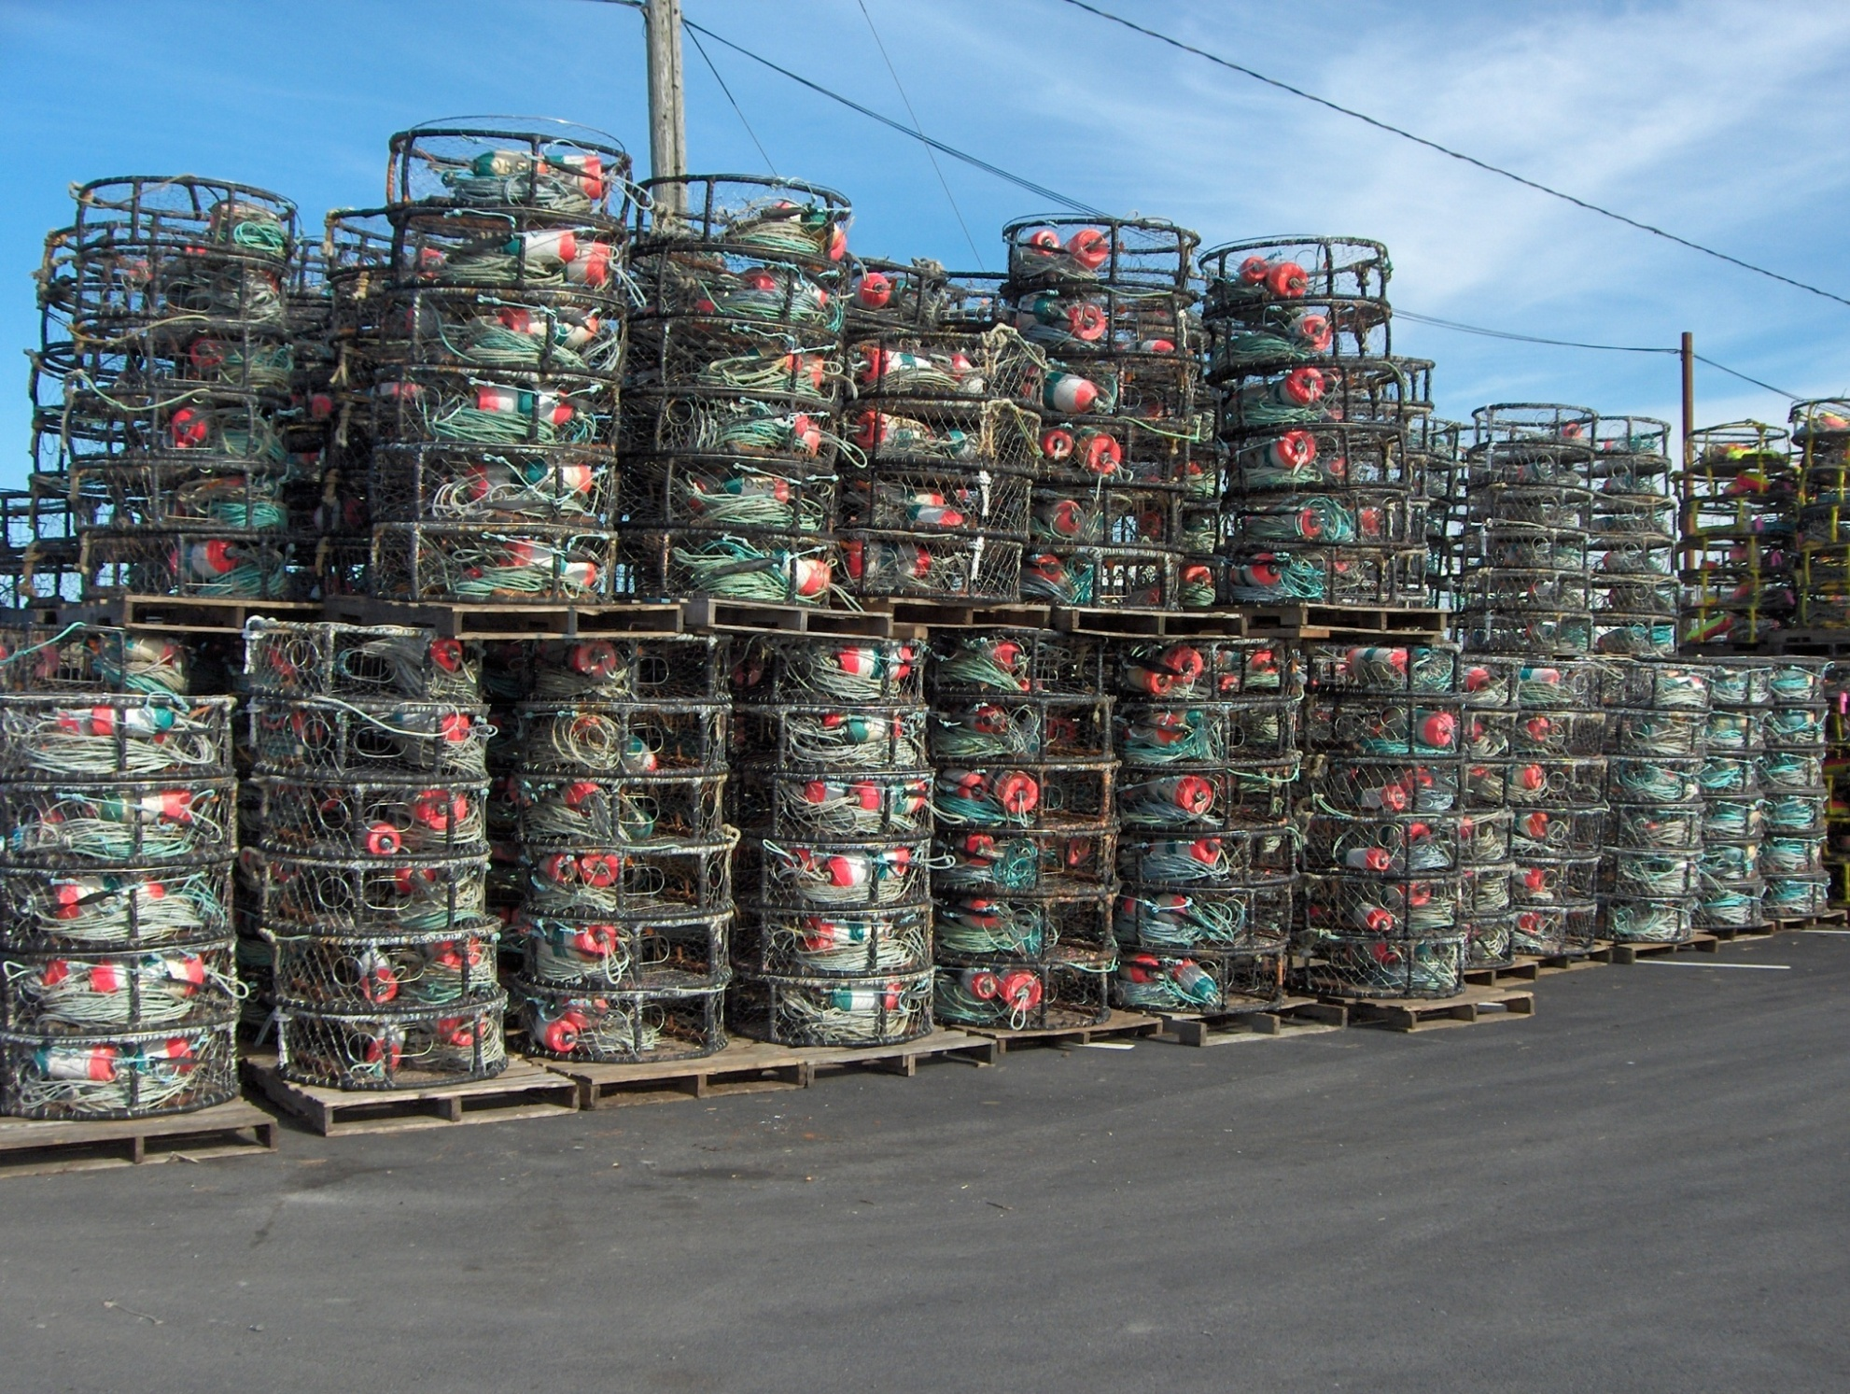
2006 – Pot Limits...
Notes:
Pot limits were implemented in 2006, after much debate within the industry and with ODFW. Pot numbers had grown significantly over the years and many crabbers felt it was time to stop the ever-increasing spiral of more gear. The ‘harvest rate’ hasn’t slowed down since pot limits were put into place, and it appears that the same crabbers who were the top producers prior to P/L’s, still are…

Slide 19
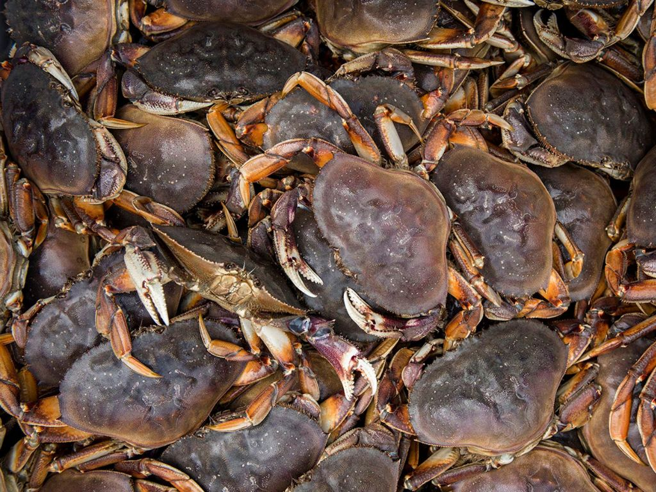
Additional regulations designed to maintain a healthy fishery include…
Summertime trip limit
Season closure date
Notes:
Continue to listen to proposals and fund research to determine if any changes are needed to the current management structure for the good of the resource. Our recent funding of a program to chart whale migrations is one example, as we work to be proactive and reduce the risk of entanglements.

Slide 20
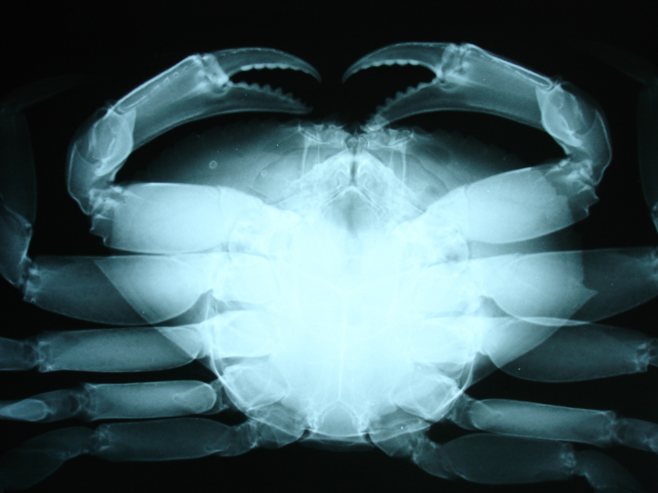
Pre-season Testing...
Notes:
Do we x-ray the crab? No but we do test to see what the shell to meat ratio is before we open the season

Slide 21
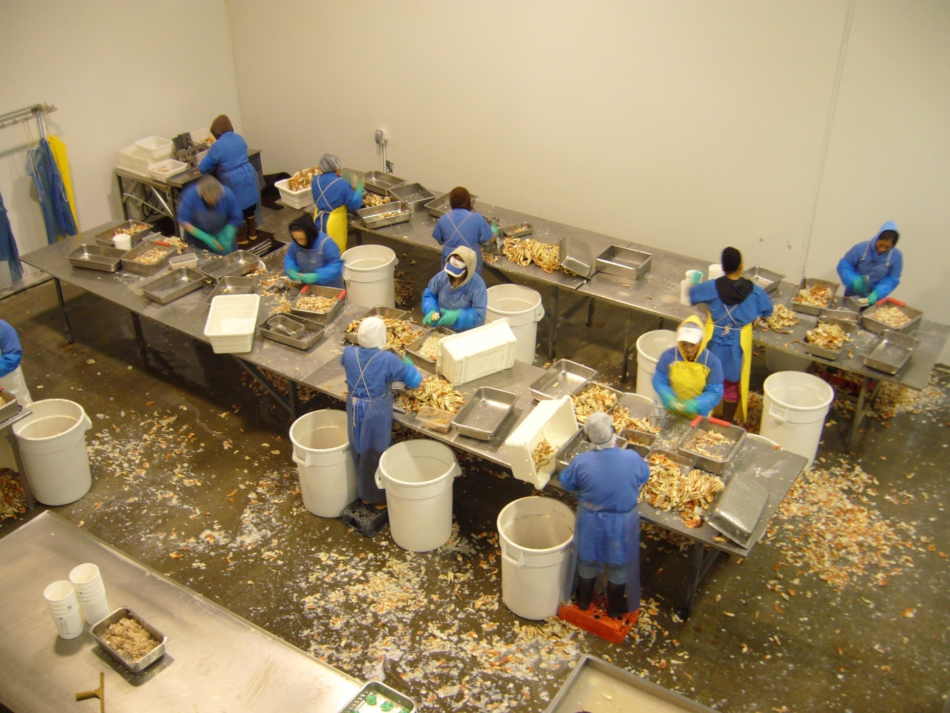
Notes:
Clean, pick and pack the meat to determine if the crab are ready or not for harvest

Slide 22
Keeping control of Oregon’s harvest areas during Harmful Algae Blooms (HAB)
Notes:
As part of that testing, we are also monitoring for levels of domoic acid. Above 30 ppm found in the guts of even one crab can close the area where that crab was found (and the immediate adjacent areas) temporarily, although, new guidelines were added a couple of seasons ago to allow for those areas to remain open if they eviscerate their catch only.

Slide 23
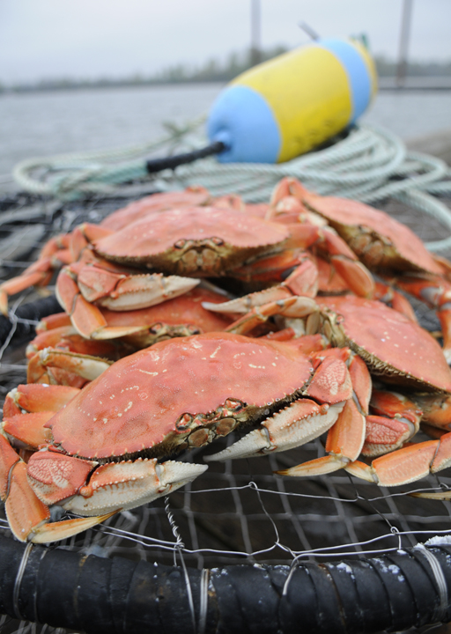
Oregon’s Dungeness Crab fishery is…
Well-managed and sustainable.
Environmentally friendly
w/ minimal impacts.
An important economic driver for coastal communities.
A part of our commercial
fishing & seafood heritage.

Slide 24
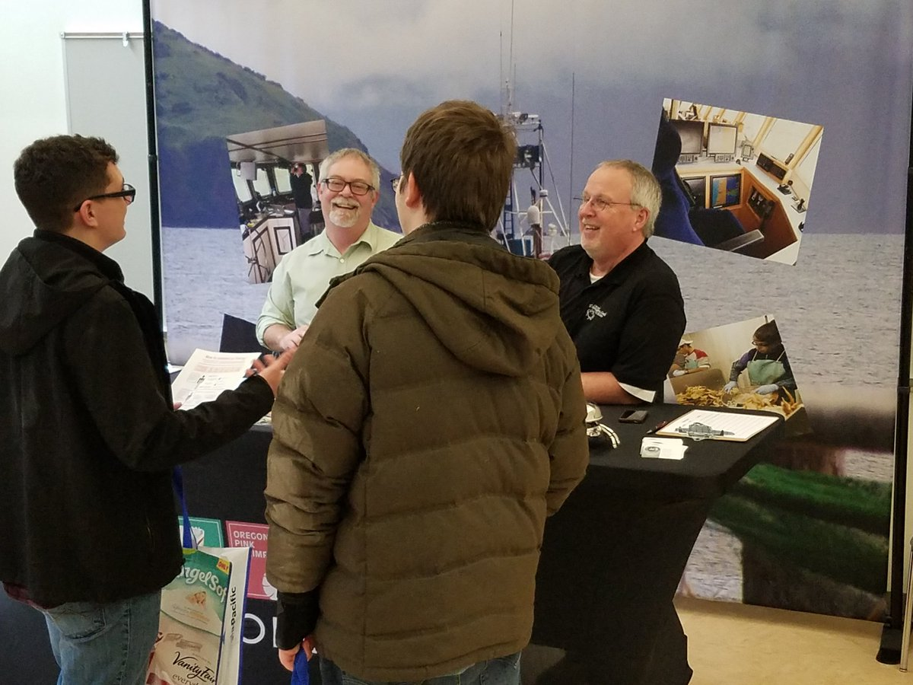
Recruiting the next generation
Notes:
In addition to working to enhance the image of Oregon Dungeness crab, through promotion, education and research, the commission also works to recruit the next generation of workers to either the fishing fleet or the processing industry…by taking part in job fairs.

Slide 25
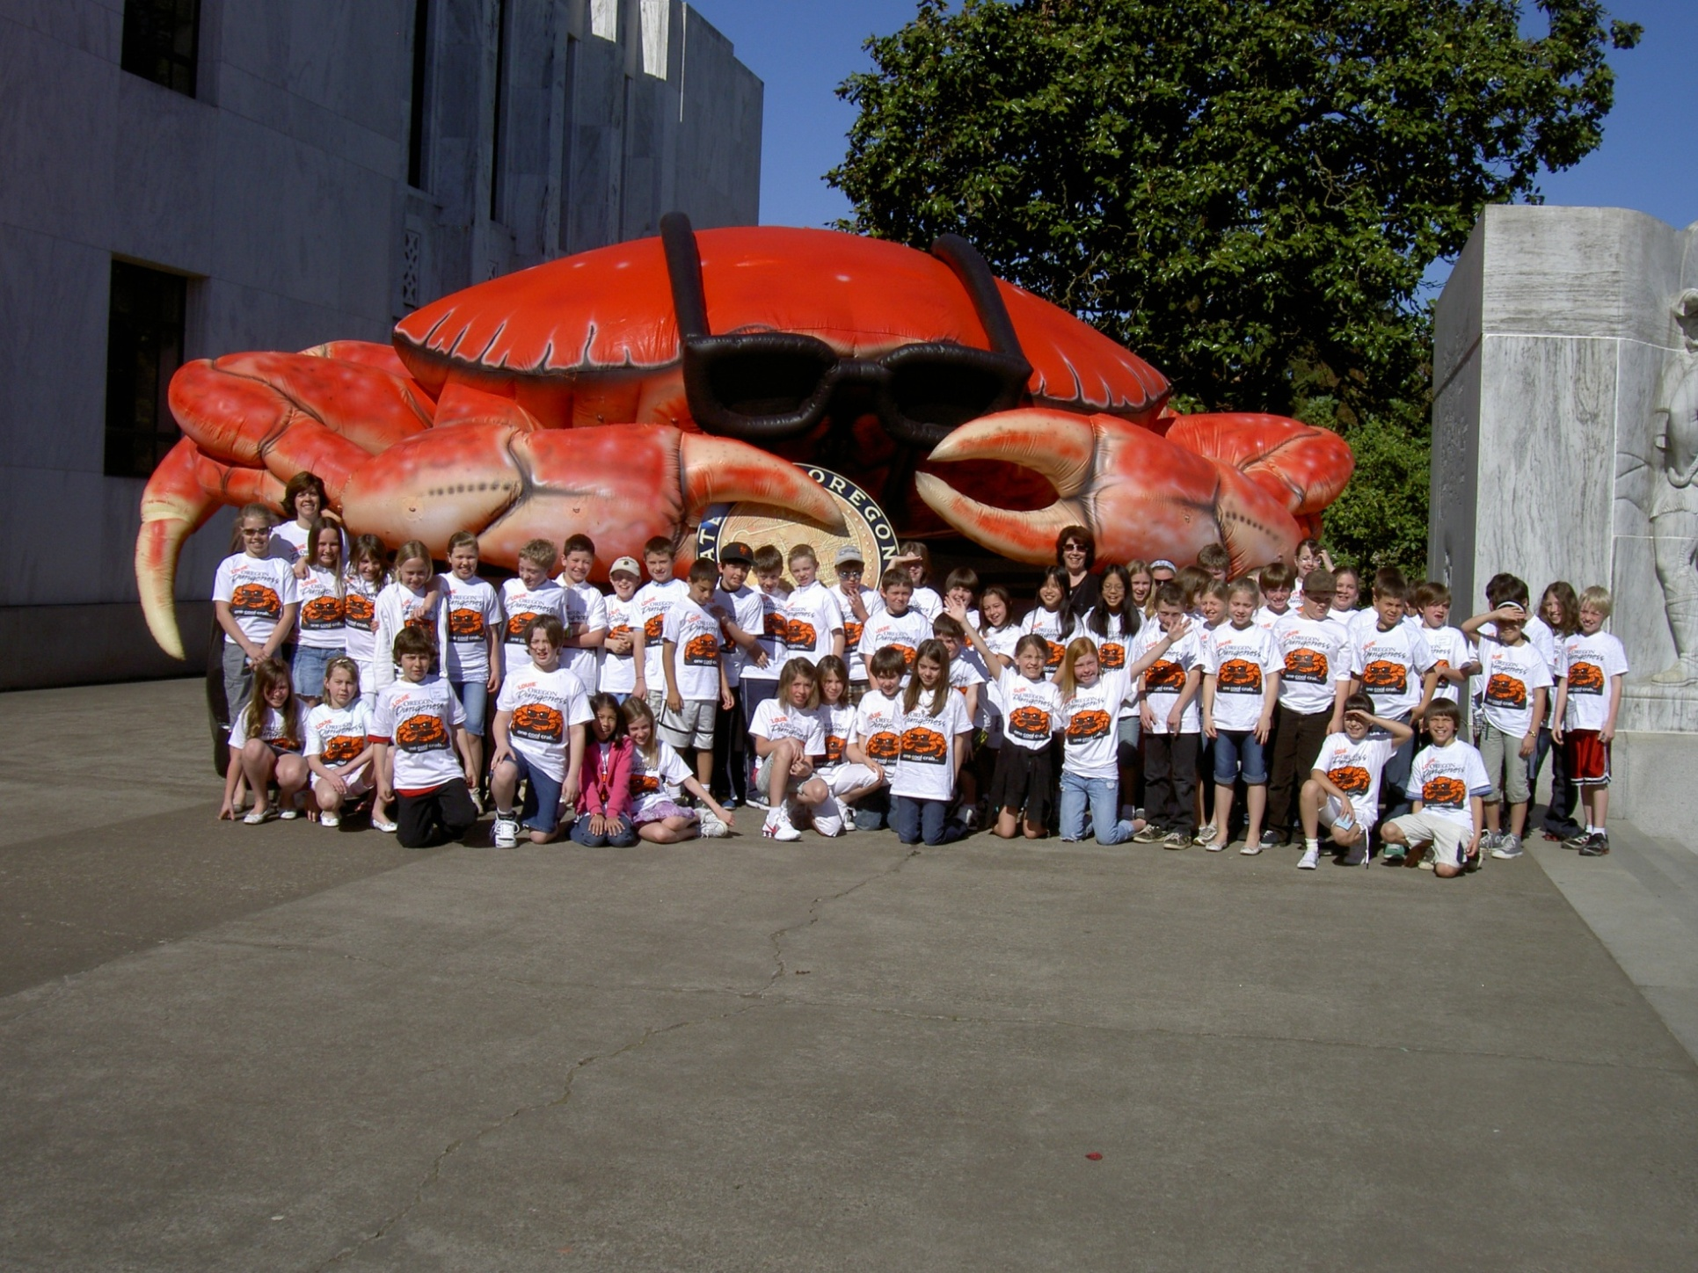
Dungeness Crab – Oregon’s official
“State Crustacean”
Notes:
This is Natalie Bruun and her 4th grade classmates at the state capital in 2009.
With the passage of HJR 37, the Oregon Legislature added Dungeness crab to the state ‘Blue Book’ as the official state crustacean.
The idea came from Natalie Bruun and her 4th grade classmates at Sunset Primary School in West Linn, OR. Turning the project into a biology, culinary, economics, and civics lesson all wrapped up in one, the students petitioned the Legislature to designate a state crustacean after realizing that two other coastal states (Maryland and Louisiana) had duly recognized their famous crustaceans.

Slide 26
Notes:
2024 Taste of Oregon Bites event at the Heathman Hotel in Portland Oregon. Crystal Adams (Executive Director of ODCC) and Leif Benson (Oregon Culinary Ambassador)

Slide 27
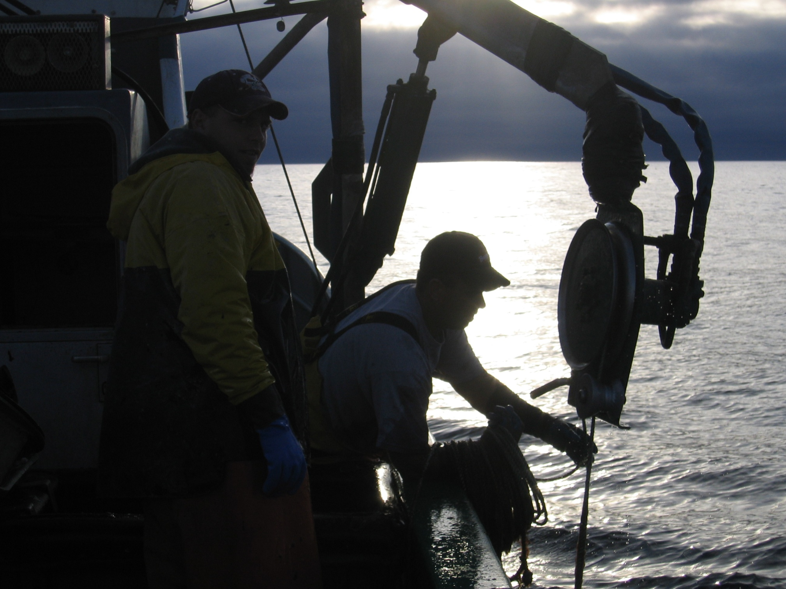
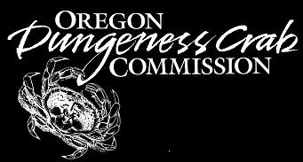
Notes:
Thank you, any questions?

