Slide 1
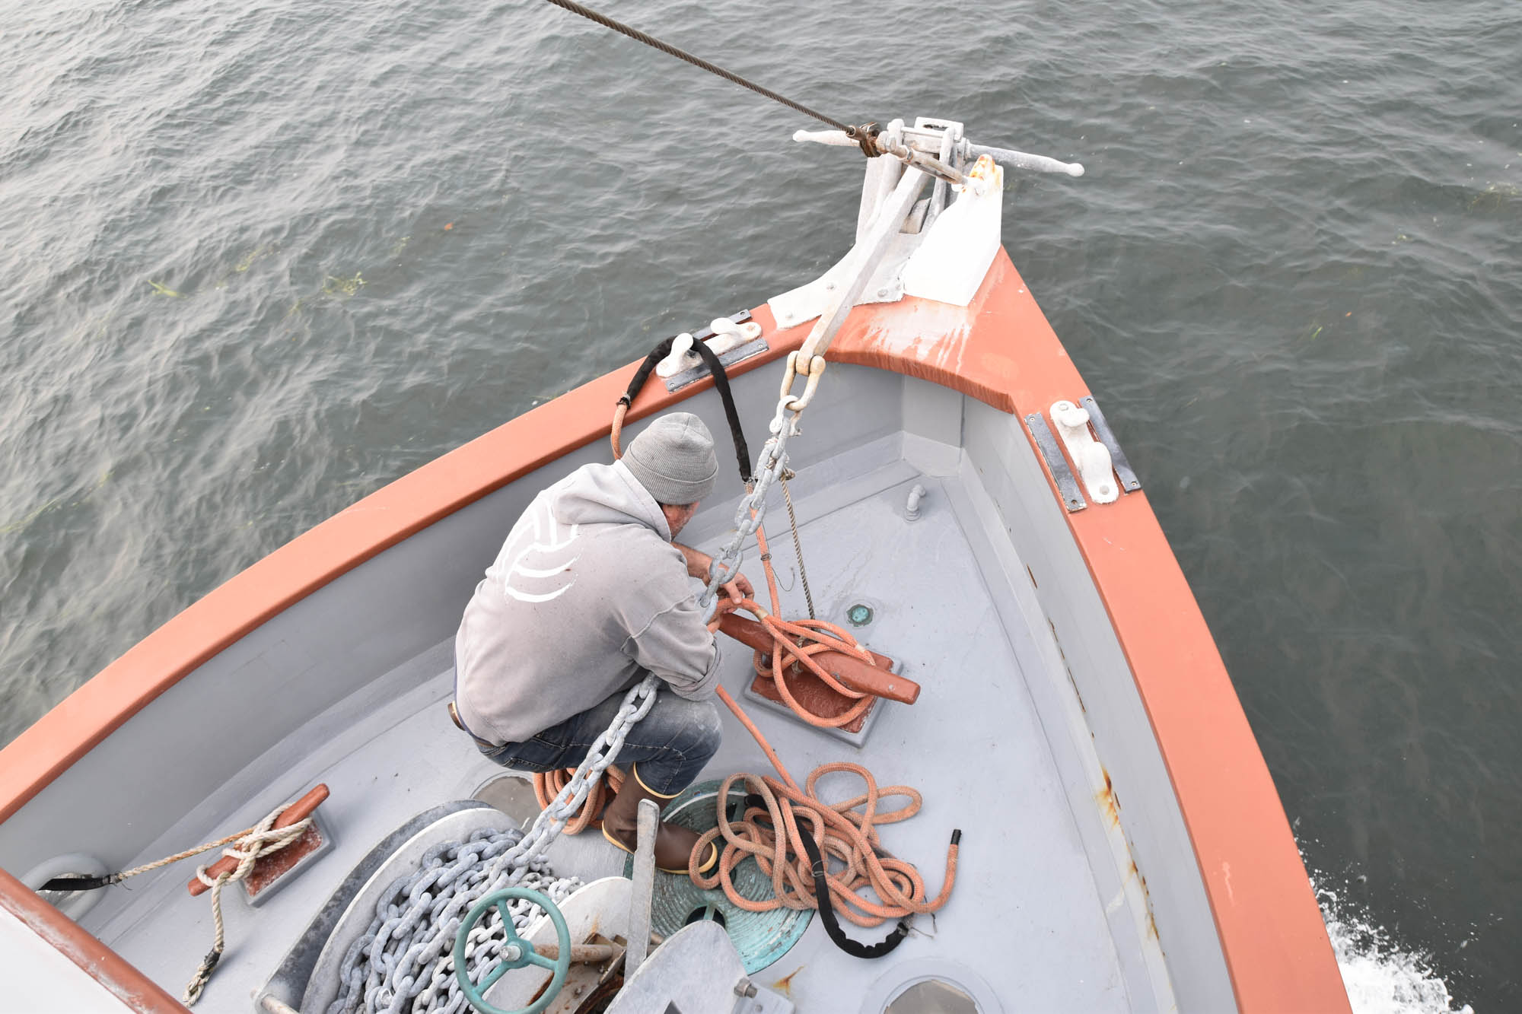
Oregon Albacore Commission
Oregon Salmon Commission
Notes:
F/V Peso II – Rick Goche

Slide 2
Oregon State Commodity Commissions
Industry Funded (.01 x ex-vessel value of albacore landed/.015 ex-vessel value of salmon landed)
Nine Commissioners
Fishermen, Processors/Buyers, Public Member
Education, Research, Communication, Promotion
Notes:
Albacore:Funding comes equally from the harvester (fisherman) and first receiver (buyer/processor).
Harvester pays .005 of the total cash value of raw product, which is withheld by the “First Receiver.”
First Receiver pays .005 of the total cash value of raw product.
Limited Fish Seller pays .01 for all albacore sold “off the boat” under a “Limited Fish Sellers” license.
Salmon: Deducted from the fishermen’s ex-vessel delivery price
Ultimate goal: Serve the commercial fishing industry by supporting and engaging in activities and research programs that benefit the production, harvesting, handling, processing, marketing and use of Oregon Albacore and Salmon and to increase opportunities for profitability. The economic viability of our fleet and processors is key right now with the greying of the fleet and plant closures.

Slide 3
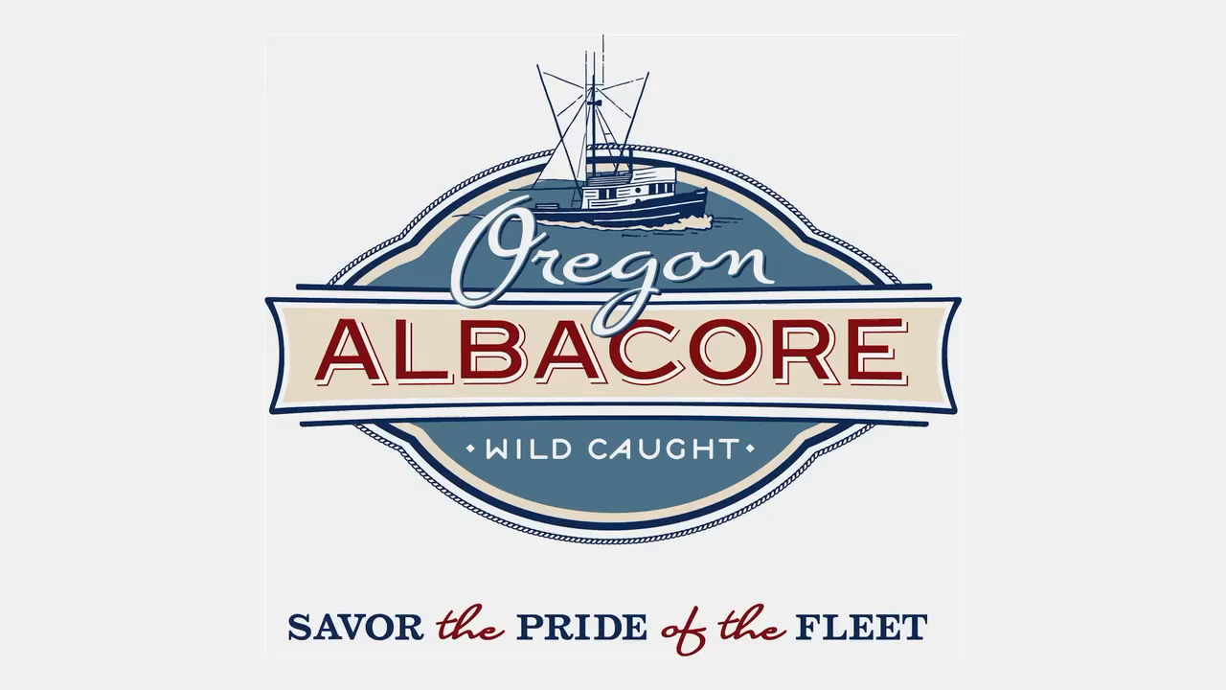
Meet the Fishermen
https://oregonalbacore.org/meet-the-fishermen/
Notes:
The link takes you to the OAC website page with the two videos, The 3-minute version on the left is great to begin a presentation. You can share with your audience that there is a longer 10-minute version they can visit later if they’d like to learn more.

Slide 4
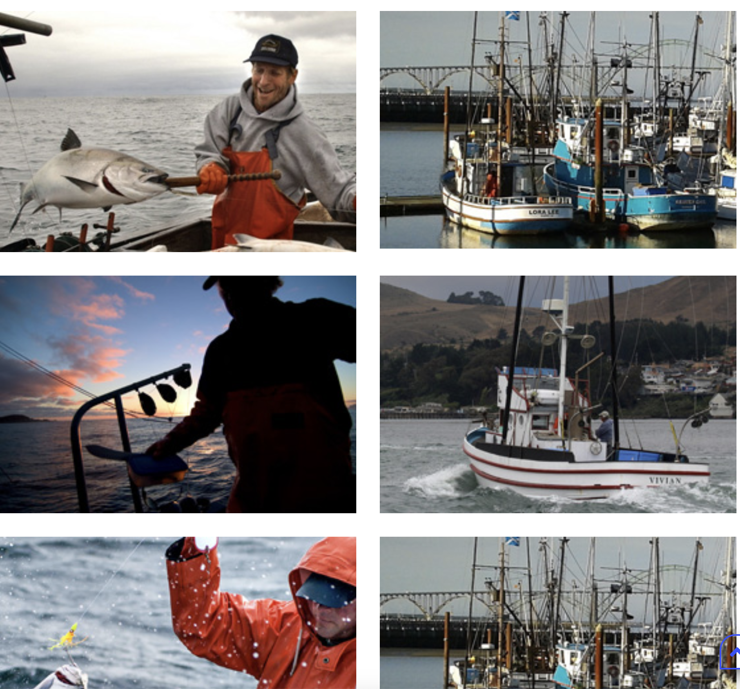

Meet the Fishermen
Notes:
Salmon fishermen at work.

Slide 5
Select Projects
Advertising Campaigns – TV, Radio, Print, Digital, Outdoor, AM NW Cooking Segments, Podcasts
Educational Displays – Oregon Institute of Marine Biology/Charleston, Pacific Maritime Heritage Museum/ Newport
Educational Booklets – Kids activity books, posters, videos, recipes
Scholarships
Research – Oregon State University, OSU Food Innovation Center, ARF
Promotional Videos: 3 and 10 min
Promotional Brochure
Website
Events – Albacore Tuna Cook-Off, International Pinot Noir Celebration, Portland Seafood & Wine Festival, Whole Foods Market Tuna Truck Sale, Newport Aquarium Tuna Day, Boston Seafood Show.
Media/Influencer Tours
The Fleet Is In – Dock sale promotional campaigns
Notes:
A sampling of the research, education, promotional and communications projects the Commissions have conducted with the goal of creating demand in the marketplace for Oregon-caught products.

Slide 6
Albacore/Salmon Fishermen
Independent Business Owners
Coastal Cultural Heritage
Multi-Generational
Notes:
This is a good spot to talk about running your own small business, the challenges and highlights. Also, the fact that many albacore fishermen also fish for other species like salmon or crab.

Slide 7
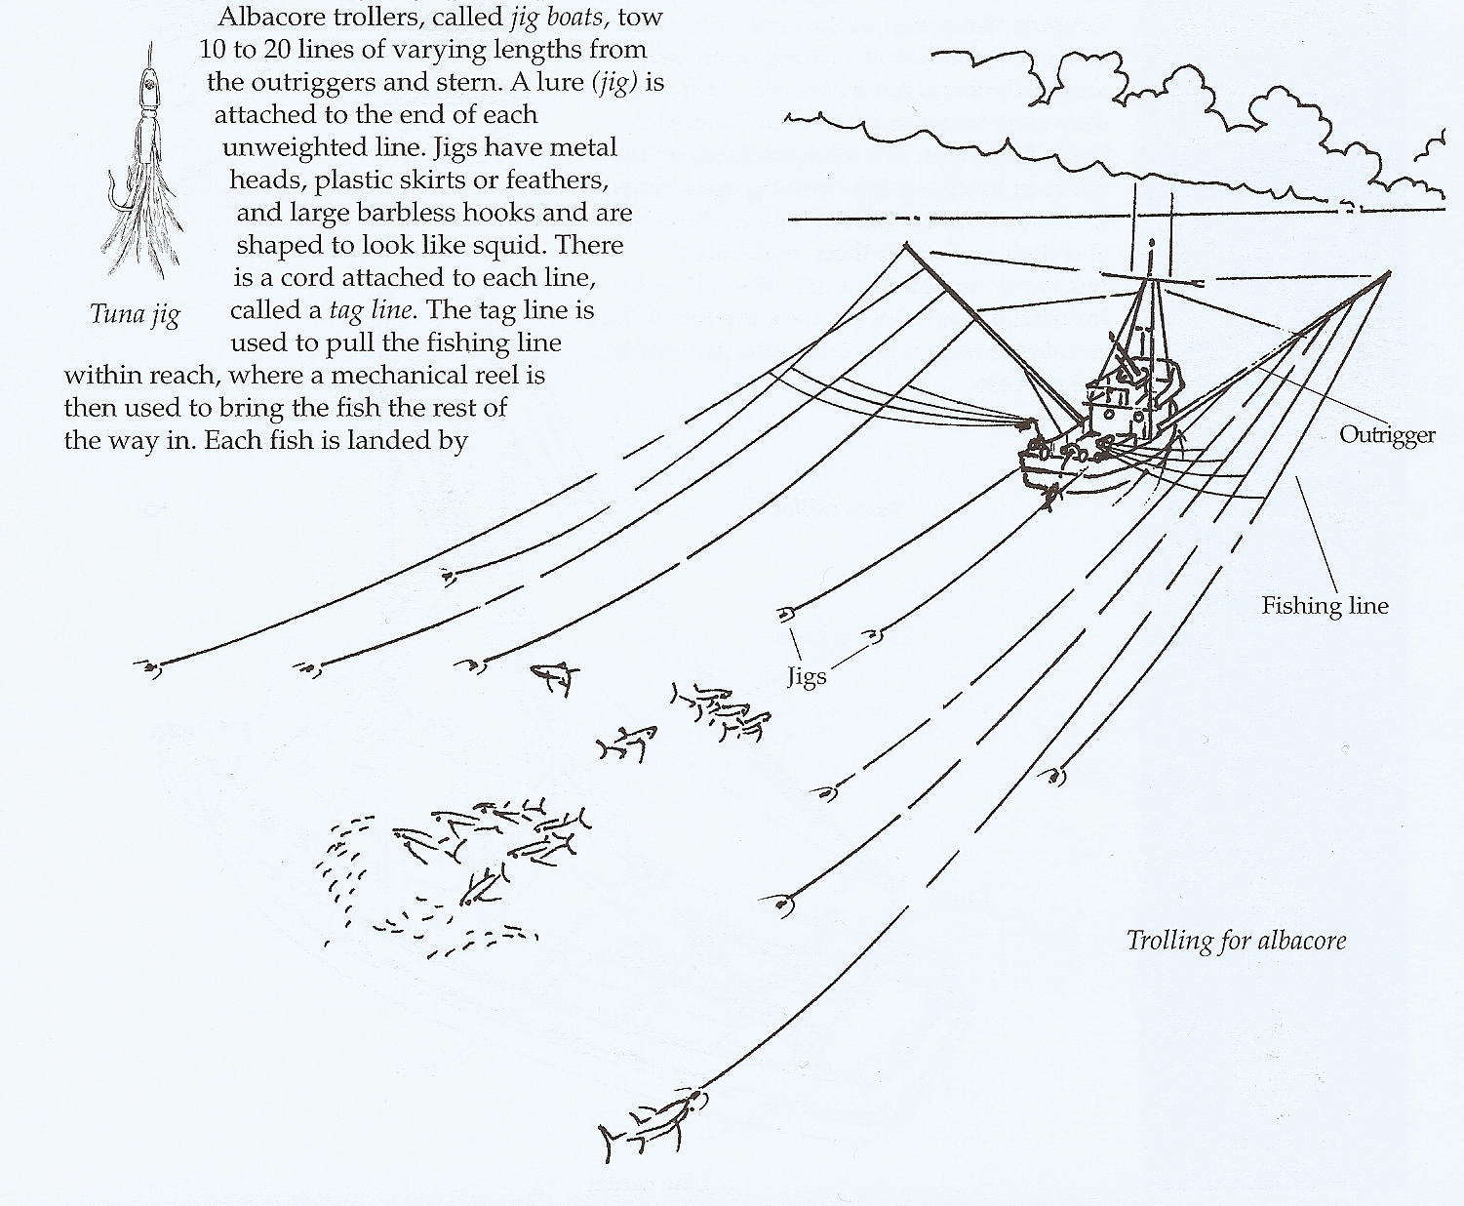
Oregon Albacore
Trolling – hook and line, one-at-a-time
Individually caught and landed.
Iced or frozen at sea
Fleet:
- short-trip boats
- long-range boats

Slide 8
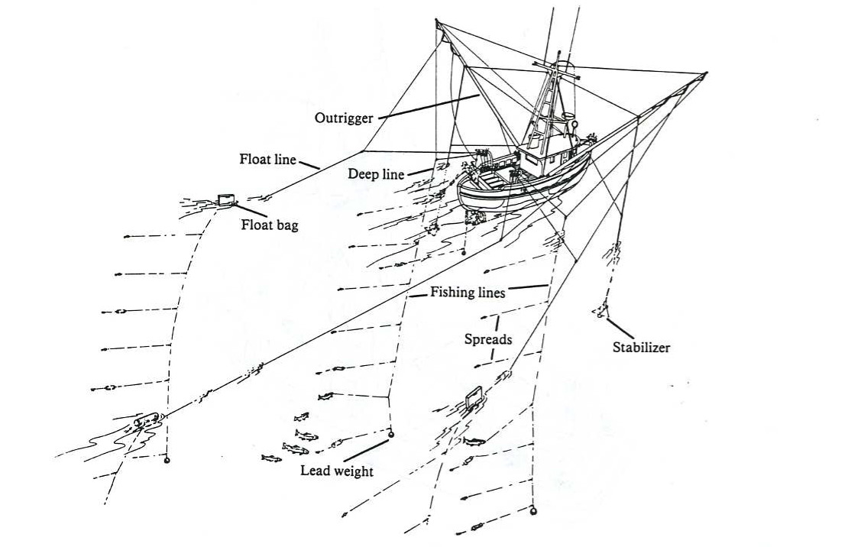
Oregon Salmon
Trolling – hook and line, one-at-a-time
Individually caught and landed.
Iced
Fleet:
- short-trip boats

Slide 9
Historical Facts - Albacore
Fished commercially off Oregon since 1929
Jig boats and bait boats
20-60 ft combination boats
Variable Oregon landings since 1929
  Low of 27,600 lbs in 1936
  High of almost 38 million lbs in 1968
  Last decade averaged 5.71 million lbs/year

Slide 10
Historical Facts - Salmon
Fished commercially off Oregon since 1912
Troll boats
20-60 ft combination boats
Variable Oregon landings since 1925
  High near 4 million lbs in 1925-41
  Lows near 1 million lbs in 1942-50
  By 1957 landings nearly 3.5 million lbs
  Last decade averaged 608,482 lbs/year
Notes:
Source: https://www.dfw.state.or.us/mrp/salmon/#:~:text=OCEAN%20TROLL%20SALMON%20FISHERY,-The%20commercial%20salmon&text=The%20State%20of%20Oregon%20began,fishing%20opportunity%20for%20recreational%20anglers.

Slide 11
Albacore Landings
2024 = 4,975,011 lbs from 223 vessels
2023 = 2,421,167 lbs from 173 vessels
2022 = 6,239,053 lbs from 251 vessels
2021 = 3,214,060 lbs from 192 vessels
In 2024 73% of catch was landed in two major ports in Oregon: Newport and Charleston
Notes:
Commercially caught albacore volume in 2023 is the lowest since 1991 and represents only 37% of the prior ten-year average (2013-2022) of 6.49 million pounds.

Slide 12
Albacore Value
Albacore accounted for 10.9% of Oregon’s marine fish revenue in the 2022 season.
Albacore typically ranks 4th or 5th for total revenues generated in Oregon marine fisheries for an entire year, behind Dungeness Crab, Groundfish, Pacific Whiting and Pink Shrimp.
Albacore value to fishermen (ex-vessel value):
2024 $8,284,586
2023 $3,442,431
2022 $14,250,000
2021 $6,593,384
Notes:
The 10- year ex-vessel value average is $9.56 million.

Slide 13
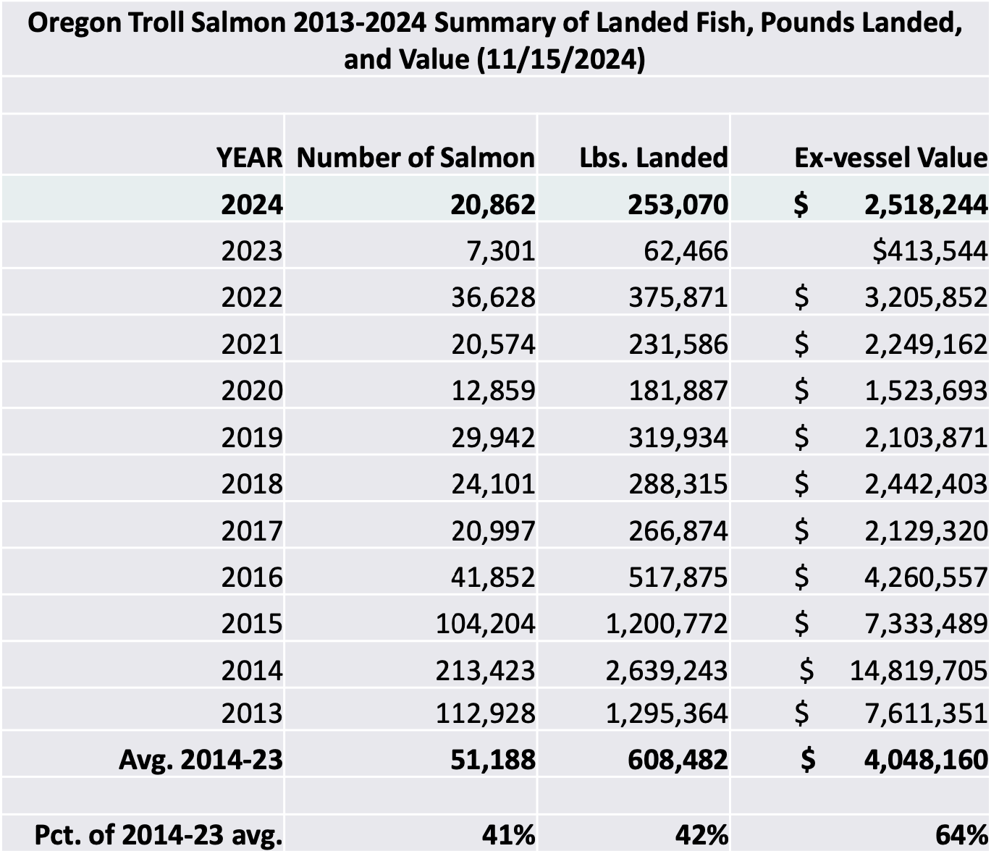
Salmon Landings

Slide 14
Salmon Value
Salmon accounted for 5.8% of Oregon’s marine fish revenue in the 2022 season.
Salmon typically ranks 7th for total revenues generated annually in Oregon marine fisheries behind Dungeness Crab, Groundfish, Pacific Whiting, Pink Shrimp, Albacore and Sablefish.
Notes:
Source: ODFW Oregon Albacore Port Sampling Program 2022 Annual Report Noordman

Slide 15
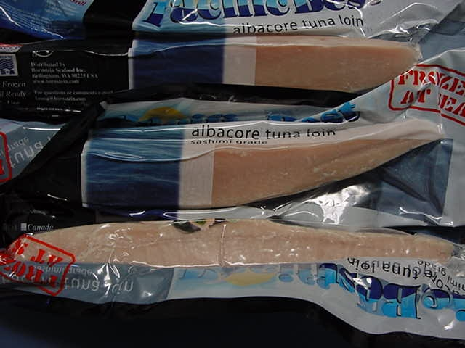
Market Forms
Whole – fresh or frozen off vessels
Albacore loins, steaks or medallions
Salmon fillets
Custom canned
Custom pouches
Value-added

Slide 16
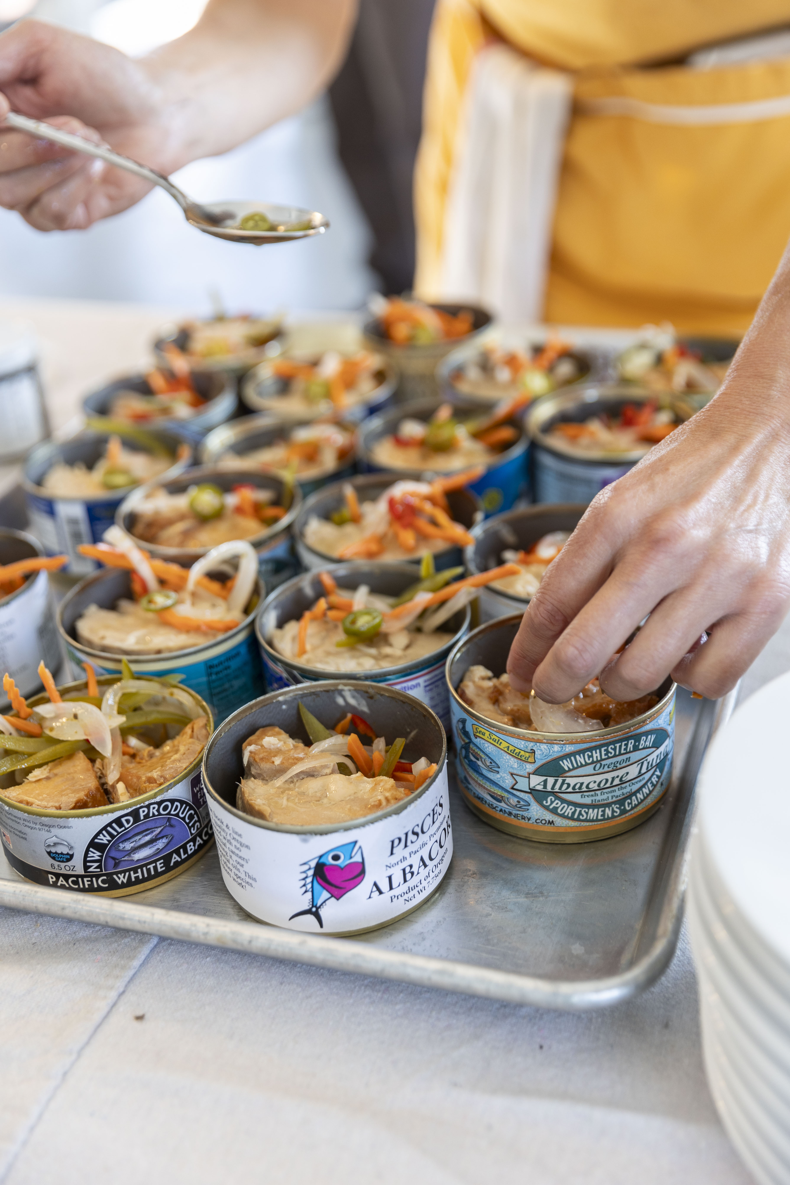
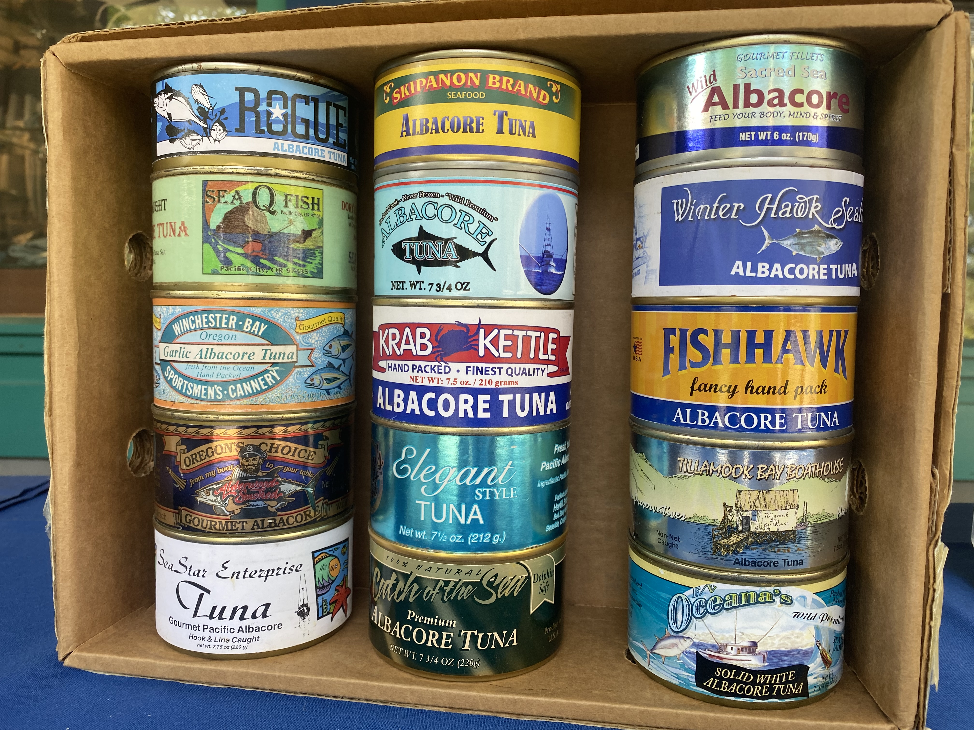
Custom Canned
Notes:
Samples of micro-canned tuna with custom labels for each fisherman/businesses brand. Photo #2 is from an event for writers/influencers where the chef highlighted custom canned albacore.

Slide 17
Key current issues -Salmon
The “Greying of the Fleet” as many current salmon fishermen reach retirement age. New programs are needed to invest in creating economic opportunity for new entrants to the fleet.
Consolidation among buyers/processors reducing market opportunity.
Impacts from fisheries closures on fishermen, fishing families, fisheries support infrastructure and coastal communities.
Timeliness of Federal Disaster support programs
Notes:
Currently waiting on 2018-2020 program disbursement. 2023 also declared a disaster.

Slide 18
Key current issues -Albacore
Promoting seafood as an agricultural product of Oregon
Creating economic opportunity for Oregon-landed products and supporting infrastructure needs
Categorizing fishing crew as agricultural workers
Crew vetting, training and healthcare

Slide 19
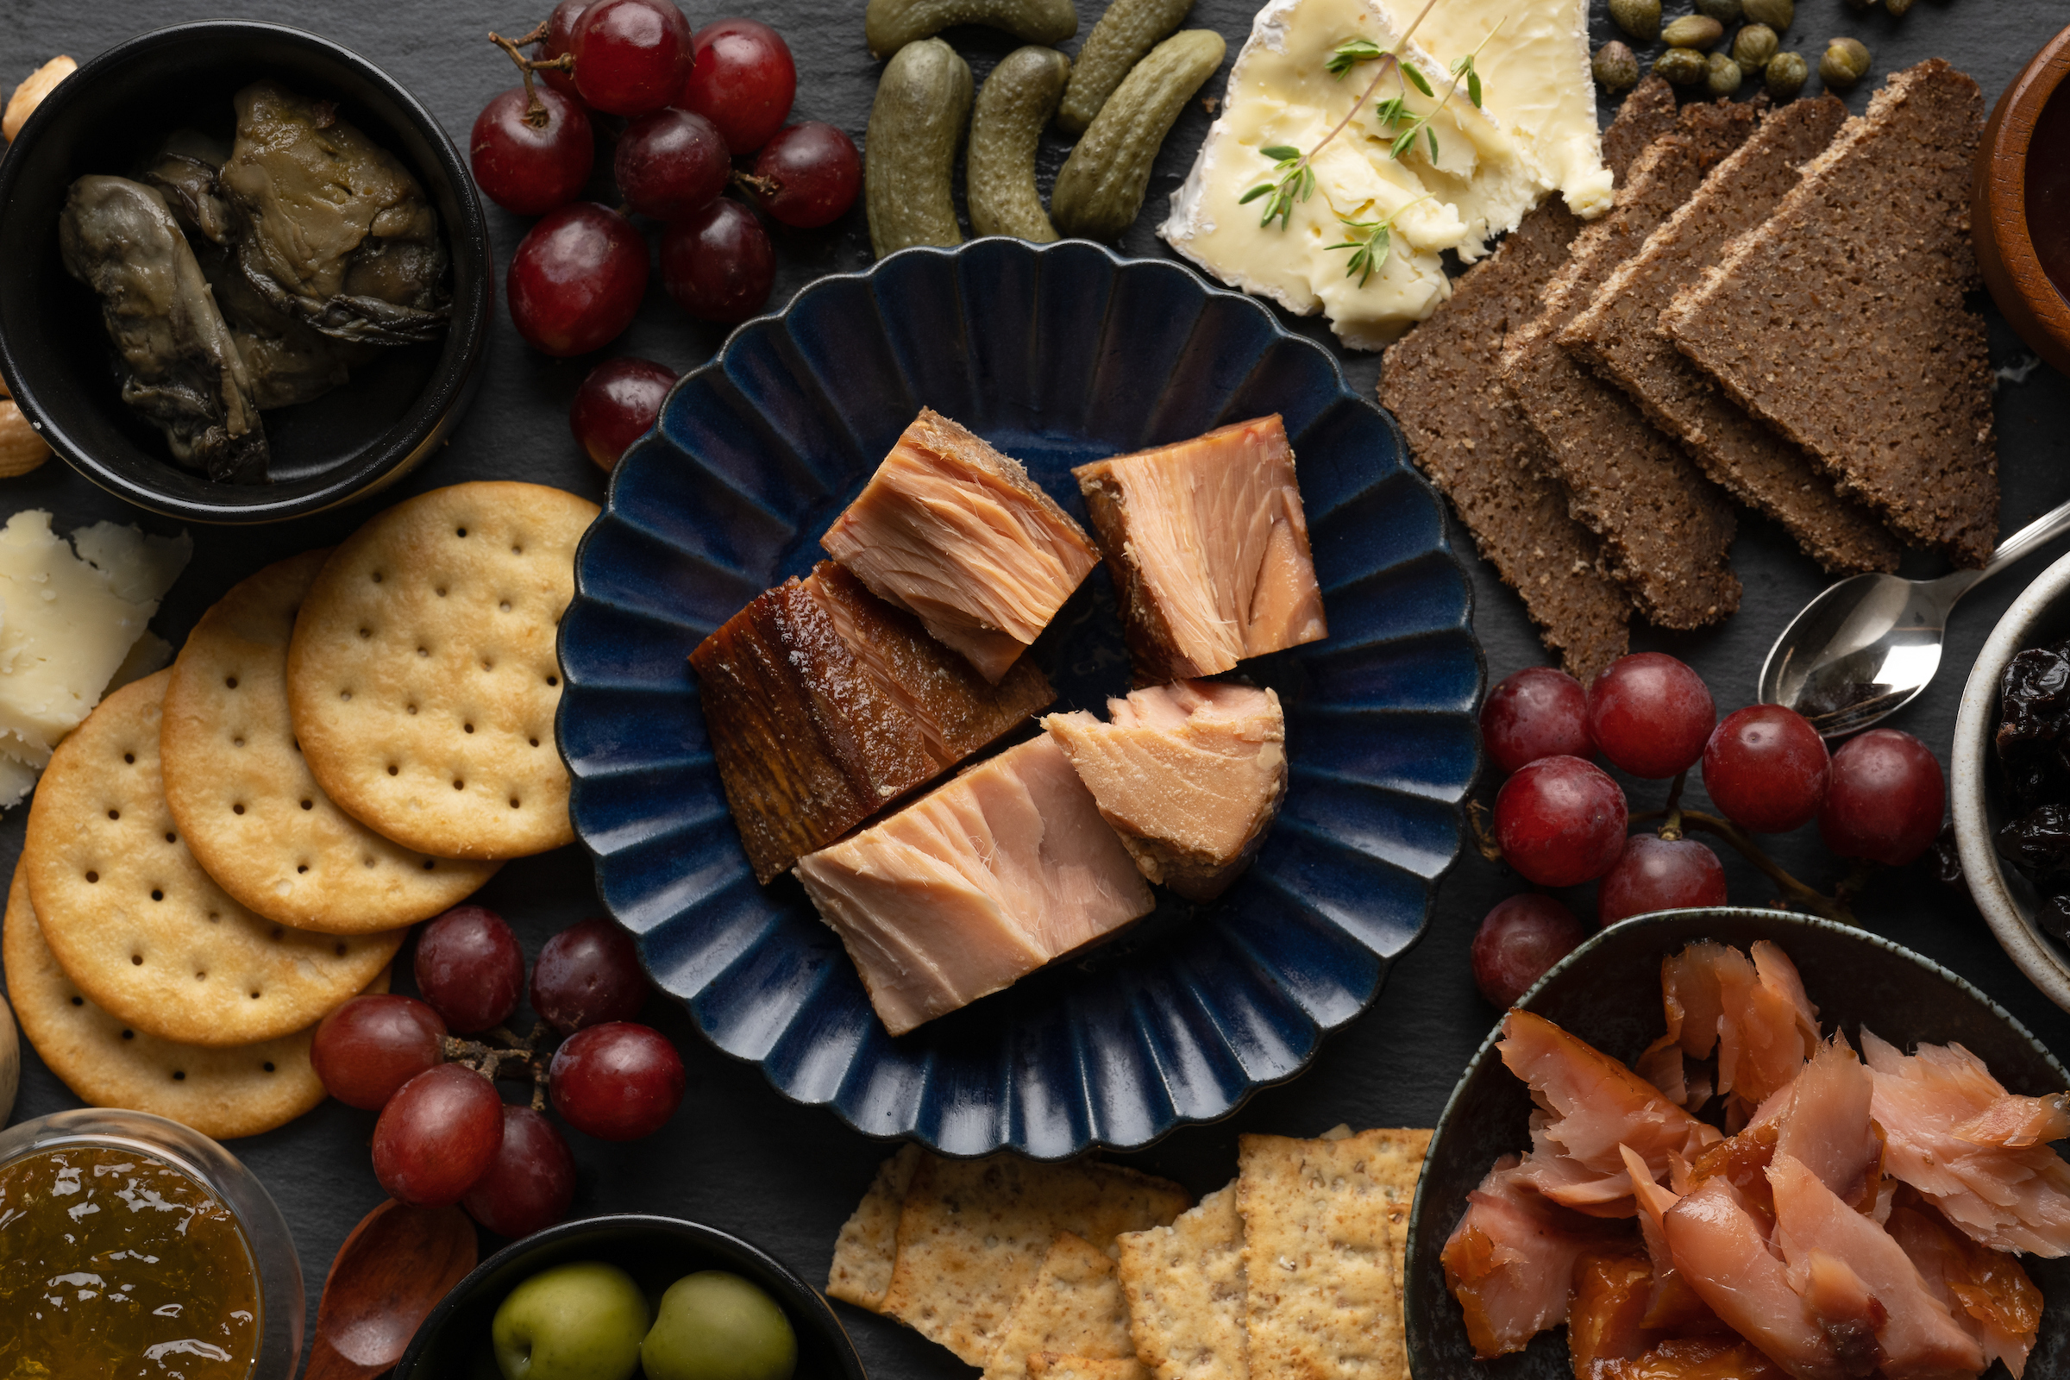
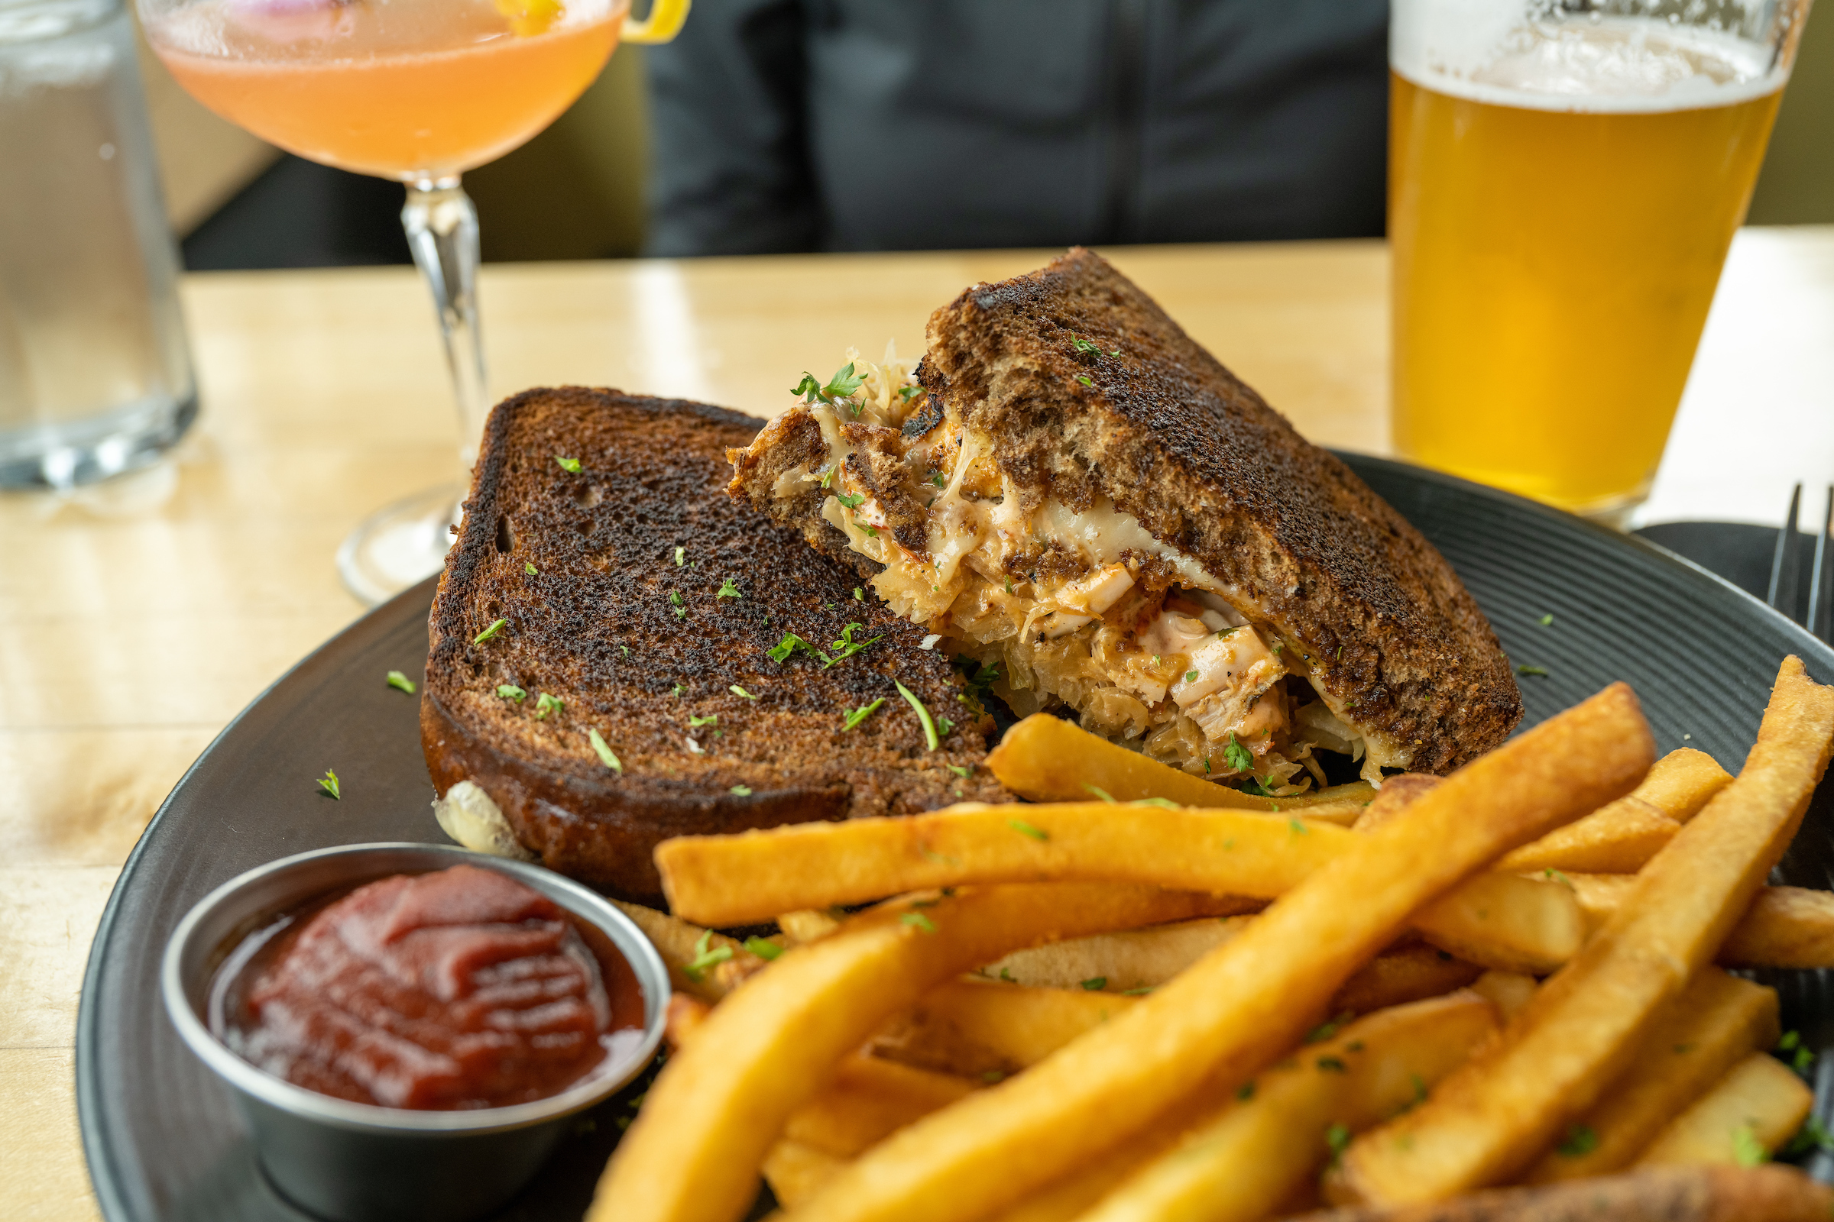
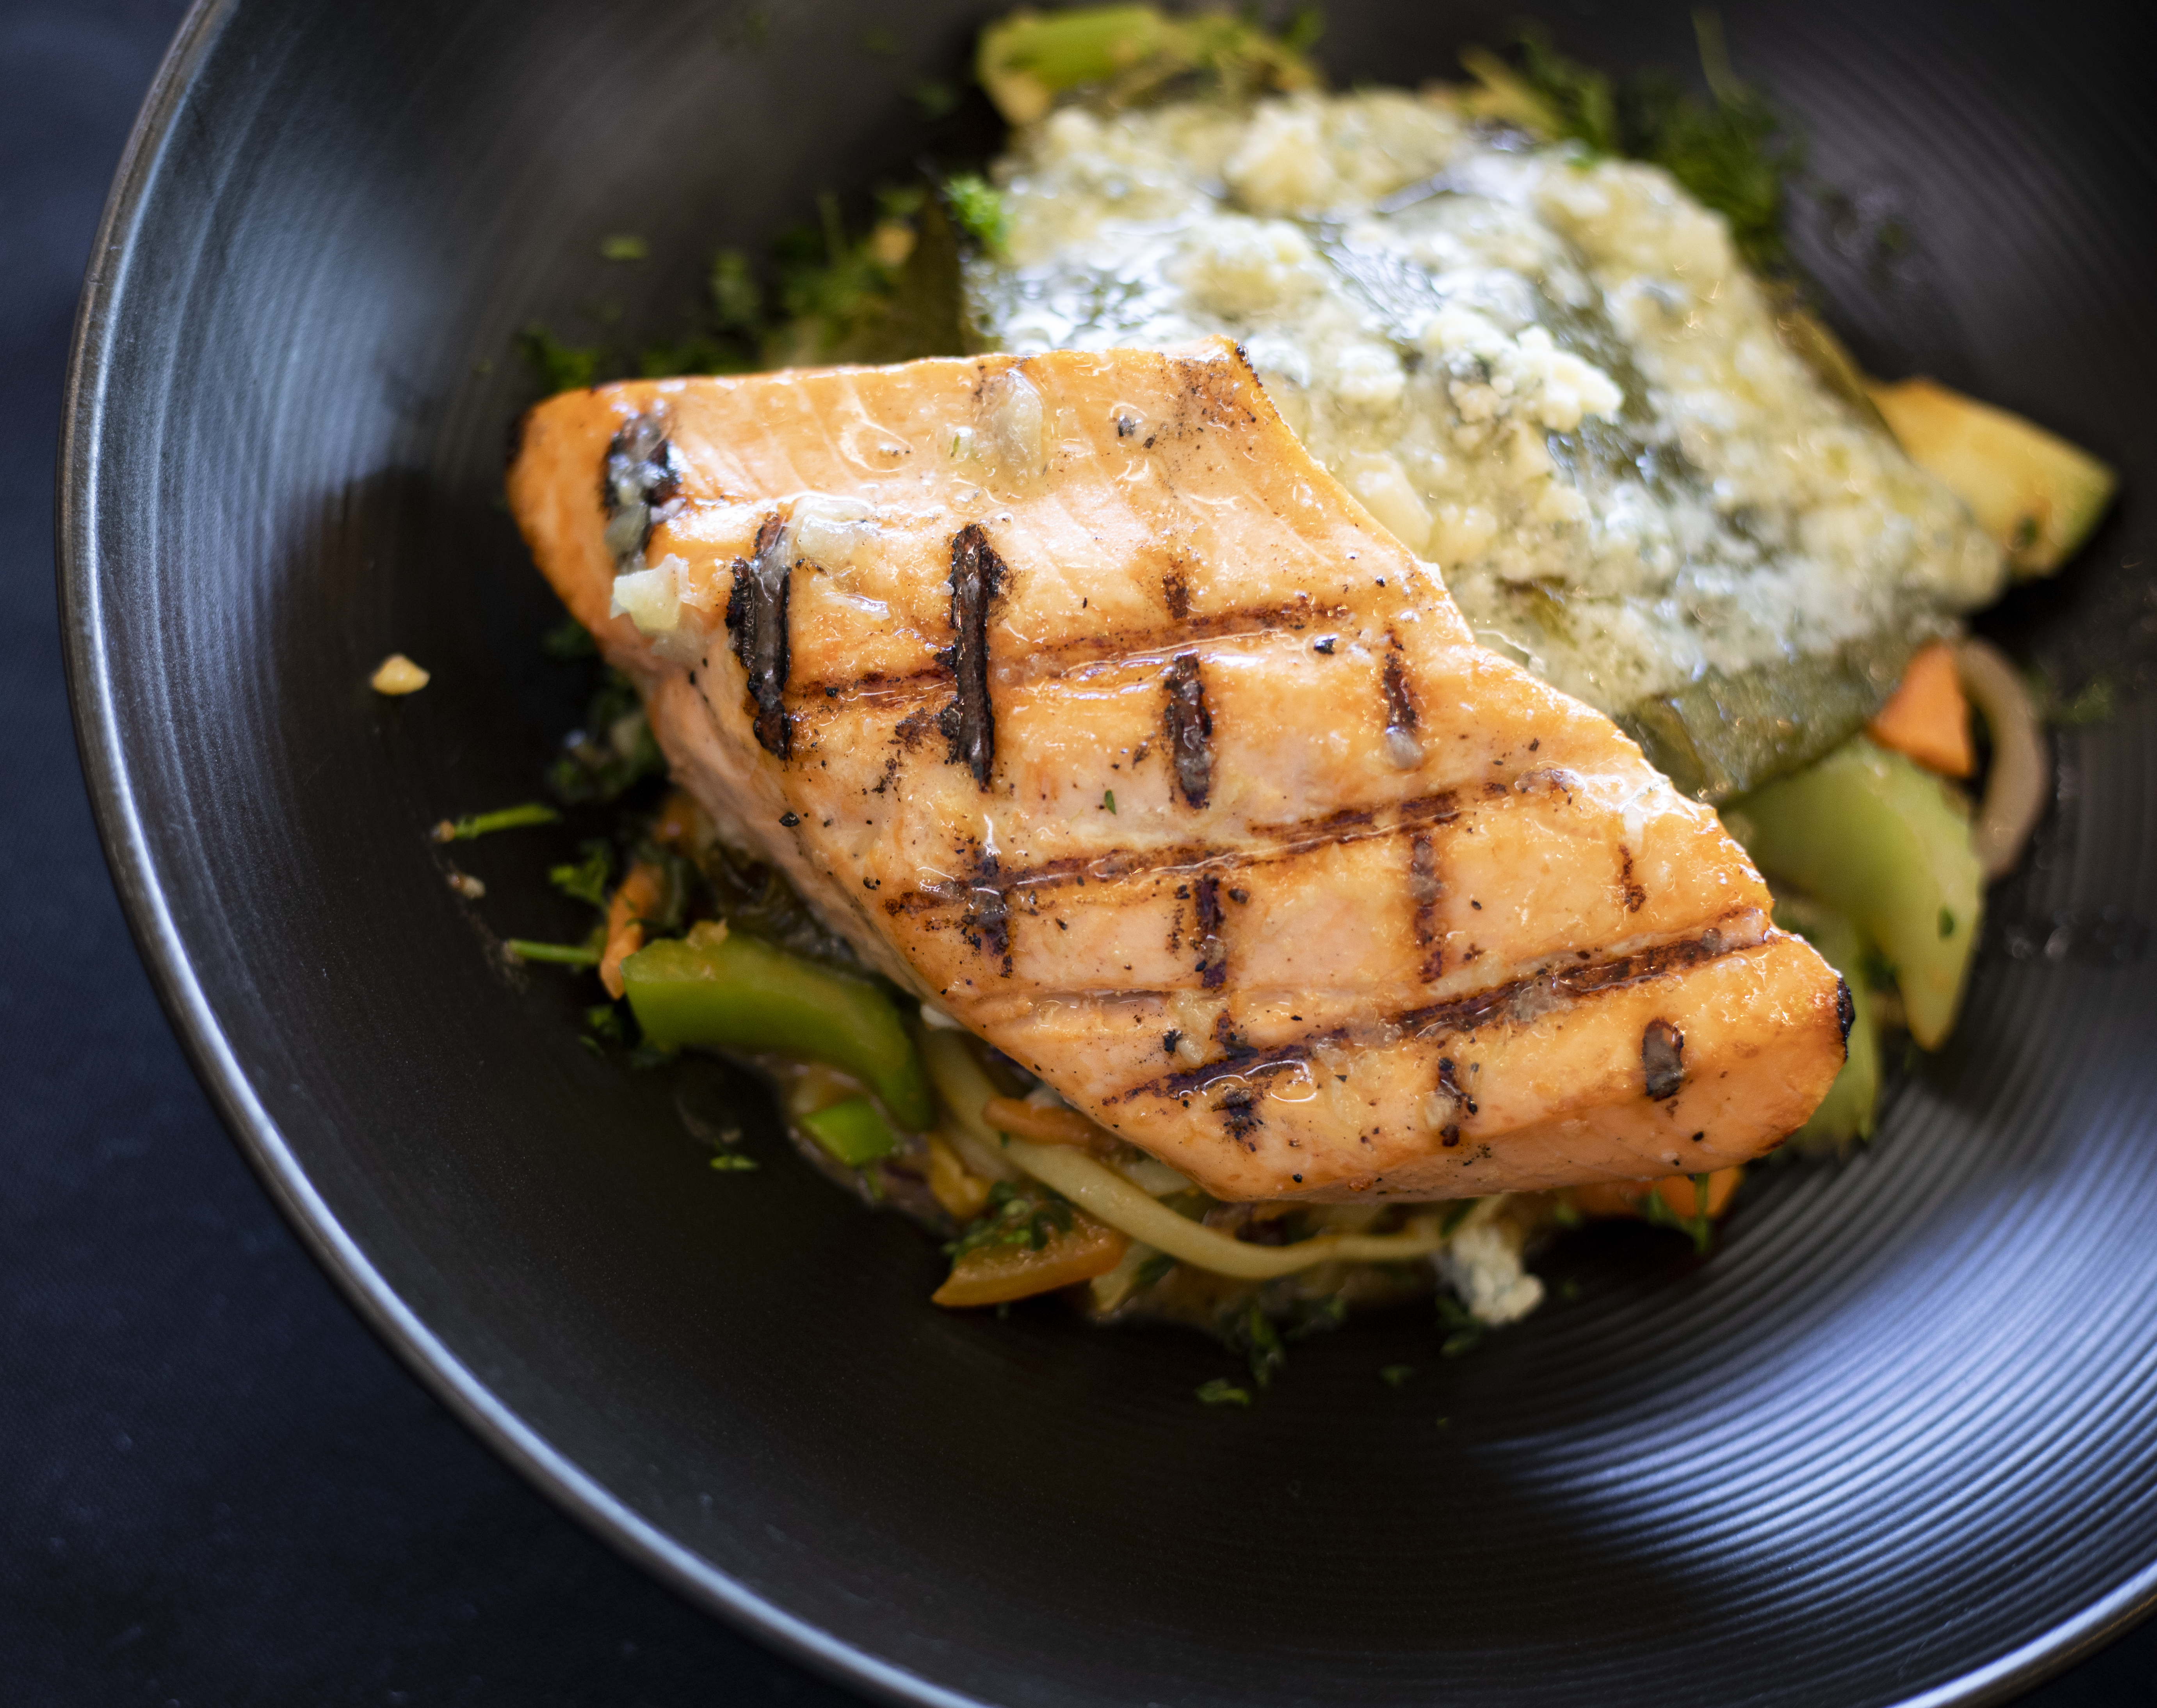
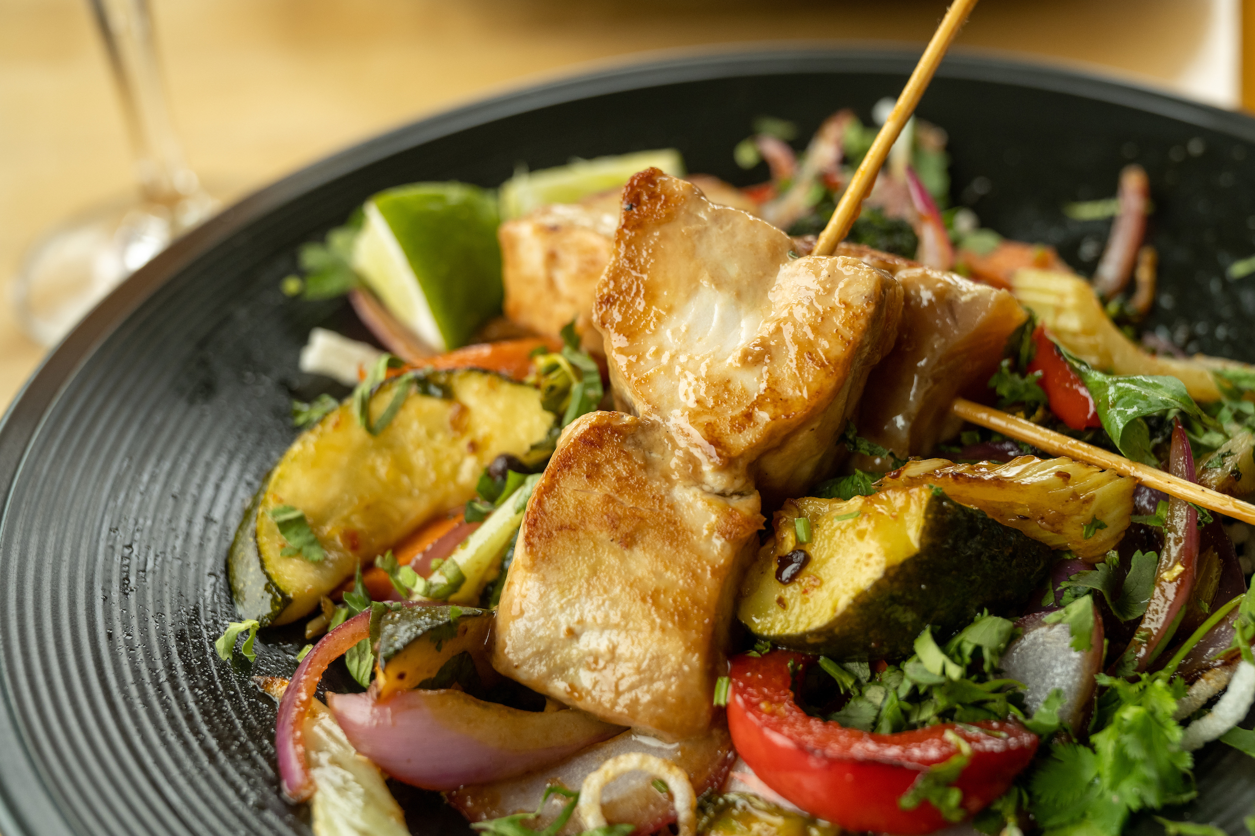
Enjoy!
Notes:
Whether it’s smoked, caned, in a tuna melt, fillet or enjoyed in skewers on a salad, Oregon caught albacore and salmon is delicious.

Slide 20


Join Us!
www.oregonsalmon.org
www.oregonalbacore.org
@OregonAlbacore
Oregon Albacore Commission
Ask for it at your local fish market, grocery store or restaurant to enjoy Oregon Albacore and Oregon Salmon year-round.

