Slide 1
Oregon GIS Framework, Hazards FIT
overview of the fit program
Presented to the state interagency hazard mitigation team (IHMT)
Bob DenOuden, Steve Lucker 1/15/2015

Slide 2
Oregon GIS Framework Program
A program within DAS Geospatial Enterprise Office (GEO)
In existence since 2000
Framework data are fundamental geospatial data elements, typically statewide in extent, considered to be authoritative, and intended to serve the purposes of a broad range of users.
Approximately 250 framework data elements
Framework datasets developed to agreed upon data standards
Sustained through a voluntary collaborative GIS community based effort
Participated in by local, regional, state, tribal, and federal level agencies
For more information go to GIS.OREGON.GOV

Slide 3
Framework Organizational Structure
Organized into 15 data themes
Each theme guided by a multi-agency Framework Implementation Team (FIT) led by a FIT chair
Framework Coordinator manages the program
Framework is under overall governance of the Oregon Geographic Information Council (OGIC)
  OGIC policy support from Oregon GIS Policy Advisory Committee (PAC)
  GIS Program Leads (GPL) is technical advisory group to OGIC

Slide 4
Oregon Framework Themes

Slide 5
How Framework Program Works
Framework Implementation Team (FIT) facilitates collaboration and standards development
FITs draft standards and present them to Oregon GIS community at Framework Forums
OGIC endorses standards once approved by GIS community at a Framework Forum
Framework data made available through the Oregon Spatial Data Library (OSDL), through web services, and elsewhere

Slide 6
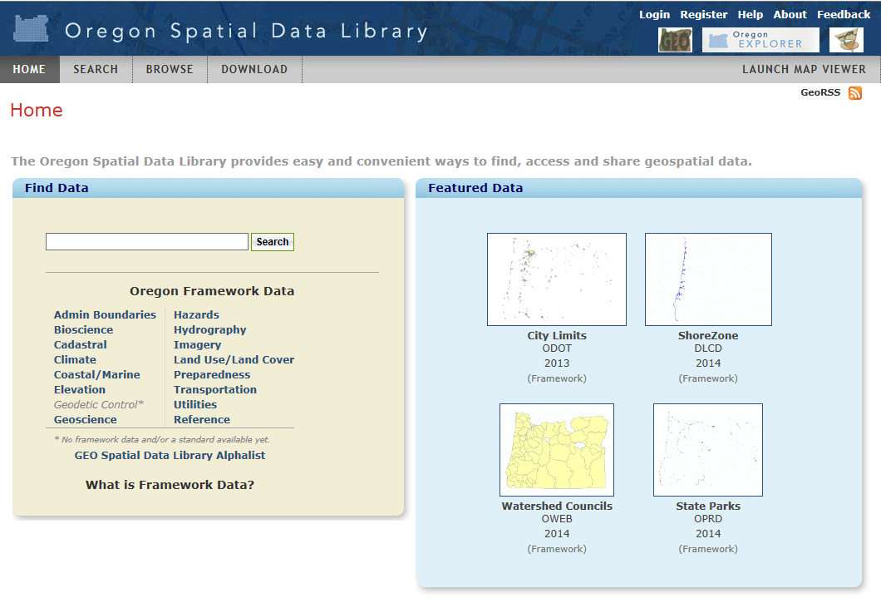
http://spatialdata.oregonexplorer.info

Slide 7
Hazards FIT
FIT chair: Steve Lucker

Slide 8
*New element added 11/2014
Hazards FIT Elements
Hazard Element | Description | Lead?
Abandoned Mine Locations* | Location of abandoned mines, using lidar | DOGAMI
Avalanche zone | Delineates areas at risk for avalanche occurrences | ???
Channel Migration Zone* | State overview study underway | DOGAMI/DLCD
Coastal erosion areas | Areas at risk for erosion; site specific, does not cover entire coast | DOGAMI
Debris flow hazard zone | Areas at risk for debris flow occurrences. | ODF
Drought areas | Delineates areas at risk for drought. | ???
Dust storm occurrence | Locations of dust storms. | ???
Earthquake hazard | Delineates areas at risk for earthquakes for many OR communities. Maps combine effects of ground shaking, amplification, liquefaction, and earthquake-induced landslides to show earthquake hazards relative to local geologic conditions. | DOGAMI/USGS
Fire | Wildland/urban interface boundary | ODF
Flood zones | Areas at risk for flood occurrence at certain probability intervals - FEMA | DOGAMI/DLCD
Landslide zones | Areas at risk for all kinds of landslides | DOGAMI
Naturally Occurring Hazardous Materials* | 16 hazardous materials that naturally exist in various parts of OR, including asbestos, erionite, arsenic, radon, etc. | DOGAMI
Tsunami inundation zone(s) | -Areas at risk for impacts from tsunami occurrences. (S.B. 379 line). -Cascadia Subduction Zone (CSZ) tsunami. | DOGAMI
Volcano | Delineates areas at risk for impacts from volcanic eruptions. | DOGAMI
Windstorm | Delineates areas at risk for windstorm occurrence. | ???
Winter Storm | Delineates areas at risk for winter storm occurrence. | ???

Slide 9
Hazards FIT
Work to do (Guided by Work Plan?)
Establish a single point of access to reliable data and information about natural hazards; webservice as well as GIS data, where appropriate
A regular inventory and assessment of existing hazard data
Potential for standards for Hazards data web viewers? Currently the data they reference may not be consistent. Ensure accessing the correct framework data sets.
Guidance and access to funding to improve state and local hazard data (promoter of new data needs including new hazards)
Hazards FIT should evolve in a way that makes the customer of the data more important than in the past. In other words, its not just about the data, but also the Users. Can we identify ways FIT data can be “packaged” that meet primary User needs?
  -The needs of the consumers of data are being met by the producers of the data-
Include an inventory of “Secondary Data?” This is hazards data produced outside the Hazards FIT (i.e. Community-sponsored study, products from a grant, etc.) but may be either “better” than FIT data or the only data existing. While not formally endorsing the data the FIT may want to at least document it.
??? State IHMT and Hazards FIT should be a two-way street, e.g., the State IHMT should be informing the Hazards FIT about the data it needs ???

