Slide 1

DOR Tax Professional Liaison Meeting
July 25, 2025
Hosted by: Daron Prara

Slide 2



Presenters
Jason McKay
Jennifer Rux
Kadie Clark
Robert Oakes
Daron Prara
Oregon Residency
Payment Center
Personal Tax and Compliance

Slide 3
Agenda
Welcome!
New Accessiblity Requirements – Robert Oakes
•Payment Center – Jennifer Rux
Residency & Nonresident Taxation in Oregon – Jason McKay
OR-W-4 Instruction Changes – Kadie Clark
Stakeholder Outreach – Robert Oakes
Federal Tax Changes – Robert Oakes
Oregon Legislative Updates – Daron Prara

Slide 4

New Accessibility Rule
No .pdf handouts
Mobile Apps
Web Content Accessibility Guidelines (WCAG)

Slide 5

WCAG Standards
Technical Standards
Digital access for people with disabilities
DOR website and online services must comply by April 2026

Slide 6
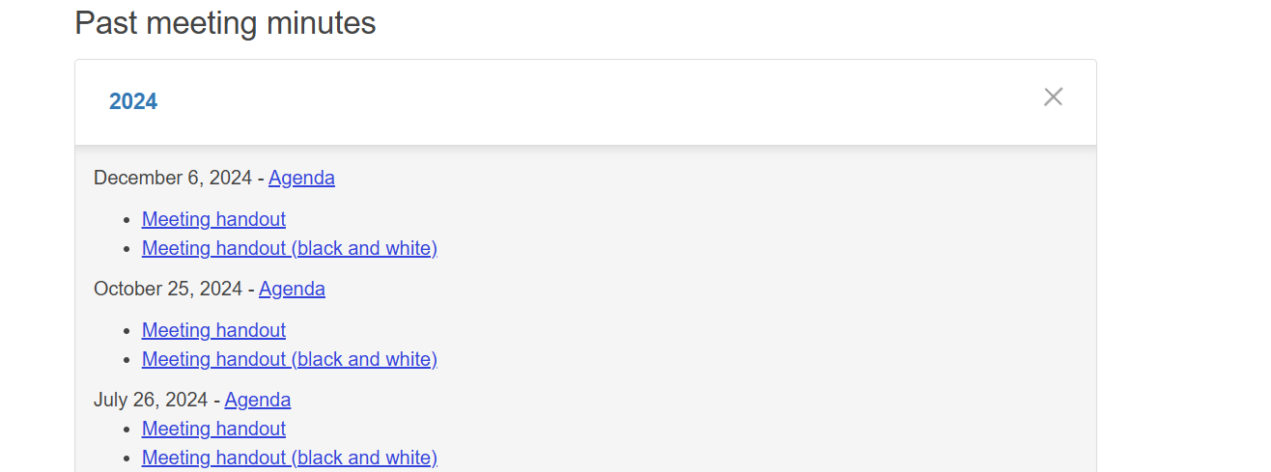
Tax Pro Liaison Web page

Slide 7
Tax Pro Liaison Meetings - Changes
No .pdf handout files
PowerPoints Slides will be posted
Print if needed

Slide 8
Questions?
TaxProfessional.Meeting@dor.oregon.gov.

Slide 9
Salem Payment Center
Jennifer Rux – Revenue Supervisor
Program Services Section

Slide 10
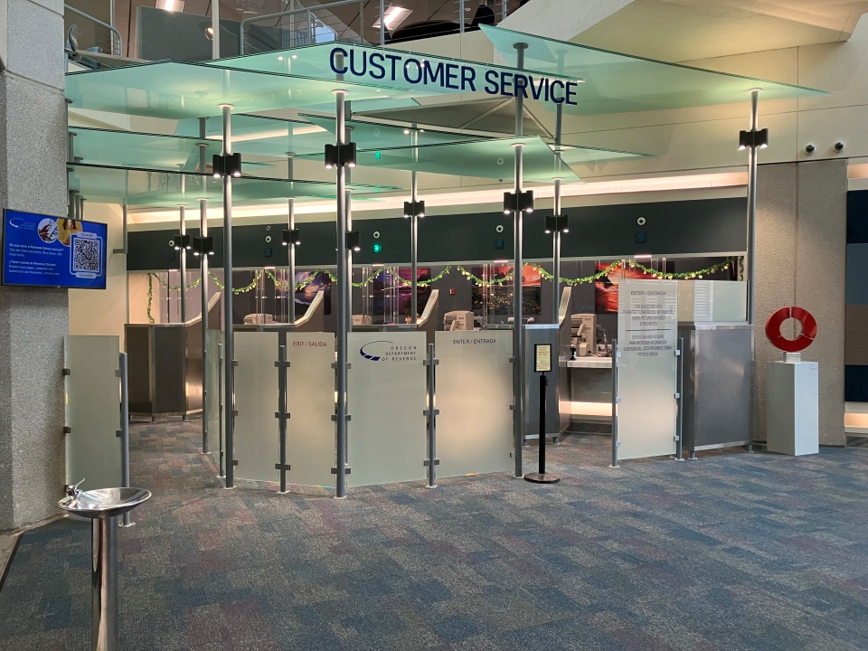
New Salem Payment Center

Slide 11
Salem Payment Center remodel
Better Serve Customers
Start December 2024
Complete February 2025

Slide 12
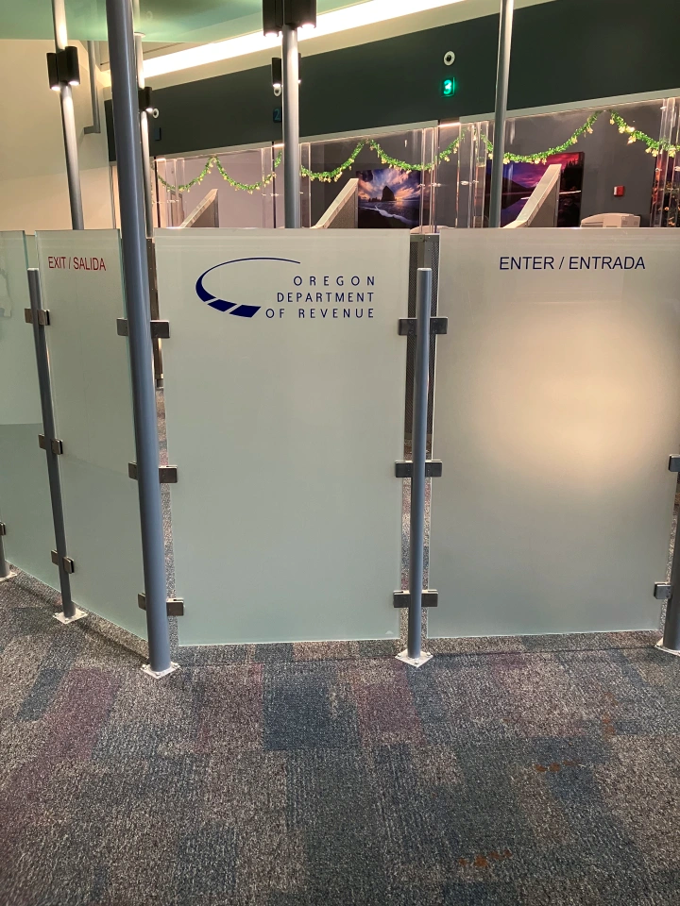
Salem Payment Center Layout
Glass panels improve traffic flow
Enter right, exit left
“Customer Service” logo
Spanish added

Slide 13
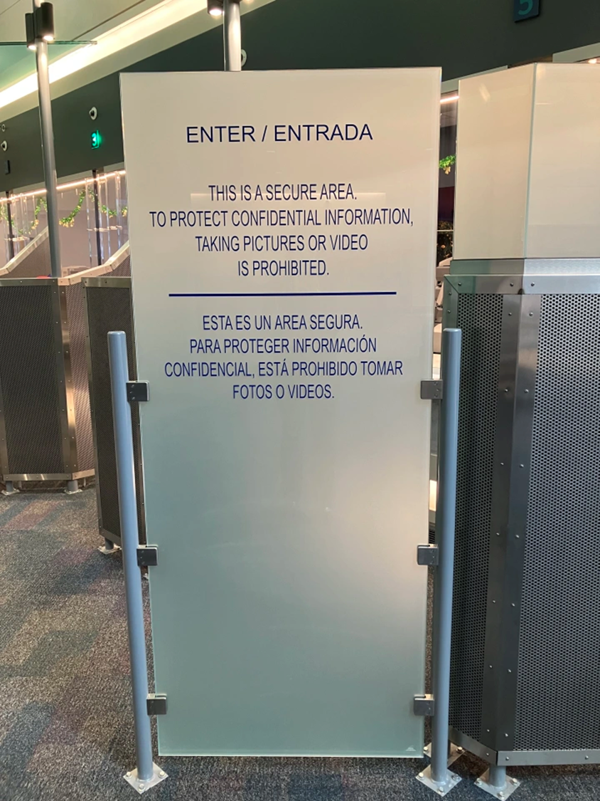
Salem Payment Center Information
No video or photography
Clearly displayed
Protect Federal Taxpayer Information (FTI)

Slide 14
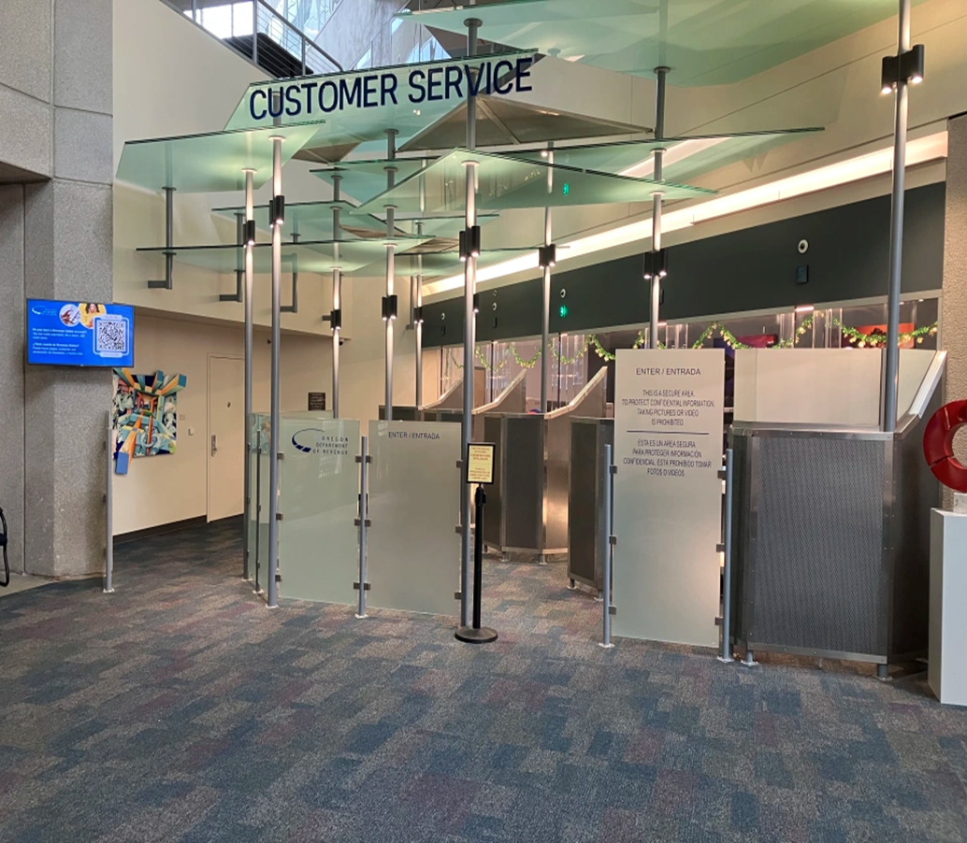
Salem Payment Center Photo
Positive customer response
Better privacy
Less confusing

Slide 15
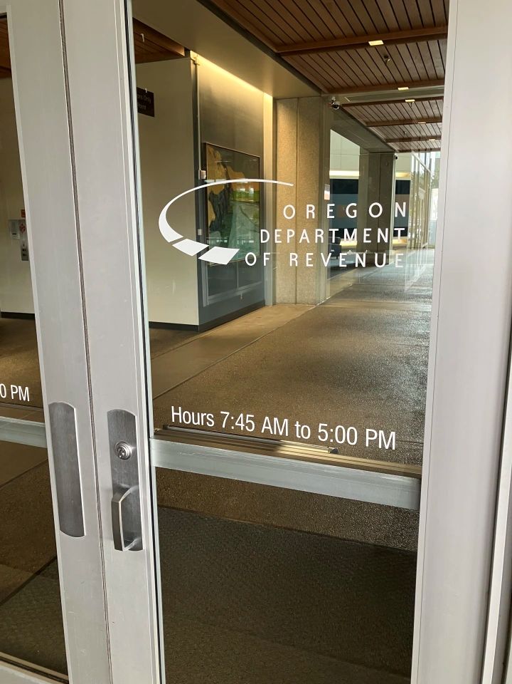
Salem Payment Center Hours
955 Center St NE
Salem, OR 97301-2555
7:45 a.m. to 5 p.m.

Slide 16
Salem Payment Center Assistance
Payments
Returns and documents
Basic questions

Slide 17
Questions?
Jenn Rux
Jennifer.Rux@dor.Oregon.gov

Slide 18
Residency & Nonresident Taxation in Oregon
Presented by Jason McKay
Tax Auditor - Gresham

Slide 19
Agenda for today
Defining Residency
Oregon-Source Income Rules
Examples
Filing Considerations
References

Slide 20

Defining Residency

Slide 21

ORS 316.027
Oregon Resident defined
An individual who is domiciled in this state unless the individual
  Maintains no permanent place of abode
  Does maintain a permanent place of abode elsewhere; AND
  Spends in the aggregate not more than 30 days in the taxable year in this state; OR
An individual who is not domiciled in this state but maintains a permanent place of abode in this state and spends in the aggregate more than 200 days of the taxable year in this state unless the individual proves that the individual is in the state only for a temporary or transitory purpose.

Slide 22
Oregon-Source Income Rules

Slide 23
Full-year, Part-year and Nonresidents.
Full-year residents. Oregon taxes your income from all sources.
Part-year residents. Oregon taxes your income from all sources earned or received while you were an Oregon resident. Oregon also taxes your income from Oregon sources while you were a nonresident.
Nonresidents. Oregon taxes only your income from Oregon sources.

Slide 24
What is Oregon Sourced Income?
Oregon income includes income shown on your federal return for services performed in Oregon.
Examples:
  Oregon wages
  Oregon fees for services performed in Oregon
  Businesses, S corporations, partnerships, and limited liability companies taxed as partnerships located or doing business in Oregon, and in some cases, work that is performed in another state for Oregon customers.
  Unemployment insurance benefits received because of an Oregon job.

Slide 25
What are Oregon Sourced Income types?
Examples:
  Severance pay you received because of an Oregon job.
  Oregon farms.
  Oregon estates and trusts.
  Sales of Oregon property.
  Rents and royalties for use of Oregon property.
  Wages for services performed in Oregon by employees who also telecommute from outside the state

Slide 26
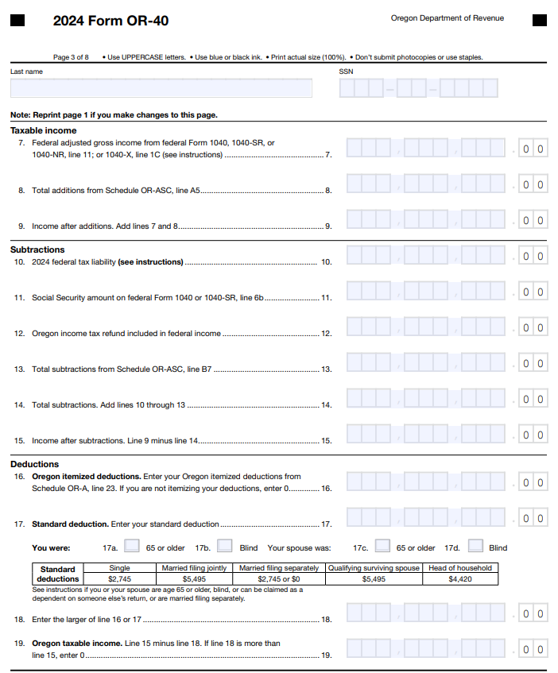
Form OR-40
Full-year resident

Slide 27
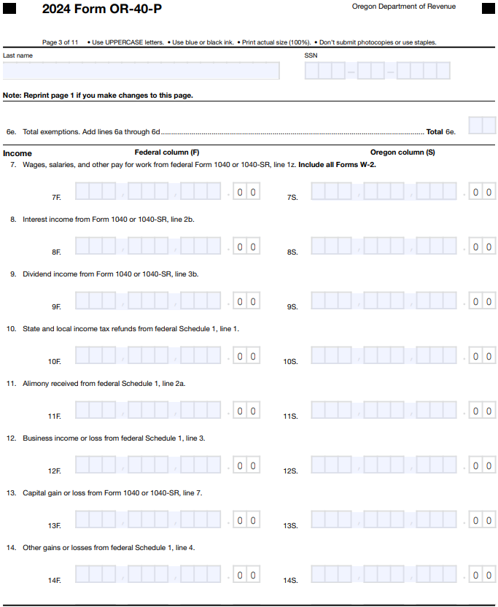
Form OR-40-P
Part-year resident

Slide 28
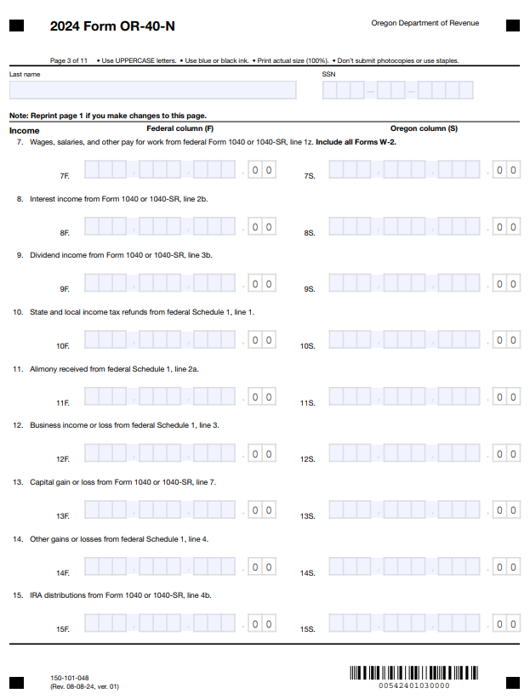
Form OR-40-N
Nonresident

Slide 29
Filing Considerations

Slide 30
Domicile vs. Residence
Domicile: Your permanent legal home that you intend to return to even when you're temporarily living elsewhere.
Residence: Any place you live temporarily or permanently.

Slide 31
Home
If you have one home, your domicile is generally where that home is located. If you have two homes, your domicile follows your center of activity. To determine your center of activity and your domicile, consider:
• Physical characteristics of the place.
• Time you spend there.
• Things you do there.
• People and property there.
• Your attitude toward the place.
• Your intent to return to the place when you are away

Slide 32
Change of domicile
Intent is the most important factor in determining a change of domicile. If intent relies on uncertain events, you haven’t changed your domicile. Once domicile is established, it’s never lost until all of the following happen:
• You intend to abandon the old domicile, and
• You intend to acquire a specific new domicile, and
• You are physically present in the new domicile.

Slide 33
Full-year resident – Form OR-40
You’re a full-year Oregon resident if your domicile is in Oregon—that is, if all the following are true for you:
• You think of Oregon as your permanent home.
• The center of your financial, social, and family life is in Oregon.
• You intend to return to Oregon when you’re away.

Slide 34
Full-year resident – the Form OR-40
You’re still a full-year resident even if you temporarily moved out of Oregon, or if you moved back into Oregon after a temporary absence.
You may be taxed as a full-year Oregon resident, even if your domicile is outside Oregon, if you maintained a permanent home in Oregon and spent more than 200 days in this state, unless you can show that you were in Oregon only for a temporary purpose.
Oregon taxes all income earned or received from any source during the period you were an Oregon resident.

Slide 35
Nonresident – Form OR-40-N
You’re a nonresident if both of the following are true for you:
• Your domicile is outside of Oregon: that is, the place that you think of as your permanent home, where the center of your financial, social, and family life is, and where you intend to return when you’re away, is not Oregon; and
• If you maintain a permanent home in Oregon, you didn’t spend more than 200 days in this state during 2024 (or you can show that you were in Oregon only for a temporary purpose).
Important: A recreational vehicle (RV) is not considered to be a permanent home outside of Oregon

Slide 36

Nonresident – Form OR-40-N
Oregon taxes only the income derived from sources within Oregon during the period you were a nonresident.

Slide 37

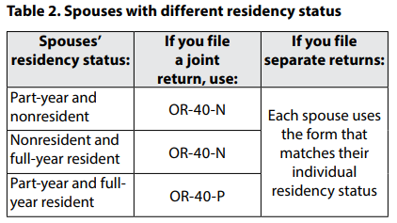
Spouses with different residencies

Slide 38
Special cases regarding residency
You may be taxed as a nonresident, even if your domicile is in Oregon, if all the following are true for you:
• You don’t maintain a permanent home in Oregon.
• You maintain a permanent home outside Oregon.
• You spent a total of 30 days or less in Oregon during 2024.
Oregon residents living abroad. You may be taxed as a nonresident if you qualify for the federal foreign earned income or housing exclusions for U.S. residents living abroad.

Slide 39
Military Personnel Exceptions
Special Case listed on previous slide
You are treated as a nonresident of Oregon, no matter where you are stationed, if both of the following are true:
  1. You are performing “active service,” as defined in 10 United States Code (U.S.C.) Section 101(d) (3), other than annual training duty or inactiveduty training, and
  2. You are a resident of another state according to DFAS payroll records.

Slide 40
Military Personnel Exceptions in Oregon
Under federal law, a member of the military and the member’s spouse may choose to be treated as a resident of any of the following for tax purposes:
  1. The residence or domicile of the member.
  2. The residence or domicile of the spouse.
  3. The permanent duty station of the member.

Slide 41
Examples
Listed in Oregon Administrative Rule 150-316-0025

Slide 42
Example 1 – OAR 150-316-0025
Ron maintains a home in Oregon and works in Oregon. He purchased a summer home in Nevada and each year thereafter spent about three or four months in that state. He continued to spend six or seven months of each year in Oregon. He continued to maintain his home and his social, club and business connections in Oregon, but established his bank accounts in Nevada. The months not spent in Nevada or Oregon he spent traveling in other states or countries. Ron is domiciled in Oregon and is taxed as a resident of Oregon because he has not demonstrated intent to abandon his Oregon domicile nor has he shown an intent to make Nevada his permanent home.

Slide 43
Example 2 - OAR 150-316-0025
Wayne is a long-haul truck driver for an Oregon company. His work requires that he travel throughout the United States. He is domiciled in Oregon but does not maintain a permanent place of abode in Oregon. Wayne spends less than 31 days in Oregon during the year. Wayne’s only residence is in his truck, which has a sleeper unit, closet and refrigerator. Except for two weeks vacation each year, Wayne stays in any given locale only temporarily and only for the purpose of delivering or picking up a load. Because Wayne does not maintain a permanent place of abode elsewhere, he is taxable as a resident of Oregon.

Slide 44
Example 3 - OAR 150-316-0025
Douglas has lived and worked in Oregon all his life. On January 1, he retired, sold his personal residence, and began traveling throughout the United States. He has not established a new domicile outside of Oregon nor does he intend to give up his Oregon domicile. Because Douglas does not maintain a fixed place of abode over a sufficient period of time to create a well-settled physical connection with a given locality, he is considered not to have a permanent place of abode elsewhere. Thus, Douglas is taxed as an Oregon resident.

Slide 45
Example 4 - OAR 150-316-0025
James is domiciled in Oregon. After retiring, James sold his Oregon home and purchased a recreational vehicle (RV). James rents space year-round at an RV park in Arizona where he spends 7 to 9 months each year. James spends the remainder of his time traveling in the United States, including Oregon, but he does not remain in any particular locality more than thirty days. James is considered to have a permanent place of abode in Arizona, as his stay at the Arizona RV park constitutes the maintenance of a fixed place of abode over a sufficient period of time to create a well-settled physical connection with that locality. James is taxed as a nonresident as long as he does not establish a permanent place of abode in Oregon and he spends less than 31 days in this state.

Slide 46
Example 5 - OAR 150-316-0025
Mark and Kim are domiciled in Minnesota. They maintain their family home there. Each October they come to the Oregon coast and stay through April, spending more than 200 days here during the year. Originally, they rented an apartment or house for the duration of their stay. Three years ago they purchased a house in Oregon. The house is either rented or put in the charge of a caretaker from May to October. Mark has retired from active control of a Minnesota business but still keeps office space and nominal authority in it. Mark and Kim belong to clubs in Minnesota, but none in Oregon. Mark and Kim have no business interest in Oregon. Mark and Kim are not taxed as Oregon residents because their presence here is temporary or transitory.

Slide 47
Example 6 - OAR 150-316-0025
Juan is domiciled in Illinois. Following graduation from high school, he moved to Oregon to attend college. Juan works in Oregon during the summer and returns to Illinois to visit family several times each year. Juan is taxed as a nonresident as his stay in Oregon is for a temporary or transitory purpose.

Slide 48
Example 7 - OAR 150-316-0025
Don, a computer consultant, is domiciled in New York where he owns a home in which his family lives and where he keeps the bulk of his personal belongings. He votes in New York, maintains bank accounts there and returns to his home whenever possible. He accepts a position in Oregon with a large corporation with the expectation that the work will take one and one-half years. He spends virtually the entire time in Oregon, living in a house built by the employer, where his wife and family join him in the summer. He intends to return to New York when the job is completed. During this period he will be taxed as a nonresident, even though he is in the state more than 200 days during the year, because he is in the state for a temporary or transitory purpose.

Slide 49
Example 8 - OAR 150-316-0025
Fran is domiciled in California. In January, she accepts a transfer to her employer’s Medford, Oregon office and rents an apartment there. The length of her assignment is indefinite, although Fran believes she may be able to obtain a promotion and transfer back to California within three years. Fran’s husband and children remain at the California residence and Fran returns there on weekends and holidays. Fran is taxable as a resident of Oregon because she maintains a permanent place of abode in Oregon, spends more than 200 days here, and her presence is not temporary or transitory.

Slide 50
Example 9 - OAR 150-316-0025
Li is domiciled in Idaho and works as a sales person for a manufacturing company. She spends her workweek traveling in a motor home in Oregon meeting with existing and potential customers. She returns to her Idaho home when it is convenient, but may be in Oregon for 2 or 3 months at a time. Li’s assignment is indefinite and thus she is not in Oregon for a temporary or transitory purpose. However, she does not maintain a permanent place of abode in Oregon, as she does not remain in any place for a sufficient period of time to create a well-settled physical connection with a given locality. Li is taxed as a nonresident.

Slide 51
References

Slide 52

References for Forms
Publication OR-17
Form OR-40-N and OR-40-P Instructions
Form OR-40 Instructions
ORS 316.027, 316.048, 316.127
OAR 150-316-0025
Questions? Send an email to Questions.dor@dor.oregon.gov

Slide 53
OR-W-4 Instruction Changes
July 25, 2025
Kadie Clark, PTAC Operation and Policy Analyst

Slide 54


Withholding Formula Limitations
Withholding formula has income limitations for allowances
Income limits:
  $100,000 per year for single filers
  $200,000 per year for married/joint filers

Slide 55
Revised Worksheets
Worksheet A—Personal allowances
Worksheet B—Deductions, adjustments, and credits
Worksheet C—Multiple jobs, nonwage income, and additions

Slide 56
Increased Transparency Regarding Employers
Employers are required to withhold the amount from a determination letter (ORS 316.167)
Taxpayer must prove personal or financial change that would allow a decrease in withholding (ORS 316.182)
The department will notify employer if withholding adjustment is allowed (OAR 150-316-0290)

Slide 57
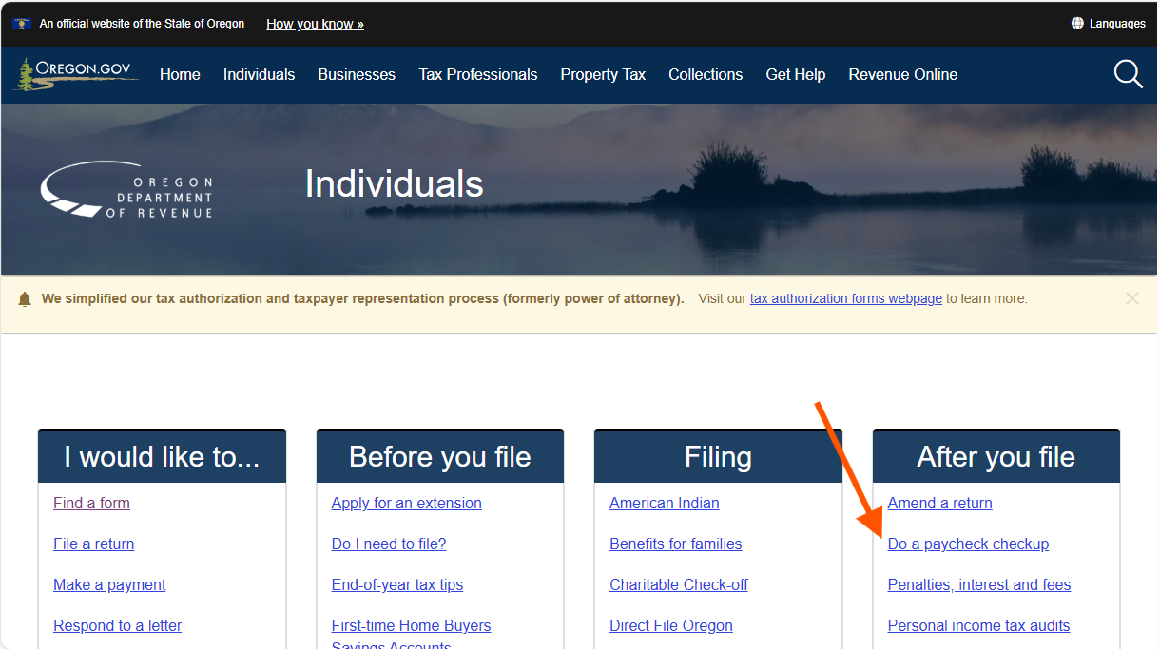
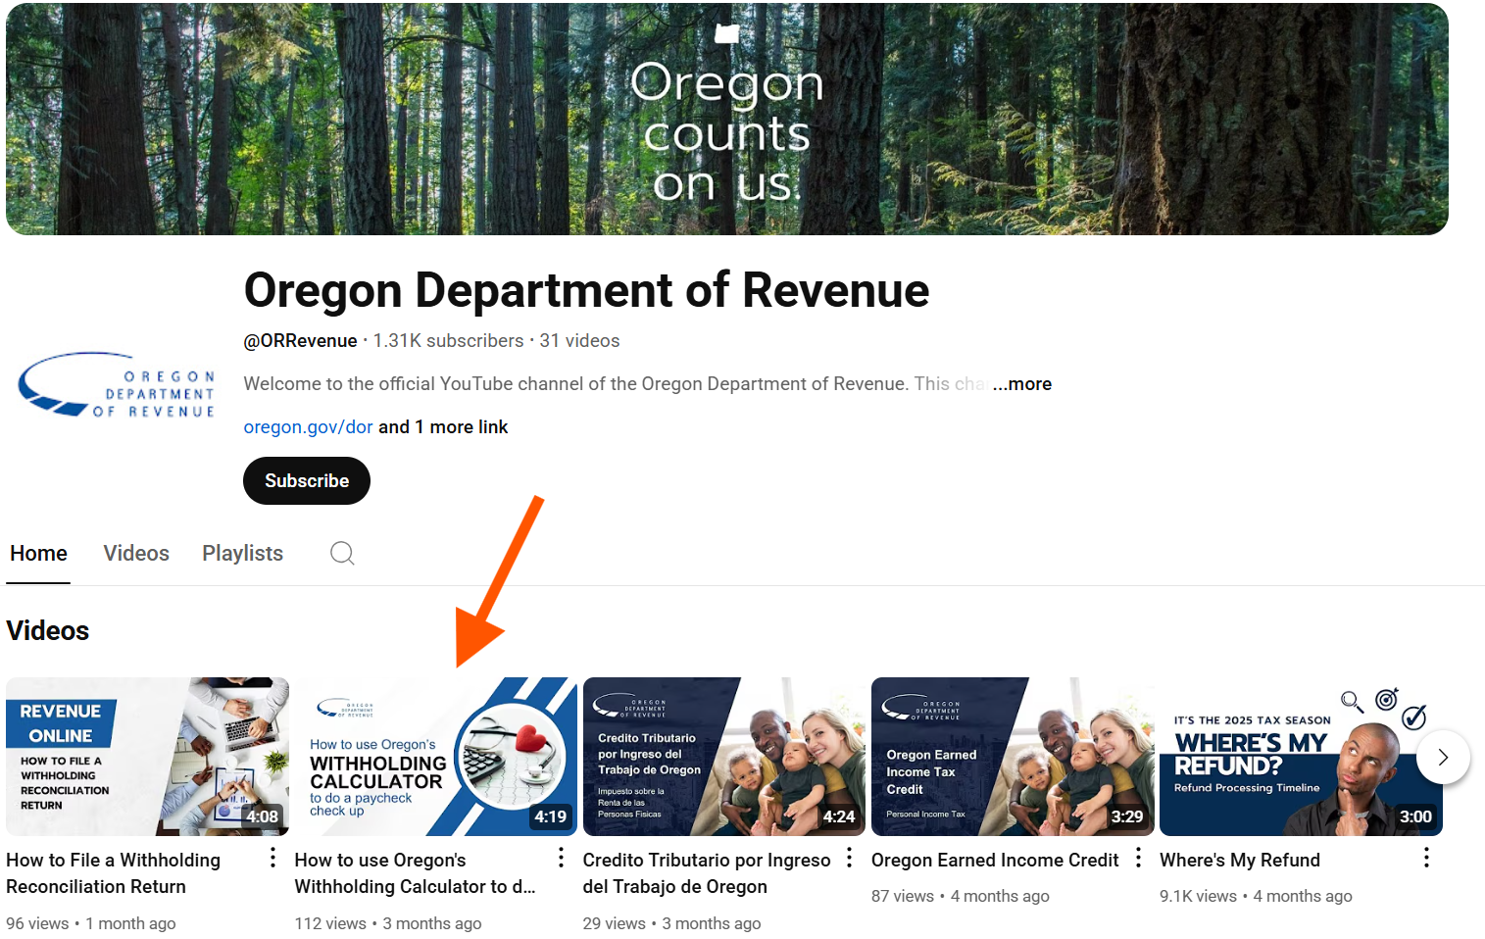
Online Withholding Calculator
Most accurate results
Look for “Do a paycheck checkup” on our website
How to video on YouTube

Slide 58
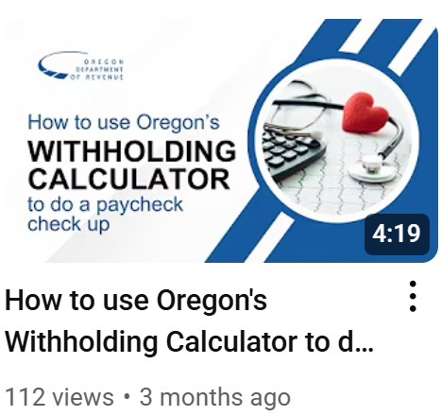
Online Withholding Calculator –
DOR YouTube Channel

Slide 59
Questions you have?
TaxProfessional.Meeting@dor.oregon.gov.

Slide 60
Stakeholder Outreach
Tax Practitioner Liaison Meeting – July 25, 2025
Robert Oakes,
Operations and Policy Analyst – PTAC Policy and Operations

Slide 61
Tax Pro Stakeholders
Oregon Association of Tax Consultants (OATC)
Oregon Society of Tax Consultants (OSTC)
National Association of Tax Professionals (NATP)
Oregon Society of CPAs (OSCPA)
Oregon Association of Independent Accountants (OAIA)
Oregon Society of Enrolled Agents (OSEA)

Slide 62
DOR Partners
Oregon Board of Tax Practitioners
Oregon Board of Accountancy
MFS Cash Oregon
H&R Block
Volunteer Income Tax Assistance/AARP

Slide 63
DOR Outreach
Tax Pro Liaison Meetings – Quarterly
New Law Update – January
ReveNews Bulletins
Requested presentations

Slide 64
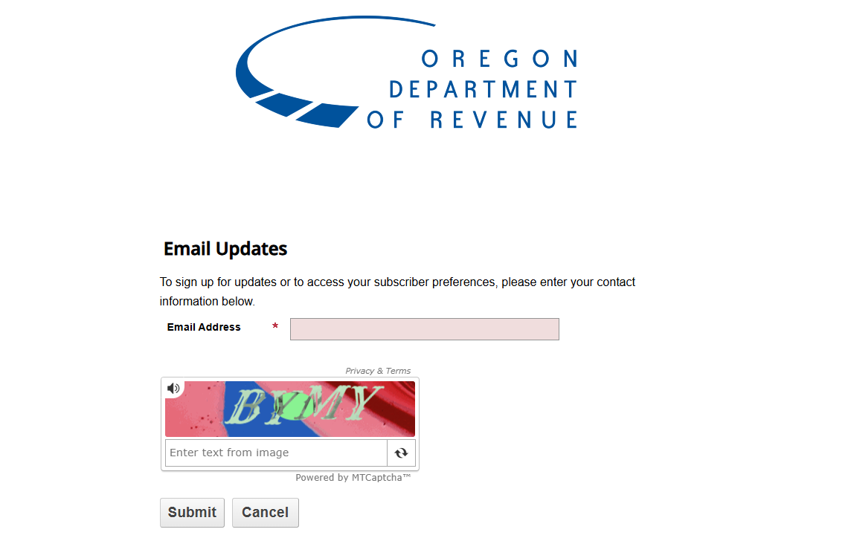
RevNews Bulletins

Slide 65
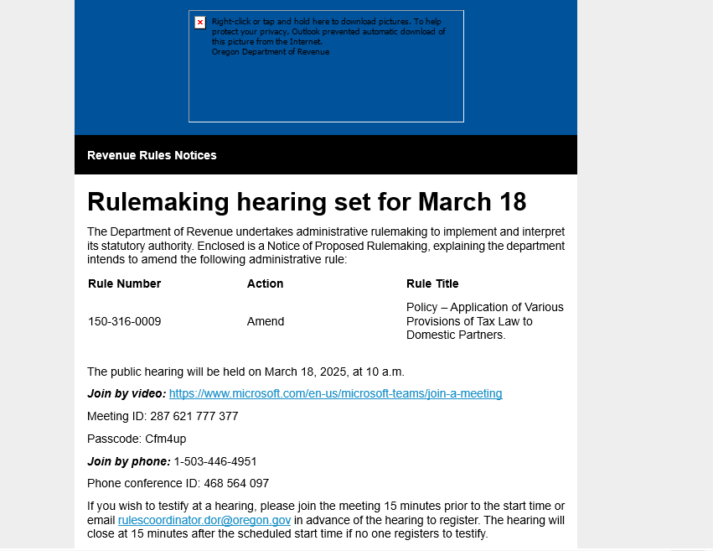
ReveNews

Slide 66
Contact Us
To reach our dedicated practitioner specialist:
Email: prac.revenue@dor.oregon.gov
Phone: 503-947-3541

Slide 67
Tax Practitioner Contacts

Slide 68
Questions to ask?
TaxProfessional.Meeting@dor.oregon.gov

Slide 69
Federal Tax Changes
Tax Practitioner Liaison Meeting – July 25, 2025
Robert Oakes,
Operations and Policy Analyst – PTAC Policy and Operations

Slide 70
State and Local Tax Deduction (SALT)
Increased Cap: The deduction limit is temporarily raised from $10,000 to $40,000
Effective for the 2025 tax year.
Income-Based Phaseout: $40,000 cap applies to households with a Modified Adjusted Gross Income (MAGI) of $500,000 or less ($250,000 for married couples filing separately).
Phaseout Details: For households exceeding the threshold, the deduction is reduced by 30% of the excess income, but the deduction cannot drop below $10,000.

Slide 71
SALT Deduction
Oregon is currently tied to the increase in the deduction for state and local taxes paid (SALT)
The same phaseout that applies to the federal deduction will also apply to Oregon

Slide 72
New Adjusted Gross Income (AGI) Deductions
New federal deductions flow through to Oregon returns - 2025 through 2028 tax years:
• Tips –
• Overtime wages
• Interest paid on new vehicle loans

Slide 73
Questions we can answer?
TaxProfessional.Meeting@dor.oregon.gov

Slide 74
Oregon Legislative Updates
July 25, 2025
Daron Prara, Operations and Policy Analyst

Slide 75
HB 2087 Credit Omnibus Bill
Contained 11 provisions
Most provisions were heard in other bills
Most provisions amend existing credits

Slide 76
HB 2087 Credit Bill passed
Earned income credit
  Extended sunset date by six years
  New sunset date is for tax years beginning before January 1, 2032
Crop donation tax credit
  Increases credit from 15 percent to 25 percent
  Extends unset date to tax years beginning before January 1, 2032
Pension income tax credit
  Extends sunset date by six years
  New sunset date is for tax years beginning before January 1, 2032
Manufactured dwelling park tax credit
  Extended sunset date by six years
  New sunset date is for tax years beginning before January 1, 2032

Slide 77
HB 2087 Tax Credit Bill
Manufactured dwelling park capital gain subtraction
  Extended sunset date by six years
  New sunset date is for tax years beginning before January 1, 2032
Affordable housing lender tax credit
  Expands the credit for certain loan types
  Loans are for an expanded universe of buyers, or
    A qualified mortgage loan fund
  Effective for loans made on or after January 1, 2026, and
    For tax years beginning on or after January 1, 2026

Slide 78
HB 2087 Tax Credits
Rural medical provider tax credit
  Increases rural emergency management services (EMS) volunteer credit from $250 to $1,000
  Effective for tax years beginning on or after January 1, 2026
  Extends credit sunset to tax years ending December 31, 2029
Individual Development Account (IDA) credit
  Increases the IDA credit cap from $7.5 million to $7.7 million for tax year beginning on or after January 1, 2025 and before January 1, 2026
  Increased the IDA credit cap from $7.7 million to $8 million for tax years beginning on or after January 1, 2026
  Adds that for a taxpayer to qualify, donations must be made prior to April 15, 2030

Slide 79
HB 2087 Credits
Film production credit
  Expands Film and Video Auction credit from $20 million to $20.6 million for fiscal years beginning on or after July 1, 2025, and before July 1, 2026
  Expands the auction credit from $20.6 million to $21.2 million for fiscal years beginning on or after July 1, 2026
Motor carrier and fuel tax
  Changes repeal date of ORS 282.475 from January 1, 2026 to January 1, 2032
  Administered by Oregon Department of Transportation
First-time home buyer savings account tax subtraction
  Amends that account must be opened from January 1, 2027 to January 1, 2032
  Amends that funds must be used from January 1, 2037 to January 1, 2042

Slide 80
HB 2339 DOR Request Bill
Department legislative concept for improving different program administration
Impacts multiple divisions
Bill includes five provisions

Slide 81
HB 2339 DOR Requested Bill
Small tract forestland severance tax (STF)
  Changed STF fund balance calculation date from May 1 to June 1 each year
  Changed distribution deadline from May 15 to June 15 each year
Data-sharing for Marijuana and Psilocybin programs
  Allows agreements with:
    Oregon Liquor and Cannabis Commission
    Oregon Health Authority
  Allows sharing data for income, excise, and corporate activity tax programs
  Increases efficiency with audit and enforcement

Slide 82
HB 2339 DOR Bill
Modifications to outdated agency reporting
  Certain statutes require the department to issue certain reports
  Some reports outdated or no longer reflect current practice
  Relevant statutes were repealed
Alignment of Agricultural Employer Overtime Tax Credit (AEOTC) statutes
  Aligns AEOTC statutes with business statutes
  Clarifies that S Corporations cannot claim the credit on the entity return
  Does not change how pass-through entities are currently filing returns

Slide 83
HB 2339 DOR Bill Request
Limiting foreign-earned income for Oregon Kids Credit qualification
  Requires addback of foreign income exclusion taken on federal return
  Intent is to prevent high-earning individuals from claiming credit
  Aligns program with original intent of legislature

Slide 84
HB 3115 Lottery Ticket Sales
Affects taxpayers that purchase winning lottery tickets from the original purchaser
Creates an addition for illegal lottery ticket sales where cost of goods sold is deducted at the federal level
The new addition will apply to tax years beginning on or after January 1, 2026

Slide 85
Questions about this?
TaxProfessional.Meeting@dor.oregon.gov

Slide 86
86
Do you have questions or need help?
www.oregon.gov/dor
503-378-4988 or 800-356-4222
questions.dor@dor.oregon.gov
Contact us for ADA accommodations or assistance in other languages.

