Slide 1
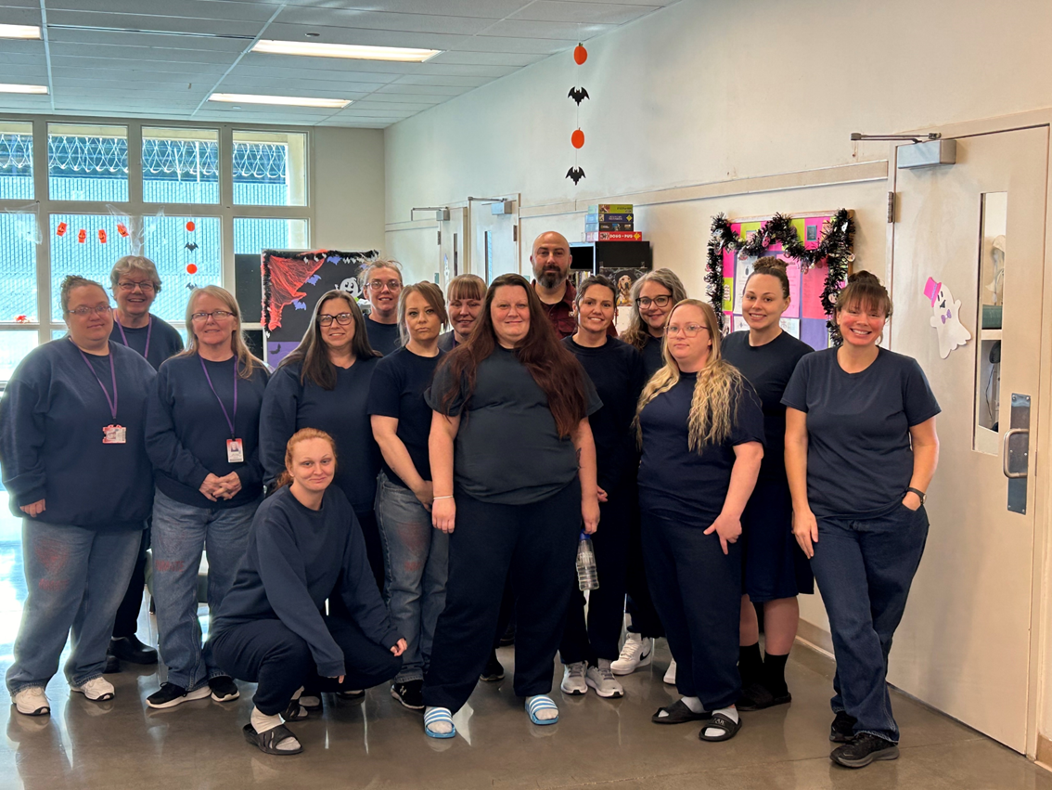
Gender Informed Practices Assessment
Director Michael Reese
Deputy Director Heidi Steward
Notes:
Mike and Heidi to introduce themselves.
Mike explains this picture and a value statement.
Heidi was the former Superintendent and this work is important to her.

Slide 2


Our Mission
Notes:
Our mission at DOC has evolved over the years and our new mission statement better reflects the work we do protecting communities, transforming lives and promoting accountability.

Slide 3
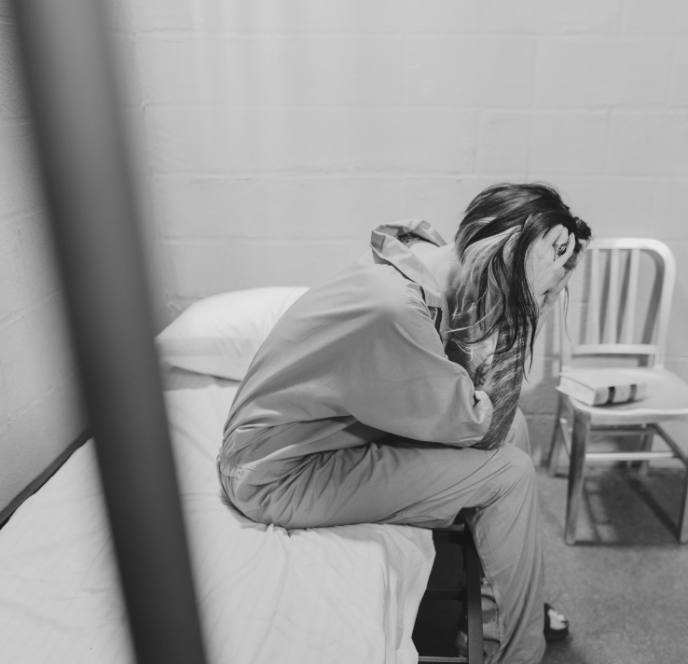
Incarcerated Women are Unique
70% of women incarcerated in prisons and jails report experiences of intimate partner violence and victimization.
90% of women with criminal justice system involvement have experienced some form of trauma.
Notes:
1. High Rates of Trauma Among Incarcerated Women
Most incarcerated women have experienced significant trauma before entering prison. This includes:
Physical and sexual abuse (often starting in childhood)
Domestic violence
Sex trafficking
Neglect and poverty
Loss of children or loved ones
Without a trauma-informed approach, the prison environment can unintentionally re-trigger trauma responses, leading to emotional dysregulation, self-harm, aggression, or withdrawal—all of which can escalate incidents and interfere with rehabilitation.
2. Women’s Pathways to Incarceration Are Different then Men
Women often end up in prison through different pathways than men, frequently involving survival crimes, substance use as a coping mechanism, or acting under coercion or abuse from partners. A gender-responsive approach acknowledges:
The role of relationships and caretaking responsibilities
The impact of sexual violence and coercion
The need for different programming than what might work for men
3. Improves Safety for Everyone
When staff are trained to recognize trauma responses and address behavior with empathy and appropriate boundaries, it de-escalates potential conflict. Trauma-informed care reduces the need for force, segregation, and discipline while building trust between staff and adults in custody.
4. Promotes Rehabilitation and Reduces Recidivism
Programs and environments that are trauma-informed and gender-responsive help women:
Regulate emotions and build coping skills
Heal from past trauma
Rebuild self-worth and identity
Learn in ways that reflect their lived experiences
This creates a better chance for successful reentry and a reduced likelihood of returning to prison.
5. Supports Staff Wellness and Retention
When staff understand the "why" behind behaviors and have the tools to respond effectively, it decreases burnout and secondary trauma. It creates a more respectful, human-centered workplace culture—which is vital in a challenging environment like a prison.
Council on Criminal Justice
The drivers of criminal behavior for women are different than for men. Women tend to:
Have significant dysfunctional relationships with family and intimate partners (main driver for drug use)
Have low self-efficacy (the belief they are capable of doing/being more and deserve better)
Experience significant exploitation throughout their life (including sex trafficking)
Have significant mental health issues because of trauma and dysfunctional relationships
Have responsibility for the children involved in their lives
For women, relationships with children and family are heavily tied to recidivism (not true of men).

Slide 4

DOC Population by Gender
*as of December 2024.
Notes:
This picture is from a recent graduation at our only women’s prison in Wilsonville, Oregon – the Coffee Creek Correctional Facility. As you can see our AIC population is mainly male.

Slide 5
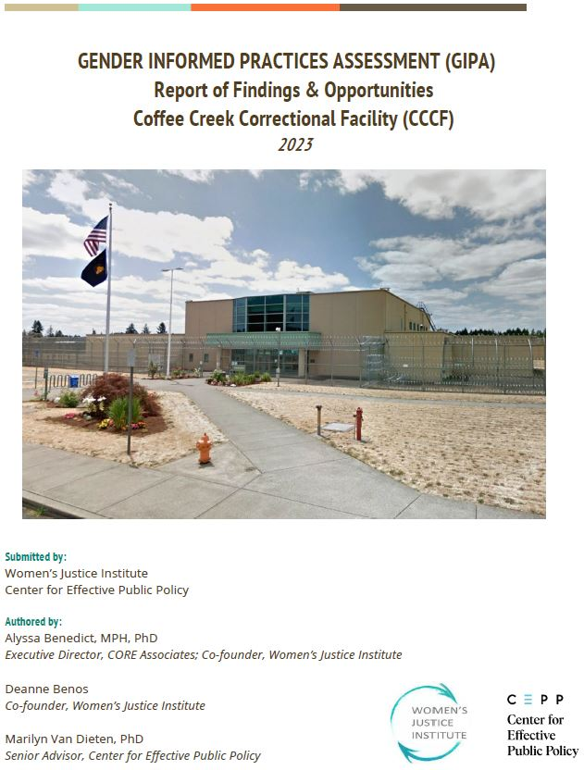
GIPA Report Summary
“To move forward, DOC must create dedicated leadership roles for women’s services, stabilize staffing, revamp training and culture, prioritize investment in women-centered services, and partner more intentionally with community organizations.
Immediate and sustained efforts are needed to improve outcomes for incarcerated women and their families.”
Notes:
This slide is a very brief high-level summary of the full 229-page GIPA report.
Establish a department-level Women’s Services Authority to lead a multi-year Gender Responsive Strategic Plan.
Ensure equitable funding and staffing for CCCF relative to male facilities, including program and medical services.
Revamp staff training to focus on trauma-informed care, effective interventions with women, and cultural change.
Redesign disciplinary and housing practices to reduce trauma and support rehabilitation.
Expand access to reentry, case management, and community-based programs to improve post-incarceration outcomes.
-------------
The Gender-Informed Practices Assessment (GIPA) conducted at Oregon’s Coffee Creek Correctional Facility (CCCF) highlights both the progress and significant gaps in implementing gender-responsive, trauma-informed, and evidence-based practices for justice-involved women. While the Oregon Department of Corrections (OR DOC) has demonstrated early leadership in this field and supported some noteworthy initiatives, many reforms have been siloed, inconsistently applied, and undermined by chronic underfunding, staffing shortages, and outdated facility designs.
The GIPA identified 12 critical domains—from leadership and staffing to mental health services and disciplinary practices—revealing widespread issues such as punitive discipline that retraumatizes women, inadequate access to medical care, lack of reentry planning, and insufficient investment in gender-specific programming. Despite strong community partnerships and legislative support, systemic barriers persist due to lack of department-wide strategic oversight and equity in resource allocation.
To move forward, OR DOC must create dedicated leadership roles for women’s services, stabilize staffing, revamp training and culture, prioritize investment in women-centered services, and partner more intentionally with community organizations. Immediate and sustained efforts are needed to improve outcomes for incarcerated women and their families.

Slide 6
GIPA Timeline
Jan. 2022
GIPA report through budget omnibus bill (HB 5202).
Apr. – Nov. 2022
DOC engages DAS and Governor’s office to initiate GIPA contracting.
Jan. 2020
Joint Judiciary LPRO convenes Gender Responsive (GR) Workgroup.
Jan. – Feb. 2023
CCCF GIPA Assessment conducted by Women’s Justice Institute.
Aug. 2023
CCCF GIPA report issued.
Sept. 2023
DOC Domain Teams formed, and Governor’s Advisory Panel and AIC GIPA Council begin work.
Nov. 2023
DOC letter to governor identifying tasks completed and 6-month work plan sent.
May 2024
DOC submits 6-month report to Governor on status of 11/23 letter actions.
Oct. 2024
Governor's Advisory Panel prioritized all proposals to determine the five strategic areas.
Jan. 2025
Project sponsors and five implementation teams formed.
Feb. 2025
DOC publishes GIPA Implementation Plan & GIPA Report update.
Current
Analysis by SME’s to assess criteria for completion, financial needs, & priorities.

Slide 7
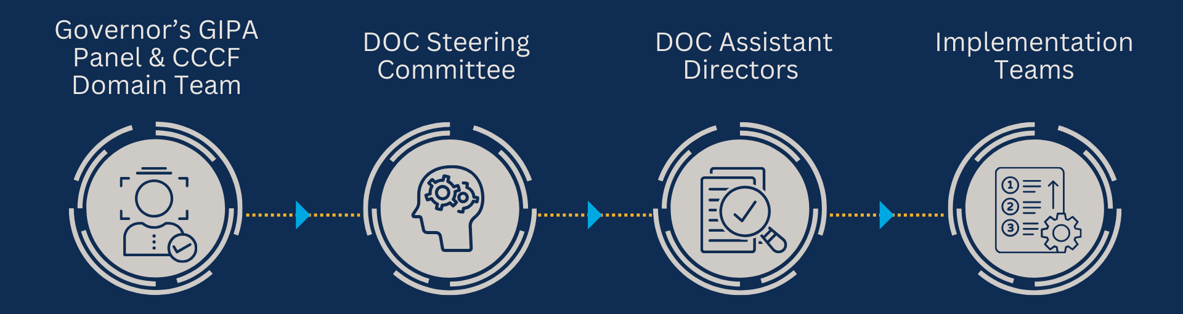
The Process of Prioritizing Proposals
The Governor’s Advisory Panel and DOC’s workgroups recommend key proposals from the GIPA Report and AIC input.
This smaller panel of two current CCCF AICs, Governor’s staff, CCCF leadership, and DOC leadership evaluate proposals and pass on to DOC Assistant Directors.
DOC Assistant Directors lead Implementation Teams to review proposals and evaluate operational requirements.
Implementation Teams meet regularly to review projects, monitor progress, and communicate updates.
Notes:
Heidi to take the first two and Mike the second two.

Slide 8
Governor’s GIPA Panel
Nichole Brown, Gender Responsive Practices Superintendent
Mandy Davis, PhD, Trauma Informed Oregon
Paige Frye-Holcomb, PhD, Criminal Justice Commission
Julia Yoshimoto, Oregon Justice Resource Center
Jessica Katz, Family Preservation Project
Brittany Wake, OHA Behavioral Health
Anna Stiefvater, OHA Maternal and Child Health
Chelsea Cappadona, ODHS Child Welfare
Leticia Longoria Navarro, The Pathfinder Network
Rima Green, Growing Gardens
Seth Johnstone, Basic Rights Oregon
Biff Chaplow, Beyond These Walls
Mariana Garcia Medina, ACLU
Kacie Hollinger, Parent Mentor & Co-chair of Incarcerated Parent Workgroup
Meghan Apshaga, Disability Rights Oregon
Alicia Roach, The Ostara Initiative
Ray Mooney, local AFSCME VP & CCCF Staff
Kendra Stidhem, Peer Wellness Specialist & former CCCF AIC
Kristina Rice, Corrections Ombuds
*Many others are included in this work through participation in panel workgroups and Implementation Teams - thank you!
Notes:
Mike.
Governor’s commitment to this work and Mia Ruston.
Representatives from state agencies, advocacy organizations, program providers, and individuals with lived experience bring unique perspectives and subject matter expertise.
Say thank you to them.

Slide 9
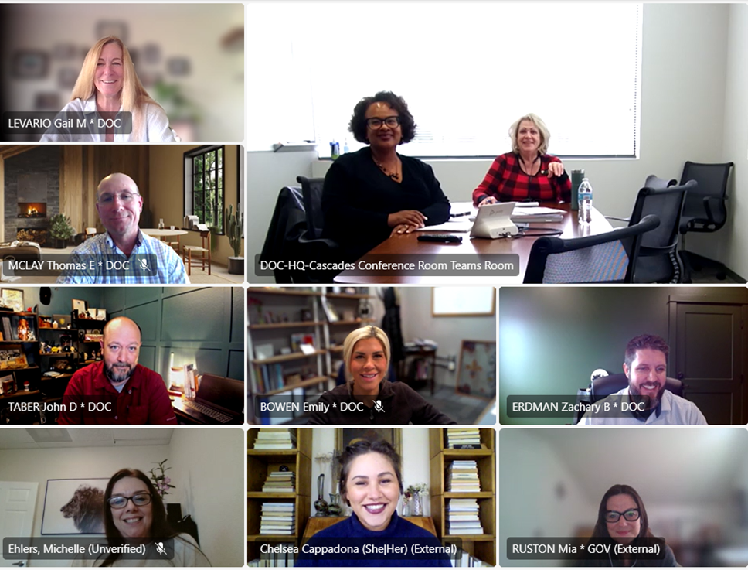
Implementation Teams
GIPA Staff Training & Facility Culture Implementation Team
Notes:
Picture – Implementation Team Number Two. Working on Culture. DOC, Gov’s Office, external partners, and those with lived experience.
Implementation – Phase One
The Steering Committee’s recommendations are now in various stages of implementation, with some already being put into action while others await necessary funding through the legislature. To ensure effective and timely execution, the work has been carefully prioritized, with each initiative being addressed based on urgency and impact. Implementation workgroups, led by members of the DOC’s Executive Team, are overseeing the progress of these initiatives, ensuring that the recommendations align with departmental goals and are carried out with the necessary resources and oversight. These workgroups are actively driving the transformation of CCCF, with a strong focus on making the facility more supportive and responsive to the unique needs of incarcerated women.
The Steering Committee identified five key focus areas for initial improvements at CCCF:
Improving Prison Rape Elimination Act (PREA) Policies and Procedures,
Staffing/Training/Facility Culture,
Reentry/Release,
Gender-Responsive and Trauma-Informed Operations, and
Medical Services.
To ensure implementation, the work has been divided into two categories: "Current Work Commitments" and "Work that Requires Policy Option Package/Funding Approval." Commitments represent initiatives currently being addressed within existing resources. The other category encompasses projects which require funding including staffing increases, facility upgrades, and expanded medical and mental health services. These unfunded priorities will move forward following the 2025 Legislative Session, if funding is allocated in DOC’s Legislatively Adopted Budget. This phased approach ensures that immediate improvements continue, while long-term enhancements remain on the department’s strategic agenda. The project teams will work with the Advisory Panel to continually monitor and evaluate implementation progress and adjust achieve desired outcomes.
Additional Notes if Needed
Implementation – Phase Two
As phase one work progresses, work in the following areas will commence, with the order of implementation to be determined based on available resources, stakeholder input, and evolving needs.
Parenting and Family Connections
Building on the foundation laid in phase one, DOC will strengthen programs that promote family reunification, parenting skills, and maintaining family connections during incarceration. This will include expanding parenting education programs, facilitating family visits, and offering mentorship opportunities for women with children to help them prepare for reintegration into family life post-release.
Community Engagement
In phase two, DOC will expand its outreach and collaboration with community organizations and support networks. Partnerships with local agencies, service providers, and advocacy groups will be integral in ensuring incarcerated women have the resources and guidance they need upon release. These efforts will include strengthening pre-release coordination with community resources to provide stable housing, employment, and mental health services upon return to the community.
Data/Monitoring/Oversight
DOC will continue to enhance its data systems to improve monitoring and oversight of reentry outcomes, program effectiveness, and gender-responsive care. This will include updating tracking systems to evaluate AIC progress, identify areas for improvement, and inform future programming. Enhanced reporting mechanisms will be implemented to ensure transparency, accountability, and ongoing evaluation of reentry-related efforts.
Access to Justice
DOC will work to increase access to justice for incarcerated women by ensuring they have the resources and support they need to engage with the legal system. This will include offering legal assistance for women navigating parole hearings, sentence modifications, and other legal processes, as well as expanding access to legal representation for those who need it. The goal is to ensure fair treatment and equitable outcomes for women involved in the justice system.
Behavioral Health Services
Expanding behavioral health services will be a key component of phase two. DOC will focus on providing comprehensive mental health care, substance abuse treatment, and trauma-informed therapy to incarcerated women. These services will address the unique needs of women, including the impacts of childhood trauma, intimate partner violence, and substance use disorders, ensuring they are better equipped to heal and succeed post-release.
Physical Facility
To support the implementation of these initiatives, DOC will also assess and address the physical needs of the facility. This includes creating dedicated spaces for reentry-focused programming, such as peer support, family visits, and educational opportunities, as well as ensuring the facility is safe, accessible, and equipped to support women’s unique needs. Considerations will also include improvements to housing and security protocols that allow for greater autonomy and safety for incarcerated women.
Other Work Related to GIPA
As part of DOC’s ongoing commitment to gender-responsive and trauma-informed practices, positive changes will be implemented that cross multiple initiative areas. Key priorities include:
Transgender AICs: Expanding housing, healthcare, and support services to ensure safety and inclusion.
Work Release/Alternatives to Incarceration: Increasing access to community-based programs that support successful reintegration.
Disabled/Special Needs/Neurodivergent AICs: Improving accommodations, services, and resources for AICs with disabilities or neurodivergence.
Telecommunications: Modernizing communication systems to strengthen AIC connections with family, legal resources, and support networks.
AIC Survey: Gathering direct input from AICs to inform policy and operational improvements.
Performance Recognition Awards System (PRAS): Review and suggest changes to ensure AICs are appropriately awarded for work inside the institution.
Food/Nutrition: Evaluating and improving dietary services to meet health, cultural, and sustainability needs.

Slide 10
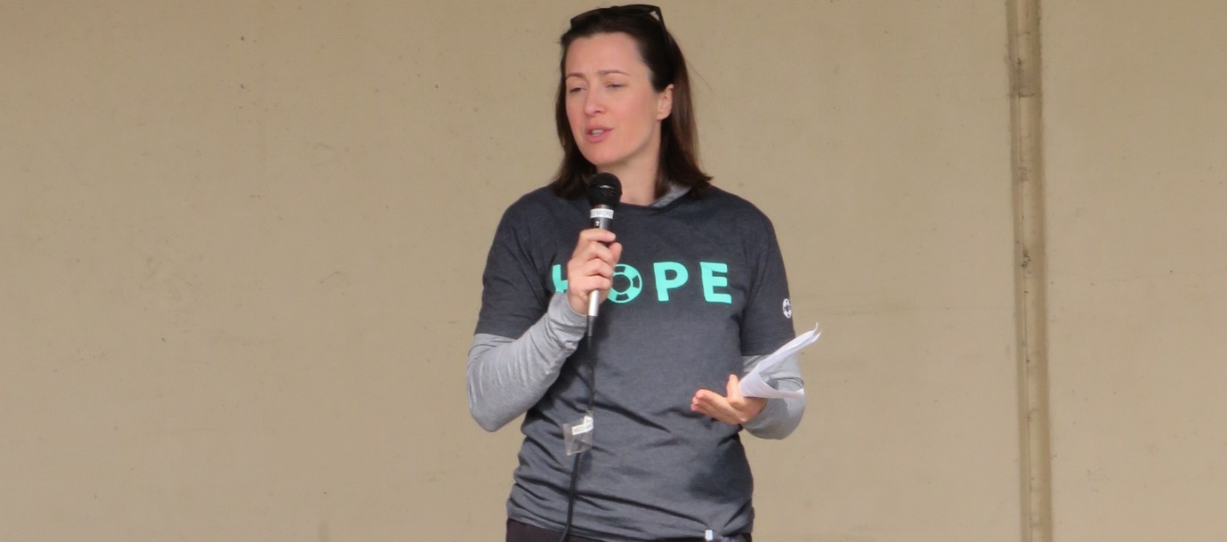

GIPA Implementation Team: PREA
Charge: Improve PREA policies and procedures.
Goal: Ensure physical safety and psychological well-being for all AICs and staff, including protection from sexual assault and retaliation.
Progress highlights to date:
Established a full-time PREA Compliance Manager who reports directly to the OIG in the Director’s office.
Established a full-time Sexual Abuse Liaison to lead the Sexual Abuse Response Team at CCCF.
Now advancing 28 recommendations.
Team members:
Gary Ninman, DOC Inspector General (Lead)
Ericka Sage, PREA Administrator
Amanda van Arcken, PREA Captain
Chris Arnoux, PREA Coordinator
Laura Hinkle, CCCF PREA Compliance Mgr
Amanda Mooney, CCCF Sexual Abuse Liaison
(Pending) Director, Center for Hope and Safety
Kendra Stidhem, Lane County Behavioral Health
Notes:
Heidi
Medical has 44 projects.
The "shorthand" list:
Immediately put Menopause/Female Supplements on canteen; conduct periodic surveys regarding canteen item addition requests.
Establish clear policies about accommodating special diets and ensure that AICs with specific nutritional needs are able to get those met.
Implement electronic medical requests and track response timelines.
Set benchmarks for HS response to AICs; audit and address lapses in compliance.
Make a system to track routine and follow-up appointments. The system should be able to show target service dates, identify which were achieved, and flag delays so that they can be addressed promptly.
Develop care timeliness benchmarks for initial encounters and follow up care. Require periodic compliance reporting.
Include external stakeholders when identifying data and reporting needs for the incoming EHR.
Following EHR implementation, conduct ongoing assessment to identify improvements and refinements.
Investigate ways to improve/replace the "TLC" care utilization system.
Assess whether it would be appropriate/possible to contract with community based healthcare providers to manage health services.
Reinstate the Chronic Disease/Chronic Pain Self-Management Program.
Provide health services staff with training in gender responsivity and trauma informed care.
Begin putting health/wellness information on the tablets. Solicit feedback from AICs about what type of information they would like to see.
Partner with outside agencies to bring in workshops, seminars, or informational sessions on women's health and wellness issues.
Immediately create more opportunities for patients to access telehealth.
Peers working as health and wellness supports for other AICs should be appropriately trained and compensated, with an avenue to achieve certification(s) that transfer to post-release settings.
End strip searches after medical procedures.
Establish a way to solicit regular, anonymous feedback from staff and AICs regarding health services policies and practices and provide that feedback to the Governor's Advisory Panel and the Corrections Ombudsperson.
Incorporate AICs and staff into discussion/policy development processes. This can help to bring the perspectives of all to address policies and practices that are being developed or modified, while providing a mechanism for information from each group to be communicated to the others.
Establish written guidelines for managing care for patients with multiple issues or complex medical needs, including scheduling longer appointments for those individuals so that a comprehensive care approach can be used and AIC time away from work/education is minimized.
Stop requiring AICs to forfeit PRAS points due to medical/behavioral health appointments. (Either pay people for those days or ensure that after-hours and weekend appointments are available.)
Establish a protocol for regular communication and improved coordination among administration, facility medical services staff, and AICs.
Implement a boundary spanner / patient advocate role within the facility.
Implement an ADL Assistant (peer) training program.
Periodically engage medical services staff to identify ways to address burnout and compassion fatigue.
Provide patients with a written after-visit summary that includes any diagnoses, test results, self-care recommendations, and care plan.
Create a shared recreational space at CCCF (gym/multipurpose building).
Develop a way for medical services and other facility staff to anonymously report issues with the provision of healthcare services.
Reinitiate targeted discussions/negotiations with AFSCME, DOC, and nursing staff to investigate the possibility of 3 x 12 or other alternative workweek schedules.
Utilize the Pregnancy Coordinator Nurse Practitioner position that is being added through the GIPA POP process to identify women's healthcare needs and advance women's health initiatives at CCCF.
Provide releasing AICS patient-centered contraceptive counseling and the contraception method of their choice upon release, with enough refills to last until they can reasonably access health care.
Identify a point person to ensure that individuals are released with a 30-day supply of all medications. Develop a written process to quickly address those situations where release meds are not provided, and provide this in writing to the releasing individual.
Assign a medical staff member to meet with individuals in advance of their release to ensure they have the resources and connections they need to ensure continuity of care.
Perform an intake-to-release systems audit at the facility to identify where a) policies are in place but are not being followed or b) policy development or clarification is needed.
Streamline processes for obtaining low-cost adaptive needs, such as hearing aids, eyeglasses, and dentures.
Establish a procedure for medical staff to appropriately document work restriction and dietary need recommendations and a procedure for individuals to timely address incidents where these are not being documented or honored.
Eliminate the practice of modifying prescription/aftercare instructions provided by outside specialists. If a modification is necessary, require that it not be done without the approval of the outside specialist.
Health services statistical reports (per NCCHC best practices) should be made at least monthly and provided to the facility administrator, agency leadership, the Corrections Ombudsperson, the Governor’s Advisory Panel, and others as appropriate.
CQI committee meeting minutes and summaries as well as the written annual review of the effectiveness of the CQI program (per NCCHC best practices) should be provided to facility administrator, agency leadership, the Corrections Ombudsperson, the Governor’s Advisory Panel, and others as appropriate.
Modify intake procedures to require that individuals receive an initial medical clearance to work in the kitchen and other areas.
Implement a Community Health Worker (peer) training and certification program.
Investigate the benefits/feasibility of moving male intake out of CCCF.
Expand the prescription medication formulary to correlate with OHP / public health offerings.
Establish “office hours” for patients to come in to ask follow-up questions and receive post-visit clarification.

Slide 11
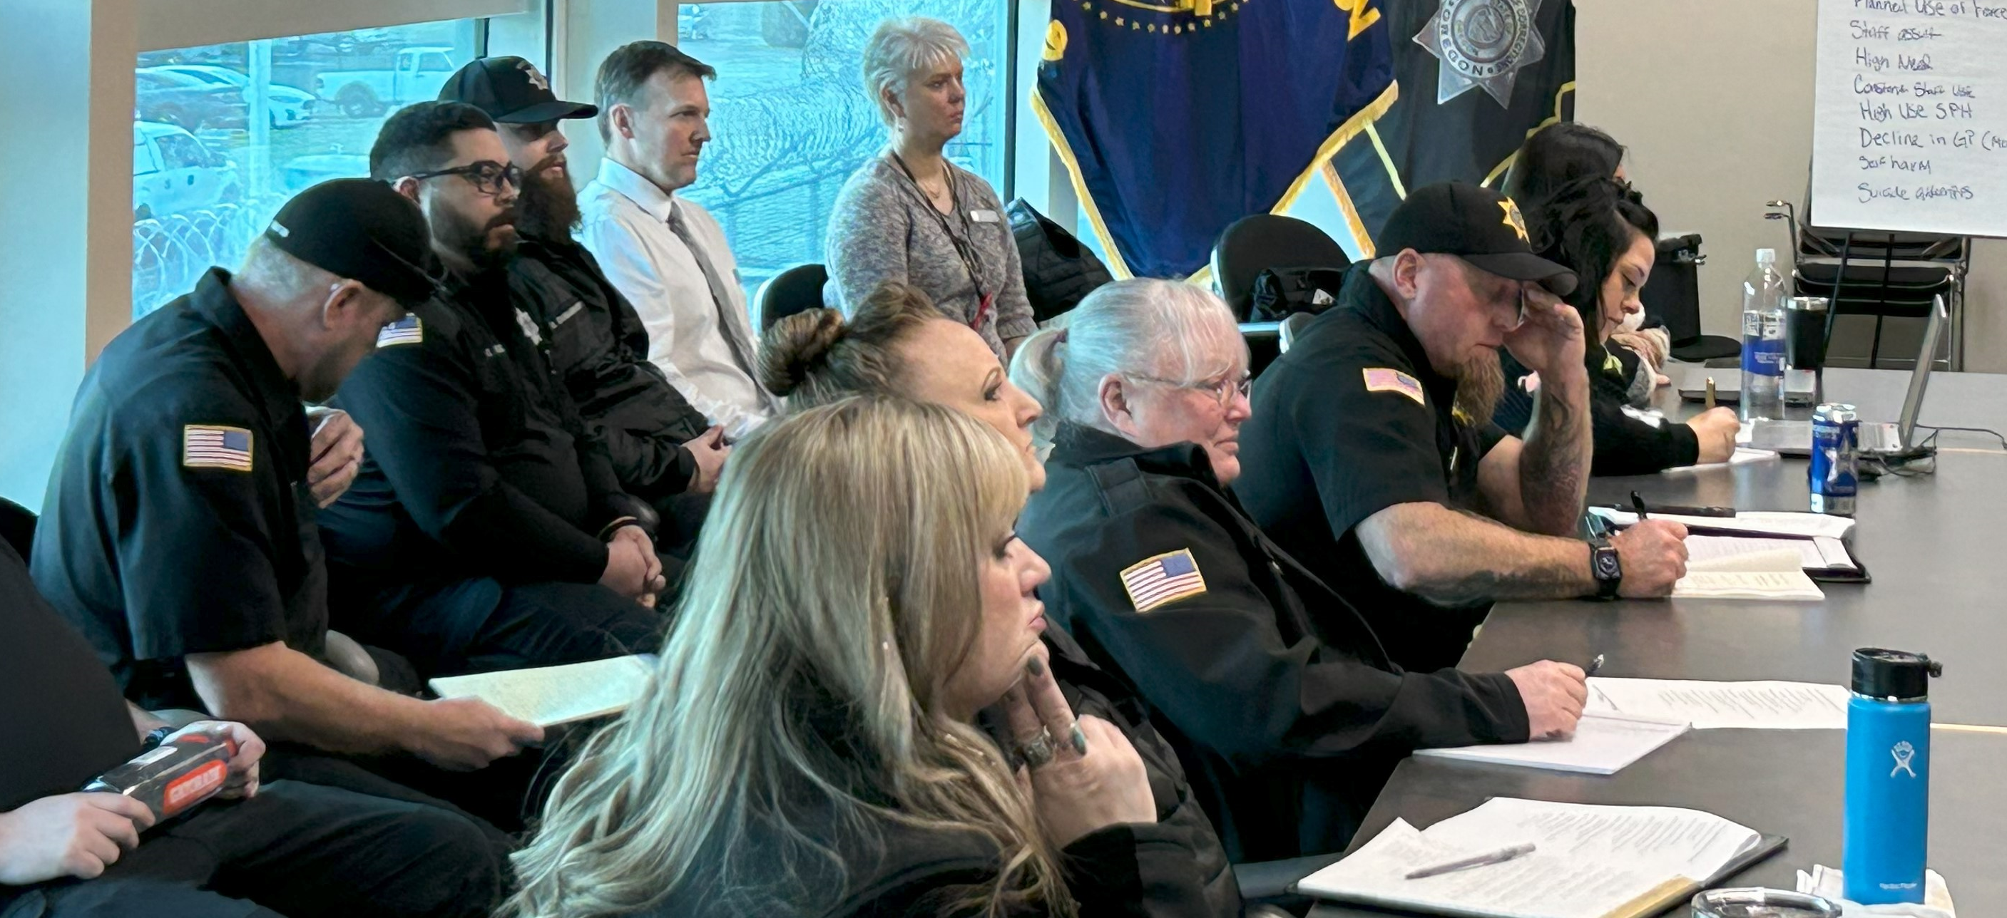
GIPA Implementation Team: Staff Training & Facility Culture
Charge: Developing and maintaining a well-trained professional staff and positive facility culture.
Goal: Utilize gender responsive recruitment, retention, training, promotion, and accountability improvements to ensure a facility culture that promotes well-being for staff, AICs, and the facility.
Progress highlights to date:
Delivered the “Creating Regulation and Resilience” (CR2) training to hundreds of staff members, instructor development courses being scheduled.
Implementation of Expectations and Accountability plan for CCCF Leadership, including specific GIPA training modules for CCCF Managers.
Now advancing 47 other recommendations.
Team members:
Gail Levario, Asst. Dir. Employee Services (Lead)
John Taber, Professional Development Administrator
Emily Bowen, Training & Development Specialist
Zach Erdman, Safety & Wellness Administrator
Christine Popoff, CCCF Asst. Superintendent
Chelsea Cappadona, ODHS-Child Welfare
Michelle Ehlers, Opportunity Oregon

Slide 12
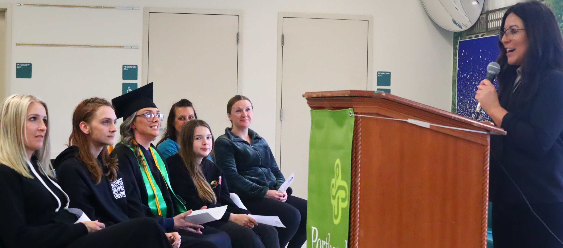
GIPA Implementation Team: Re-entry and Release
Charge: Establishing comprehensive supports for successful release and reentry.
Goal: Implement gender responsive practices and expand access to resources that address the unique needs of women and support their successful return to their communities.
Progress highlights to date:
Launched a Transitional Unit known as “Hope House.”
Established a WorkSource center at Coffee Creek, including linkages to community-based resources through the Inside Out Network.
Now advancing 32 recommendations.
Team members:
Larry Bennett, Asst. Dir. of Correctional Services (Lead)
Amy Bertrand, Re-entry and Release Services Administrator
Brooke Vice, Deputy Director, Community Corrections
Promise Parker, Release Services Manager
Polly Rowland, CCCF Assistant Superintendent
Paula Fata, Community Corrections Coordinator
Paige Frye-Holcomb, CJC
Kyle Black, OJRC
Notes:
Medical has 44 projects.
The "shorthand" list:
Immediately put Menopause/Female Supplements on canteen; conduct periodic surveys regarding canteen item addition requests.
Establish clear policies about accommodating special diets and ensure that AICs with specific nutritional needs are able to get those met.
Implement electronic medical requests and track response timelines.
Set benchmarks for HS response to AICs; audit and address lapses in compliance.
Make a system to track routine and follow-up appointments. The system should be able to show target service dates, identify which were achieved, and flag delays so that they can be addressed promptly.
Develop care timeliness benchmarks for initial encounters and follow up care. Require periodic compliance reporting.
Include external stakeholders when identifying data and reporting needs for the incoming EHR.
Following EHR implementation, conduct ongoing assessment to identify improvements and refinements.
Investigate ways to improve/replace the "TLC" care utilization system.
Assess whether it would be appropriate/possible to contract with community based healthcare providers to manage health services.
Reinstate the Chronic Disease/Chronic Pain Self-Management Program.
Provide health services staff with training in gender responsivity and trauma informed care.
Begin putting health/wellness information on the tablets. Solicit feedback from AICs about what type of information they would like to see.
Partner with outside agencies to bring in workshops, seminars, or informational sessions on women's health and wellness issues.
Immediately create more opportunities for patients to access telehealth.
Peers working as health and wellness supports for other AICs should be appropriately trained and compensated, with an avenue to achieve certification(s) that transfer to post-release settings.
End strip searches after medical procedures.
Establish a way to solicit regular, anonymous feedback from staff and AICs regarding health services policies and practices and provide that feedback to the Governor's Advisory Panel and the Corrections Ombudsperson.
Incorporate AICs and staff into discussion/policy development processes. This can help to bring the perspectives of all to address policies and practices that are being developed or modified, while providing a mechanism for information from each group to be communicated to the others.
Establish written guidelines for managing care for patients with multiple issues or complex medical needs, including scheduling longer appointments for those individuals so that a comprehensive care approach can be used and AIC time away from work/education is minimized.
Stop requiring AICs to forfeit PRAS points due to medical/behavioral health appointments. (Either pay people for those days or ensure that after-hours and weekend appointments are available.)
Establish a protocol for regular communication and improved coordination among administration, facility medical services staff, and AICs.
Implement a boundary spanner / patient advocate role within the facility.
Implement an ADL Assistant (peer) training program.
Periodically engage medical services staff to identify ways to address burnout and compassion fatigue.
Provide patients with a written after-visit summary that includes any diagnoses, test results, self-care recommendations, and care plan.
Create a shared recreational space at CCCF (gym/multipurpose building).
Develop a way for medical services and other facility staff to anonymously report issues with the provision of healthcare services.
Reinitiate targeted discussions/negotiations with AFSCME, DOC, and nursing staff to investigate the possibility of 3 x 12 or other alternative workweek schedules.
Utilize the Pregnancy Coordinator Nurse Practitioner position that is being added through the GIPA POP process to identify women's healthcare needs and advance women's health initiatives at CCCF.
Provide releasing AICS patient-centered contraceptive counseling and the contraception method of their choice upon release, with enough refills to last until they can reasonably access health care.
Identify a point person to ensure that individuals are released with a 30-day supply of all medications. Develop a written process to quickly address those situations where release meds are not provided, and provide this in writing to the releasing individual.
Assign a medical staff member to meet with individuals in advance of their release to ensure they have the resources and connections they need to ensure continuity of care.
Perform an intake-to-release systems audit at the facility to identify where a) policies are in place but are not being followed or b) policy development or clarification is needed.
Streamline processes for obtaining low-cost adaptive needs, such as hearing aids, eyeglasses, and dentures.
Establish a procedure for medical staff to appropriately document work restriction and dietary need recommendations and a procedure for individuals to timely address incidents where these are not being documented or honored.
Eliminate the practice of modifying prescription/aftercare instructions provided by outside specialists. If a modification is necessary, require that it not be done without the approval of the outside specialist.
Health services statistical reports (per NCCHC best practices) should be made at least monthly and provided to the facility administrator, agency leadership, the Corrections Ombudsperson, the Governor’s Advisory Panel, and others as appropriate.
CQI committee meeting minutes and summaries as well as the written annual review of the effectiveness of the CQI program (per NCCHC best practices) should be provided to facility administrator, agency leadership, the Corrections Ombudsperson, the Governor’s Advisory Panel, and others as appropriate.
Modify intake procedures to require that individuals receive an initial medical clearance to work in the kitchen and other areas.
Implement a Community Health Worker (peer) training and certification program.
Investigate the benefits/feasibility of moving male intake out of CCCF.
Expand the prescription medication formulary to correlate with OHP / public health offerings.
Establish “office hours” for patients to come in to ask follow-up questions and receive post-visit clarification.

Slide 13
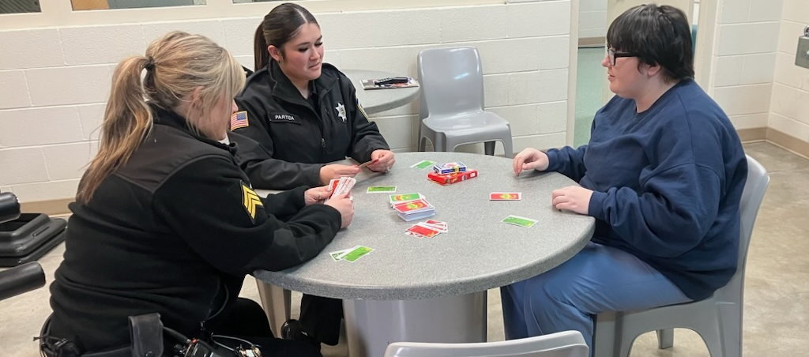
GIPA Implementation Team: Gender Responsive Operations
Charge: Infuse gender responsive and trauma informed practices into all aspects of facility operations.
Goal: Maintain a custodial setting that furthers the goals of safety and security while providing opportunities for personal growth and rehabilitation.
Progress highlights to date:
Improve identified issues in the Special Housing Unit.
AICs on intake status have access to canteen purchases.
Now advancing 54 recommendations.
Team members:
Josh Highberger, Assistant Director Operations (Lead)
Nichole Brown, Supt. of Gender Informed Practices
Tom McLay, Westside Institutions Administrator
Chris Randall, Acting CCCF Superintendent
Veva Campeau, DEI Manager
Mandy Davis, Trauma Informed Oregon
Angela Kim, OJRC
Notes:
AIC’s in special housing may access tablets and other incentives have been introduced to encourage improved behavior and promote increased out-of-cell time.
A DOC Counselor is offering cognitive programming in DSU as a pilot
Special Housing Staff Training
The CCCF team has undergone specialized training in de-escalation techniques and alternatives to the use of force.
This training is delivered through the Oregon Way program in conjunction with Resource Team training in California, ensuring staff are well-prepared to handle sensitive situations in special housing environments.
Creating Regulation and Resilience Training (CR2)
An 8-hour course has been introduced to foster self-regulation and communication skills among corrections staff, enhancing their capacity to manage challenging situations and build resilience.

Slide 14

GIPA Implementation Team: Medical Services
Charge: Provide timely and appropriate medical care to all AICs.
Goal: Promote AIC wellness through the effective delivery of quality medical care and resources.
Progress highlights to date:
Coffee Creek’s Doula Program.
Substance Use Disorder (SUD) treatment now available to all AICs at all stages of their sentence.
Now advancing 44 recommendations.
Team members:
Heidi Steward, Deputy Director - Acting Assistant Director Health Services
Aimee Hughes, Medical Services Administrator
Buffy Ross, Assistant Health Services Administrator
Mira Nicolas, Medical Services Manager CCCF
Jodi Hansen, Former Healthcare Administrator, ED Remnant Initiatives
Alicia Roach, Doula, Ostara Initiative
Notes:
**Notes**
The "shorthand" list:
Immediately put Menopause/Female Supplements on canteen; conduct periodic surveys regarding canteen item addition requests.
Establish clear policies about accommodating special diets and ensure that AICs with specific nutritional needs are able to get those met.
Implement electronic medical requests and track response timelines.
Set benchmarks for HS response to AICs; audit and address lapses in compliance.
Make a system to track routine and follow-up appointments. The system should be able to show target service dates, identify which were achieved, and flag delays so that they can be addressed promptly.
Develop care timeliness benchmarks for initial encounters and follow up care. Require periodic compliance reporting.
Include external stakeholders when identifying data and reporting needs for the incoming EHR.
Following EHR implementation, conduct ongoing assessment to identify improvements and refinements.
Investigate ways to improve/replace the "TLC" care utilization system.
Assess whether it would be appropriate/possible to contract with community based healthcare providers to manage health services.
Reinstate the Chronic Disease/Chronic Pain Self-Management Program.
Provide health services staff with training in gender responsivity and trauma informed care.
Begin putting health/wellness information on the tablets. Solicit feedback from AICs about what type of information they would like to see.
Partner with outside agencies to bring in workshops, seminars, or informational sessions on women's health and wellness issues.
Immediately create more opportunities for patients to access telehealth.
Peers working as health and wellness supports for other AICs should be appropriately trained and compensated, with an avenue to achieve certification(s) that transfer to post-release settings.
End strip searches after medical procedures.
Establish a way to solicit regular, anonymous feedback from staff and AICs regarding health services policies and practices and provide that feedback to the Governor's Advisory Panel and the Corrections Ombudsperson.
Incorporate AICs and staff into discussion/policy development processes. This can help to bring the perspectives of all to address policies and practices that are being developed or modified, while providing a mechanism for information from each group to be communicated to the others.
Establish written guidelines for managing care for patients with multiple issues or complex medical needs, including scheduling longer appointments for those individuals so that a comprehensive care approach can be used and AIC time away from work/education is minimized.
Stop requiring AICs to forfeit PRAS points due to medical/behavioral health appointments. (Either pay people for those days or ensure that after-hours and weekend appointments are available.)
Establish a protocol for regular communication and improved coordination among administration, facility medical services staff, and AICs.
Implement a boundary spanner / patient advocate role within the facility.
Implement an ADL Assistant (peer) training program.
Periodically engage medical services staff to identify ways to address burnout and compassion fatigue.
Provide patients with a written after-visit summary that includes any diagnoses, test results, self-care recommendations, and care plan.
Create a shared recreational space at CCCF (gym/multipurpose building).
Develop a way for medical services and other facility staff to anonymously report issues with the provision of healthcare services.
Reinitiate targeted discussions/negotiations with AFSCME, DOC, and nursing staff to investigate the possibility of 3 x 12 or other alternative workweek schedules.
Utilize the Pregnancy Coordinator Nurse Practitioner position that is being added through the GIPA POP process to identify women's healthcare needs and advance women's health initiatives at CCCF.
Provide releasing AICS patient-centered contraceptive counseling and the contraception method of their choice upon release, with enough refills to last until they can reasonably access health care.
Identify a point person to ensure that individuals are released with a 30-day supply of all medications. Develop a written process to quickly address those situations where release meds are not provided, and provide this in writing to the releasing individual.
Assign a medical staff member to meet with individuals in advance of their release to ensure they have the resources and connections they need to ensure continuity of care.
Perform an intake-to-release systems audit at the facility to identify where a) policies are in place but are not being followed or b) policy development or clarification is needed.
Streamline processes for obtaining low-cost adaptive needs, such as hearing aids, eyeglasses, and dentures.
Establish a procedure for medical staff to appropriately document work restriction and dietary need recommendations and a procedure for individuals to timely address incidents where these are not being documented or honored.
Eliminate the practice of modifying prescription/aftercare instructions provided by outside specialists. If a modification is necessary, require that it not be done without the approval of the outside specialist.
Health services statistical reports (per NCCHC best practices) should be made at least monthly and provided to the facility administrator, agency leadership, the Corrections Ombudsperson, the Governor’s Advisory Panel, and others as appropriate.
CQI committee meeting minutes and summaries as well as the written annual review of the effectiveness of the CQI program (per NCCHC best practices) should be provided to facility administrator, agency leadership, the Corrections Ombudsperson, the Governor’s Advisory Panel, and others as appropriate.
Modify intake procedures to require that individuals receive an initial medical clearance to work in the kitchen and other areas.
Implement a Community Health Worker (peer) training and certification program.
Investigate the benefits/feasibility of moving male intake out of CCCF.
Expand the prescription medication formulary to correlate with OHP / public health offerings.
Establish “office hours” for patients to come in to ask follow-up questions and receive post-visit clarification.

Slide 15
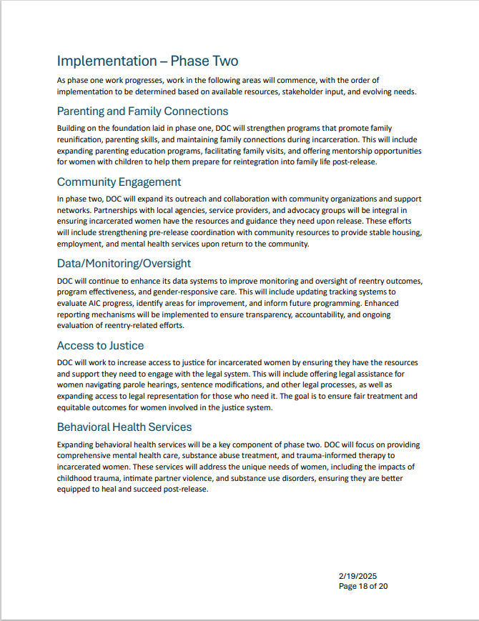
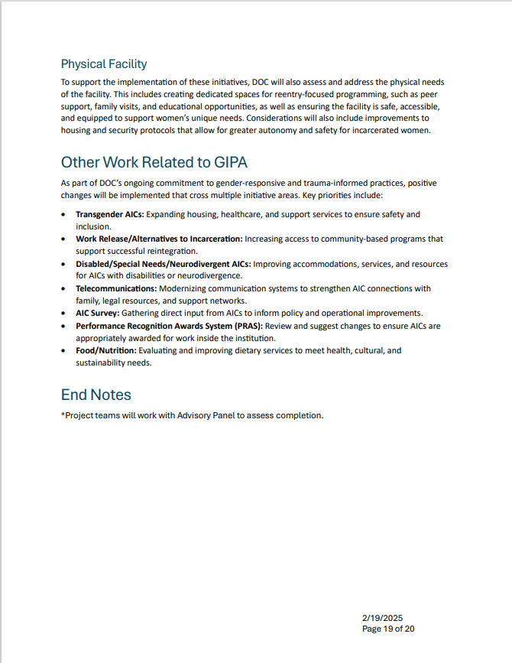
Two Phase Approach to Implementation
Behavioral Health Services:
  Goal: Effectively deliver high-quality behavioral health services, including evidence-based substance disorder treatment.
Community Engagement:
  Goal: Promote engagement and collaboration with citizens, communities, and leaders to advance improvements for the benefit of AICs and staff.
Data, Monitoring, and Oversight:
  Goal: Establish oversight and accountability protocols to ensure transparency and continuous quality improvement.
Access to Justice:
  Goal: Increase access to justice for incarcerated women by ensuring they have the resources and support they need to engage with the legal system.
Parenting and Family Connections:
  Goal: Leverage intrinsic motivational factors through support for connections with family and other important supports.
Indoor/Outdoor Facilities:
  Goal: Provide a physical environment that supports AIC growth, wellness, and transformation.
Notes:
Making the work part of DOC’s value system. Thoughtful about the first five and then our commitment to all – this work will begin as resources become available.

Slide 16
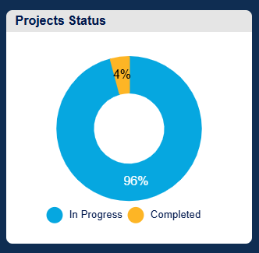
Accountability and Transparency
A detailed report of all GIPA-related projects and their status lives on the DOC website, with a link on the home page: www.Oregon.gov/DOC
We are committed to a system of accountability that includes providing quarterly updates to the legislature and stakeholders.
Notes:
The public-facing website draft can be viewed here: https://app.smartsheet.com/b/publish?EQBCT=d620d9cd166e4f15b7732056f37fd9bd

Slide 17
Our Challenges
Staffing
Culture
PREA
Healthcare
Funding
Notes:
I want to spend some time talking about our challenges at DOC…(see Mike’s notes)

Slide 18
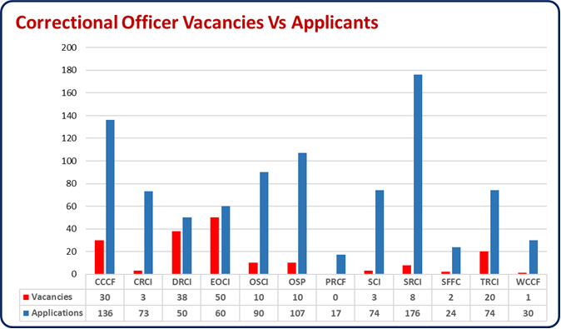
Staffing
Notes:
We're optimizing candidate flow by reaching out to those in the Portland and Salem pipelines who are unlikely to move forward due to limited vacancies. We're offering them faster paths by transferring applications to institutions with immediate need—e.g., 5 CRCI candidates were successfully redirected to CCCF for quicker onboarding.
Our new HR Assistants are delivering strong results. They’re maintaining candidate engagement and moving people efficiently through eSOPH, with 20+ candidates completing it weekly and moving into background checks.
We’re growing awareness of ODOC careers through active presence at hiring events, the State Fair, and targeted outreach at local universities and high schools.
We’ve developed a cadet program for behavioral health and CO roles in partnership with Salem’s Career Technical Education Center (CTEC) - targeting early talent and building a long-term pipeline.
The Correctional Professional Trainee program is now embedded at CCCF, EOCI, and TRCI. CCCF just advanced four CPTs to CO status (with two more close behind), and EOCI has transitioned five CPTs to permanent roles.
We are seeing success in bringing lots of candidates - with attrition (retirements, promotions, etc) we are still maintaining a positive trend toward full staffing over the next year
Despite natural attrition from retirements and promotions, we’re seeing steady hiring progress. With strong candidate flow and improved onboarding systems, we’re on track to strengthen staffing levels across institutions - supporting safer operations and long-term stability.

Slide 19
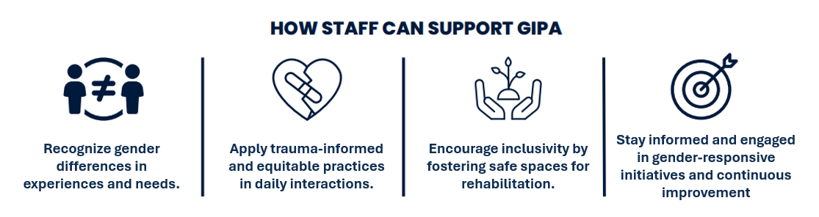
Institution Culture
Notes:
Leadership matters – leadership challenges at CCCF. Many Superintendents over the years. Interim Sup we will select a visionary leader. Likely from outside – new ideas, etc.
Employee engagement – we have to take care of our employees, so they can run the institution with care.
GIPA Training and Staff Culture Workgroup (Team 2):
What We've Done
We’ve developed a practical expectations roadmap for institutional managers - a guide to strengthen staff visibility, engagement, communication, and accountability. It’s not about adding tasks - it’s about reinforcing what good managers already do.
We created a one-page visual resource to clarify what GIPA is, and what it isn’t. This will help reintroduce the initiative in a way that’s accessible, actionable, and cuts through confusion.
We built a foundational training framework that includes short videos and interactive materials to give staff the tools they need to lead, coach, and communicate more effectively.
What’s Coming Next
We’re launching a structured training series to embed these tools into daily operations, starting with CCCF and expanding across the agency.
We’ll continue partnering with facility leadership to reintroduce GIPA in practical ways, starting with what's working, building trust, and engaging every level of staff in the culture we’re shaping.

Slide 20

PREA
Zero tolerance for PREA violations.
PREA-specific staffing.
Addressing structural vulnerabilities.
PREA dashboard.
Notes:
Heidi – value statement – we want our institutions to be safe, we want our staff to feel protected, and we will hold staff responsible, include prosecution and termination. Changes to physical structure and also using technology – body cameras. Speed up investigations
The PREA Compliance Manager (PCM) is a management staff person with sufficient time and authority to coordinate the facility’s efforts to comply with the federal PREA standards. This position is required by the PREA standards. The PCM reports to the Inspector General, independent of the facility and serves as a back up to for the Sexual Abuse Liaison. The PCM has responsible for the overall PREA program at the facility. The PCM leads reviews of unsubstantiated and substantiated allegations of sexual abuse within 30 days of investigational closure. The PCM acts as the facility’s main point of conduct for audits and audit preparation, as well as the primary point of contact for litigations, tort claims, and criminal cases related to PREA. The PCM works closely with facility staff to ensure camera mapping is updated and PREA remains a consideration when changes are proposed or made to the physical plant.
The Sexual Abuse Liaison (SAL) is a management staff person designated by the facility’s functional unit manager to coordinate response, reporting, and monitoring of AIC abuse within the facility. The SAL reports to the facility superintendent and serves as a back up to the PCM. The SAL has oversight of the Sexual Abuse Response Team (SART) and is responsible for the recruitment of new members, assigning and reviewing administrative investigations, investigating allegations of retaliation, and ensuring notifications occur when investigations are completed. The SAL schedules and facilitates SART meetings and ensures all team members are appropriately trained.
As management members, the PCM and SAL may conduct investigations involving staff suspects. Both positions are full-time with no collateral duties assigned to them.
The SART is a multidisciplinary team comprised of members designated in writing by the facility to educate facility staff on proper response to allegations made by AICs, assist with and/or complete administrative investigations of AIC-to-AIC sexual abuse and sexual harassment, conduct retaliation monitoring, and may conduct 72-hour and 30-day risk screenings.
Rule of 3 – why. Cameras. Doors with windows.
The Prison Rape Elimination Act (PREA) was passed unanimously by both parties in Congress in 2003. The purpose of the act is to “provide for the analysis of the incidence and effects of prison rape in federal, state, and local institutions and to provide information, resources, recommendations and funding to protect individuals from prison rape.” (Prison Rape Elimination Act, 2003.) In addition to creating a mandate for significant research from the Bureau of Justice Statistics and the National Institute of Justice, PREA funding through the Bureau of Justice Assistance and the National Institute of Corrections has supported major efforts in many state correctional, juvenile detention, community corrections, lockups, and jail systems.
Background on PREA audits
All correctional facilities are required to receive a national PREA audit once every three years, and a third of our facilities are audited annually. Auditors are certified by the United States Department of Justice (US DOJ) and independent of the agency for which they are auditing. Auditors receive specialized training, must follow the requirements in the PREA auditor handbook PREA Auditor Handbook Version 2.1 (12.23.22 Update), and are overseen by US DOJ. PREA audits are rigorous, practice-based, and include a systematic review of evidence that involves document review, interviews of AICs, staff, contractors, volunteers, and community-based advocacy organizations. Auditors must ensure institutionalization of each provision of every PREA standard in order to make a compliant finding.
Based on the extensive requirements outlined in the PREA standards, it is expected that all facilities will enter various levels of corrective action. Once an interim audit report is issued, the facility has up to 180 days to demonstrate sustained compliance and institutionalization with every provision of the standards.
The Oregon Department of Corrections has had one facility that was not able to become compliant in 2023 within the allotted corrective action period. Columbia River Correctional Institution received another audit in 2024 and was able to achieve full compliance.
CCCF PREA Audit
CCCF’s PREA audit took place the first week of November 2024. An interim audit report was issued on December 16, 2024, which identified 16 PREA standards that were not compliant. The facility actively engaged in a corrective action plan, which included weekly meetings with the auditor, facility leadership, the Inspector General’s office PREA HQ team, and agency leadership. During the corrective action process, the facility made significant headway in many standards.
The auditor has notified us that she does not believe we have enough time at the end of the corrective action period to become fully compliant with every standard. We will continue through the end of the corrective action, which is June 14, 2025, to be as compliant as possible. She explained that, although CCCF had made great progress, there were factors that impacted institutionalization, such as:
Newly hired staff in key PREA positions (PREA Compliance Manager hired in December 2024 and the Sexual Abuse Liaison hired in March 2025.)
Overall staffing at the facility (currently around 24% vacancy rate)
Turnover in key leadership positions (Interim Operations Superintendent hired November 2024, reassignment of GIPA Superintendent February 2025, Acting Assistant Superintendent of Security March 2025.)
Next Steps for PREA at CCCF
We expect to receive a final audit report from the auditor by July 29, 2025, which outlines her compliance determinations. Every final audit report is posted on the ODOC website at Department of Corrections : PREA Statistics and Reports : Prison Rape Elimination Act : State of Oregon.
CCCF will continue with its efforts to address noncompliance in all areas of PREA and the agency will work to schedule a new PREA audit once compliance can be achieved and sustained.
ODOC and CCCF continue to have zero-tolerance for sexual abuse and sexual harassment. The safety of the AICs in our custody is imperative, and we continually improve our processes to ensure all allegations are responded to appropriately.
Consequences of Non-Compliance
Every year, the Governor for each state certifies the level of compliance with state ran correctional facilities. In Oregon, that is the Oregon Youth Authority and the Department of Corrections. The Governor’s office has not been able to certify compliance in several years due to staffing ratio issues at the Oregon Youth Authority and is unrelated to the audit at CCCF. In 2023 there were 26 states that certified compliance and 29 states and territories that did not. When a Governor is not able to certify compliance, it will have a 5% grant funding impact on two grants:
BJA’s Edward Byrne Memorial Justice Assistance Grant Program, and
The Office of Juvenile Justice and Delinquency Prevention’s (OJJDP’s) Juvenile Justice and Delinquency Prevention Act (JJDPA) Formula Grant Program.
Although the total amount varies from year to year, is typically around $60,000 for both grants total. We have not been notified what the total amount will be for this year.

Slide 21
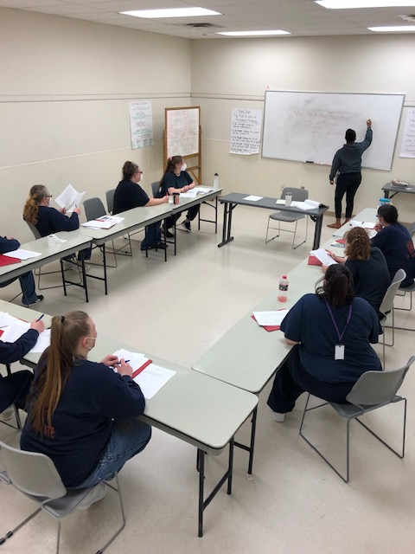
Health Services
Medical Services
Behavioral Health Services
SUD Treatment Services
Dentistry
Pharmacy and Pharmacy Stores
Notes:
Need to address: 1) inadequate care 2) delayed & denied care 3) poor quality care 4) not calibrated to women’s needs.
Also focus on what we’ve done to improve staff training, communication & coordination across functions, and better responsiveness to mental and physical needs since 2023.
Other issues identified in the GIPA: lack of response to medical kytes and high turnover/vacancy rates among health services staff. Also disproportionate relative to male AICs: suicide attempts, pharmacy medications, medical emergencies, lack of outside medical trips, mental health UIRs.
The use of the 3 “Rage Cages” in SHU might be brought up.
See pages 157-168 in the report.

Slide 22
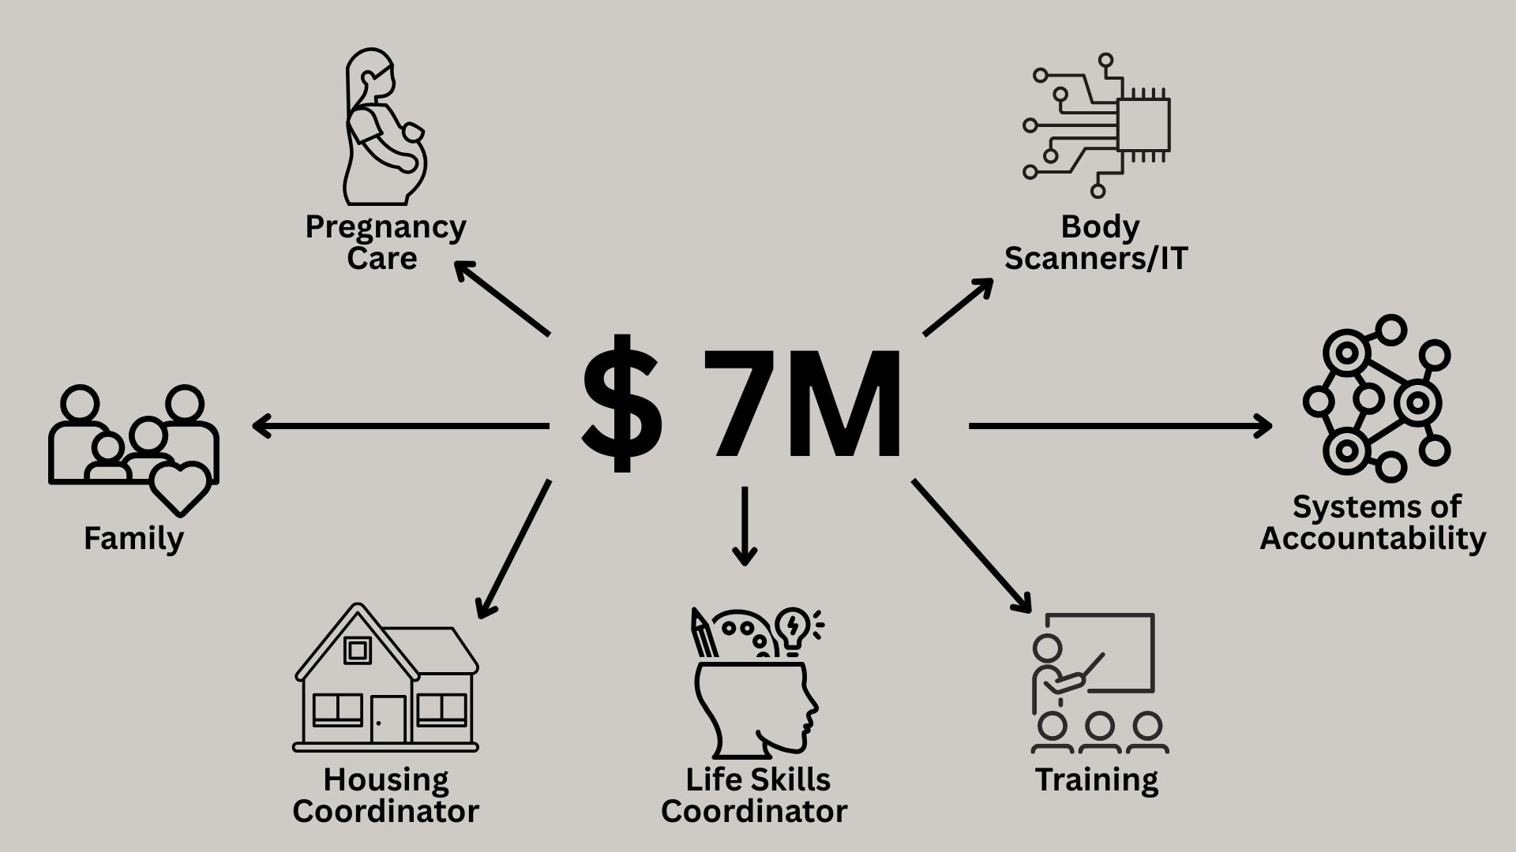
Gender Informed Practices Assessment (POP)
Notes:
(Mike) The 2025-27 Governor’s Recommended Budget (GRB) includes Policy Option Packages (POPs) to support the GIPA work at CCCF. These strategic investments will help ensure CCCF continues to implement the recommendations from GIPA, improving outcomes for incarcerated individuals and staff alike.
Operations - $3.75M
GIPA Manager, Admin Specialist, Sexual Assault Liaison, PREA Compliance Manager, Policy Analyst, Life Skills Coordinator, Community Liaison
Three additional body scanners
Central Admin - $1M
Three Inspector positions
Health Services - $400,000
Pregnancy Coordinator
Correctional Services - $1.7M

Slide 23
Our Successes
Reentry Housing Unit
Doula Program
Communication
Partnerships
New CCCF Superintendent
Notes:
We have work to do and there is good work happening and I want to share those with you.

Slide 24
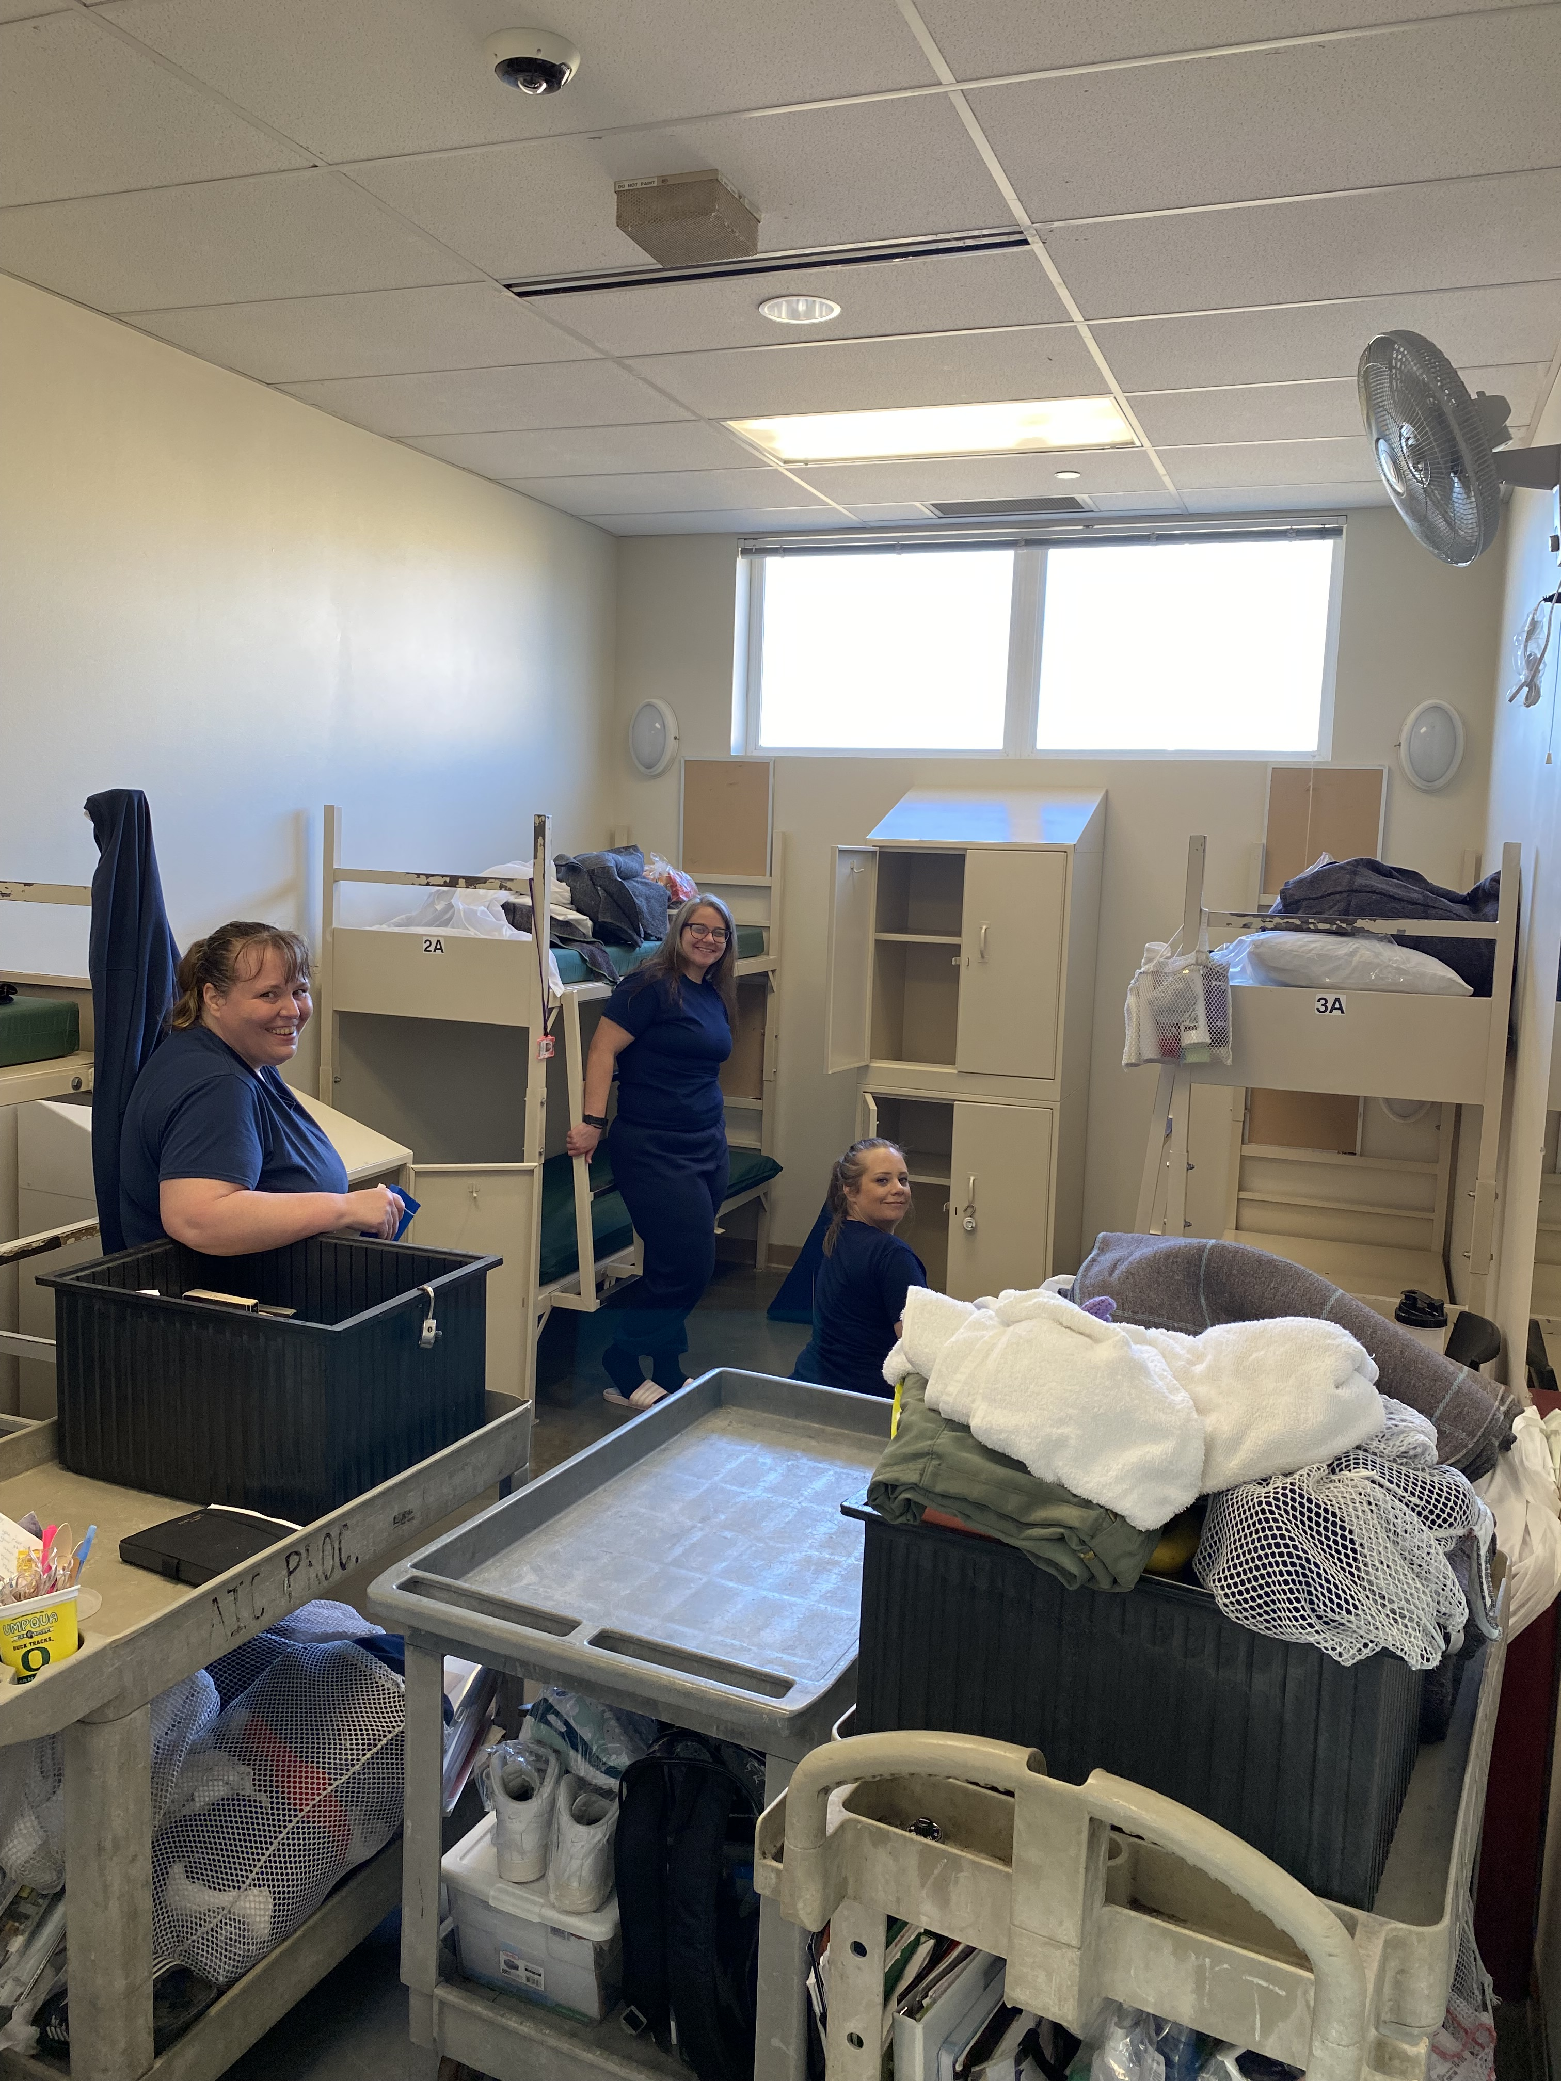
Freedom House Reentry Housing Unit
“I now have been at the Freedom House for two weeks and wake up every day refreshed with a new mindset of getting out.
It’s allowing me to solely focus on me, my release, my recovery, and my potential success.
Thank you to all that have worked so hard to make this happen!!!”
- Former AIC Sharipof
Notes:
(Mike) Became Transition Unit in August 2024
Vision:
Creating an organizational climate that encourages diversity, wellness, and a pro-social environment.
Providing the opportunity to try new practices or approaches, tolerate the uncertainty that accompanies transitional periods during which practices and procedures are evolving, respond to unforeseen barriers, and revise current behaviors that are not achieving desired results.
Named the “Freedom House” by the AIC residents
Houses up to 25 women and four puppies… (currently 20 women living there)
Women apply to join the house… outlook and behavior must be 100% committed to preparing for transition
Must be 6 months or less remaining, have good conduct, and actively working or programming (or both), to be admitted
To apply with longer than six months to release, must be a Peer Wellness Support member or Certified Mentor and with good conduct
Outside speakers and organizations providing reentry-focused services in the community hold presentations and workshops for the women
Residents create their own structure (community rules, chore schedules, etc.), take care of their own “house”, and have a voice in how or what the operation of the house is or can be.

Slide 25
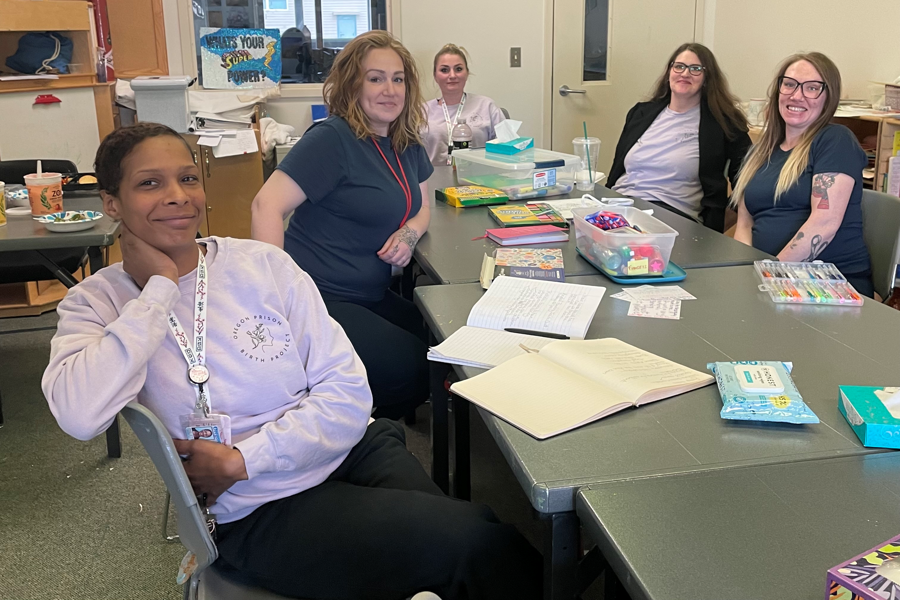
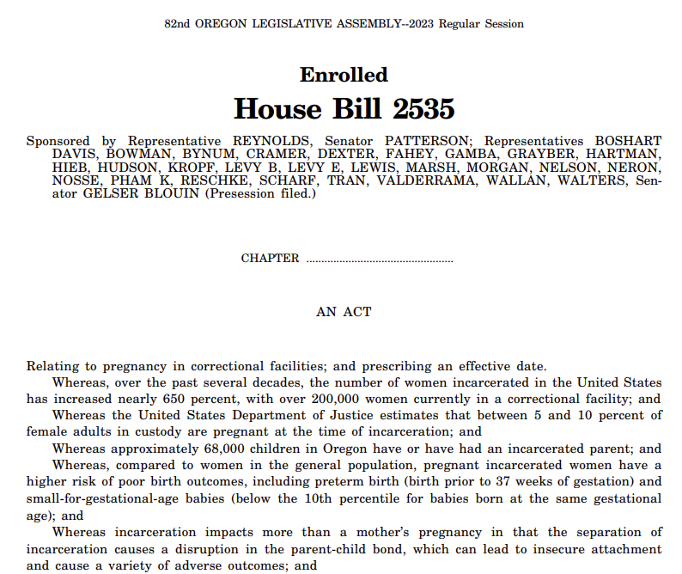
Doula Program
Notes:
(Heidi) DOC has successfully implemented a Doula Program at CCCF. A Doula Program at a women's prison is crucial for enhancing the health and well-being of incarcerated pregnant and postpartum women. Doulas provide essential emotional, physical, and informational support, which is particularly beneficial in a prison environment where healthcare resources and emotional support are often limited. Such programs can improve birth outcomes, reduce the stress and anxiety associated with incarceration, and promote maternal-infant bonding, ultimately fostering a more supportive correctional environment. Additionally, these programs can offer valuable childbirth education and parenting skills, contributing to the rehabilitation and empowerment of incarcerated women.

Slide 26
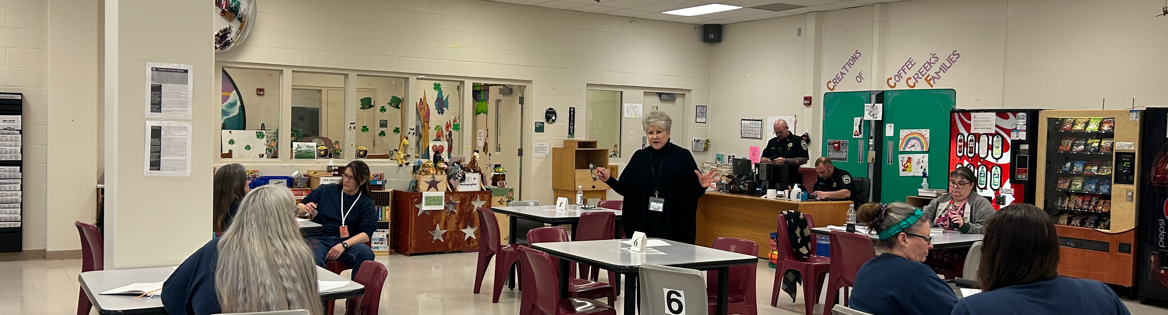
Communication
AIC Communication
Employee Communication
One-on-one meetings with leadership
Townhalls
Newsletter articles on GIPA, PREA
Clear expectations of Managers
PAF Check ins
Policy changes

Slide 27







































Success through Partnership
Oregon Coalition for Higher Education in Prison (OCHEP)
Notes:
At CCCF, this spirit of partnership is not just a philosophy; it's a daily practice. Whether it's through programming, parenting support, education, or reentry planning, we rely on the strengths of our external partners to meet the complex and varied needs of incarcerated women. Today, there is more collaboration between DOC and external organizations—governmental, nonprofit, and community-based—than at any point in our history.
But make no mistake: this work cannot and should not be done by DOC alone.
If we are serious about interrupting the cycle of incarceration, especially for women—many of whom are survivors of trauma, are mothers, and are navigating significant barriers to stability—then we must continue investing in partnerships. That includes collaboration with state and county agencies, sovereign nations, nonprofits, volunteers, and, importantly, with you—our legislators.
Every external partnership we foster is aimed at one clear goal: increasing the chances of success when a woman leaves our custody. That translates directly into less recidivism, fewer victims, stronger families, and safer communities across Oregon.
CCCF has 296 active volunteers, to include:
51 education volunteers
162 Religious Service Volunteers
63 Lifeskill volunteers
20 volunteers placed under other umbrellas (such as ADMIN for the TACE event, etc.)
We have absolutely seen an increase in volunteers over the last couple years! For example, on December 10, 2024, CCCF had 250 active volunteers. That is 46 new volunteers since December!!

Slide 28
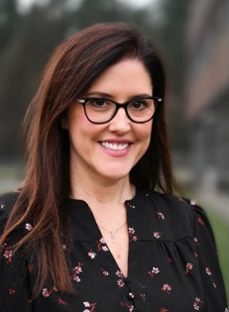
Charlotte Thrasher, new CCCF Superintendent
“I am honored to join the Oregon Department of Corrections and am thankful for the opportunity to continue my commitment to improving the lives of incarcerated women by leading enhancement of trauma and gender practices. I am excited to work side by side with the staff at CCCF as we build this initiative together.”
Notes:
Starts June 23, 2025. As Superintendent of the Washington Corrections Center for Women, Ms. Thrasher oversaw numerous meaningful programs which infuse hope and humanity into the practices of treating criminogenic needs. She believes in the power of progression, dynamic security and building safe/humane systems to prepare incarcerated individuals for reentry into the community. Ms. Thrasher has strong commitment to staff safety and prioritizes facility security practices. She currently serves as the west side Incident Commander for the Department Incident Management Team and has deployed to numerous states to provide emergency management support to large scale events within and outside of DOC. In addition to completing her Bachelor of Arts degree in Law and Justice at Central Washington University, she has participated in numerous partnerships and training opportunities with Amend, National Institute of Corrections, Washington State Association of Police Chiefs, Prison Fellowship, and FEMA.

Slide 29
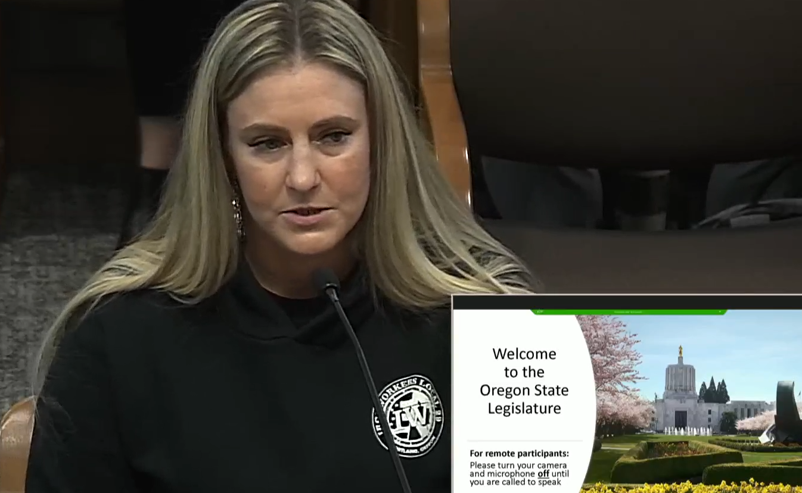
Ways and Means Public Testimony
“I was incarcerated for 5 years at Coffee Creek. At first, I took my sentence as a punishment. Then I realized that I could use that time as an opportunity to change my life for the better if given the right opportunity.
U-PACT was that chance. Not only did they teach me the ways of the trades, but they set me up for success. I was released July 5, 2024, and went straight to work…this program changed my life.”
-Ashley Lautenschlager
Notes:
Mike – feelings during Ways and Means. We heard from women who were incarcerated - transformational power
I urge you to listen to THEIR words and I urge you to come and visit. This is about transparency and accountability. The Governor, Gov’s Office, Legislators (Manning, Thatcher have been this year). The media – please watch.
Please come see the good work and challenges.

Slide 30
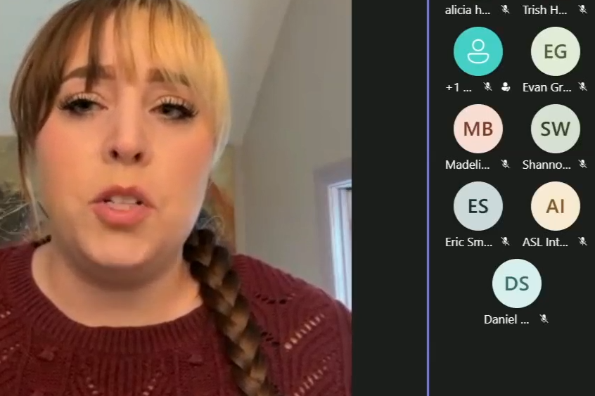
Ways and Means Public Testimony
“I was incarcerated at Coffee Creek for 30 months and released in November 2023. I was able to leave incarceration with a career as a paralegal.
Now that I’m on the other side of incarceration and able to assist adults in custody who are swimming in the tumultuous waters of reintegration, it is the most fulfilling work I’ve ever found.”
- Stephanie Davis
Notes:
Mike – feelings during Ways and Means. We heard from women who were incarnated - transformational power
I urge you to listen to THEIR words and I urge you to come and visit. This is about transparency and accountability. The Governor, Gov’s Office, Legislators (Manning, Thatcher have been this year). The media – please watch.
Please come see the good work and challenges.

Slide 31
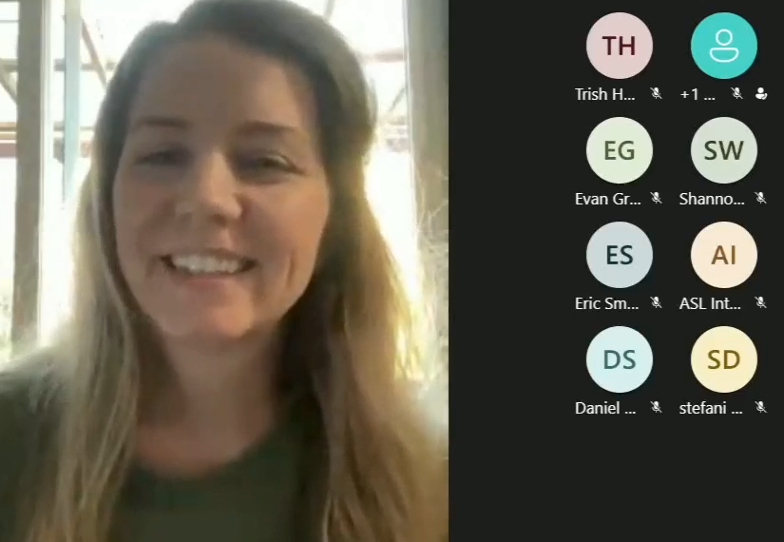
Ways and Means Public Testimony
“There are tons of excellent programs – job training, coping skills, learning how to manage life on the outside once you’re released. There’s just not enough funding to expand these programs. We need the AICs to have the opportunity to enter those programs that will give them job skills and confidence to move forward.”
- Alicia Humbert
.”
- Alicia Humbert
Notes:
Mike – feelings during Ways and Means. We heard from women who were incarnated - transformational power
I urge you to listen to THEIR words and I urge you to come and visit. This is about transparency and accountability. The Governor, Gov’s Office, Legislators (Manning, Thatcher have been this year). The media – please watch.
Please come see the good work and challenges.

Slide 32
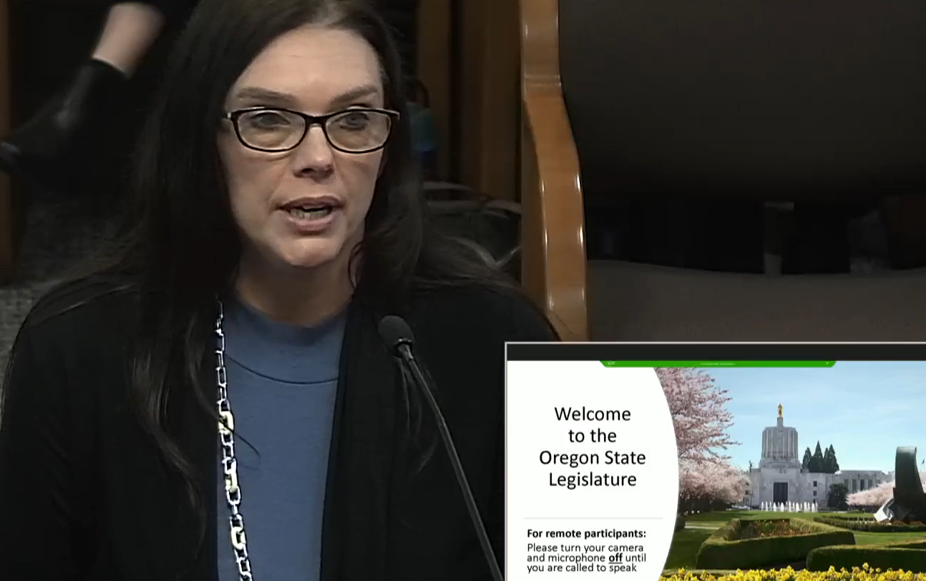
Ways and Means Public Testimony
“While I was incarcerated, I was able to become a certified recovery mentor, peer wellness specialist and I was also the first woman to achieve their bachelor’s degree through [PSU] while incarcerated … Everything that I did in there gave me the foundation to be successful and that’s why I sit here today and speak to you on behalf of the DOC.”
- Michelle Ehlers
Notes:
Mike – feelings during Ways and Means. We heard from women who were incarnated - transformational power
I urge you to listen to THEIR words and I urge you to come and visit. This is about transparency and accountability. The Governor, Gov’s Office, Legislators (Manning, Thatcher have been this year). The media – please watch.
Please come see the good work and challenges.

