Slide 1
ADRC of Oregon Training
Pre-requisite: Introduction to the ADRC

Slide 2
Agenda
History of the ADRC
Information and Referral
Options Counseling

Slide 3

Aging & Disability Resource Centers Program/No Wrong Door System
The No Wrong Door (NWD) System initiative is a collaborative effort of the Administration for Community Living (ACL), the Centers for Medicare & Medicaid Services (CMS), and the Veterans Health Administration (VHA). The NWD System initiative builds upon the Aging and Disability Resource Center program and CMS’ Balancing Incentive Program No Wrong Door requirements which support state efforts to streamline access to long-term services and support (LTSS) options for older adults and individuals with disabilities. NWD systems simplify access to LTSS, and are a key component to LTSS systems reform.
Notes:
We are one of 8 states who got a grant to pilot the ADRC since 2012 to pull together standards and best practices. They will be pulling recommendations together to create a handbook for other states.

Slide 4

The Older Americans Act of 1965
The Older Americans Act (OAA), originally enacted in 1965, to help seniors stay as independent as possible in their homes and communities. In addition, OAA services help seniors avoid hospitalization and nursing home care and, as a result, save federal and state funds that otherwise would be spent on such care.
OAA was reauthorized in 2016 for the 2017-2019 biennium. It includes provisions that aim to protect vulnerable elders by strengthening the Long-Term Care Ombudsman program and elder abuse screening and prevention efforts.
Notes:
See OAA Fast Facts handout

Slide 5

What is the ADRC?
The ADRC is a philosophy for delivering services to the community in a collaborative partnership model with our core partners.
Mental Health
ID/DD
Local Community Partners
AAA
Veterans Administration
APD
CILS
Notes:
It’s not brick and mortar, it’s a philosophy.
Do these look familiar? They are very similar to the core services included in the OAA, and offered by AAAs and CILs

Slide 6

Oregon Association of Area Agencies on Aging and Disabilities
Area Agencies on Aging & Disabilities provide long-term care services statewide Older Americans Act programs and Oregon Project Independence statewide.
The Oregon Association of Area Agencies on Aging and Disabilities (O4AD) is comprised of 17 Area Agencies on Aging located throughout all of Oregon, and advocates to protect the independence, dignity, choice and safety of Oregon’s seniors and people with disabilities.
Area Agencies on Aging provide core services including Information & Referral, Case Management, Preventative Health and Nutrition Services, and Family Caregiver Support.

Slide 7
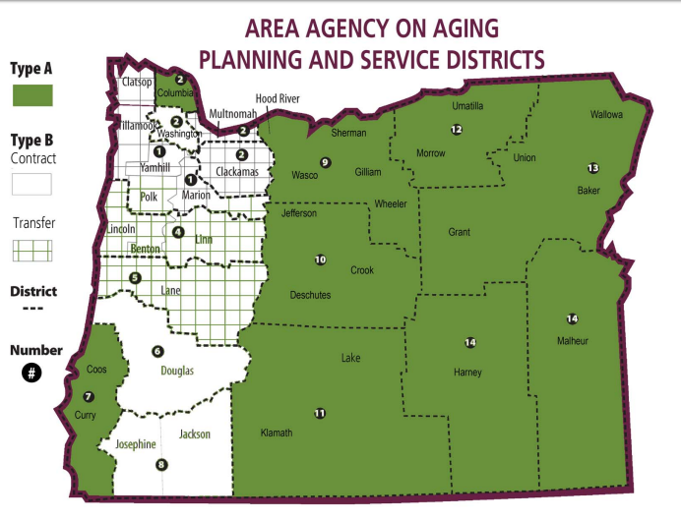
Northwest Senior & Disability Svcs
2. Columbia Cty Community Action
2. Clackamas County SS
2. Multnomah County ADVSD
2. Washington County DAVS
4. Oregon Cascades West COG
5. Lane Council of Governments
6. Douglas County SDS
7. South Coast Business Employment Corp.
8. Rogue Valley COG
9. Mid-Columbia COG
10. Council on Aging of Central Oregon
11. Klamath and Lake Counties COG
12. Community Action Program of Eastern Oregon
13. Community Connection of Northeast Oregon
14. Harney County Senior & Community Service
15. Malheur COG
Notes:
file:///C:/Users/hansonle/Downloads/AAA's%20map%206-08.pdf
Update map

Slide 8
Centers for Independent Living
Inspired by the Civil Rights Movement, and created by the Federal Rehabilitation Act, Independent Living Centers grew out of a movement on the part of people with disabilities to take responsibility for their own lives and make choices on issues affecting every aspect.
Oregon CILs are community based, consumer directed, not for profit organizations. Independent Living Centers are nonresidential organizations serving individuals of any age with any disabilities in Oregon. Unique in the world of human services, CILs are governed and operated by board and staff composed of a majority of people with disabilities. All CILs provide four core services, which are similar to AAA core services and include:

Slide 9
Centers for Independent Living, cont’d...
Information and Referral – one-stop shopping for information related to disability or services for individuals with disabilities, families, employers, and the community.
Peer Support – staff and trained volunteers provide support, encouragement and guidance for individuals with disabilities.
Independent Living Skills Training – assessment and training in areas such as money management, housekeeping, communication, self-advocacy, pre-vocational skills and socialization.
Individual and Systems Advocacy – individuals with disabilities are taught to advocate for themselves. In addition, CILs can engage in activities designed to affect positive change in local, state, and federal systems affecting individuals with disabilities.

Slide 10
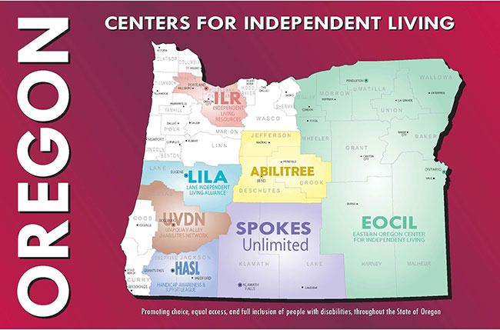
Notes:
Discuss coverage for unrepresented areas
EOCIL helps Mid-Columbia, LILA helps NW, UVDN helps South Coast

Slide 11

Timeline for ADRC of Oregon
• 2007-2008: SPD(APD) and 04AD initiated planning and developed a draft concept
• 2008: SPD awarded a 3-year federal grant to develop a prototype ADRC in Lane County
• 2009: SPD awarded a 3-year federal grant to expand to 9 additional counties
• Spring 2010: ADRC opens in AAA serving Lane County
• Fall 2010: ADRC website goes live, process to develop 5-year strategic plan begins
• Early 2011: ADRC opens in AAAs serving Linn, Benton, Lincoln, Marion, Polk, Yamhill, Clatsop and Tillamook counties
• Spring 2011: Adopted 5-year strategic plan for statewide ADRC
• Fall 2011: PSU conducts consumer satisfaction survey of pilot ADRCs
• Spring 2012 – set statewide and local metric standards
• 2015 - Nine regional ADRCs statewide
• 2016 - ADRC Grant renewed for 2017-19 biennium

Slide 12
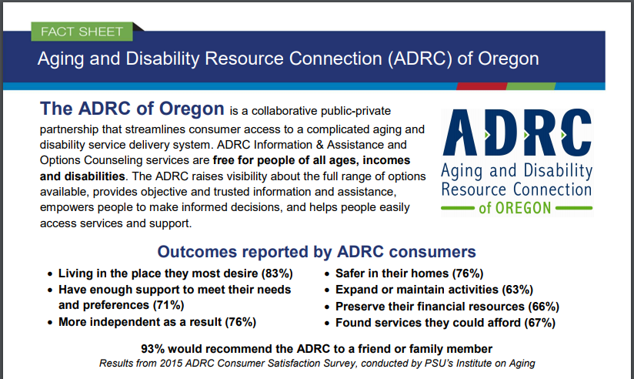
Aging and Disability Resource Connection
Notes:
A solution to a complicated system

Slide 13
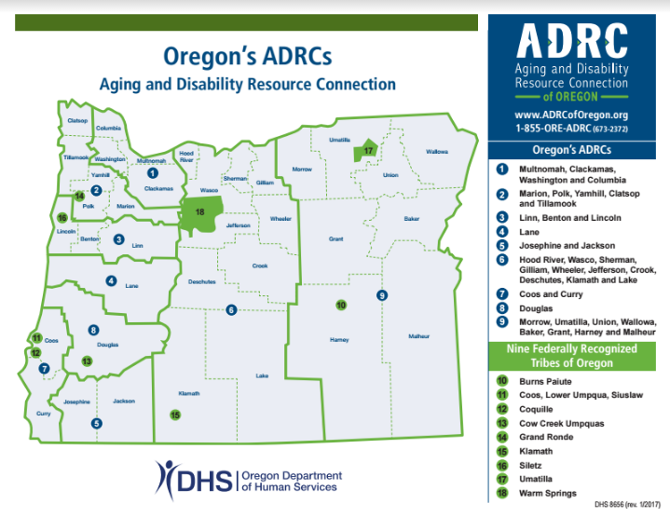
Notes:
O4AD Created ADRC Regions

Slide 14
Why ADRC?
97% of Oregonians will never access long term supports and services (public benefits)
63% of Oregonians look to health care providers as their source of information for community services and supports
Only 1 in 5 consumers who apply for Medicaid are eligible
Through December 2009, Oregonians who participated in Living Well with Chronic Conditions are estimated to have avoided 557 ER visits, saving $634,908 and 2,783 hospital stays, saving $6,501,088
Falls Prevention programs report a significant decrease in falls. 4,500 Oregonians age 75 and above are discharged from the hospital each year from a fall-related injury. Hospitalization cost for each fall averages $16,000.
*Data from 2009, inception of ADRC

Slide 15
What are the benefits?
Awareness, assistance and access
No Wrong Door (consumers can access information through any of the partner organizations)
Person-centered values
Wider range of resources because of collaborative partnerships
Serves a broader consumer population than would be possible through individual organization

Slide 16

The ADRC Challenge

Slide 17
Information & Referral (I&R) and Person-Centered Options Counseling (PCOC)
I&R and PCOC are available to anyone, regardless of age or income level. These services are delivered consistently throughout the state in order to provide the same all access service to all Oregonians.
I&R and PCOC are similar and can flow back and forth. Information and Referral is usually a brief encounter

Slide 18
ADRC Service Continuum
Information
Referral and Assistance
Person-Centered Options Counseling
Case Management

Slide 19

AIRS: Alliance of Information and Referral Systems
The Alliance of Information and Referral Systems is the professional membership association for community Information and Referral (I&R) and Information and Referral/Assistance (I&R/A) providers.
Our diverse membership consists of individuals, agencies, community organizations, governmental departments and others helping connect people to the services they require. Our 5000+ members are primarily located in the United States and Canada, and last year answered more than 28 million calls for help about community, social and health services.
We offer membership, networking, training, and individual certification and agency accreditation credentialing. We encourage you to explore this site for more information and contact us at anytime.
Notes:
http://www.airs.org/i4a/pages/index.cfm?pageid=1

Slide 20

I&R as Defined by AIRS
I&R programs help individuals, families and communities identify, understand and effectively use the programs that are part of the human service delivery system. Professional I&R specialists help people understand their problems and make informed decisions about possible solutions. They may advocate on behalf of those who need special support, and reinforce the individual’s capacity for self-reliance and self-determination through education, affirmation, collaborative planning and problem solving. I&R services are a vital link bringing people and services together.

Slide 21

I&R Bill of Rights from AIRS
* The I&R service maintains accurate, comprehensive, unbiased information about the health and human services available in their community.
* The I&R service provides confidential and/or anonymous access to information.
* The I&R service provides assessment and assistance based on the inquirer’s need(s).
* The I&R service provides barrier-free access to information.
* The I&R service recognizes the inquirer’s right to self-determination.
* The I&R service provides an appropriate level of support in obtaining services.
* The I&R service assures that inquirers are empowered to the extent possible.
* The I&R service assures that inquirers have the opportunity to access the most appropriate I&R service available in the system.
Notes:
* The I&R service maintains accurate, comprehensive, unbiased information about the health and human services available in their community.
* The I&R service provides confidential and/or anonymous access to information.
* The I&R service provides assessment and assistance based on the inquirer’s need(s).
* The I&R service provides barrier-free access to information.
* The I&R service recognizes the inquirer’s right to self-determination.
* The I&R service provides an appropriate level of support in obtaining services.
* The I&R service assures that inquirers are empowered to the extent possible.
* The I&R service assures that inquirers have the opportunity to access the most appropriate I&R service available in the system.

Slide 22

ADRC of Oregon Standards for I&R
IIC.1 ADRC staff provide I&R/A services according to guidelines as listed in the ADRC of Oregon Policy & Procedure manual.
IIC.2 ADRC staff are knowledgeable about ADRC resources and services and explain how to get help or information well. ADRC staff spend enough time with consumers to understand their concerns and ensure the consumer feels respected and receives information in a person-centered manner.
IIC.3 ADRC staff record required data in the state information system for the ADRC call module including information about the caller, consumer, demographic information, met and unmet needs, and referrals provided.
IIC.4 Follow-up calls are performed according to the I&R/A follow-up policy as listed in the ADRC of Oregon Policy & Procedure manual.

Slide 23

ADRC of Oregon Standards for I&R continued...
IIC.5 I&R/A staff will have their CIRS-A/D certification within 18 months of hire.
IIC.6 I&R/A staff identify potential Options Counseling consumers.
IIC.7 Information & Assistance staff promote the health and safety of consumers by identifying health issues, and referring to appropriate community health promotion programs, healthcare preventive services, and/or dementia resources.
IIC.8 ADRC staff provide I&R/A services according to AIRS standards.
IIC.9 ADRC staff only refer to resources maintained in the ADRC resource database when making referrals.

Slide 24

AIRS Certification
ADRC Standards say that I&R staff should attempt AIRS certification within 1 year of hire, if possible. AIRS Certification requires:
At least 1 year of employment in I&R for applicants with a Bachelors’ or higher degree
2 years of employment in I&R for applicants with an Associates/Community College degree
3 years of employment in I&R for applicants with a High School diploma or GED.
5 years of I&R employment with no educational qualification
CIRS-A/D — Certification for I&R Specialists in Aging/Disabilities (before March 15th 2015, this was known as the CIRS-Aging) (This is designed for practitioners who work directly with clients and caregivers within the aging and/or disabilities area and perform the same basic range of skills and tasks as a comprehensive I&R Specialist but who also have a special depth of knowledge related to their core client group)
Notes:
AIRS Certification information: http://www.airs.org/i4a/pages/index.cfm?pageid=3310
CRS — Certification for Resource Specialists (This is designed for practitioners who maintain databases of resources for the communities they serve and have expertise in the gathering, organizing, indexing and dissemination of information about programs/services and the organizations that provide them)

Slide 25
What is Person-Centered Options Counseling?
Person-Centered Options Counseling is another one of the Core Services of ADRCs

Slide 26

Oregon Definition
Options Counseling supports informed long-term care decision-making through assistance provided to individuals and families to help them understand their strengths, needs, preferences and unique situations and translates this knowledge into possible support strategies, plans and tactics based on the choices available in the community.
Notes:
This is Oregon’s definition of how OC applies to us. (there are also federal and national definitions).
Read definition.

Slide 27
Benefits of Person-Centered
Options Counseling
Consumers are able to consider the available community-based options before turning to institutionalized care settings.
Consumers are guided in accessing and understanding online information, which can be complex, contradictory, and confusing
Families receive individualized support making decisions about long-term care.
Consumers are encouraged to plan ahead for long-term care support needs.
Notes:
1. Go through each point on the slide.

Slide 28
Benefits of Person-Centered Options Counseling
Person-Centered Options Counseling is proactive and interactive.
Options counselors are able to connect consumers to a full range of community supports, both public and private.
Person-Centered Options Counseling may help consumers preserve their resources and maintain their independence.
Notes:
1. Go over each point.
2. Can ask participants if they can think of any other benefits.

Slide 29
How is it different from Information and Referral?
Person-Centered Options Counseling is more than Information and Referral.
Emphasis is on relationship building and providing decision support.
May involve more time spent with consumer and their family.
Includes documenting decision support provided and action steps for consumers, families and the ADRC.
Follow-up activities to support the consumer in their planning process.
Notes:
10:15-10:25 (10 min) Slide 24-25
Ask participants: What are the elements in I&R? What is involved in I&A?
Explain that OC goes beyond this. Review slide and go to next slide of continuum.

Slide 30
Continuum
Information
Referral and Assistance
Person-Centered Options Counseling
Case Management
Notes:
1. Refer Participants to Continuum handout
2. Explain that the continuum is a flow of service that sometimes does not have hard, clear lines. This is a way to begin to identify when you are moving from one type of service to another.
Information and Referral: Brief encounter; Consumer knows what they want; Information given
Information and Assistance: Brief encounter; Consumer may need help identifying what they want; Information given
Options Counseling: Longer or multiple encounters; Assessment of strengths, resources and needs; Decision making support; Follow-up
Case Management: On-going relationship and support; Active assistance with access to resources; Monitoring of consumer needs over time
3. Ask participants if they have any questions.

Slide 31
Person-Centered Options Counseling Values and Practices
Relationship-Based
Empowering Personal Choice
Facilitating Connection to Resources
Notes:
11:25-11:45 (20 minutes) Slides 28-33
Options Counseling is based in guiding values that are reflected in all aspects of practice.
Relationship Based: This is about really getting to know the person and understanding what they need, what their strengths and resources are, and what will really fit with their preferences and life.
Empowering Personal Choice: OC is about using your skills to help consumers make their own choices and decisions about what they want to do to meet their current and long term needs.
Facilitating Connection to Resources: Options Counselors bring a knowledge of resources that consumers can use to inform their choices and planning.
Wrap-up before lunch: If you have time, quickly summarize what you have covered this morning and ask if there are any remaining questions or comments.

Slide 32

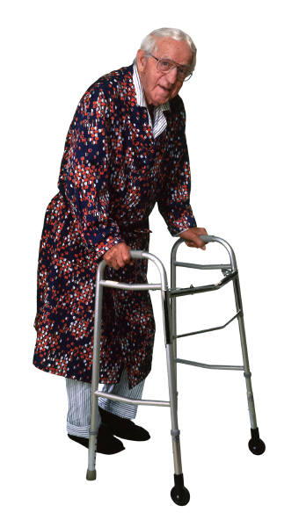

Who Receives Person-Centered Options Counseling?
Adults with disabilities over 18 years old and all older adults and their families, regardless of income.
Notes:
Trainer explains: OC broadens the definition of who we serve. OC is available to any adult with disabilities who is over 18 years old, and to all older adults and their families regardless of income.
Explain that historically OAA served only people over 60.

Slide 33

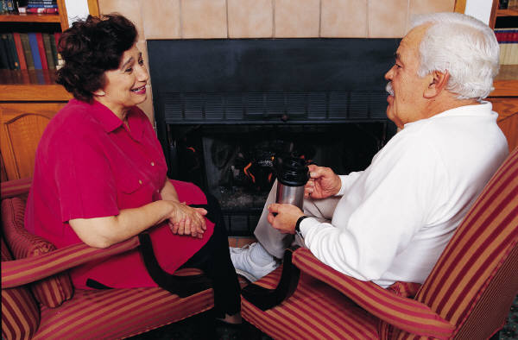
Where does it occur?
Wherever the consumer needs it to happen
On the Phone
E Mail
Face-to-Face
In-Home Visit
Notes:
1. OC may occur in a variety of settings, depending on the need of the consumer.

Slide 34
When is a good time for Person-Centered Options Counseling?
When an individual has immediate or short range long-term care needs.
Prior to Hospital or Long-term Care discharge
When a family caregiver needs help to continue providing care.
When a long distance caregiver has concerns about the increased frailty or care needs of a loved one.
Anytime!
Notes:
1. Refer participants to Trainer-only copy of “Timing for Options Counseling Scenarios’ and briefly explain the timing of OC for each.
a. When an individual has immediate or short range long-term care needs.
Story of Ms. Apple
b. Prior to Hospital or Long-term Care discharge
Story of Ms. Berry
c. When a family caregiver needs help to continue providing care.
Story of Ms. Jones
d. When a long distance caregiver has concerns about the increased frailty or care needs of a loved one.
Story of Mr. Johnson

Slide 35
Support for Decision Making in Person-Centered Options Counseling
Person-Centered Assessment
Information about Resources and Options
Knowledge Needed for Decision-Making
Notes:
Trainer explains: OC provides a person-centered approach to assessing a consumer’s needs, information about relevant resources for the consumer to consider, and skillful guidance to help consumers make decisions that will work for them
Show Thin Edge of Dignity you tube video and talk about “Important to and important for”

Slide 36
What Does Person-Centered Options Counseling Offer?
A supportive relationship that helps consumers and their families make informed choices about meeting current and long-term needs.
A firm foundation in quality information about state and local resources
An person-centered assessment approach that incorporates consumer preferences, strengths, culture and unique individual situations.
The skills to assist individuals and families in decision making.
Notes:
Go through each bullet
Relationship is key to understanding
Along with knowing your local resources, there is a state-wide resource data base to refer to as you help consumers and/or family members.
Last two bullets: Can read these as self-evident

Slide 37
Core Competencies of Person-Centered Options Counseling
Six Core Competencies
  Determine the need for Person-Centered Options Counseling
  Person-Centered Assessment-goals, needs, values and preferences, etc.
  Understanding & Educating about public and private sector resources
  Facilitating Self-Direction
  Encourage future orientation
  Follow-up
Notes:
12:45-12:50 (5 minutes)
Trainer explains: Administration on Aging designated these 6 competencies for OC.
Read them and explain that you will be going though each one in more detail.

Slide 38
Facilitating Self-Direction
Be committed to the process.
Let go of the outcome.
  Person-Centered Options Counselors are responsible for ensuring the best process for decision-making.
  The consumer/client is responsible for the decisions they make.
Notes:
Trainer explains that the OC process requires using the skills, knowledge and self-awareness to support the consumer in making their own informed decisions.
Trainer stresses that the OC role is to bring our best work forward to address consumer’s needs and goals. The consumer is in charge of decisions made.
Letting go of the outcome refers to the dilemma helpers have when consumers make decisions that seem to be poor ones.

Slide 39

Person-Centered Options Counseling
Evaluation: Making sure we are getting there.
For Staff
How is it working?
What do you need (e.g., information, support)?
For Consumers
Preferences, values and needs supported
Empowered
Aware of all options
Making decisions that preserve resources & independence
Satisfaction with Person-Centered Options Counseling services
Notes:
9:30-9:40 (10 min) Slides 9 and 10
Trainer explains: this is an overview of the basic purpose of evaluation. As we implement OC, we want to make sure staff have what they need to do their jobs well, and consumers are experiencing the values and person-centered decision-making support that is the core of the OC process.
Then review each point on the slide.

Slide 40
ADRC Services:
Offering the right amount and depth of assistance at the right time in order to support the person, and family, to make an informed decision.
Notes:
4:00-4:10 (10 minutes) Slides 60-63
Trainer introduces that now we will be summarizing and wrapping up the day’s work.
Read slide 60 and point out that this emphasizes the who person-centered and empowering foundation of OC.

Slide 41

Additional Tools
ADRC of Oregon public website: www.adrcoforegon.org
NASUAD (National Association of States United for Aging and Disabilities) training:
http://www.nasuad.org/initiatives/information-and-referralassistance/ira-training
No Wrong Door website by the ACL (Administration for Community Living), formerly the ADRC Technical Assistance Exchange: https://nwd.acl.gov/
Oregon State Unit on Aging website: https://www.oregon.gov/DHS/SENIORS-DISABILITIES/SUA/Pages/index.aspx
Notes:
https://adrcoforegon.org/consite/
http://www.nasuad.org/initiatives/information-and-referralassistance/ira-training
https://nwd.acl.gov/
https://www.oregon.gov/DHS/SENIORS-DISABILITIES/SUA/Pages/index.aspx

