Slide 1
Knowledge Transfer / Succession Planning Process
DHS
August 2018
Steve Hastings

Slide 2
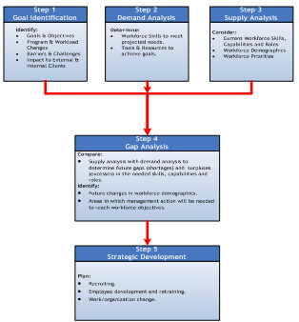
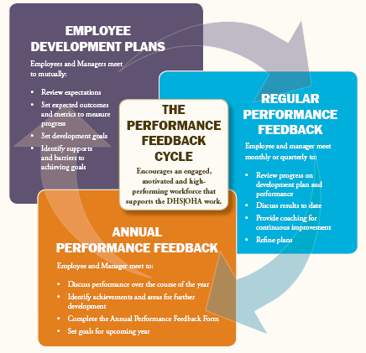
The System / The Relationships
Workforce Planning
Continuity &
Succession Planning
Maximizing
Workforce Capability
&
Potential
Client
Outcomes
Organization Knowledge Transfer
Employee Development

Slide 3
Knowledge Transfer / Succession Planning Through a Repeatable Processes & Tools
Replicating the expertise, wisdom and knowledge of critical professionals into the heads and hands of their coworkers
to ensure
Right people, Right place, Right time, Right skills
to
Lead and do the work now, and in the future
so that our individuals and organizations are
reaching their maximum potential
maximizing business continuity when employee changes occur
flexible and adaptable
to meet our clients needs
Knowledge Transfer Matrix
Step 1
Skill Development Plan
Step 2
Knowledge Transfer Workshop TBD
Step 3
Employee Development Plan
Metric: 1) Each organization identify 3 positions that business continuity is at greatest risk
2) Determine level of existing knowledge coverage
3) Set 6 to 12 month goal of having at least 3 other members of the organization to be >90% capable of doing all
knowledge areas
4) Monitors metric in the QBR
DRAFT
Model adapted from Knowledge Transfer Process material from the Steve Trautman Company

Slide 4
Business Issues
Developing Leaders
  Executive succession
  High potential acceleration
Evaluating and bridging capability gaps
  New business needs (e.g., budgeting)
  Retirements and skill shortages
  Process and skill evolution
  Leadership skill evolution (Leadership Model)
Strengthening staff development
  Job transitions (internal and external)
  Retention
  Dispersed/diverse employees
  On-boarding

Slide 5
Benefits to be gained / risks avoided
What Benefits will be gained?
Development of the workforce needed to accomplish our strategies
Engagement and retention of Millennials through increased career opportunities
Identifying best practices and creating consistency (e.g. working with offshore partners)
Business continuity when employee departure occurs (for whatever reason)
What Risks will be Avoided?
Reduce number of employees with unique siloe’d knowledge
Minimizing the knowledge loss impact of retiring workers
Load leveling to reduce overreliance on one expert = Talent Risk Mitigation
Prepare for emergency talent loss scenarios
Not being prepared for management changes
Model adapted from Knowledge Transfer Process material from the Steve Trautman Company

Slide 6
The Process

Slide 7
Knowledge Transfer Matrix: Critical Positions – Step 1
Step 1: List all the key positions in the organization
Step 2: Identify from the list those positions that business continuity is at greatest risk (high, medium, low)
Step 3: Identify position vulnerability
Step 4: Select one position at a time to build Knowledge Transfer Matrix
Priority | Position | Level of Business Continuity Risk (high, medium, low) | Position Vulnerability - Open < 1 year - Open 1-3 years - Open 3 + years | Current Incumbent
1 | Ocean and Marine Program Manager | High | varied | Mary
2 | Deputy Directors | High | varied | Bill & Shannon
3 | Watershed Managers | High | varied | Larry & Jim
4
5

Slide 8
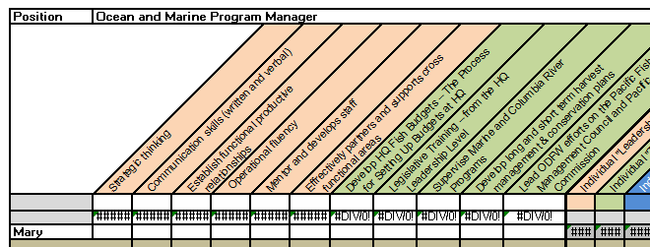
Knowledge Transfer Matrix – Step 2
To assess risk, start with listing all of the knowledge silos across the top.
Silos are:
“Business Process/ Technical Skills”
  Tools
  Processes
  Job functions
  Regulations
“Leadership Skills”
  Accountability
  Communication
  Empowerment
Leadership Competencies | Business Process/Technical Skills
Strategic thinking | Develop HQ Fish Budgets – The Process for Setting Up Budgets at HQ
Communication skills (written and verbal) | Legislative Training – from the HQ Leadership Level
Establish functional productive relationships | Supervise Marine and Columbia River Programs
Operational fluency | Develop long and short term harvest management & conservation plans
Mentor and develops staff | Lead ODFW efforts on the Pacific Fishery Management Council and Pacific Salmon Commission
Effectively partners and supports across functional areas
Note: If you have a Skills Versatility Matrix developed, cross reference to ensure you are capturing the “key” components of the position

Slide 9
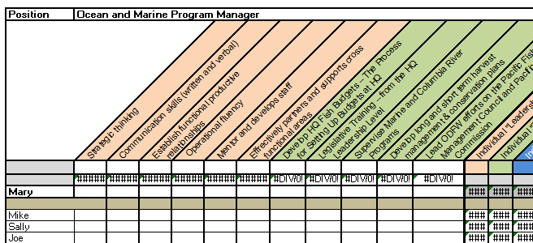

Knowledge Transfer Matrix: Add the People/Team – Step 3
Then add in the people you want to include in the risk assessment exercise.
Organize them by team (one under each supervisor) or by job family (e.g. case workers).
Whatever makes sense.

Slide 10
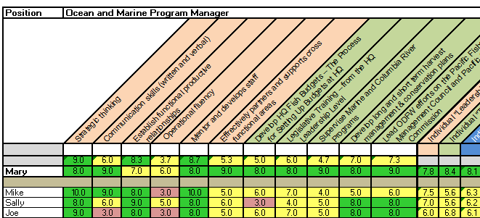

Knowledge Transfer Matrix: Evaluate each employee on competency – Step 4
For each silo, rate on a scale the employee’s current level of perceived proficiency
Note: If you have a Skills Versatility Matrix developed, look at those fully capable for a knowledge silo as possible mentors

Slide 11
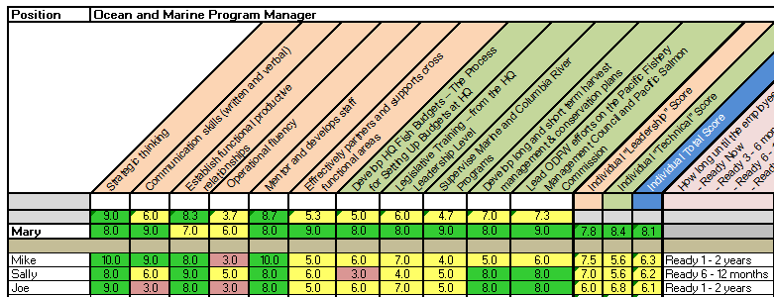

Knowledge Transfer Matrix: Duration To Ready – Step 5
Assess duration to readiness:
Employee for entire position
“Knowledge silo” with at least 1 or 2 “mentors”

Slide 12
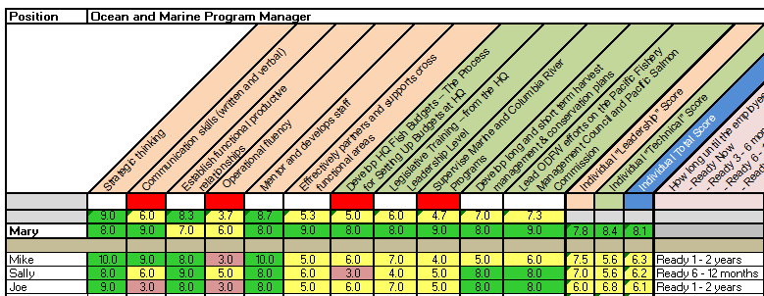
Knowledge Transfer Matrix- Greatest Risk Areas – Step 6
Identify greatest “risk” competency areas
Shade cell in red of most critical/lowest scoring competencies

Slide 13
Assess Interest – Step 7
Discuss desire to develop the identified employee to determine interest for succession
Discuss desire to develop an employee with a critical knowledge gap to determine interest
If employee is supportive, begin development plan process

Slide 14
Create Knowledge Transfer Plans / Skill Development Plan – Step 8
To be expanded
Model adapted from Knowledge Transfer Process material from the Steve Trautman Company

Slide 15
The Plan
 | M 9 | M 10 | M 11 | M 12 | M 1 | M 2 | M 3 | M4 | M5 | M 6 | M 7 | M 8
Identify competencies | X | X
Identify the employees |  | X | X
Assess the employees |  | X | X
Duration to ready |  |  | X | X
Determine competency “risk” areas |  |  | X | X
Determine employees desired to develop |  |  | X | X
Discuss interest with identified employees |  |  |  | X
Development to plan |  |  |  | X | X | X | X | X | X | X | X | X
Evaluate |  |  |  |  |  | X |  | X |  | X |  | X
Reassess plan |  |  |  |  |  |  |  |  |  | X

Slide 16
Next Steps
Team to determine common competencies (Month 1/2)
  “Technical”
  “Leadership”
            Facilitated by XXXXX
Each organization will identify the 3 to 5 key organization specific competencies (Month 1/2)
            Facilitated by XXXXX
Check in on progress against plan at (XXX) team meeting

Slide 17
Appendix

Slide 18
Skill Development Plan – Assessment Questions
“One reason we value experts in any organization is for their ability to do great work. We also value them because they are able to answer the questions we have for them with the “right” answer.
We all know how great it is to talk with an expert who can quickly decode a problem from their wealth of experience.
The difference between experts and apprentices (non-experts) is that they either can’t answer our questions or they may even give us the wrong answer.
I know I’m stating the obvious but I’m doing so to make a point: one clear gap between experts and non-experts is their ability to provide good answers to tough questions.”
Steve Trautman - blog

Slide 19
Skill Development Plan – Assessment Questions
Be sure your apprentice is able to explain:
The most common vocabulary words, acronyms, and terms
The number of steps in the process and why each is important
The top 3 things that often go wrong when someone is learning this skill
The relationship between x and y
How to troubleshoot the three most common problems
The first 3 things to check when troubleshooting anything
Who is/should be involved/affected/consulted and why
How to identify and define a “problem” vs. a “crisis” in this area
How to escalate a problem or crisis in this area to get additional help
The 3 best practices for this topic
Where to find resources (documents, experts, samples, websites, etc.)
How to choose between x and y
How to recognize “quality” work
What standards or rules exist and how rigorously they are applied
How the skill relates to the overall job
The 3 greatest potential safety hazards on this job
The 3 ways to shortcut safety procedures and their consequences (so they can be avoided)
What to look for, listen for, feel, or smell
The relevant historical issues to consider
The characteristics of a normal state and the most common characteristics of abnormal state
Model adapted from Knowledge Transfer Process material from the Steve Trautman Company

Slide 20
Knowledge Transfer / Succession Planning Excel Template & Competency Matrix
Knowledge Transfer Template | Competency Matrix
 | option

